Slide 1


Scalable Assessment of
Wiki-based Collaborative Assignments
Manuel Palomo-Duarte
University of Cadiz (Spain)

Slide 2
Contents
Introduction
Wikis assignments
Assessment of wiki assignments
  Quantitative approach
  Qualitative approach
Challenges
Conclusions
References

Slide 3
Introduction
In the web 1.0: user = consumer
In the web 2.0: user = consumer + creator
A wiki: group of web pages. Easy to edit and link using the browser. Open to collaboration
  Wikipedia: the largest collaborative project in human history
  Wikis used to keep companies know-how
  Wikis can be integrated in software development system to document their processes and products

Slide 4
Introduction
Wiki vs. Content Management System (CMS)
  Usually, in a CMS:
    The process of information creation is structured and controlled
    There are hierarchic roles: content creators, information reviewers, user who allow publishing, etc
  While in a wiki:
    Few horizontal roles (loosed permission system)
    Visitors are encouraged to contribute

Slide 5
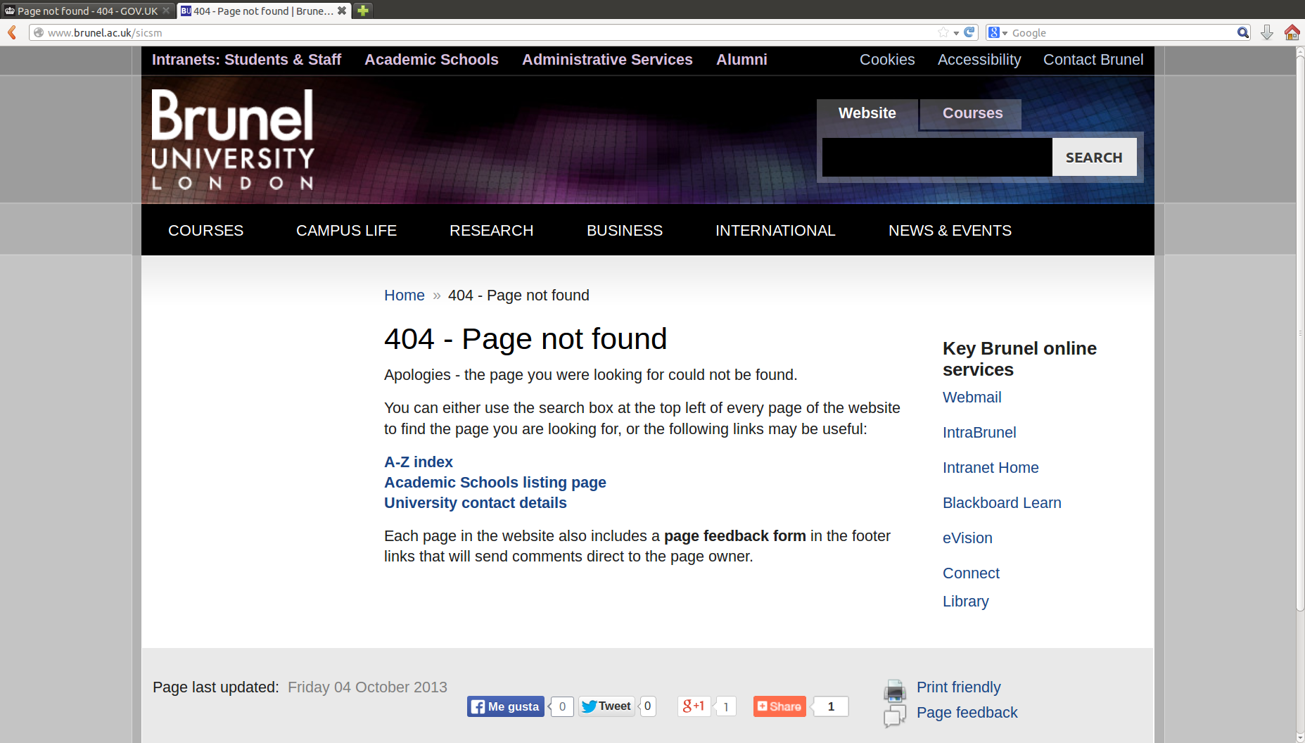
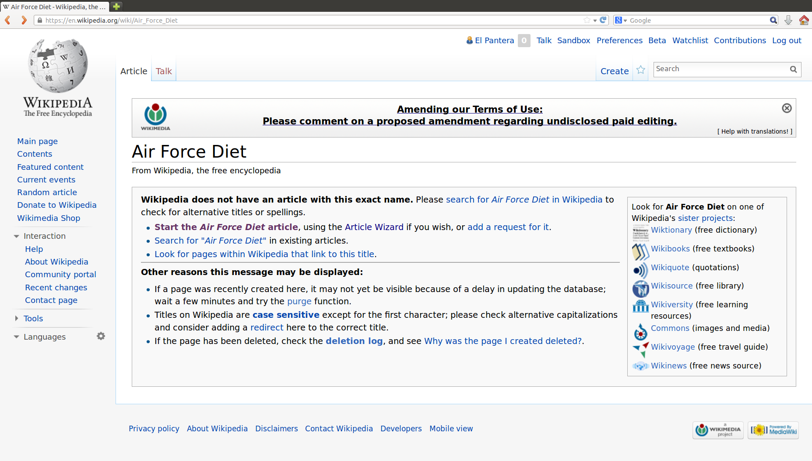
Introduction
A broken links is treated in a CMS as an error
In a wiki is a chance to improvement:
  No information for the moment, will you add something?
  Imperfect editions are welcome

Slide 6
Introduction
Wiki technologies for educational assignments:
  Asynchronous collaboration
  Distributed work
  Easy to monitor
  Powerful (depending on the wiki engine)
… but also pose challenges:
  Too much freedom for students to work
  Too much information to be used for assessment

Slide 7
Wiki assignments

Slide 8
Wiki assignments
Wikis, as any general purpose (collaborative) writing distributed software allows for a great variety of educational assignments to be deployed:
  Assignments
  Shared knowledge base of experiments
  Projects
  Explaining concepts
  Brainstorming
  Lecture notes
  ...

Slide 9
Wiki assignments
We can get advantage of “wiki way” in assignments:
  Monitorization: see their state at any moment
  Supervisors can contribute too
  Detect common mistakes for most of students
  Comparison between peers:
    Adopt the good ideas of colleagues
    Work harder if you are not performing well
  Change roles and responsibilities during the development of the task

Slide 10
Assessment of wiki assignments

Slide 11
Assessment of wiki assignments
Can we know who wrote each part of a wiki?
Imagine:
  Anthony writes a paragraph
  Philips interchanges two of the phrases in it
  Mary writes a “not” in a phrase
  Mark moves the paragraph to other section of the page
  Christina makes a briefing of two phrases
  Charles separates the paragraph into two, moving one of them to the end of the document
  Frank rewrites the phrase where Mary wrote ”not”

Slide 12
Assessment of wiki assignments
Identifying who wrote each part of a wiki is a task that has to be made by a human
  It is not scalable
We have to think “the wiki way”:
  Each page content is responsibility of a student, a group of them or the whole class and we have to act consequently
  If they receive contributions from others, they have to decide whether to keep, adapt or simply remove them

Slide 13
Assessment of wiki assignments
In the assessment, we have to consider the final result in the wiki. Each page has responsible student(s)
  Similar to real world, stakeholders main interest is “the final product”
The wiki keeps a log of the content, author and time of every edition
  There is a lot of information to enrich this grading
  But we have a limited time for assessment
  Find a good balance and support of automatic tools

Slide 14
Assessment of wiki assignments
Different aspects to be assessed:
  Concerning the content:
    Quantity
    Quality
    Presentation and respect to rules
    ...
  Concerning the process:
    Contributions timeline
    Work distribution
    Coordination / conflict resolutions
    ...

Slide 15

Quantitative case studies

Slide 16

Quantitative approach
First case study: WikiHaskell
  Elective course on Functional Programming
  Computer Science degree, 5th year
  The libraries of Haskell programming language are poorly documented
  Each group of 3 students had to document a library in Spanish language

Slide 17
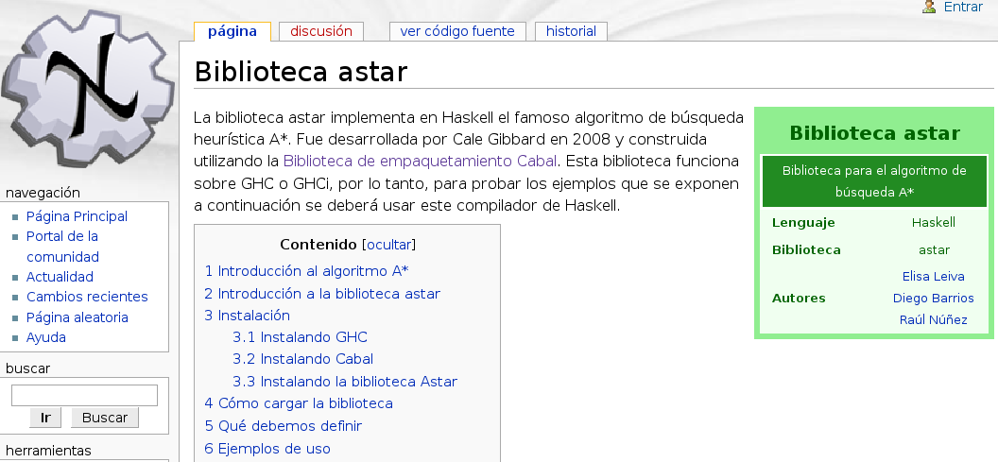
WikiHaskell

Slide 18
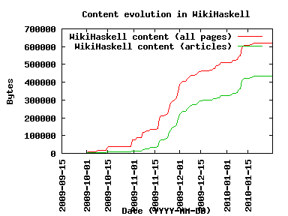

StatMediaWiki
For this case study we developed StatMediaWiki
Stats of a MediaWiki
GPL software
  http://statmediawiki.forja.rediris.es/

Slide 19
StatMediaWiki
Information provided:
  Global wiki evolution
  Rankings of edits and bytes contributed for every:
    User
    Page
    Category
  Cloud of tags
  Activity every hour of the day, every day of the week and every week in the semester

Slide 20
StatMediaWiki

Slide 21
WikiHaskell
We identified 5 students profiles:
  Continuous: works on a regular basis, 3 studs.
  Step-wise: works near deadlines, 16 studs.
  Early peak: abandons: 4 studs.
  Middle peak: decides to do all work at once and forget about the wiki, 17 studs.
  Late peak: try to do everything when its too late, 6 studs.
But how can we see “the group picture”?

Slide 22
WikiHaskell

Slide 23
WikiHaskell
Work distribution inside each category
  Each group was responsible for a set of pages
  We draw percentages in a chart
  We detected other interesting findings
    Leadership skill

Slide 24
WikiHaskell: leader

Slide 25
User talk pages for coordination
Regular article talk pages for conflict resolution
# | Page | Namespace | Edits
1 | Biblioteca ... Cabal | Main | 14
... | ... | ... | ...
N | Biblioteca ... HPDF | Main | 2
# | Page | Namespace | Edits
… | ... | ... | ...
42 | User talk:...Jose | User talk | 1
43 | Talk:Biblioteca ... Cabal | Talk | 1

Slide 26
Quantitative approach
Second case study: WikiRA
  Poner gráfico del pico final

Slide 27
Quantitative approach
Third case study: WikiIW
  Course of Web Engineering
  Students developed a web application in groups. The process is documented in the wiki
    Each project in just one wiki page
  It was analysed using HistoryFlow
    Each author has one color
    Draws contributions and new text
    Highlights text that remains between versions
    Privative non-maintained software

Slide 28
WikiIW
Overall effort
  amount of contributions throughout time as the growth of vertical lines on the timeline
Distribution of effort
  each learner’s contribution is colored differently
  distribution of individual contributions in the top left
Work organization
  reorganizations and moves as slashed line patterns

Slide 29
WikiIW
Conflict resolution (not detected in our case)
  editions and undoing as zig-zag line patterns
other transferable skills
  e.g. leadership as first-mover events
  early text parts persists across page versions

Slide 30
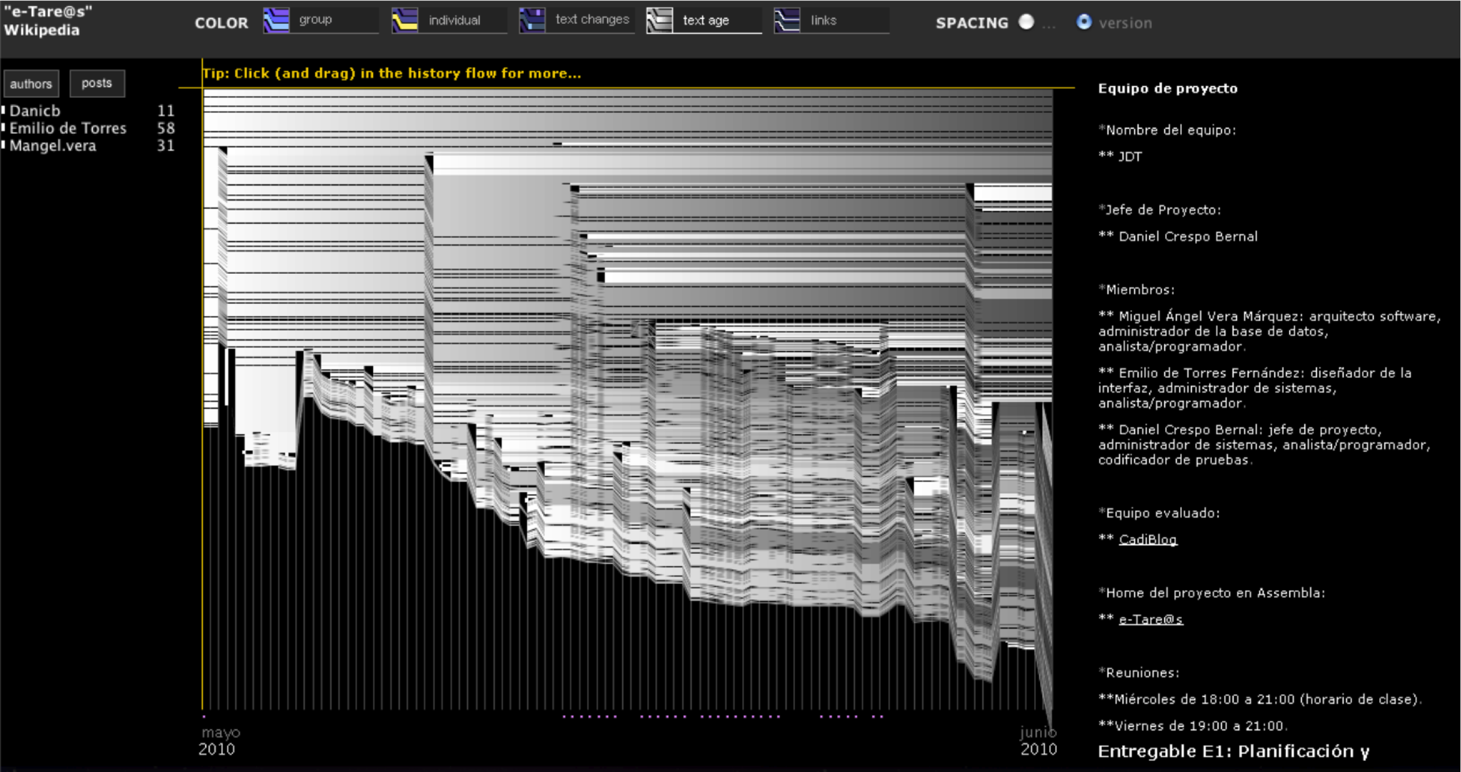
WikiIW: textage diagram

Slide 31
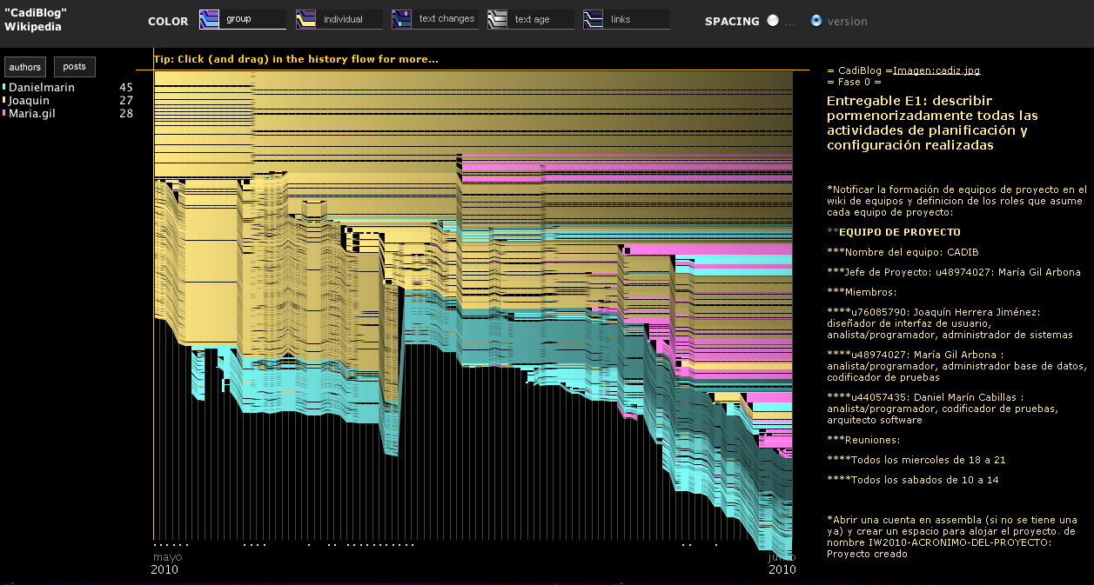
WikiIW: work contribution diagram

Slide 32
Qualitative test case

Slide 33
Qualitative approach
Third case study: wikiASO
  Fictional migration plan for IT infrastructure in a company: data center, desktop computers, gantt planning, software updates, etc
  We used StatMediaWiki to measured previously commented skills
  We complemented it with a qualitative approach
    If we just assess the final version it is poor approach
    Assessing every single wiki edition in not scalable

Slide 34
WikiASO
We used AssessMediaWiki:
  Supports assessing “the wiki way”: self-assesment, peer-assessment and hetero-assessment
  Each student is randomly assigned 10 large wiki contributions
  He assess it according to a rubric
    Mainly considers specific skills
    Also other transferable, like wiki syntax, references, writing, etc
    Grades are anonymously received by author

Slide 35
WikiASO
Poner imagen de evaluacion

Slide 36
WikiASO
Self- and peer-assessment have proven to be formative
The provide “prospective retroevaluation”
  Each student can see exactly for what editions he received his grade
The process scale: the more students contribute, the more assessments are made
If students are not satisfied with assessment received can ask to supervisor to review

Slide 37
Poner gráficas enriquecidas

Slide 38
WikiASO
Assessment:
  Ability to be critical: % of assessment made by students that had to be corrected by supervisor
  Fine-grain collaboration: different students contributed to a same technical dimension of the rubric
  Constant wiki contribution: number of assessed contributions each month
  We checked it skills were worked in right order

Slide 39
Conclusions and future lines of work

Slide 40
Conclusions

Slide 41
Challenges
Different challenges lie ahead:
  Mix quantitative and qualitative assessment approaches
  Reinforce assessment with automatic NLP tools
  Semantic forms
  Privacy
    The information stored in a wiki database is similar to that stored in an usual LMS. Anyway, the information stored and shown can be limited
  Wikipedia assignments? Students will be “in the wild”
    WikiMedia Chapters can help

Slide 42
References
Papers in indexed journals:
  Manuel Palomo-Duarte, Juan Manuel Dodero, Inmaculada Medina-Bulo, Emilio J. Rodríguez-Posada, Iván Ruiz-Rube. Assessment of Collaborative Learning Experiences by Graphical Analysis of Wiki Contributions. Interactive Learning Environments. 2014
  Manuel Palomo-Duarte, Juan Manuel Dodero, Antonio García-Domínguez, Pablo Neira-Ayuso, Noelia Sales-Montes, Inmaculada Medina-Bulo, Francisco Palomo-Lozano, Carmen Castro-Cabrera, Emilio J. Rodríguez-Posada, Antonio Balderas. Scalability of Assessments of Wiki-based Learning Experiences in Higher Education. Computers in Human Behaviour. 2014

Slide 43

Thank you for your attention
Questions?

