Slide 1
Simulation optimization model for groundwater management by coupling MODFLOW with PySOT (EX2A_SCE1A)
Partha Majumder

Slide 2
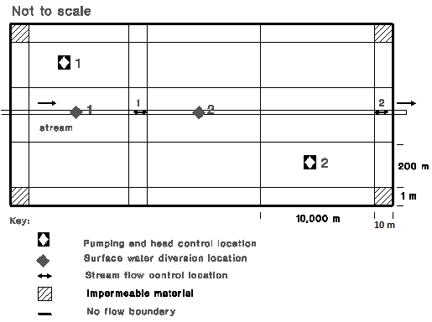
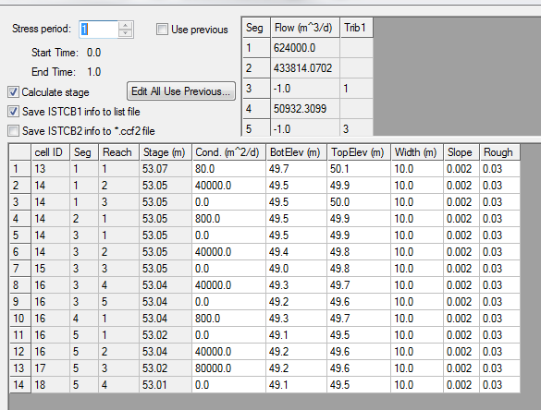
Ex2A_Sce1A
Aquifer Parameters | Values
Top elevation | 60 m
Bottom elevation | 0 m
Hydraulic conductivity | 4.5 m/day
No of stress period | 1 (Steady state problem)
Fig.1. Map of EX2A-Sce1A problem study area (Unconfined aquifer)
5 rows and 6 columns problems. 26 cells are active.
Two pumping wells to divert water
Fig.1. Information of stream

Slide 3

Ex2A_Sce1A The objective function is to maximize total pumping and diversion.
$$\begin{matrix}\left.Min F=\sum_{i=1}^{n}{Q_{i}+\sum_{i=1}^{m}{−D_{i}}} Eq[1\right] \\ −50000≤Q_{i}≤0 i=1,2 (a) \\ \left.0≤D_{1}≤500000 (b\right) \\ \left.0≤D_{2}≤100000 (c\right) \\ 46≤h_{i}≤55 i=1,2 (c) \\ \left.SFR(3,2)≥0 (d\right) \\ \left.SFR(3,4)≥0 (e\right) \\ \left.SFR(3,3)≥150000 (f\right) \\ SFR(3,3)≥150000 (g) \\ In the above equation, Q_{i} is the pumping rate from i^{th} well; \\ D_{j} is the diversion rate from j^{th} diversion location; \\ h_{i} is the hydraulic head from the i^{th} pumping well location \\ SFR(ii,jj) is the stream flow rate at the node (row=ii, column=jj) \end{matrix}$$

