Slide 1
ESTCP Problem
Dr. Partha Majumder

Slide 2
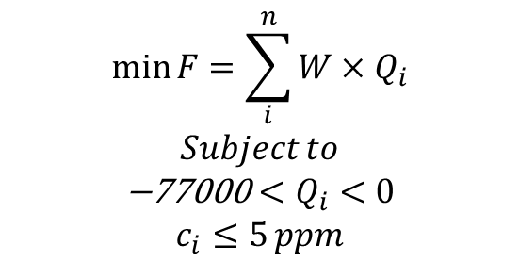
The flow and transport simulation is carried out using flopy module of python.
$$\begin{matrix}min\text{​ }F=\sum_{i}^{n}{W×Q_{i}} \\ Subject to \\ \text{−77000}<Q_{i}<0 \\ c_{i}≤5 ppm\end{matrix}$$
Fig.1. ESTCP confined aquifer
Pumping (Q) : LB=-77000, UB=0 Permissible contaminant concentration (c) =5 ppm
Note: (1) The SOMO3 optimization is not carried out by me.
(2) Only three pumping wells are assumed to be active.
bin_vect=[0, 0, 1, 0, 1, 0, 1, 0, 0, 0]; The binary vector can be shuffled very easily with every simulation

Slide 3
Aquifer parameters | Values
Number of layers, number of rows, number of columns | 1, 20, 25
Aquifer domain | 12500 ft * 10000 ft
Delr, Delc , Rows, Colimns | 500 ft, 500 ft, Rows=20, Columns=25
Aquifer type | Confined aquifer
Top elevation | 100 ft
Bottom elevation | 0 m
Constant head (Left boundary) | 120 ft
Constant head (Right boundary) | 80 ft
Transmissivity | 5000 ft^2/day
Storage coefficient | 0.0001
Anisotropy factor | 1
Number of pumping wells Only three pumping wells will be active. Selection of active pumping wells are random | 10
Number of stress period | 5
Length of the stress period | 365 days
Number of time step in each stress period | 10
Longitudinal dispersivity | 150 ft
Porosity | 0.15
TRPT | 0.2
TRVT | 0
Effective molecular diffusion coefficient (dmcoef) | 0
Fig.1. ESTCP confined aquifer

