Slide 1
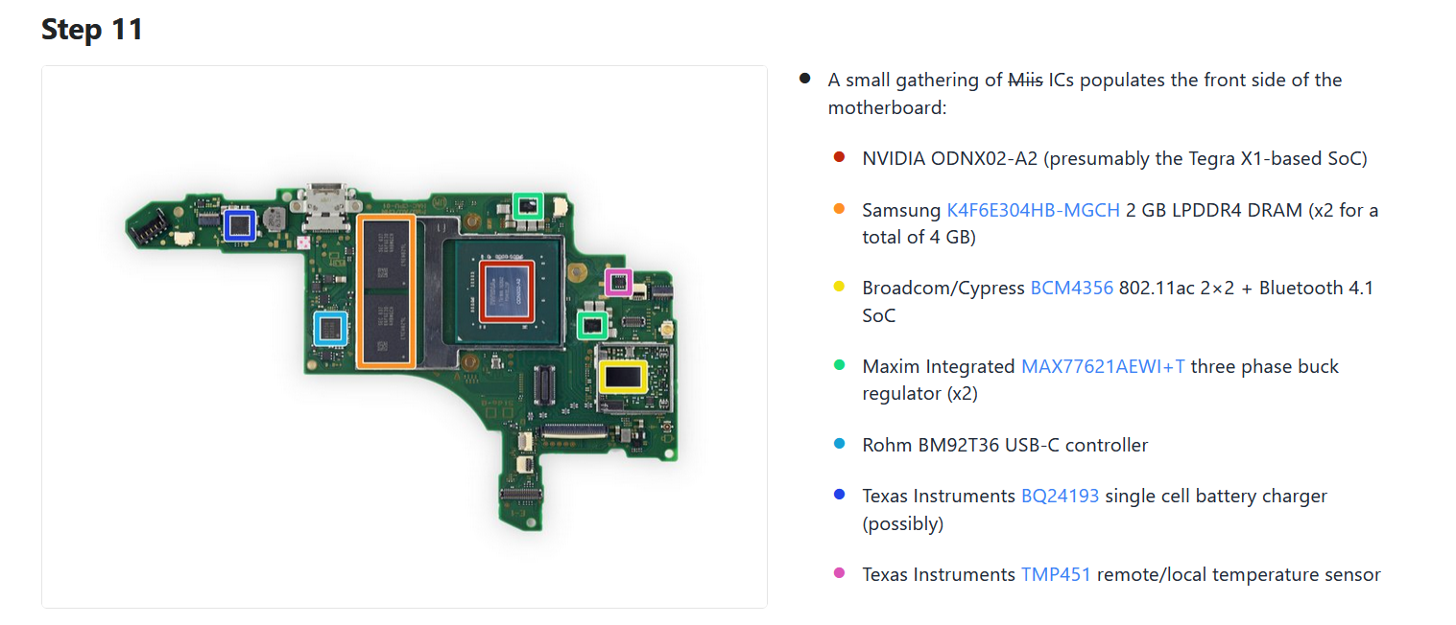
Nintendo Switch Front of the Motherboard

Slide 2
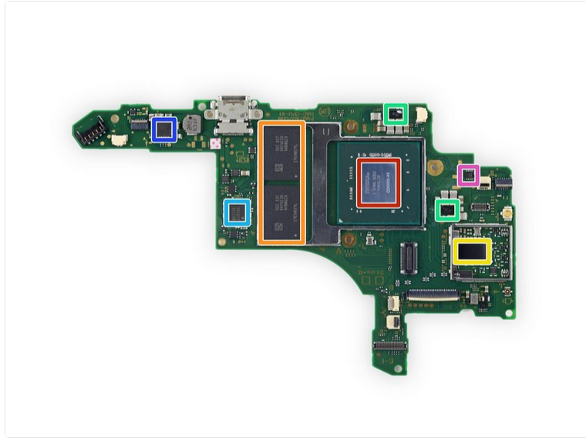
Nintendo Switch Front of the Motherboard Components
CPU
RAM
Network Adapter
Motherboard

Slide 3
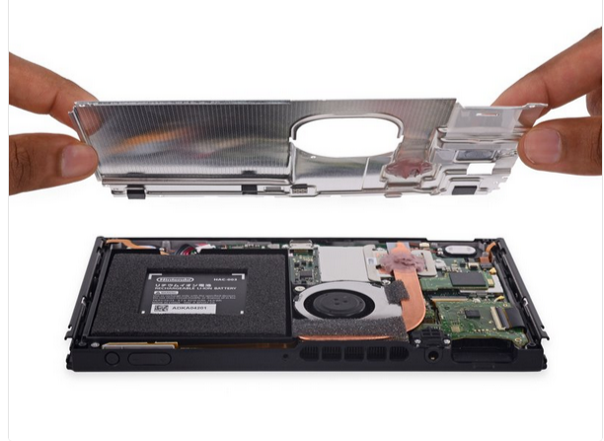
Nintendo Switch Power Supply
Rechargeable battery power supply

Slide 4
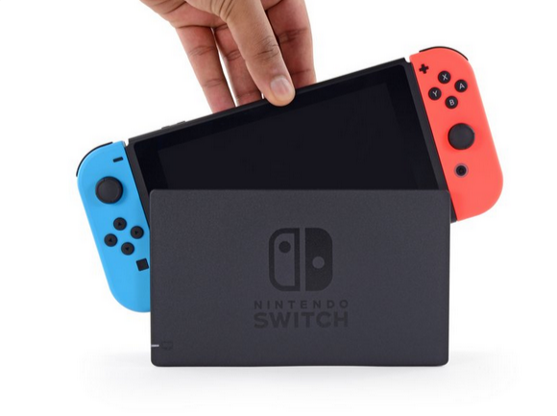
Nintendo Switch Input/Output Devices
Input Devices
Input/Output Device

Slide 5
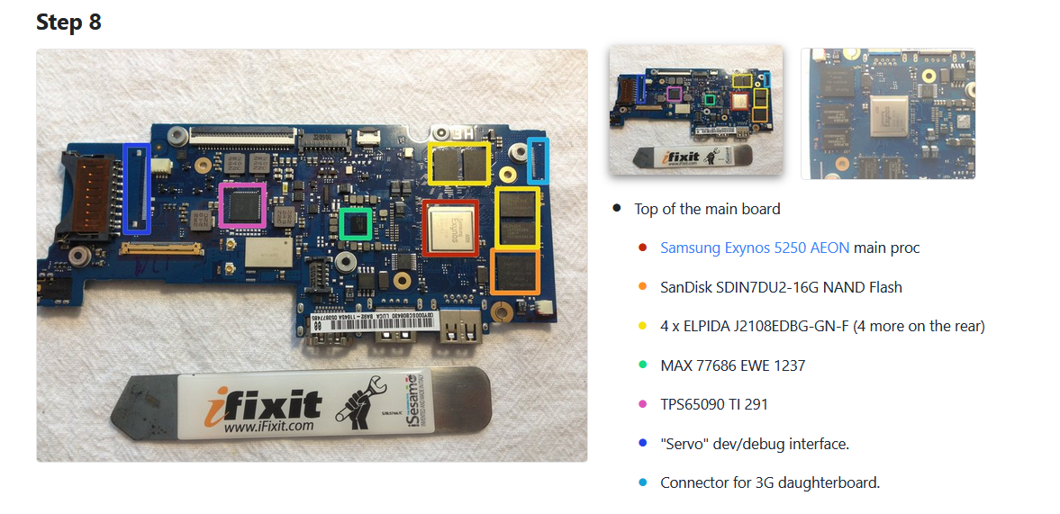
Samsung Chromebook Series 3

Slide 6
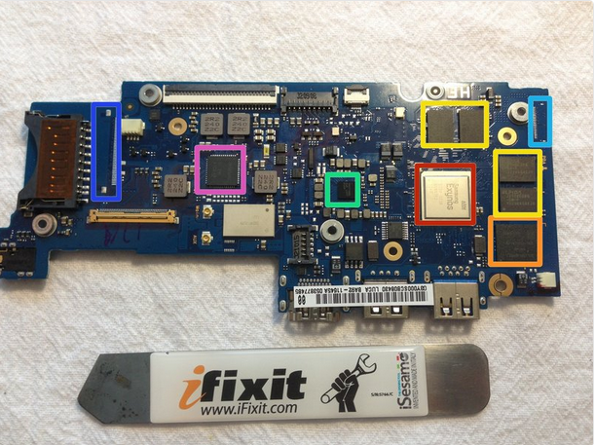
Samsung Chromebook Series 3 Motherboard Components
CPU
Motherboard
RAM
Hard Drive

Slide 7
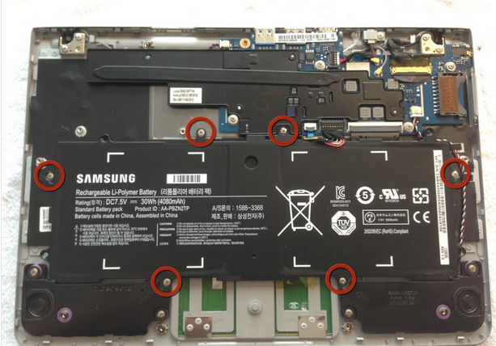
Samsung Chromebook Series 3 Power Supply
Rechargeable Battery Power Supply

Slide 8
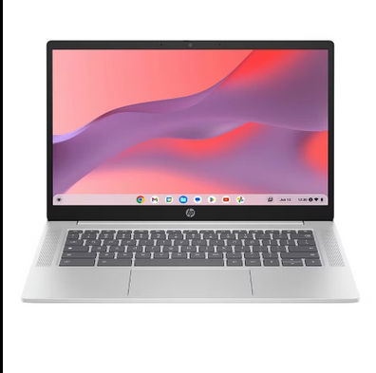
Samsung Chromebook Series 3 Input/Output Devices
Output Devices
Input Devices

Slide 9
Hardware Discussion
The two devices that I chose were the Nintendo Switch and the Chromebook Series 3. They weren’t much different, but I though that it was interesting that the Chromebook’s motherboard was bigger than the Nintendo Switch. They both have the input and output devices attached to them from the get go and since they are both portable devices, they are both battery powered.
The inside of the devices did look the way that I expected them to look. I’ve taken apart of a lot of different devices just to see what they’re like, so I had a pretty good understanding of what it would probably look like.
It was equally difficult to find the components on the devices. While looking at the teardowns, I would google what some of the components were because some of the names of the components I was unfamiliar with so it was a quick fix.
I picked the switch because I have a Nintendo Switch but I’ve never opened it up. This was a fun way to see what the inside of it looked like without taking mine apart. I picked the Chromebook because even though it’s not the exact model, my little sibling uses a Chromebook for school and I thought it would be interesting to see what the inside of it looked like since I’ve already taken apart my laptop and my desktop.
I found that this website is a good tool to look at when I’m looking for guides on how to disassemble the devices I’m looking at.
While reading the Switch teardown, I thought it was interesting that the vents on top were used the most while docked. It makes complete sense after reading that, but it was something that I never thought about.

