Slide 1

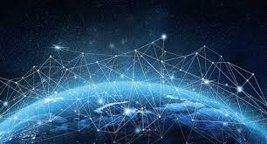
Computer security
Popov Yury
SKB - 172

Slide 2
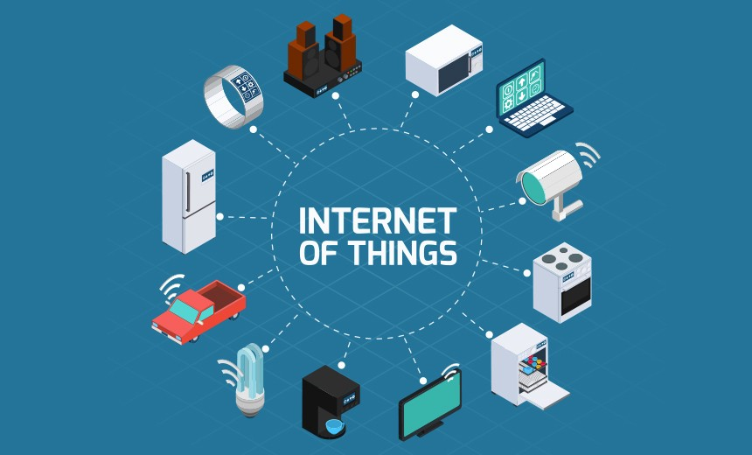

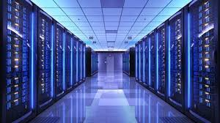
The importance of Cyber Security

Slide 3
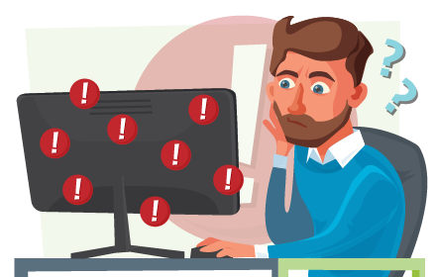
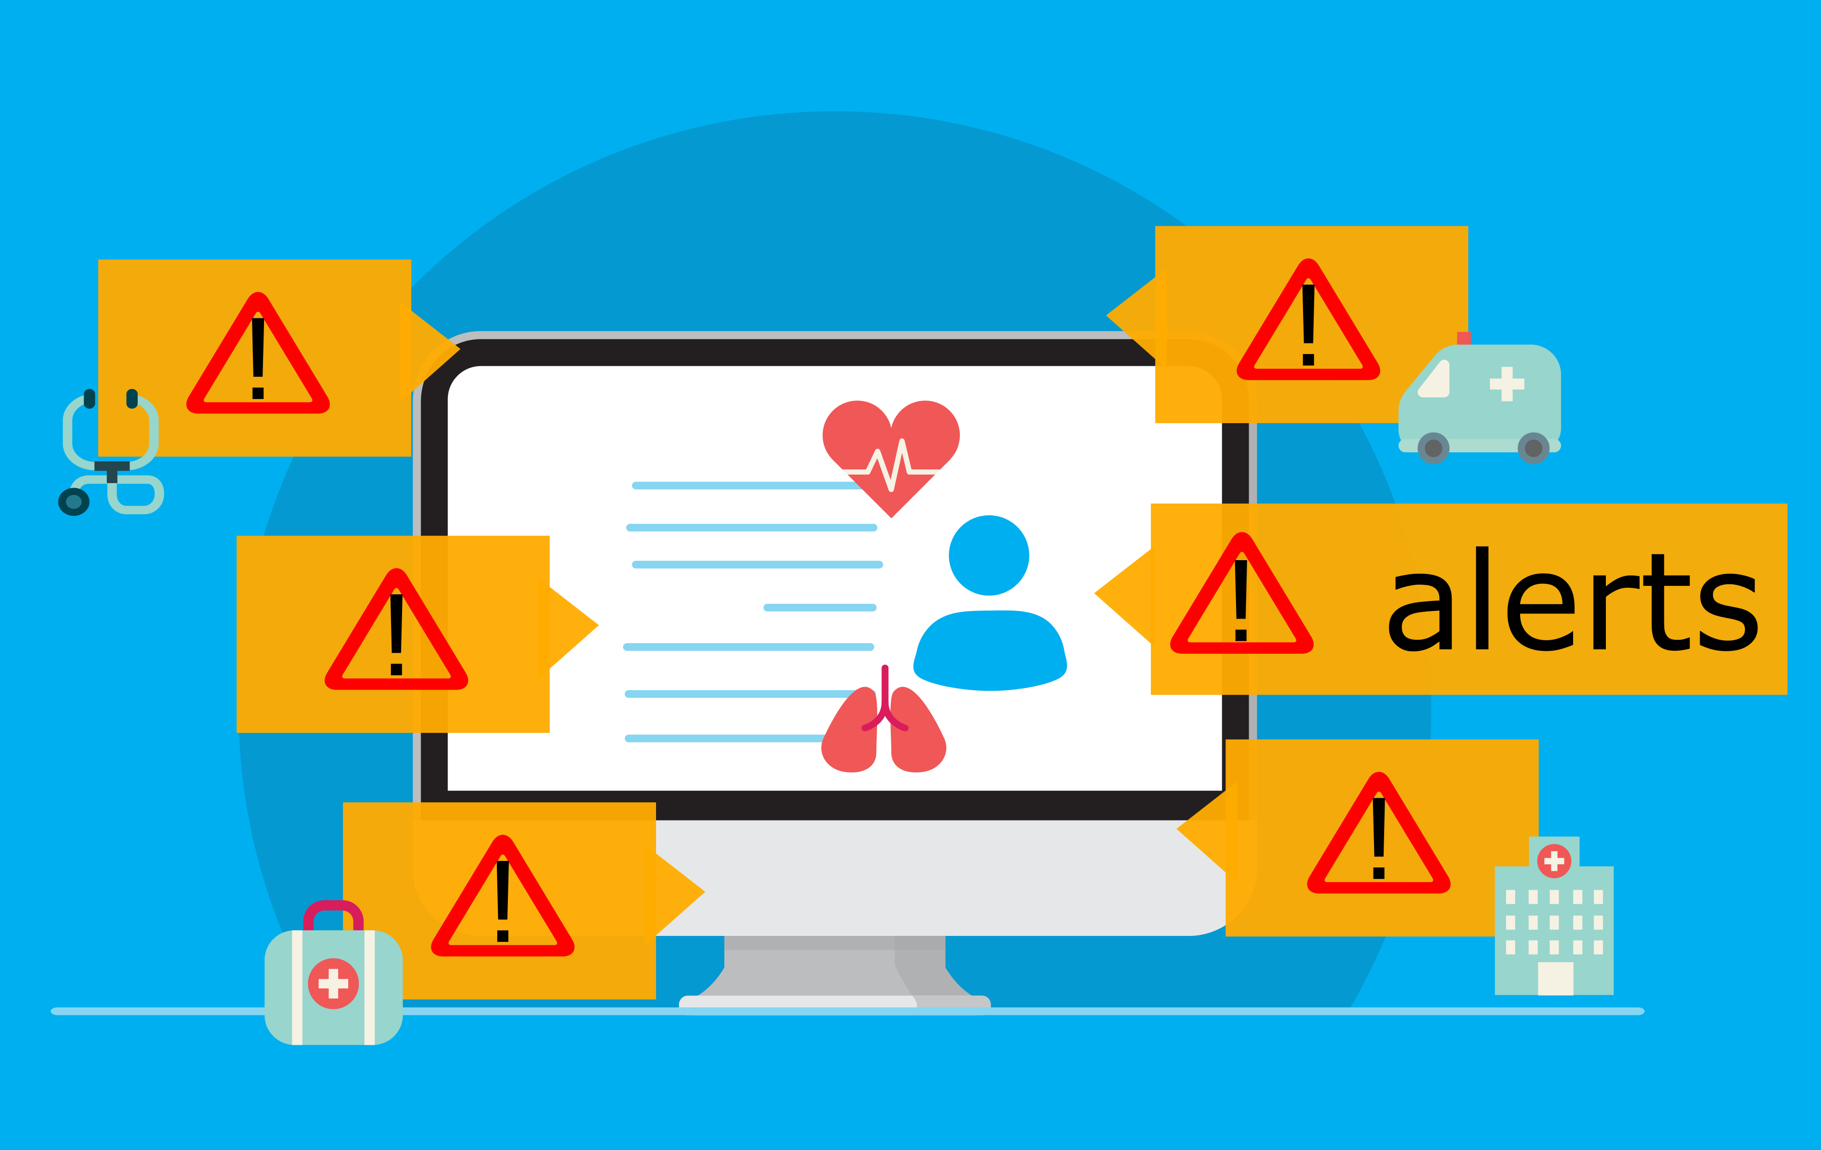
Cyber Security and AI
New tools → More switching → More alerts →Less time for each alert → likelihood of mistakes
Alert fatigue

Slide 4
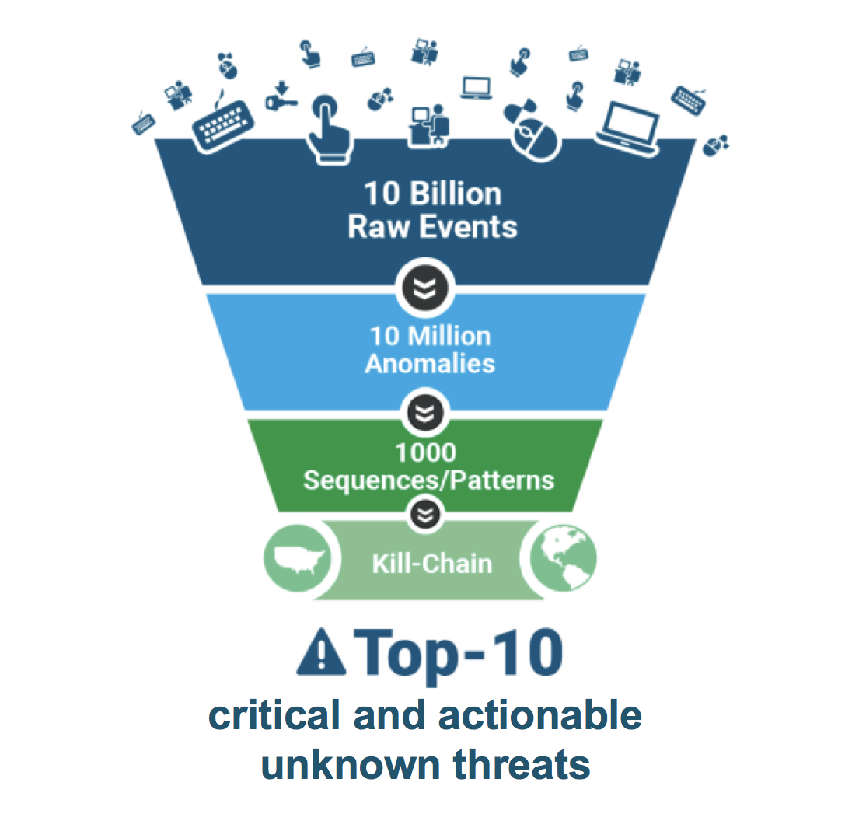
UBA
User Behavior Analytics
How does it work?
1) Collect information
2) Build a model
3) Immediately registers

Slide 5
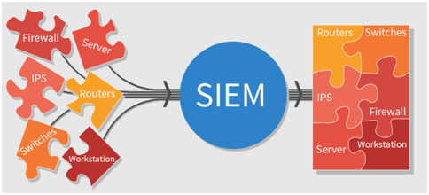
SIEM
Security information and event management

Slide 6
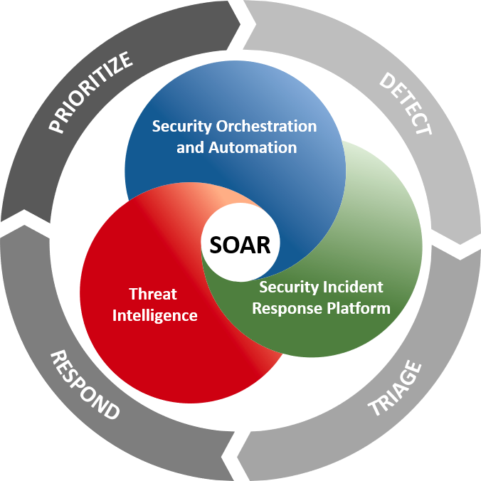
SOAR
Security Orchestration, and Automated Response

Slide 7
Sources
https://www.cisco.com/c/en/us/products/security/what-is-cybersecurity.html
https://www.varonis.com/blog/what-is-siem/
https://www.varonis.com/blog/user-entity-behavior-analytics-ueba/
https://swimlane.com/blog/siem-soar/
https://www.rapid7.com/solutions/security-orchestration-and-automation/

Slide 8


