Slide 1
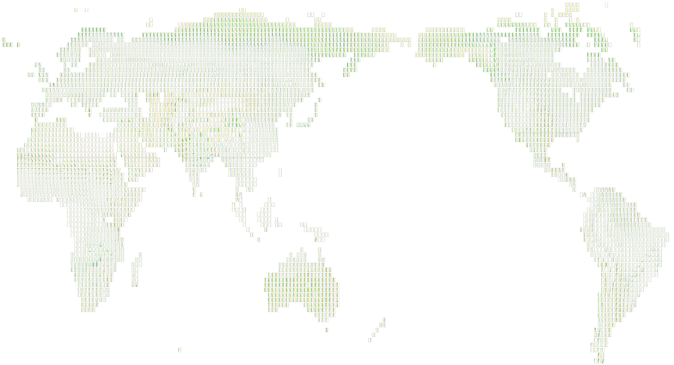
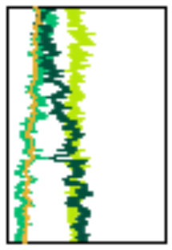
Simulated Holocene Earth system variability (vegetation)
…some 4500 „virtual pollen records“ (= predicted vegetation cover fraction)
0k
8k
des.
grass
shrub
tree
0 1

Slide 2
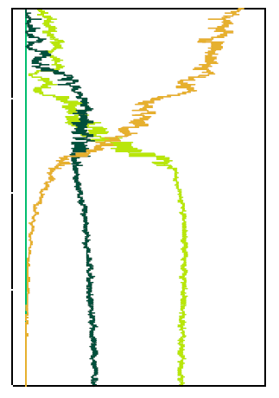
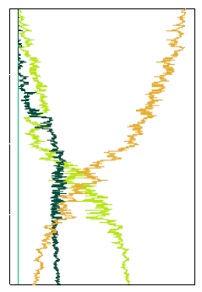
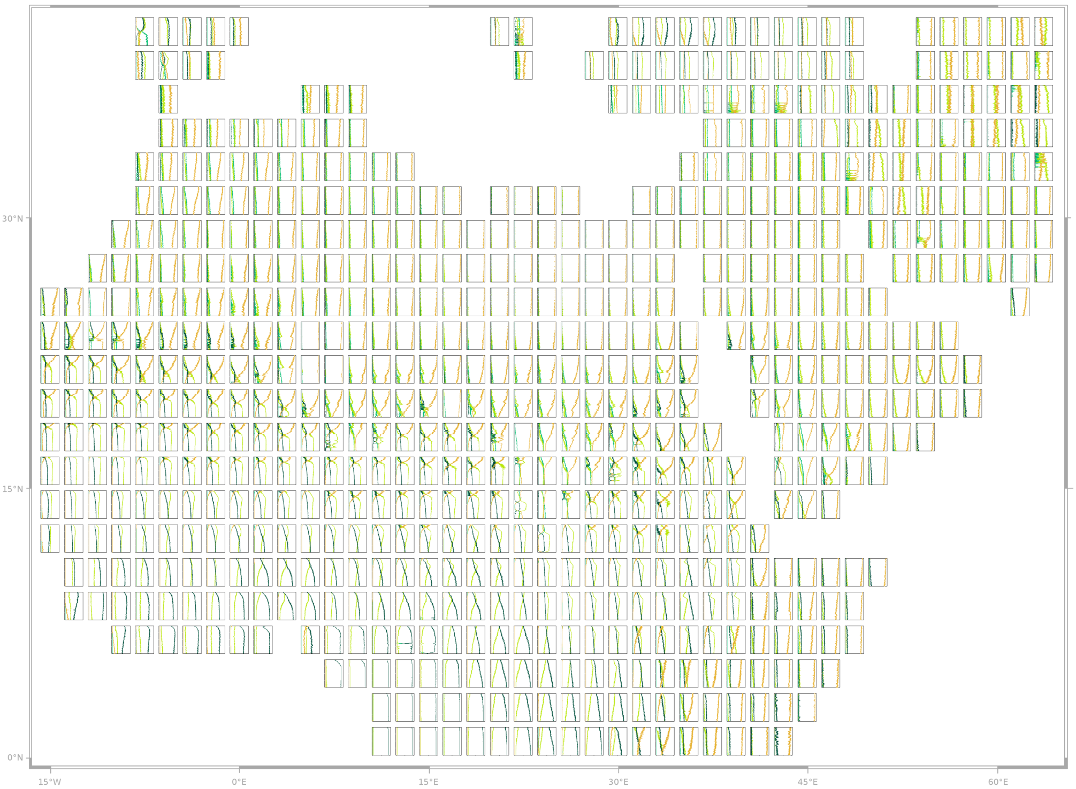
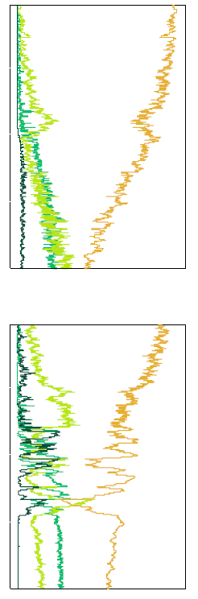
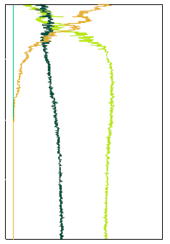
Regional zoom of global vegetation dynamics
0k
8k
0k
8k
desert
Model simulations reveal rapid changes in some regions of the Sahara and more gradual transitions in others.
The model shows a timetransgressive termination of the AHP, which, however, seems to occur latter than data indicate.
„Lake Yoa grid cell“
tree
grass
0 1
0 1
relative coverage
relative coverage
0k
8k
0 1
relative coverage

