Slide 1
Utilizing the UK Property Price Dataset for Market Analysis using PySpark and databricks
MSML 651: Big Data Analytics
Qiao Qin

Slide 2
Introduction
This is a housing price prediction project.
The goal is to analyze and model the UK Property Price dataset.
Utilizing the distributed and parallel computing capabilities of PySpark and Databricks to handle the processing of 1.5 million rows of data.

Slide 3
Data Exploration

Slide 4
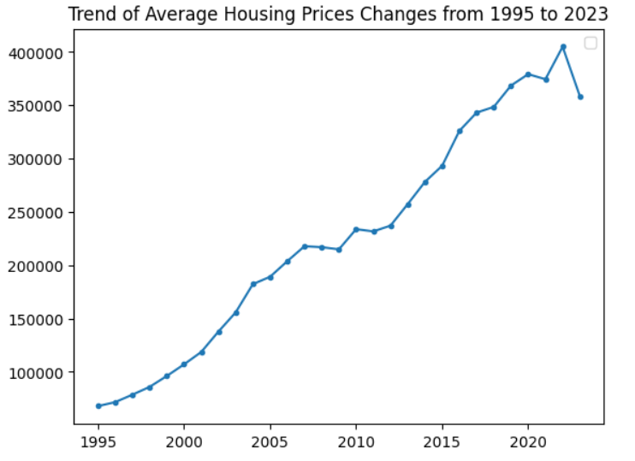
Price
There is an overall upward trend from 1995 to 2023
There is also a decline from 2022 to 2023.

Slide 5
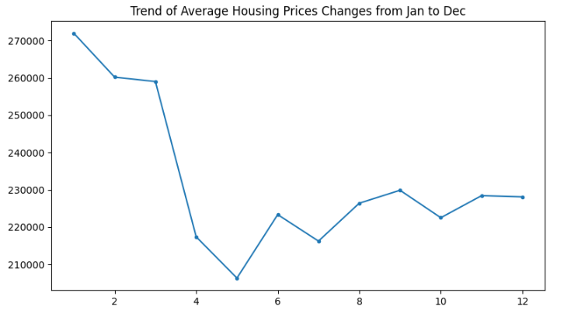
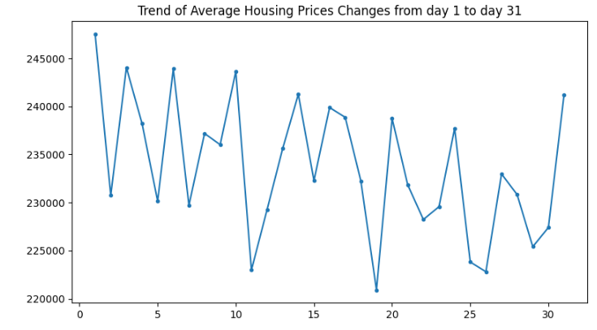
Price
The distribution of housing prices is not uniform across months or dates, indicating the presence of peak seasons or off-peak seasons.
Therefore, these two features should not be dropped.

Slide 6
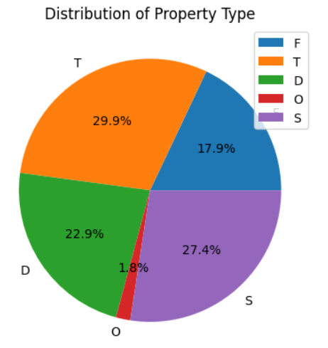
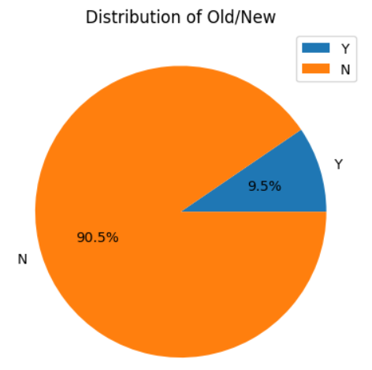
Categorical Features

Slide 7
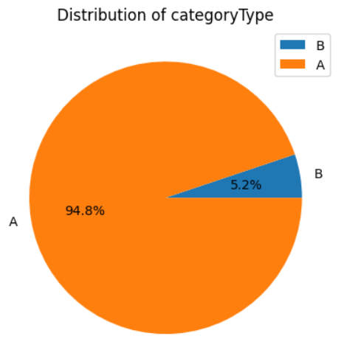
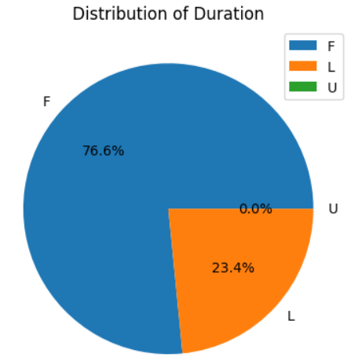
Categorical Features

Slide 8
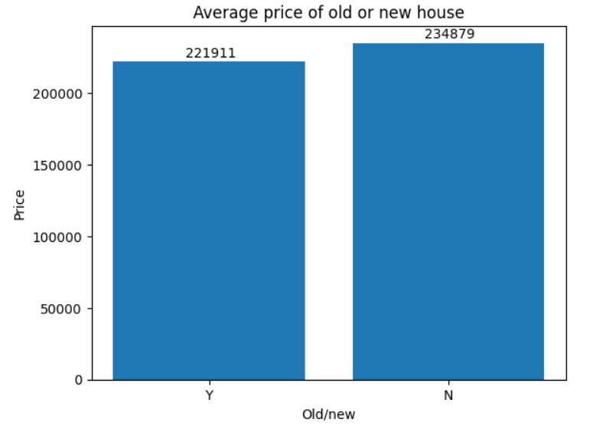
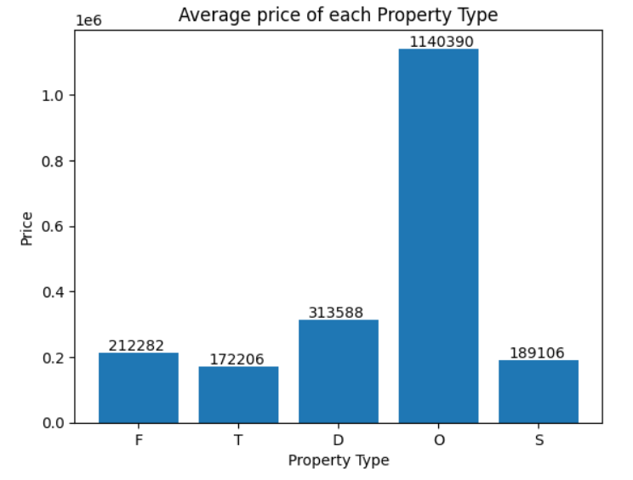
Categorical Features

Slide 9
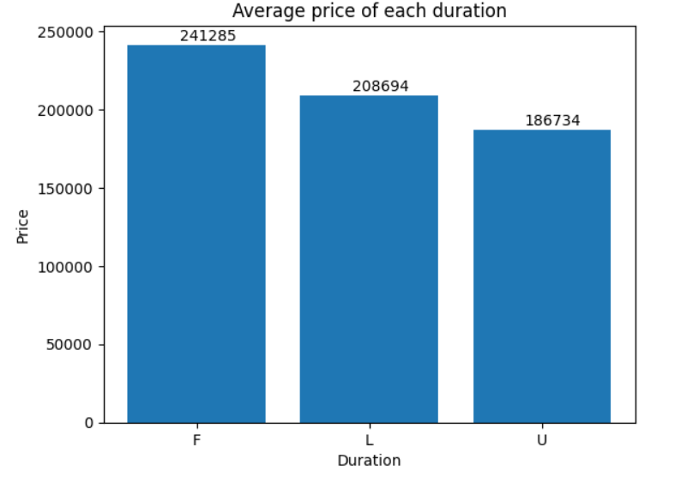
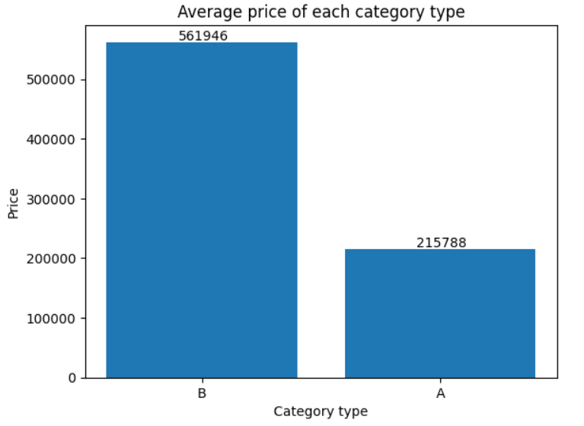
Categorical Features

Slide 10
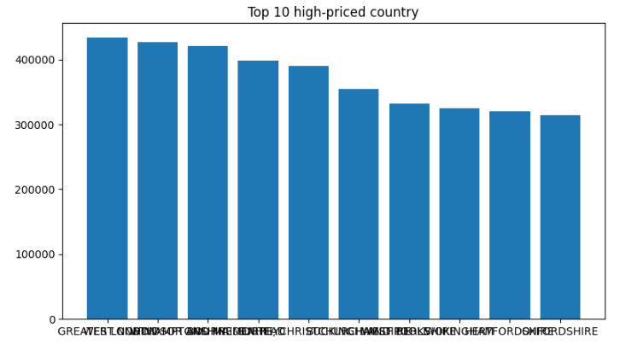
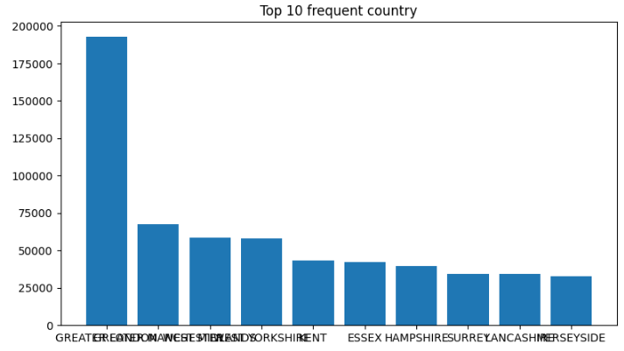
Country
Top 3 high-priced country: ['GREATER LONDON' 'WEST NORTHAMPTONSHIRE' 'WINDSOR AND MAIDENHEAD']
Top 3 frequent country: ['GREATER LONDON' 'GREATER MANCHESTER' 'WEST MIDLANDS']

Slide 11
Other Features
Categorical Features but with a very large range of values.
PAON: 102298
Street: 214214
Town/City: 1167
District: 464
Country: 132

Slide 12
Dropped Features
TransactionID: each house has a unique ID.
Postcode: too many unique values, and its geographical location information can be represented by other features, e.g. locality, country, etc.
SAON: too many missing values (184661 non-null out of 1578903).
Locality: too many missing values (961523 non-null out of 1578903).
RecordStatus: only 1 unique value.

Slide 13
Preprocessing

Slide 14
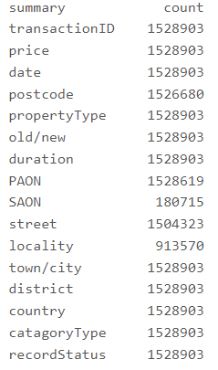
Fill in missing values
In this dataset, for most features, there are not many missing values.
SAON and locality: dropped.
PAON and street: since they are categorical, missing values are filled with the mode.

Slide 15
Encode
Date: convert it into three new integer columns: year, month, day
PropertyType: one-hot encode using OneHotEncoder
Old/New, Duration, CategoryType: 0/1 encode using StringIndexer
PAON, Street, Town/City, District, Country:
ordinal encode
target (mean) encode
frequency encode

Slide 16
Normalization
Using StandardScaler
After train-test split

Slide 17
PCA
Using PCA
Cover over 90% information
12 principal components of training data and their explained variance:
[0.26085647, 0.13705841, 0.11923137, 0.07735423, 0.05852654, 0.05508724, 0.0454256 , 0.03937712, 0.035855 , 0.03454819, 0.02175942, 0.02098715]
Total = 0.906

Slide 18
Building Model

Slide 19
Build the model
pyspark.ml.regression.GBTRegressor
pyspark.ml.regression. RandomForestRegressor
pyspark.ml.regression. GeneralizedLinearRegression
pyspark.ml.regression. DecisionTreeRegressor
Train/Predict
fit / transform / evaluate

Slide 20
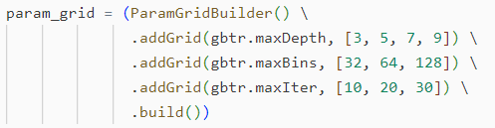
Train the model
Grid Search
Cross Validation k=3
Polynomial Extension

Slide 21
Experiment Result

Slide 22

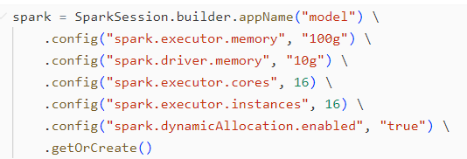
Environment
Databricks
Runtime Version: 14.2 (includes Apache Spark 3.5.0, Scala 2.12)
Node Type: i3.4xlarge (122 GB Memory, 16 Cores, 4DBU/h)

Slide 23
Result
Algorithm | Train |  | Test |  | Time
 | RMSE | R2 | RMSE | R2
Gradient Boost Decision Tree (n=100,depth=5) | 493851 | 0.681 | 1349397 | -3.818 | 1.38 Hour
Random Forest (n=200,depth=9) | 471571 | 0.709 | 476664 | 0.399 | 24.33 Min
Random Forest (n=210,depth=8) | 512009 | 0.657 | 482332 | 0.384 | 19.96 Min
Linear Regression(d=2) | 510993 | 0.658 | 5237383 | -72 | 1.75 Min
Linear Regression(d=3) | 468162 | 0.713 | 97768842 | -25293 | 13.73 Min
Decision Tree(depth=20) | 86361 | 0.990 | 1163503 | -2.58 | 26.02 Min

Slide 24
Conclusion & Future

Slide 25
Summary:
Learned about databricks (how to create a compute cluster, upload data, run code, etc) and Pyspark (how to build a spark session, use pyspark to analyze data, etc)
analyze, process UK property price dataset
build several models to predict the price.
Next:
The model can be further optimized.
Try other models (like LSTM).
Try to leverage Pyspark and Databricks (or other cloud) to utilize the whole dataset.

Slide 26
Thank you!

