Slide 1
How To Emulate Web Traffic Using Standard Load Testing Tools
James F Brady State Of Nevada, Carson City, NV 89701 jfbrady@admin.nv.gov
Neil J Gunther Performance Dynamics, Castro Valley, Ca 94552
njgunther@perfdynamics.com

Slide 2
Introduction
We Describe The Problem.
We Provide A Conceptual Solution To The Problem.
We Show How To Verify That Solution Is Achieved.
We Present a Detailed Case Study Based On Our Methodology.

Slide 3
The Problem
Conventional Load Testing Tools Simulate A Fixed Set Of Users Accessing The System Under Test (SUT).
Web Traffic Is Produced By A Transient User Population Who’s Size Is Unknown At Any Given Point In Time.
How Can Conventional Load Testing Tools Be Used To Produce Traffic Consistent With This Dynamic Web User Population?

Slide 4
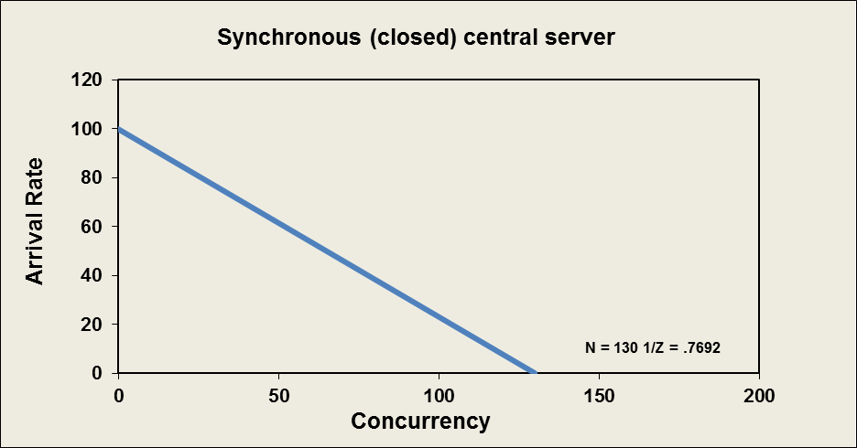
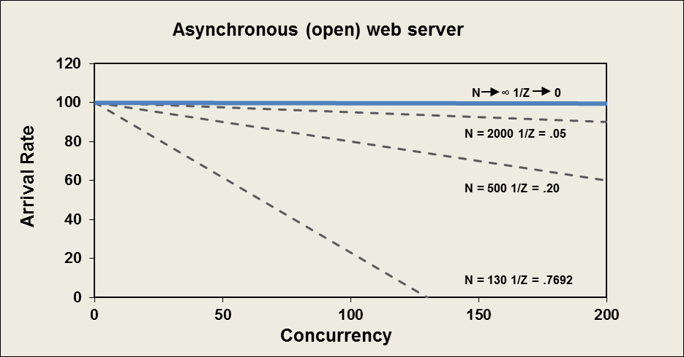
Synchronous Vs Asynchronous Arrivals
Where:
N = Number of Virtual Users
Z = Think Time Setting
Q = Number In Residence
λ = Arrival Rate

Slide 5
Virtual Users And Web Users
Steps Each 😐 Performs In Loop:
Make A Web Request
Wait For & Time Response (R)
Sleep For Think Time (Z)
Wake Up & Wait On Run Queue
Compute And Return Results

Slide 6
Web Testing Methodology
The Key Insights Come From Comparing The Load-test Simulation Models With The Appropriate Queue-theoretic Models
Open Queue - The Number Of Users Generating Requests Is Unknown
Closed Queue - The Number Of Users Generating Requests Is Known And Fixed
The Dynamics Of These Queues Differ Dramatically So They Need To Be Characterized In Completely Different Ways

Slide 7
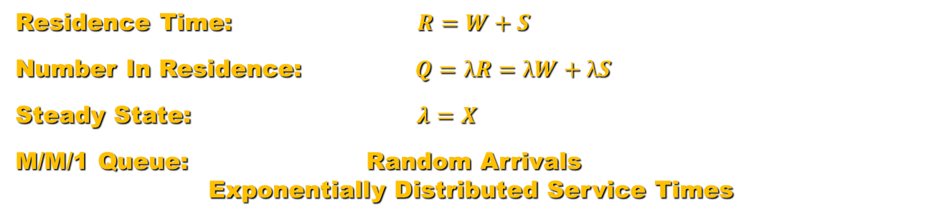
Asynchronous Open Users
W
λ X
S
R
Where:
λ = Arrival Rate
W = Time Waiting In Line
S = Service Time
R = Residence Time
X = Service Rate
Q = Number In Residence
Residence Time: $R=W+S$
Number In Residence: $Q=λR=λW+λS$
Steady State: $λ=X$
M/M/1 Queue: Random Arrivals
Exponentially Distributed Service Times

Slide 8

Synchronous Closed Users
Where:
N = Number of Users
Z = Think Time
λ = Arrival Rate
W = Time Waiting In Line
S = Service Time
R = Residence Time
X = Service Rate
Q = Number In Residence
N, Z
W
λ X
S
R
Round Trip Time: $RTT=R+Z$
Number Of Users: $N=λ RTT=λR+λZ$
Number In Residence: $Q=λ R$
Steady State: $λ=\frac{N}{Z}−\frac{Q}{Z}=X$
M/M/1/N/N Queue: Quasi-Random Arrivals
Exponentially Distributed Service Times

Slide 9




Theoretical Comparison
Where:
λ = Arrival Rate
N = Number of Users
Z = Think Time
Q = Number In Residence
$$λ=\frac{N}{Z}–\frac{Q}{Z}$$
Constant Z virtual users
Scaled Z web users
$$λ sat=\frac{1}{Smax}$$
$$λ rat=\frac{N}{Z}$$
$$λ rat≤λsat$$

Slide 10
Web Testing Principle A
Principle A
To efficiently emulate web traffic the mean think-time, Z, in each of the N load generators should be scaled with N such that the ratio N / Z remains constant thereby ensuring the request rate λ approaches the soft bottleneck λ_{rat} .

Slide 11
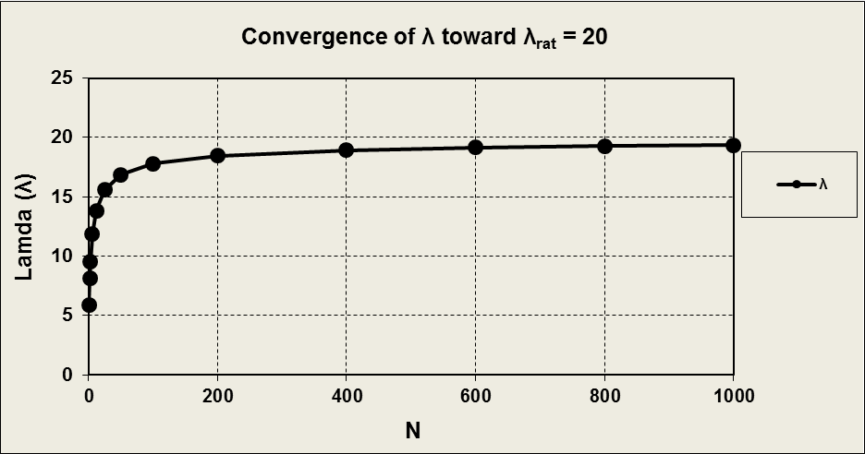
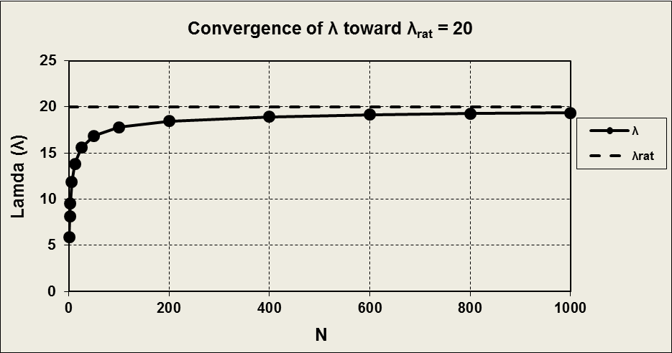


Visualizing Principle A
Where:
N = Number of Users
λ = Arrival Rate
λ_{rat} = Soft Bottleneck
R = Residence Time
Q = Number In Residence
Z = Think Time
$$λ=\frac{N}{Z}–\frac{Q}{Z}$$
$$λ rat=\frac{N}{Z}=20$$

Slide 12
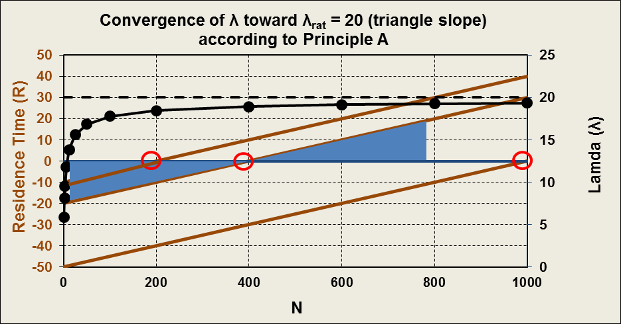
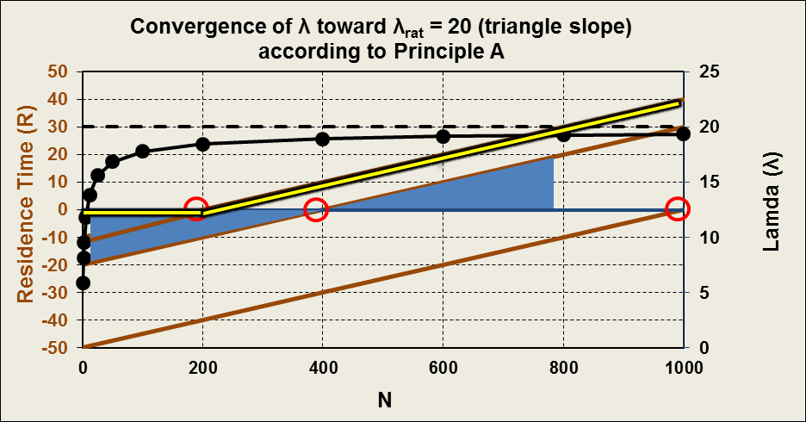





Visualizing Principle A
$$For λ=λ rat=20$$
$$R= .05 N – Z$$
$$λ=\frac{N}{Z}–\frac{Q}{Z}$$
Where:
N = Number of Users
λ = Arrival Rate
λ_{rat} = Soft Bottleneck
R = Residence Time
Q = Number In Residence
Z = Think Time
$$Q=λR$$
$$R=\frac{N}{λ }–Z$$

Slide 13
Applying the Methodology Mimicking a Poisson Process
The Number Of Arrivals In Each Fixed Time Interval Is A Random Variable That Is Poisson Distributed.
The Time Periods Between Arrivals Are A Random Variable That Is Exponentially Distributed.
Combining Arrivals From N Poisson Processes, Each Having Mean Request Rate λ, Produces An Aggregated Poisson Process Having A Mean Request Rate Nλ.
Combining N non-Poisson Processes Asymptotically Approaches An Aggregated Poisson Process Provided N Is Large And Each λ Is Small. (Palm-Kintchine Theorem)

Slide 14









Visualizing a Poisson Process
t
$$\overline{x}= \frac{\sum_{i=1}^{n}{x_{i}}}{n}, s^{2}=\frac{\sum_{i=1}^{n}{{\left(x_{i}−\overline{x}\right)}^{2}}}{n−1}, s=\sqrt{s^{2}}$$
Inter-arrival Times
$$Where:$$
3 2 3 2 2 4
$$x_{i}=the i^{th}sample value$$
x
Count per Interval
$$n=sample size$$
$f\left(t\right)=\frac{1}{μ}e^{−\frac{t}{μ}}$
Exponential
Exponential
$$p\left(x\right)=\frac{{\left(\frac{1}{μ}\right)}^{x}}{x!}e^{−\frac{1}{μ}} x=0, 1, …$$
Poisson
$$Where:$$
$$μ=mean time between arrivals, t$$
$$\frac{1}{μ}=mean arrivals, x, per time interval$$
$$For f\left(t\right), μ=mean=sdev= \sqrt{variance}$$
Mean = Sdev
Mean = Sdev
$$For p\left(x\right), \frac{1}{u}=mean=variance$$
Mean = Variance

Slide 15
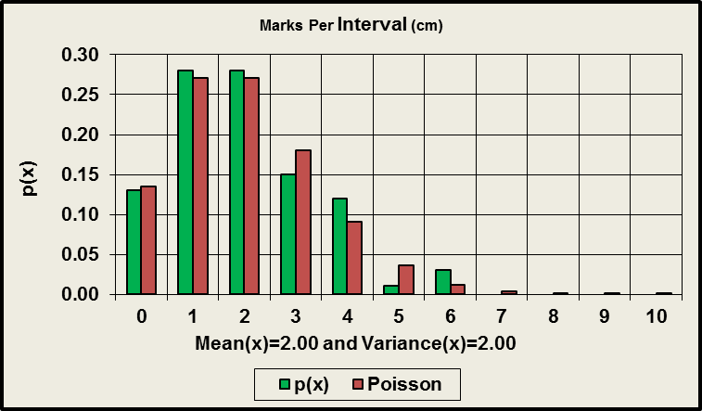
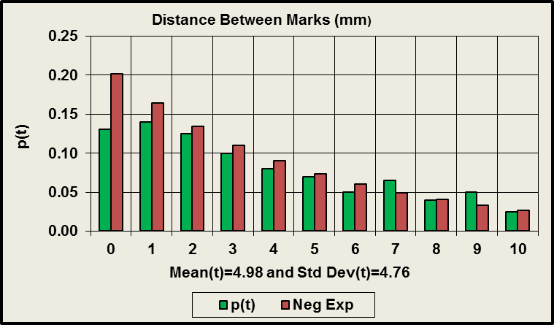
One Meter Ruler Illustration

Slide 16


Combining N non-Poisson Processes
Uniform Distribution Of Z Values
f(z)
$f\left(z\right)=\frac{1}{\text{z}\text{max} }$
Where:
z_{mean} = mean think time
0 z_{mean} z_{max}
Exp Dist Of Times Between Requests - Superposition Of N Threads
f(t)
$f\left(t\right)=\frac{1}{μ}e^{−\frac{t}{μ}}$
Where:
µ = mean time between requests
For f(t), mean = sdev
0 t

Slide 17
Web Testing Principle B
Principle B
Verify that the requests generated by applying Principle A (i.e., large N with low rate 1/Z) closely approximate a Poisson process by measuring the coefficient of variation of the inter-arrival periods and demonstrating that CoV ~ 1 within acceptable measurement error.
Where:
CoV = Sdev / Mean = 1 for an Exponential Distribution

Slide 18
Website Case Study
Government Web Site – WEB.gov
Citizens obtain government statistics
Reconfiguring site from standalone servers to a virtualized load sharing environment
WEB.gov test objects
Object | Definition
010_Home | Home page
012_Home_jpg | Background image
020_Depart | Department data
022_Depart_jpg | Department image
030_Demographics | Demographic data
040_Statistics | Government user data
Mapping between web pages and objects
Web Page | Objects
Home | 010_Home + 012_Home_jpg
Department | 020_Depart + 022_Depart_jpg
Demographics | 030_Demographics
Statistics | 040_Statistics
Test Objectives
How many web users will real WEB.gov support?
Do the virtual servers scale?
Is the load shared evenly across the virtual servers?

Slide 19
Test Configuration
Traffic Generator
Traffic_1
Traffic_200
Enet
Network
F5 Load Balancer
Network
GOV1
GOV2
Blade Server - Virtual Environment

Slide 20
Test Conditions
All Tests Are Run With 200 JMeter Threads
One Uniform Random Timer For Think Times
Load Increased By Reducing Mean Think Time
Web Objects Are Accessed In Random Order
Seven 25 Minutes Tests Performed
First Two And Last Three Minutes Excluded To Ensure Steady State
Test Start Times Based On 24 Hour Clock - 1800, 1830,1900, 1930, 2000, 2030, 2100

Slide 21
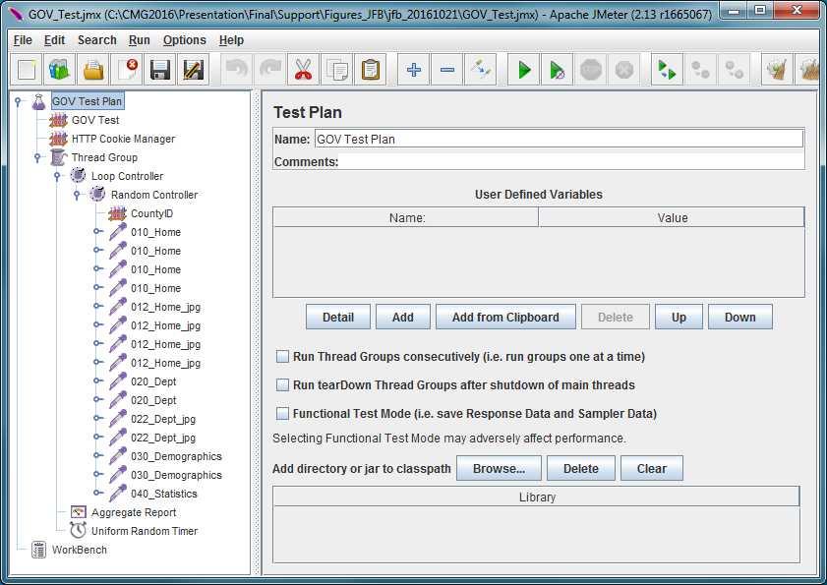
Test Script - JMeter
Random Order
Home Page Objects (4)
Uniform Random Timer

Slide 22
WEB.gov Simulated Web User Loads
Where:
Q (obj) = λ x R
N (obj) = λ (R + Z)
CoV = Sdev / Mean of Inter-arrival Time

Slide 23
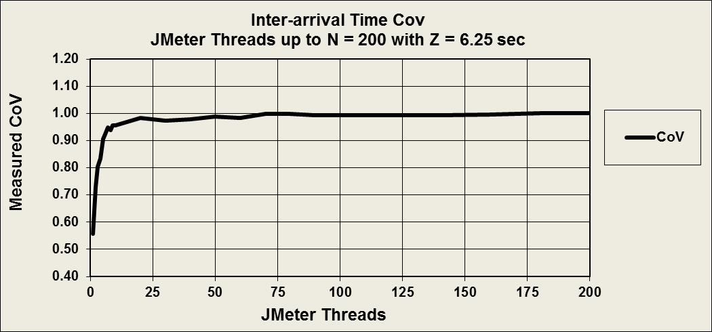
Inter-arrival Time Coefficient of Variation
(CoV By Thread Count For Run 1830)
Where:
N = Number of Threads
Z = Think Time
λ = Arrival Rate
CoV = Sdev / Mean of Inter-arrival Time

Slide 24

WEB.gov Estimated Internet Web Users
Number Of Users:
$$N′= λ (R+Z′)$$
95.50 x (.25338 + 30) = 2889.08
Where:
N’ = Number of Internet Web Users
λ (pgs/s) = Arrival Rate in Pages/Sec
R = Residence (Response) Time
Z’ = Nominal Internet Think Time

Slide 25



WEB.gov Estimated Internet Web Users
Number Of Users:
$$N′= λ (R+Z′)$$
$$λ=\frac{N′}{Z′}–\frac{Q}{Z′}$$
Where:
N’ = Number of Internet Web Users
λ (pgs/s) = Arrival Rate in Pages/Sec
R = Residence (Response) Time
Z’ = Nominal Internet Think Time
Q = Number In Residence
$$λ10 =\frac{363.72}{10}−\frac{2.16}{10}=36.16$$
$$λ30 =\frac{1086.84}{30}−\frac{2.16}{30}=36.16$$

Slide 26
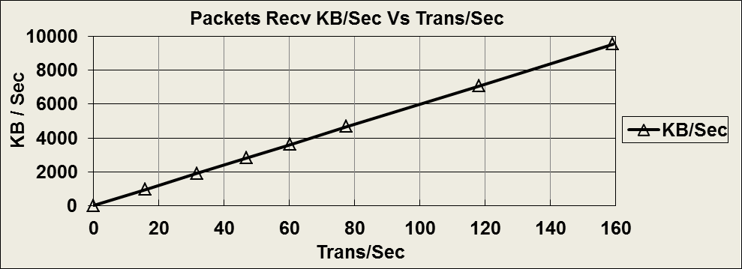
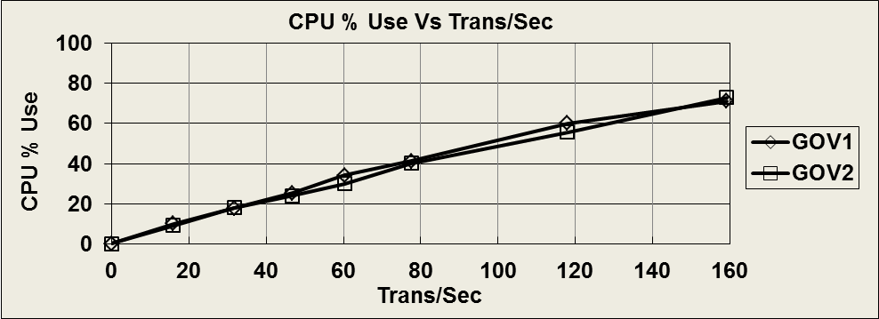
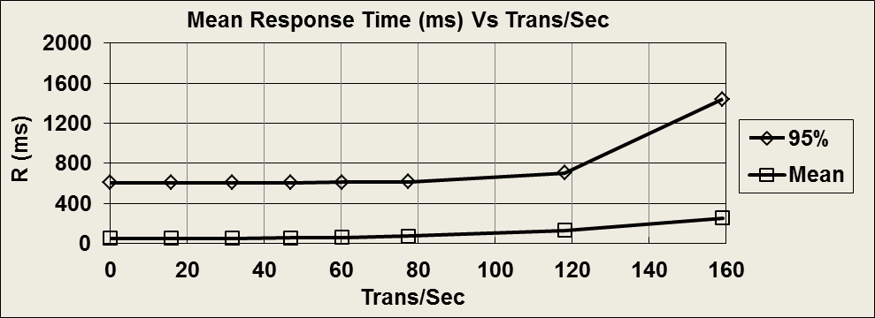
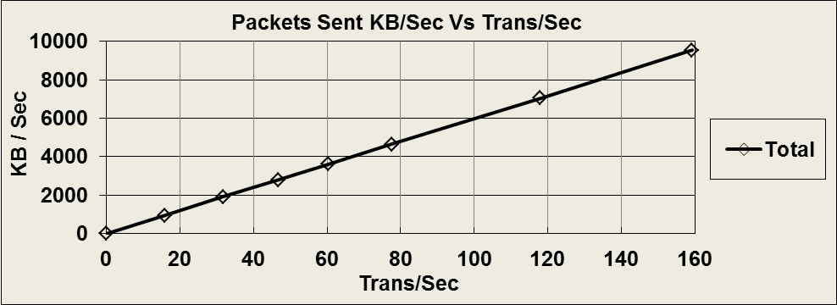
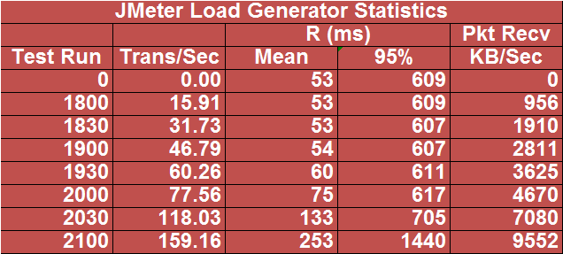
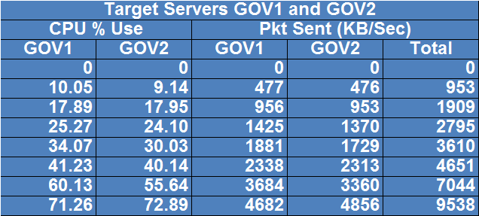
Gov Test - SUT Scalability

Slide 27
Conclusions
Conventional Tools Simulate A Fixed Set Of Users While Web Traffic Is Produced By A Dynamic User Population.
Our Methodology For Adapting Conventional Tools To Web Traffic Is Based On Two Fundamental Principles:
Principle A – Shows How To Scale Parameters N and Z To Produce A Poisson Process.
Principle B – Confirms These Parameter Settings Actually Mimic A Poisson Process.
Real Web Traffic Has Some Synchronization Properties But They Are Weak So Properly Implemented Conventional Tools Are Better Than Explicitly Asynchronous Tools For Mimicking Web Traffic.

Slide 28
Conclusions (cont)
The Case Study Provides A Practical Example Of How Our Methodology Is Implemented And Highlightes Some Of Its Nuances:
It Illustrates That An Estimation Of Actual N’ Internet Users Rather Than The Number Of Test Generator Threads May Need To Be Reported.
It Provides Insights Into How Many Load Tool Threads Are Needed To Mimic A Poisson Process
The Statistical Analysis Tools Used To Produce These Results, ”web-generator-toolkit”, Is Available Online (Free) With This Case Study As The Example.

Slide 29
QUESTIONS ? ? ?

