Slide 1
Interpreting the Sign of Fieldtrip PSI Values…An Investigation

Slide 2
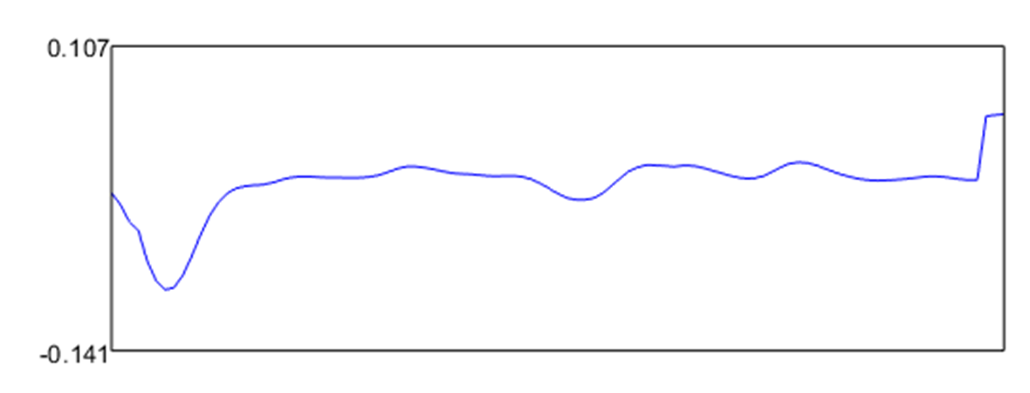


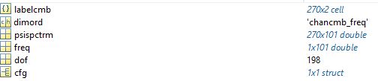
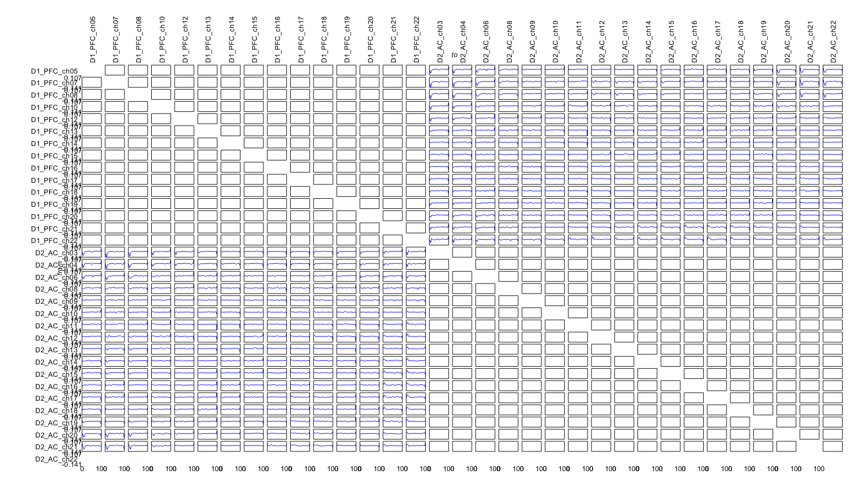
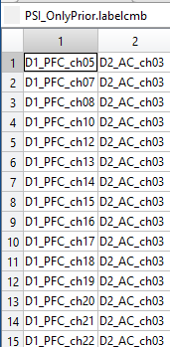
First, my data using cfg.channelcmb
PFC_ch05, AC_ch03, 1 Hz
Channel pair x freq
to
from

Slide 3
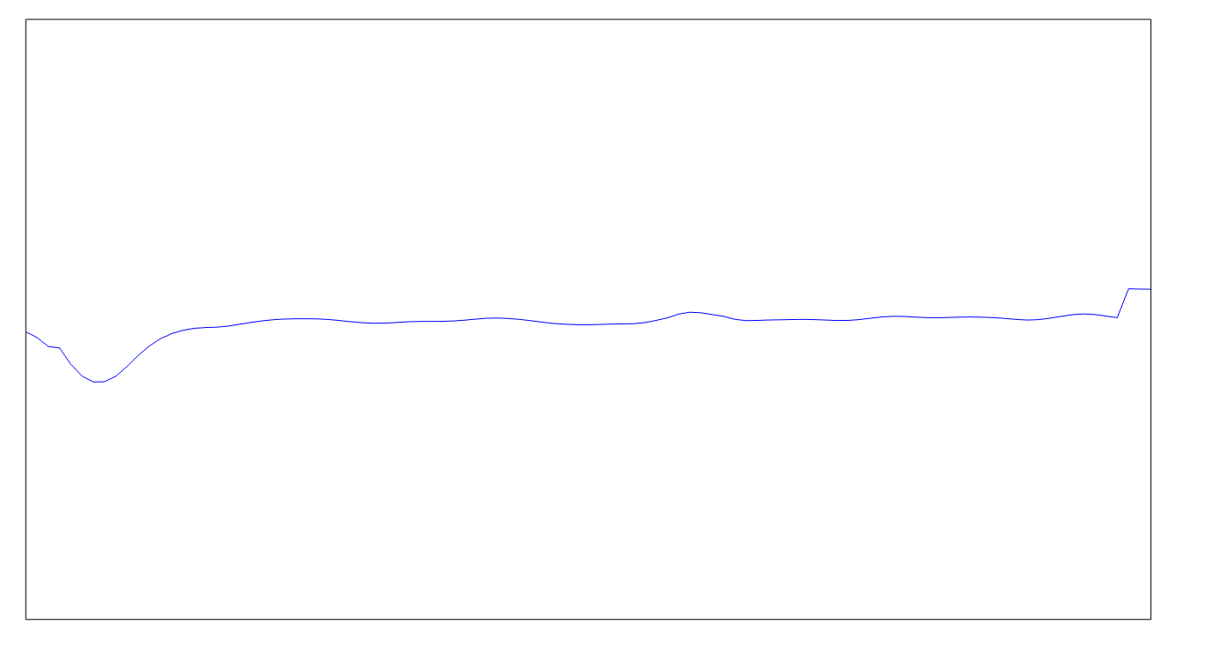


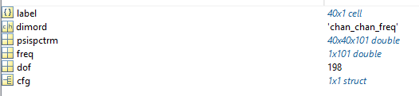

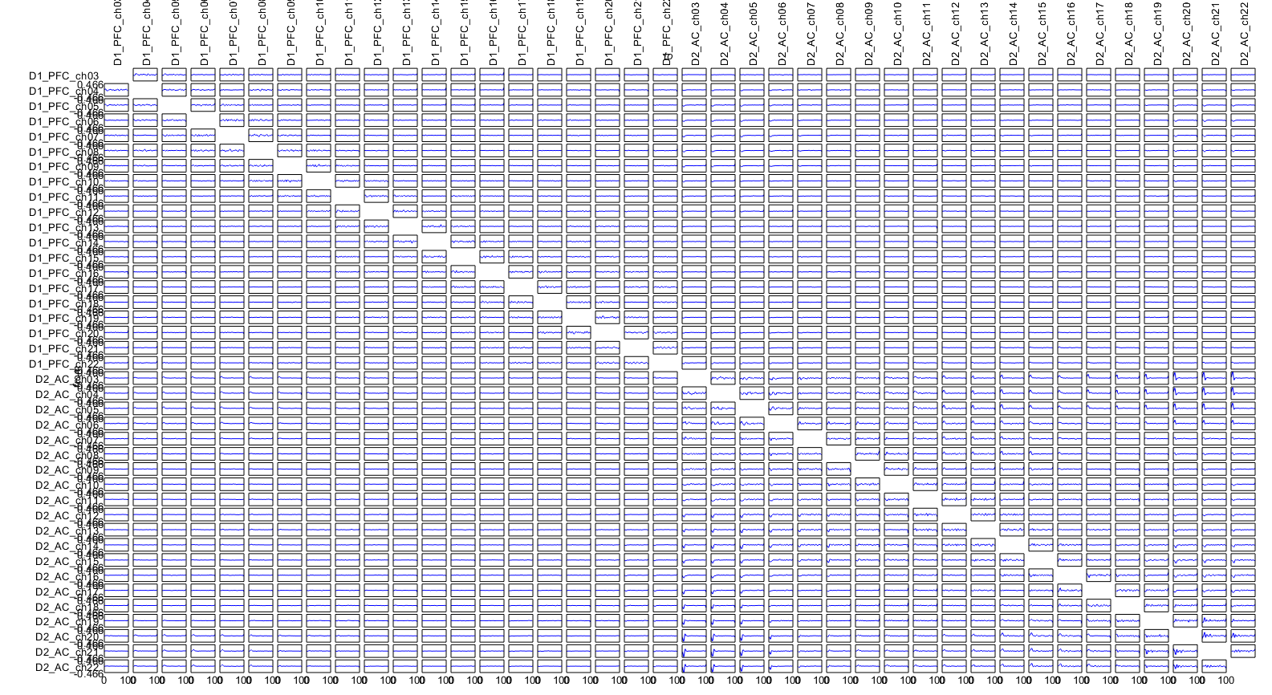
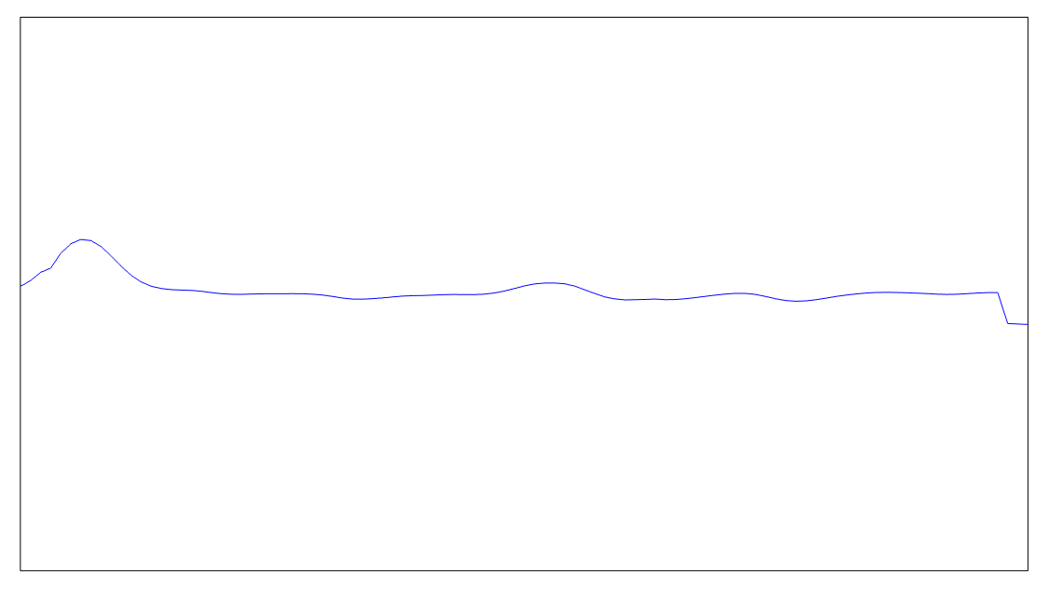

Next, my data utilizing all channel pairs
pfc5_ac3 = PSI_OnlyPrior.psispctrm (3, 21, 1)
to
ac3_pfc5 = PSI_OnlyPrior.psispctrm (21, 3, 1);
from

Slide 4
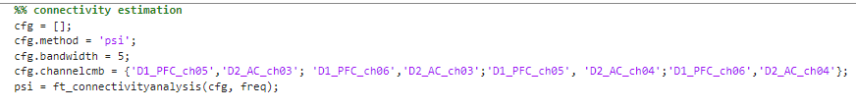
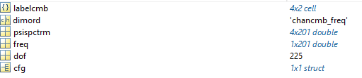
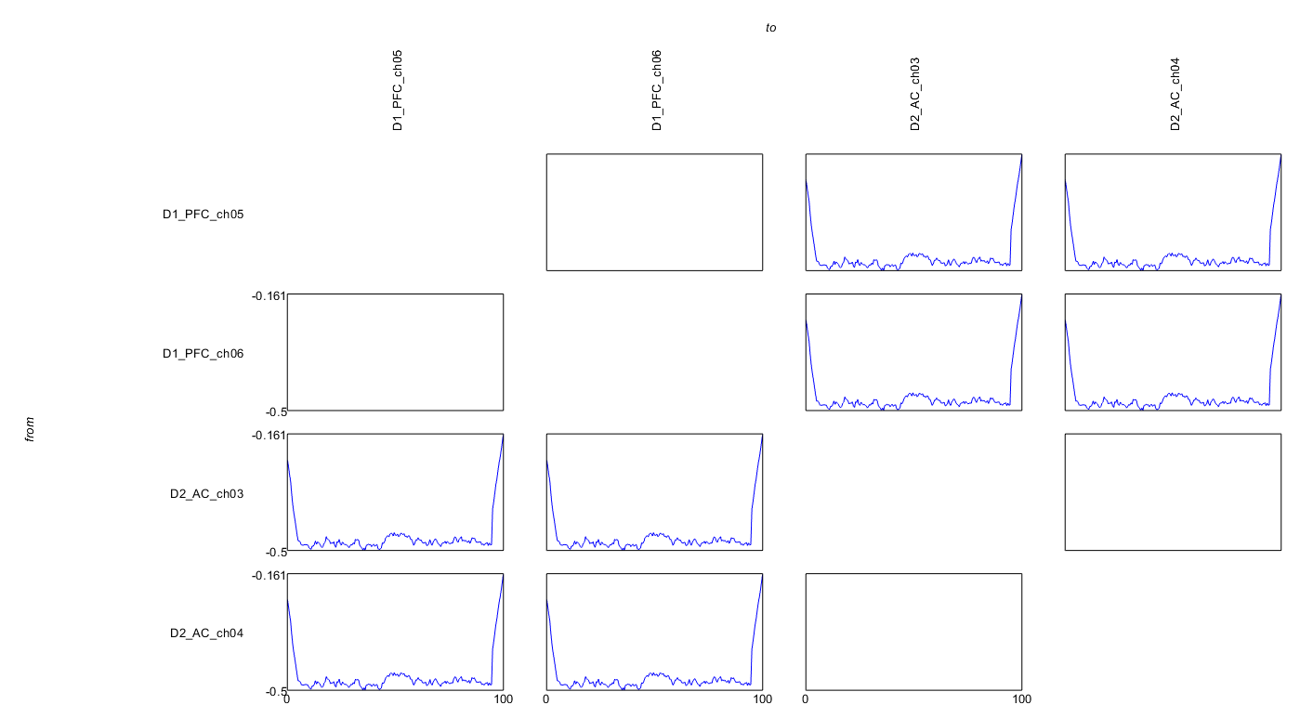
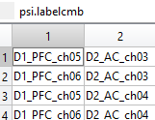
still confused, let us move to simulated data, where both AC channels lead both PFC channels
Channel pair x freq
Note, that all of these have a negative inflection

Slide 5

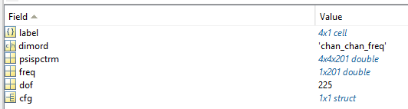
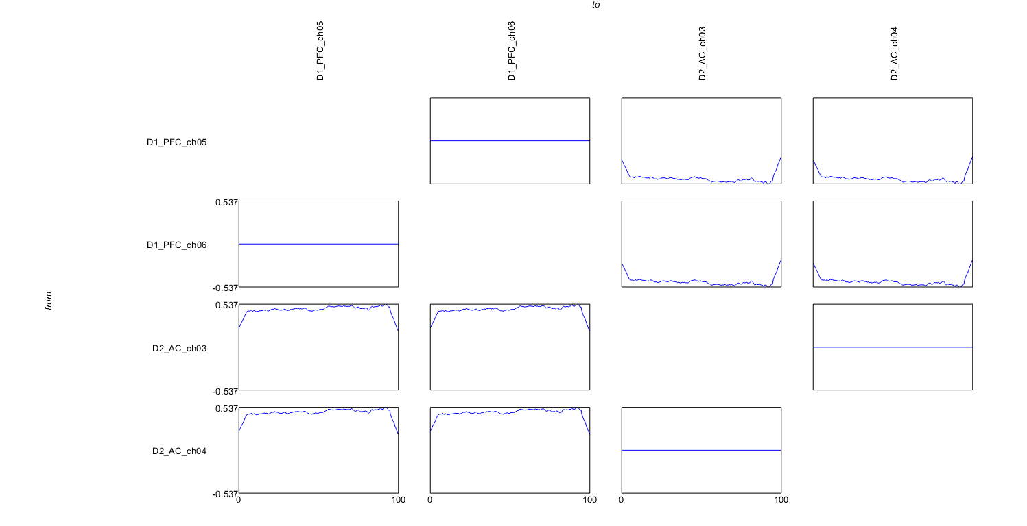

Ok, now we can home in on ground truth. Remember, we know AC leads PFC
As with out real data, the negative inflection is in the top right quadrant.
Now we know that for our data, a negative PSI denotes that that AC leads PFC, and that...
BLUE = BOTTOM UP

