Slide 1
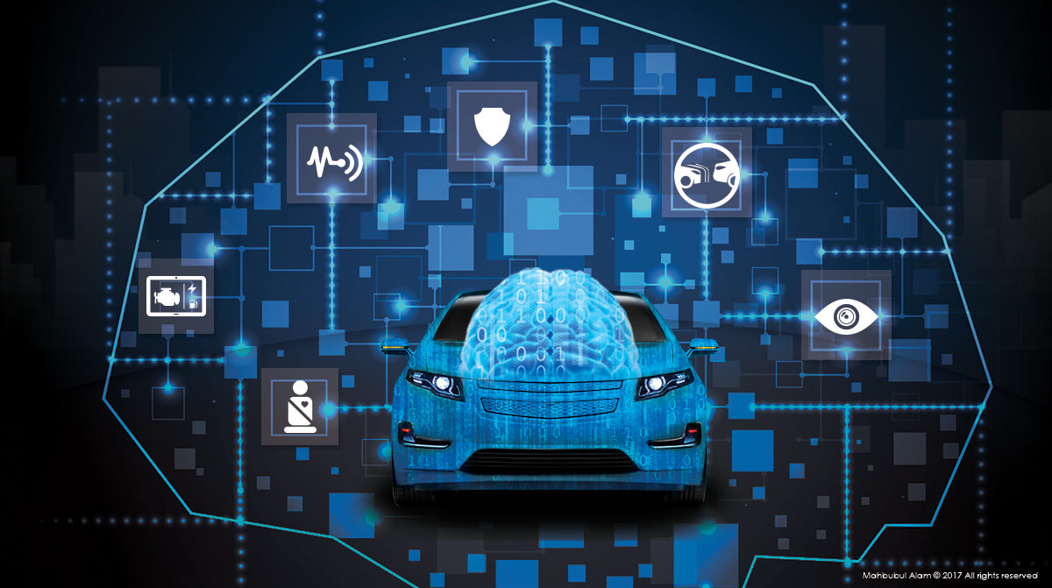

Root-Cause Failure Analysis of Automobile with Deep Learning
Tatsuru Kikuchi, Ph.D.
Data Science Japan Practice, Think Big Analytics
October 26, 2017

Slide 2

Table of Contents
Introduction to the Think Big Analytics
Art-of-the possible within Predictive Asset Maintenance (PAM), IoT, and Analytics of Things (AoT)
How to get started
Case study and Demo
Next steps

Slide 3
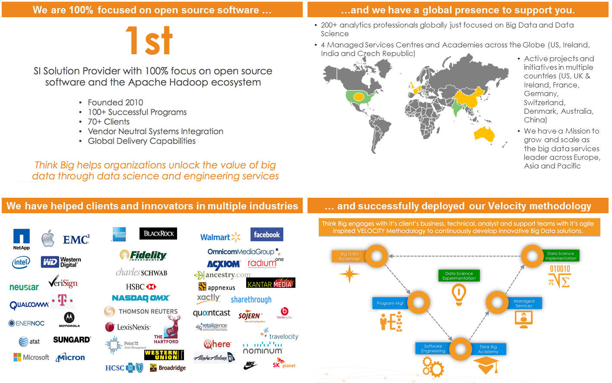
Introduction to the Think Big Analytics

Slide 4
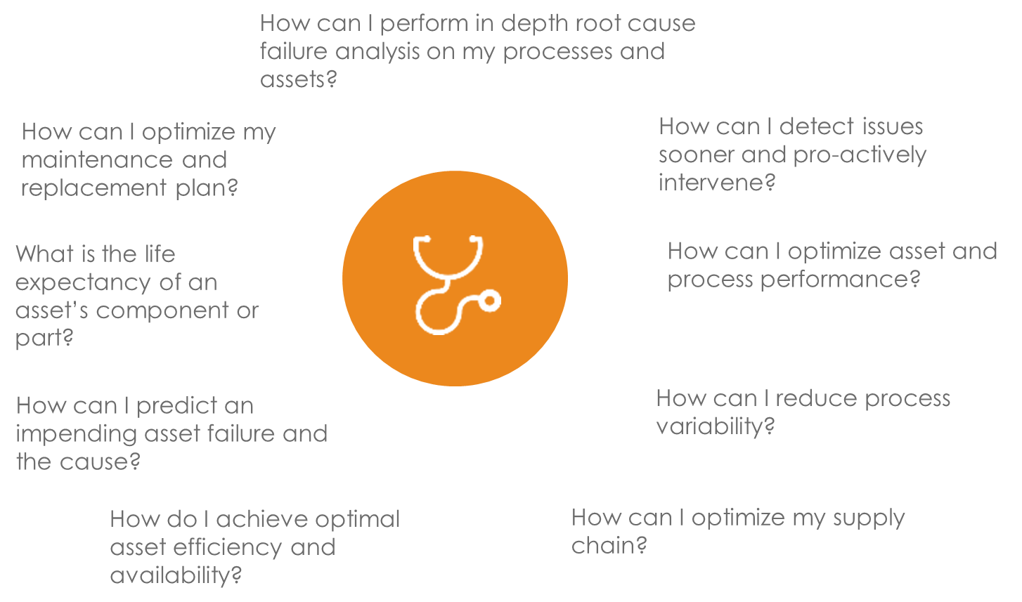
Understanding to the challenges of asset and process performance…

Slide 5
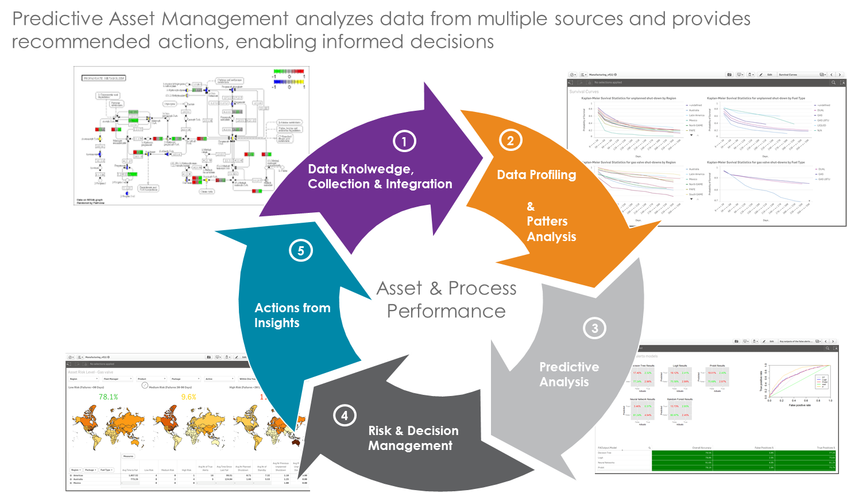
A proven approach customized to your needs

Slide 6
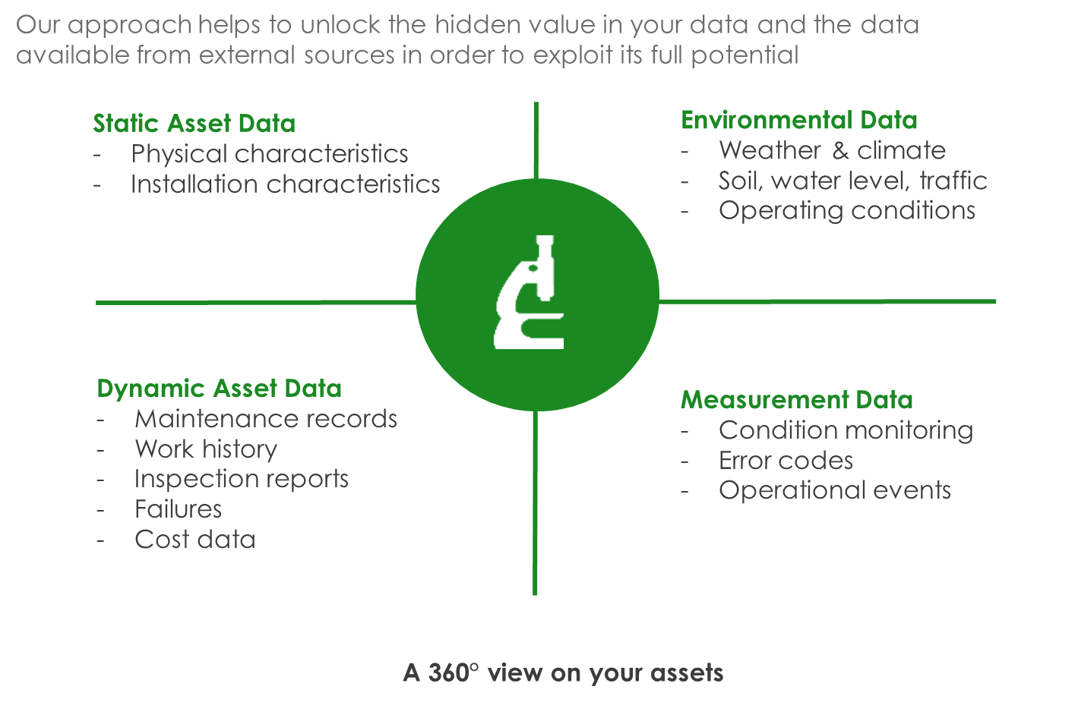
Exploring the full data environment

Slide 7

Use Cases and Examples

Slide 8
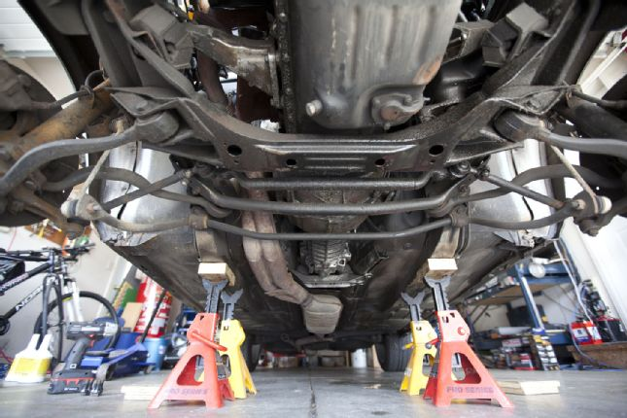
Care Coordination
Root-Cause Failure Analysis of Automobile with Deep Learning
Challenge
Identify the fault cause of the vehicle automatically.
Deliver the analytics result in near real time before the relevant vehicle visits the dealer.
Solution
Automated fault cause classification processing powered by Artificial Intelligence to identify the fault cause and send the result before the relevant vehicle visits the dealer.
Results
Reduce the vehicle downtime. It can be fixed immediately after receiving the analytics result.
Increase the repair success rate, avoid repeated fixing and eliminate the unnecessary parts replacement cost.

Slide 9
Executive Summary
Care Coordination
Purpose
To identify the fault cause automatically using DTC and sensor data (Time series form) in order for the mechanics in dealer to fix the vehicle immediately even with less skill and experience.
Data and Analytics
Establish model for classification
Operationalize
Identify root cause using sensor data automatically
Provides the analytics service by Teradata to send back the result after receiving the data from them.
fault happens
Fuel injection vol.
Pressure
RPM
DTC Code
Temp.
+
Dealer
XNNNN
Repair
Establish variables
＝
Fault Cause : Leak in Fuel System…
Output
Sensor data
Cause
Feature selection
Output
DTC Code
Classi fication
Result
XNNNN
+
Cause
Deep learning
y=f(x)
＝
Fault Cause : Turbo Charger…
Business Value
Reduce the vehicle downtime. (Can be fixed immediately after receiving the analytics result by dealers.)
Increase the repair success rate (avoid repeated fixing) with higher customer satisfaction and loyalty.
Notes:
The colours of the triangles indicate the type of Use Case:
Orange = Traditional Teradata / Data Warehouse
Red = ‘Big Data’ / Advanced Analytics
Blue = Non-Analytical Hadoop / Data Lake use case (e.g. Archiving)

Slide 10
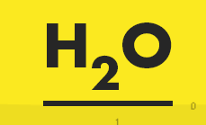

Outline of failure cause analysis with Deep Learning
Care Coordination
IoT sensor data
Feature Engineering
Multiple Classification
Even if one cannot obtain any information to select important variables from engineering point of view from extremely large class of IoT sensor data. Once we adopt Deep Learning methodology, a feature engineering can be done almost automatically even from tons of variables.
Upon receiving the IoT sensor data from each automobile, root cause failure analysis is performed. This is the multiple classification problem in data analytics.
Teradata
fault happens
Teradata
Fuel injection vol.
Feature Engineering by Deep Learning
Pressure
In analyzing a variety of IoT sensor data, it is hard to find some features just from engineer’s point of view. However, one can almost automatically extract features by the use of Deep Learning.
RPM
Root cause failure analysis with Deep Learning
Temp.
Root Cause A
Since automobile is so complex system, there exist so many variety of sensor data.
Root Cause B
Root Cause C
Report
Root Cause D
Car ID=1234
Root Cause=A
Accuracy=97%
Root Cause E
The R interface to the H2O package is used for implementing our analysis of Deep Learning.

Slide 11
Some technical details on failure cause analysis with Deep Learning
Care Coordination
IoT sensor data
Basic strategy of our analysis
We treat each row or time as independent data.
Proceed a multiple classification analysis for each time using Deep Learning.
Final result of prediction is determined according to a majority rule.
Teradata
t=1
DL
Root Cause=A
t | x1 | x2 | x3 | … | x108
voting
explanatory variables
t=2
DL
Root Cause=B
t=3
DL
Root Cause=A
Prediction=A
sensor data
t=4
DL
Root Cause=A
time
t=5
DL
Root Cause=A
The R interface to the H2O package is used for implementing our analysis of Deep Learning. Several parameters in the Deep Learning is fixed to optimize the final result of root cause failure prediction. The below is just one example set of parameters.
Hidden layers and neurons: (100, 100)
L1/L2 regularization: 0.01
Max w2: 10
Each data is a time series data for a particular vehicle after the failure.
First column shows a short time period for each broken vehicle.
We have 108 input variables (from “x1” to “x108”) at each time.

Slide 12
Outcome and Benefit
The results of this automated pipeline have a number of applications in PAM/IoT/AoT context in the manufacturing industry. Overall, the process is aimed to improve the efficiency and effectiveness of engineering workers.
Failure vs No Failure
No Need for Experienced Engineers
The system can process the original sensor data before the engineers fix the broken parts in the complex system and therefore drive decision making in relation to customers onboarding. Particular devices which are more likely to be broken can be prioritized, fixed and replaced in advance.
The pipeline can be used within manufacturing factory to create automated product assessments even with less skill and experience and compare the effect of an accident on subject and control groups.

Slide 13
Demo

Slide 14
Next Steps

