Slide 1
Prudential Life Insurance Evaluator
Members –
Swarup Mishal
Prasad Mantri
Trupti Gore
Ziyan Hu

Slide 2
Project Details
Insurance Data Set
Predict the response using different Regression techniques :
Linear Regression
Support Vector Machine Regression
Decision Tree Regression

Slide 3
Preparing for Pre-Processing
Input
Train and Test data
Variable Types
Train data set for Prudential Life Insurance
We extract the last 10000 entries in the data set of the given train data set and set it as Test data for prediction
Categorical data, Continuous data and Discrete.

Slide 4
Pre-processing
Pre-processing forms a major part of the data prediction which is done over a number of stages :
Handling Missing Values –
Deleted Columns – Missing values for a column over 60%
Replace Missing values : Continuous Variables – average/mean value of column
1 to C coding – Categorical -> Numerical
Normalization – Already normalized.
Dimensionality Reduction – Applied Principal Component Analysis

Slide 5
3 Regression Techniques considered
Target
Linear Regression
Decision Tree Regression
SVM Regression
Linear Regression
Decision Tree Regression
Support Vector Machine Regression

Slide 6
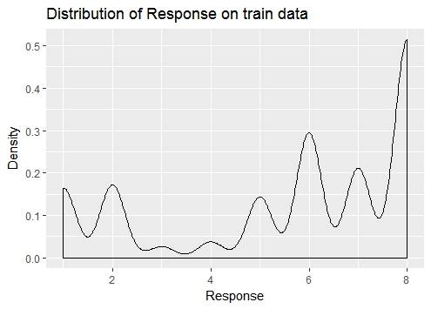
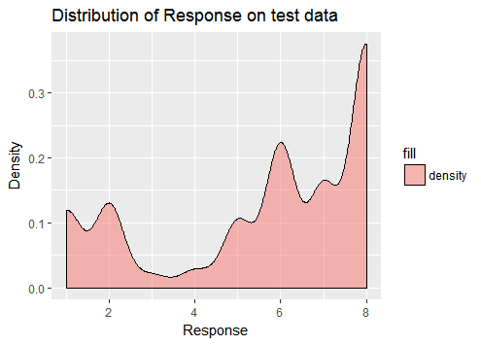
Linear Regression
Distribution of Response on Train data
Distribution of Response on Test data

Slide 7
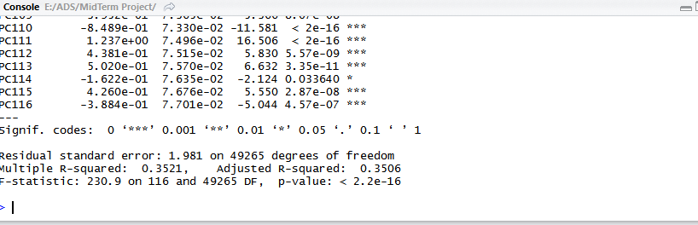
Linear Regression
Summary

Slide 8
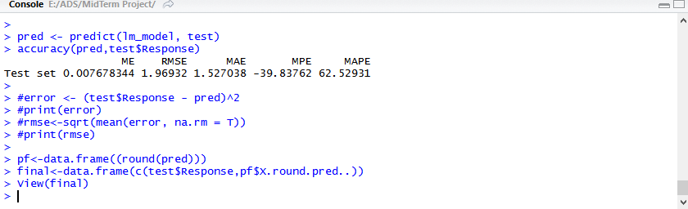
Linear Regression
Error Summary

Slide 9
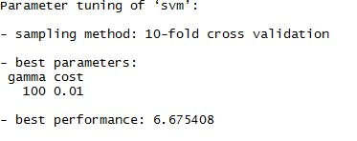
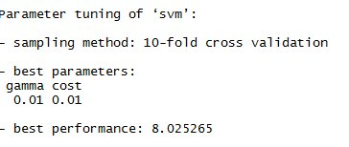
SVM Regression
Tuning to find Best Kernel and parameters
Polynomial Kernel
Sigmoid Kernel

Slide 10
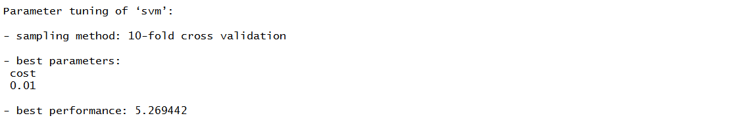
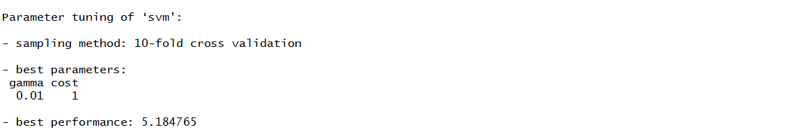
SVM Regression
Tuning to find Best Kernel and parameters
Linear Kernel
Radial Kernel

Slide 11

SVM Regression
Best Kernel Decision
Lowest Best Performance → Best Kernel : Radial
Accuracy for SVM :

Slide 12
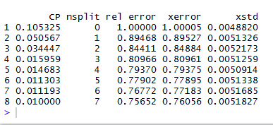
Decision Tree
CP Values

Slide 13
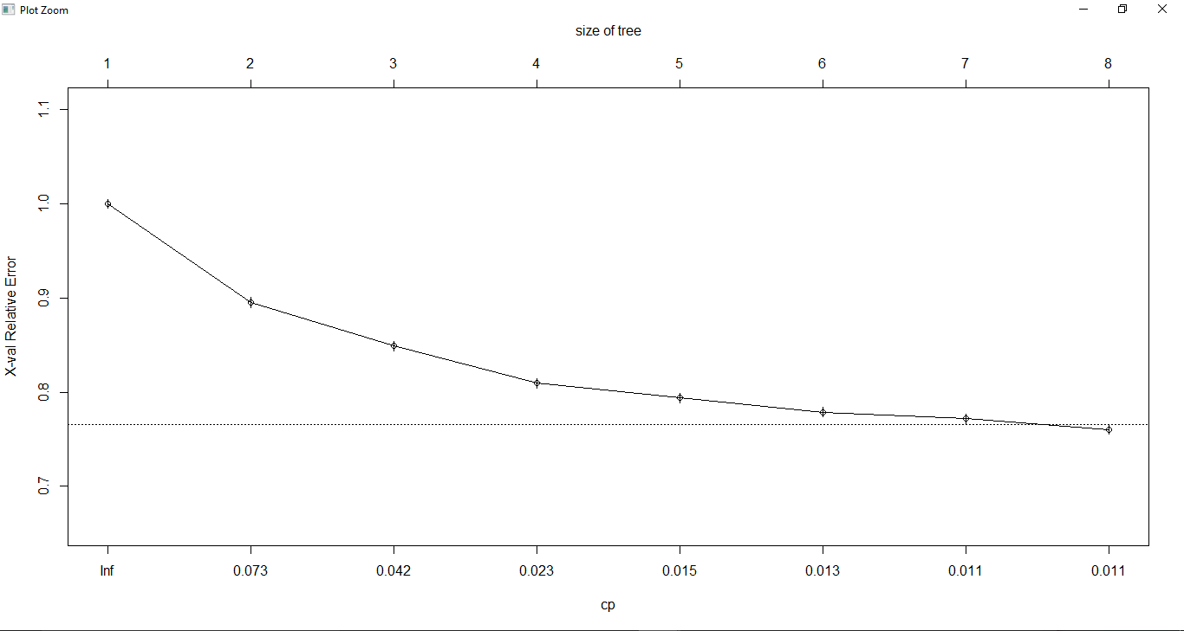
Decision Tree
CP values Plot

Slide 14
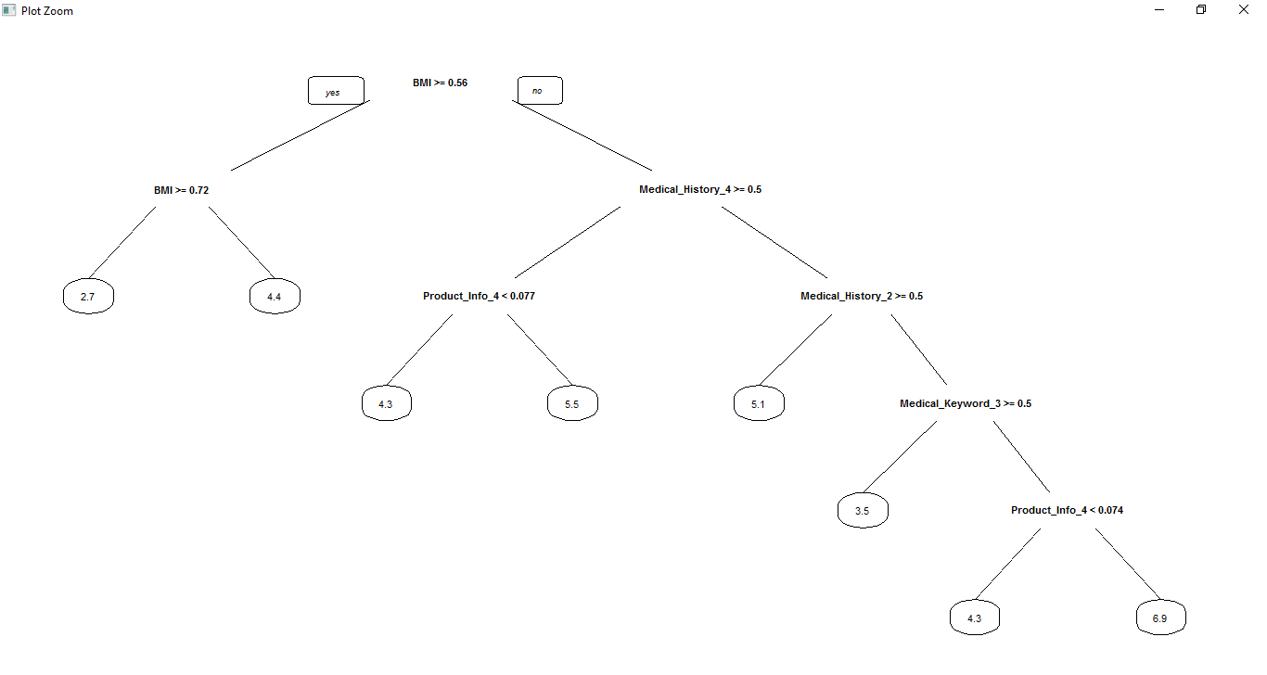
Decision Tree
Diagram

Slide 15

Decision Tree
Accuracy for Decision Tree Prediction

Slide 16
Conclusion
After performing all three types of Regressions, we can see that best prediction was achieved using Linear Regression with least error value of 1.967 RMSE value.

