Slide 1

Quantitative Strategies on High Frequency Data
Umid Suleymanli & Nijat Aliyev

Slide 2
Overview
Data 1:
ES – futures contract for S&P 500 index (transaction cost = 4$, 1 index point = 50$).
Data 2:
MSFT – Microsoft stocks (transaction cost = 0.2$)
AAPL – Apple stocks (transaction cost = 1$),
NQ – futures contract for NASDAQ index (transaction cost = 4$, 1 index point = 25$).

Slide 3
Introduction
The data 1 used for strategies formulation includes intraday one minute frequency data (period of 2011-01 – 2012-03 (just trading hours 9:30-16:00 NY time) and is divided in 5 quarterly files. Only three quarters data are used for strategy selection while last two quarters data are treated as out-of- sample.

Slide 4
Assumptions
The following common assumptions were defined:
do no use in calculation the data from the first and last 10 minutes
exit all positions 15 minutes before the session end
do not trade within the first 20 minutes of quotations

Slide 5

Strategy selection

Slide 6
Group 1 Asset - ES
We tried different strategies for futures contract of S&P500 index based on slow and fast moving averages, volatility windows and the multiplier. The best strategy we decided eventually on was 30 ,70, 90, 2 for signal EMA, slow EMA, standard deviation and multiplier respectively . Mean reverting strategy worked quite well here, with net Sharpe Ratios of 3.54, -1.03 and 5.98. Total net Sharpe Ratio is 8.48 for this strategy and we feel optimistic that it work well for out of sample data as well, even though we had negative Sharpe Ratio in second quarter.

Slide 7
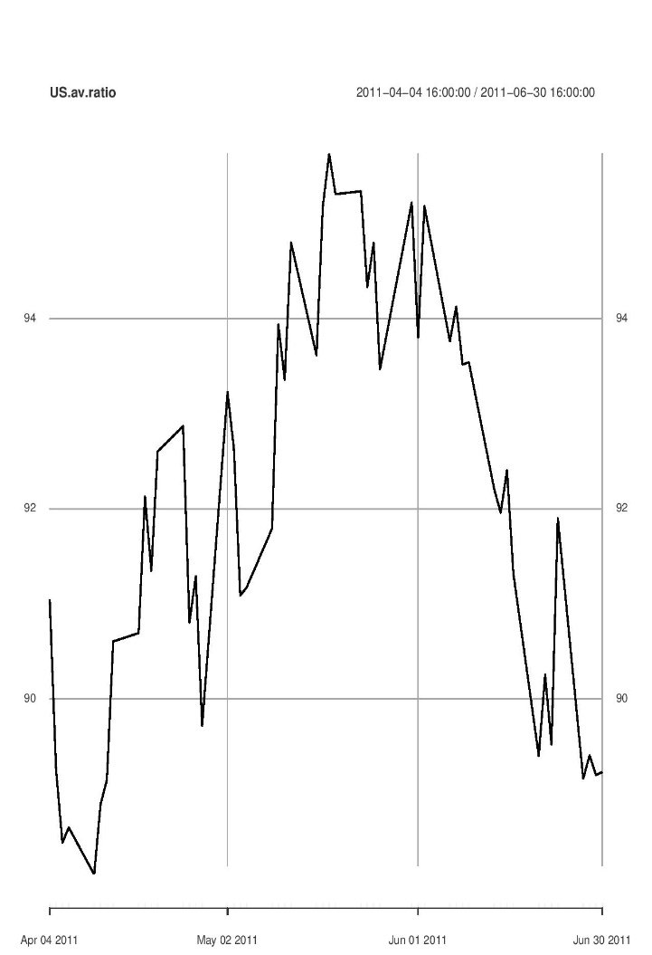
Group 2 Assets .Nasdaq and Microsoft
For group 2 assets we tried different pairs for pair trading strategies and Nasdaq-Microsoft pair proved to be relatively successful one. That’s why we decided to stop at this pair. As seen from the plot the average ratio between Nasdaq and Microsoft is about 90-95

Slide 8
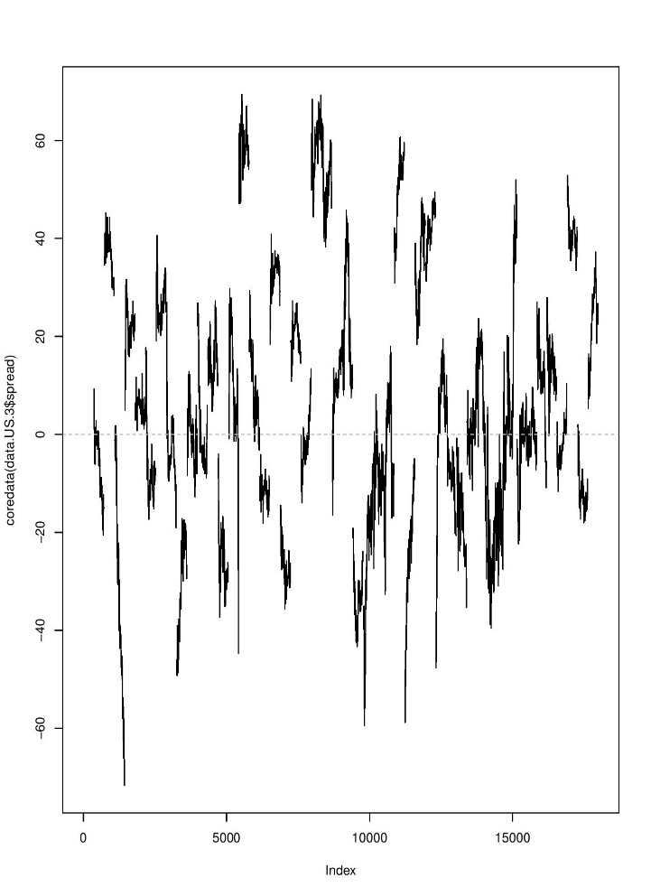
Strategy
Below, on the plot you can see that the spread is mean reverting to 0, even though it fluctuates very strongly.

Slide 9
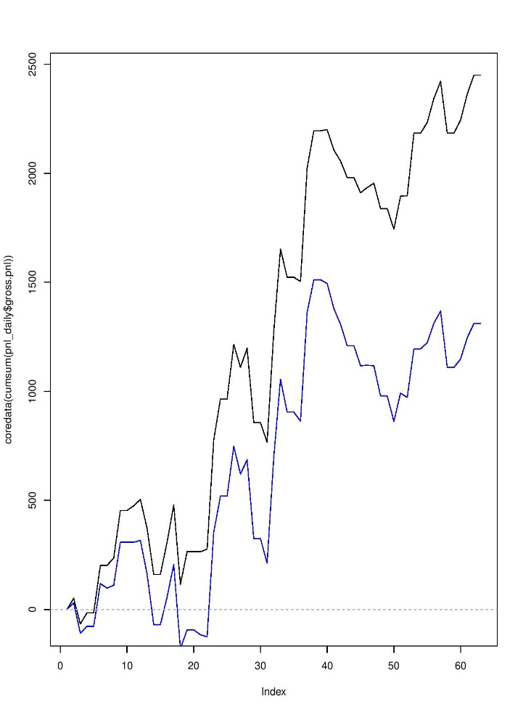
Strategy
For NQ and MSFT we considered both momentum and mean reverting strategies and mean reverting proved to be the better one. Results again are not fascinating: SR is -3.07 in first quarter, - 1.79 in second quarter. But, this time we have got Sharpe Ratio of 1.99 for quarter 4 and felt optimistic that this strategy may work well in future, out of sample data.

Slide 10
Group 2 Assets - APPLE
For Apple stocks we first tried strategies based on pair trading and considered Nasdaq – Apple and Microsoft – Apple strategies but results were below our expectations, thus, we switched to volatility breakout model with different parameters for signal EMA, slow EMA, rolling standard deviation and the multiplier. Mean reverting strategy gave negative result while momentum strategy with parameters signal EMA 30, slow EMA 60, vol std 90 and m 1 gave positive total Sharpe ratio of 1.27.

Slide 11


