Slide 1

FORECAST AT BARAJAS AIRPORT MADRID (BETWEEN 1997 – 2015)
By
Team Radical
Mansoor Baba Shaik, Serdal Sakali, Kratika Bagora, Archi Gogne

Slide 2

Influence of weather on Aviation industry
Aviation is greatly affected by weather compared to other modes of transportation.
From thunderstorms and snow storms, to wind and fog as well as temperature and pressure extremes, every phase of flight has the potential to be impacted by weather.
Bad weather may result in delays of flights and damages to the aircrafts during flight which eventually causes loss to the commercial aviation companies.
Although there are many available forecasting techniques with the Air Traffic Control of various airports, there are still cases of wrong forecasts or sudden climate changes that were not expected at times
2

Slide 3
DATA
The data is originally collected from https://www.wunderground.com/ and is made available to public by https://www.kaggle.com
https://www.kaggle.com/juliansimon/weather_madrid_lemd_1997_2015.csv

Slide 4
Exploring the dataset
In the original dataset, we have 6812 rows(observations) and 23 columns(variables).
Our variables of interest for the project are as follows:
(1) CET – Date range from 1997-01-01 to 2015-12-31
(2) Mean.TemperatureC – Mean Temperature in Celsius
(3) Mean.Humidity – Mean Humidity in gram per cubic meter. (Humidity is the amount of water vapor in the air. This indicates the likelihood of precipitation, dew or fog.)
(4) MeanDew.PointC – Mean Dew Point in Celsius. (Dew point is the highest temperature at which airborne water vapor will condense to form liquid dew. A higher dew point means there will be moisture in the air.)

Slide 5
(5) Mean.VisibilityKm – Mean Visibility in Kilometers. (Visibility is a measure of distance at which an object or light can be clearly discerned.)
(6) Precipitationmm – Precipitation is the standard way of measuring rainfall or snowfall n the standard rain gauge. It is measured in millimeters(mm).
(7) CloudCover – Cloud cover refers to the fraction of the sky obscured by clouds when observed from a particular location. It ranges from 0 Okta(completely clear sky) to 9 Okta(sky obstructed from view)
(8) Events – Natural weather changes like Rain, Snow, Fog, Thunderstorm etc. caused one at a time or a mixture of more than one event.

Slide 6
Handling missing values
In the CloudCover variable, we have encountered missing values, for this we replaced the missing values with -1 to save the entire rows to get omitted if na.omit() is applied of the analysis dataset containing our variables of interest. The reason behind this is as mentioned previously Cloud Cover ranges only from 0 to 9, so we have replaced missing values with -1 just to fill them.
In the Events variable, though there are no missing values we have a factor of empty string for some observations. To handle this we assumed the event to be Normal as no other is recorded.
In the Mean.VisibilityKm variable, we have encountered missing values and for this we didn’t take a chance of replacing it with a measure of central tendency. Therefore, now we have applied na.omit() for the analysis dataset

Slide 7
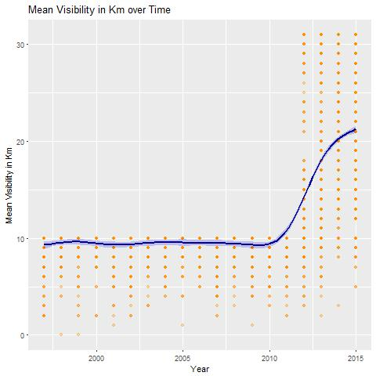
Visualizations through plots – ggplot2
In this plot, we can see that over time the change in mean visibility is steady till the year 2011 and starting 2011 there is a sudden rise which indicates some error or change of criteria.
In order to be more meaningful we shifted our focus from the observations recorded starting the year 2012

Slide 8
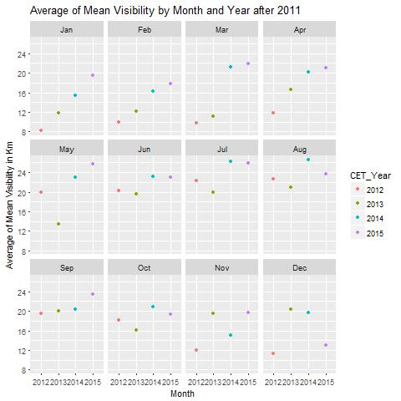
Focusing on the analysis dataset with observations starting from the year 2012
This plot gives the information of average mean visibility by month and year.
It is clear that during the month of January after 2011, the average mean visibility kept rising from year to year, which indicates that the visibility range is becoming clearer.
In December after 2011, the average mean visibility showed variation and eventually went down at the end of year 2015.
This gives us a sign that the weather cycle is shifting during the timeframe over time.

Slide 9
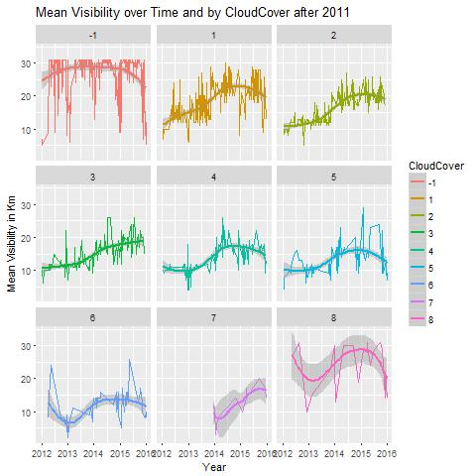
In this plot, we have closely looked at three variables of interest namely Mean.VisibilityKm, CloudCover and Time in years starting from 2012
Time-series plot in the slide shows how the visibility is effected by cloud cover over years.
As described previously, the less the cloud cover below the clear the sky is.
-1 here is the replacement for missing values

Slide 10
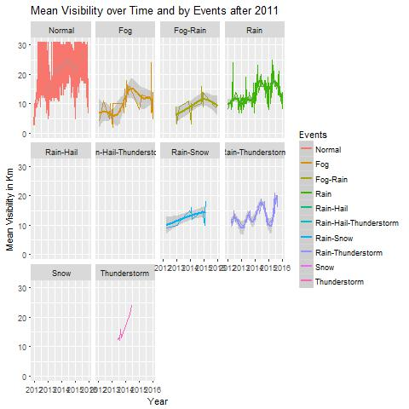
This time series plot gives us visual information how the visibility got effected by the causation of an event starting the year 2012.
When closely observed we can see that for events such as Rain-Hail, Rain-Hail-Thunderstorm and Snow were not much abundant. Therefore we not seen in the plot compared to the largely occurred events.

Slide 11
Conclusion
We have chosen the mean visibility for the presentation so that we can give better visuals information from the plots, as in general it plays an important role during a flight.
In the future, we would like to do in-depth analysis to find the relationships and associations between the variables on interest and therefore use them to forecast the upcoming weather changes.

Slide 12

Hope you liked the Weather Report. Next Take off Awaits!!!

