Slide 1

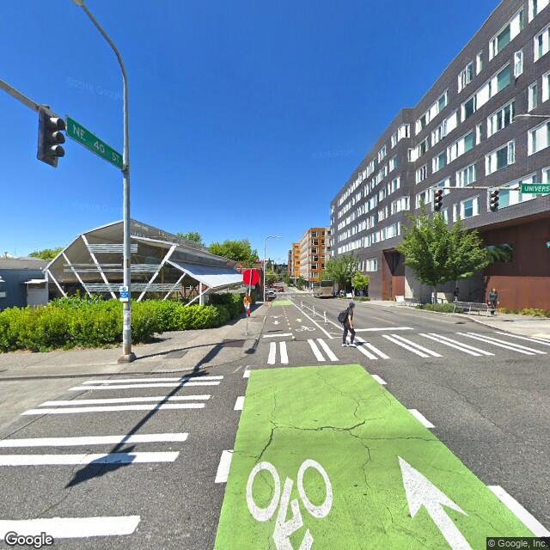
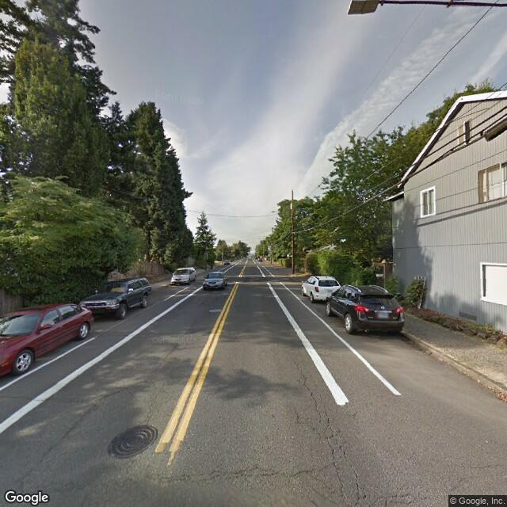
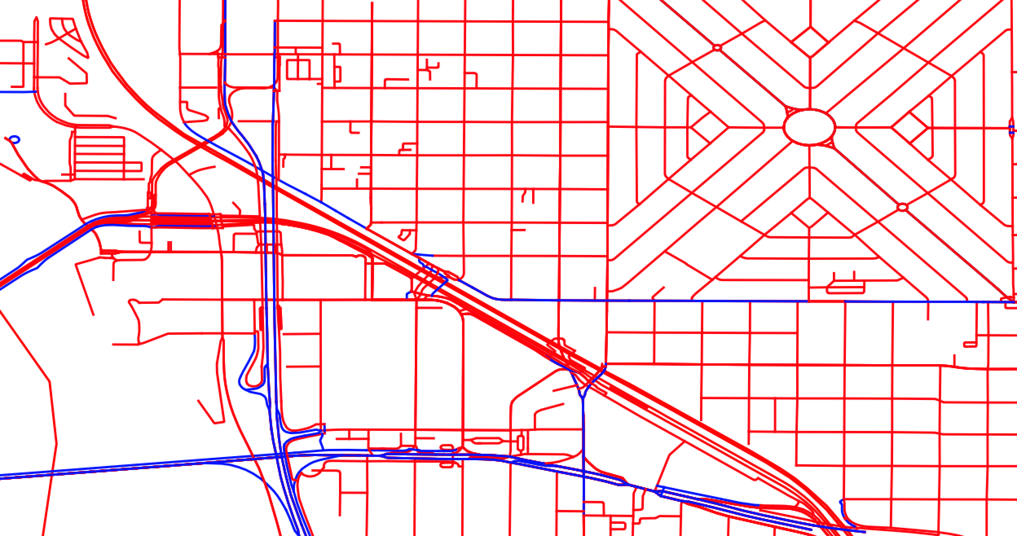
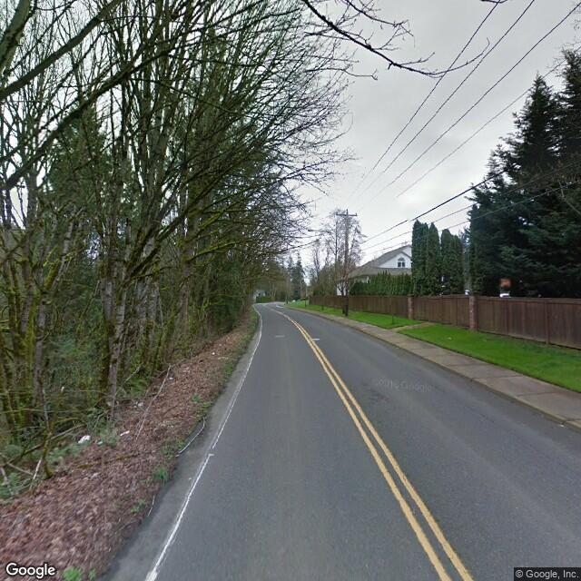
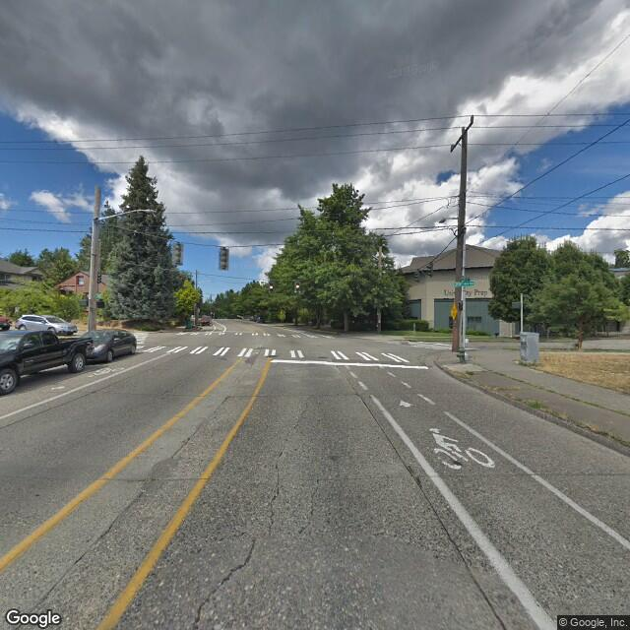
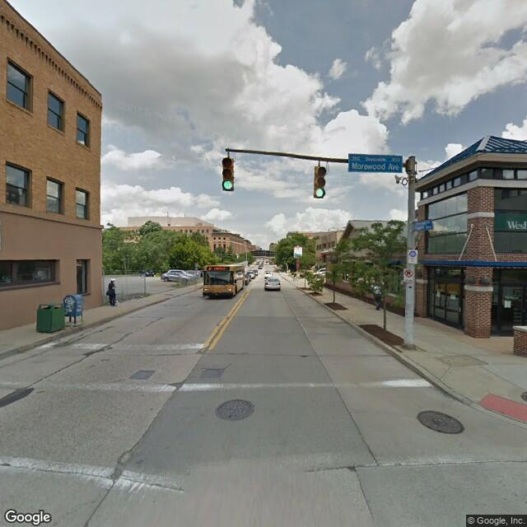
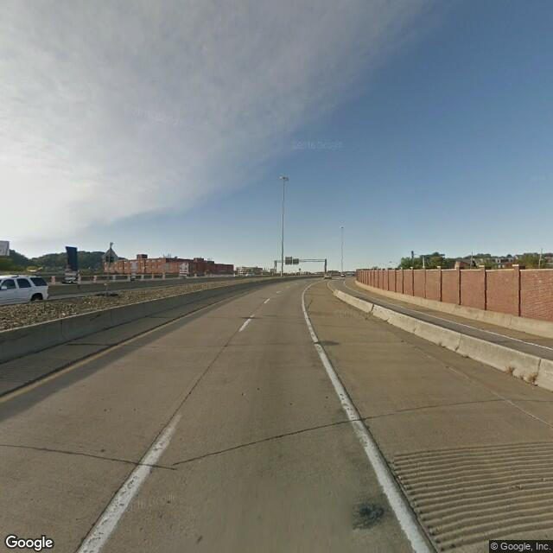
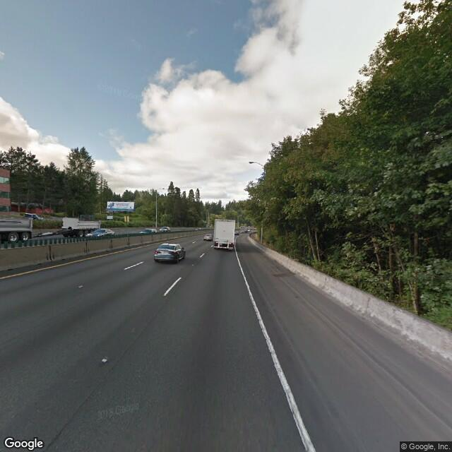
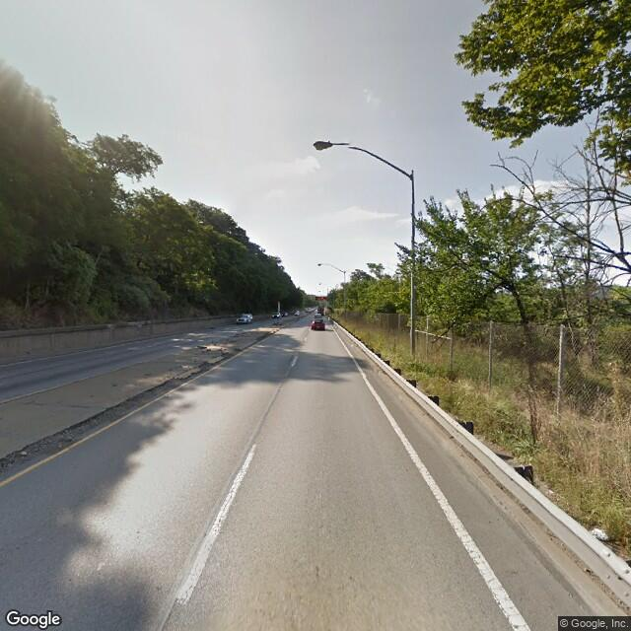
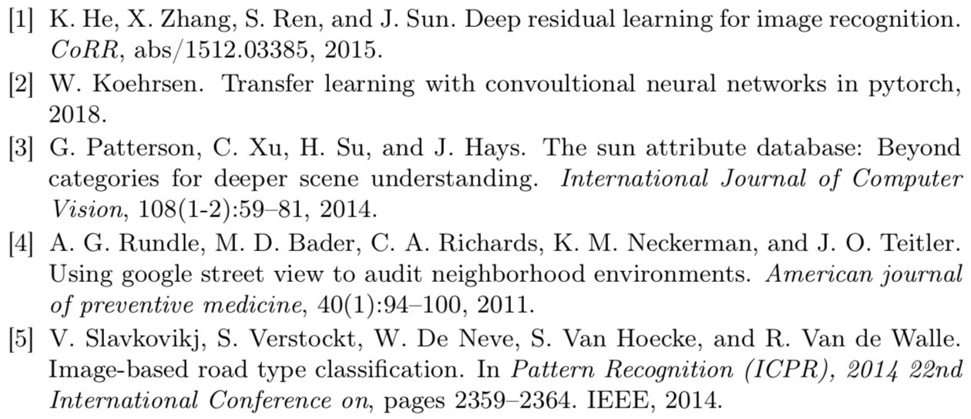
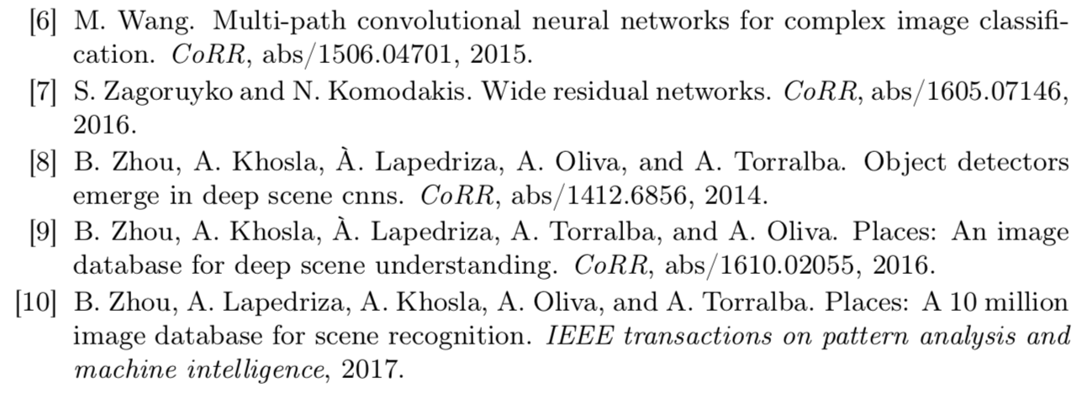
Friendly Streets: A Street Classifier For Cautious Cyclists
Josh Sennett, Evan Rourke
Motivation
Data
Mapping and routing software depends on road designation to provide cyclists with safe, accurate, and efficient bike routes.
“Bike-friendly” designation is unavailable, outdated or inaccurate.
Can we classify which roads are bike-designated using Street View images?
We generate a dataset of 17,270 images labeled “bike-designated” or “not” within Portland, Seattle, Pittsburgh, and Boulder.
We exclude residential roads, which rarely include bike-designation tag
We capture a single image at road midpoint to increase image heterogeneity with a fixed budget
bike-designated
Google Street View API
not
Open Street Map
bike-designated
Architecture
Methodology
Setup:
We divide data into training (60%), validation (20%), and test (20%) sets
We fine-tune ResNet18 pre-trained on the Places365 scene database
We replace the final FC layer with custom layers and fix all other weights
We add random rotation/jitter/h-flip, center-crop images, and normalize
Experiments: (trained on a ~10% random sample of training/validation)
Custom layers: 1/2/3 FC layers, (Leaky)ReLU, w/w.o. dropout, Softmax
Optimizers: Adam vs. SGD with momentum, L2 regularization
Hyperparameters: L2 regularization strength, learning rate, hidden units
Final model: (based on training and validation loss and accuracy results)
Custom layers: 3 FC layers with LeakyReLU, 10% dropout, Softmax
Cross Entropy Loss criterion, SGD with momentum, L2 regularization
Results
Overall accuracy: 68%
Human baseline*: XX%
Human performance was evaluated using a custom mechanical turk application
Accuracy
 |  | bike | not | all
City | N | acc | acc | acc
Bould. | 313 | 72% | 56% | 67%
Pittsb. | 500 | 63% | 65% | 64%
Portl. | 1551 | 90% | 33% | 77%
Seattle | 1090 | 43% | 67% | 58%
Overall | 3454 | 76% | 57% | 68%
References

