Slide 1
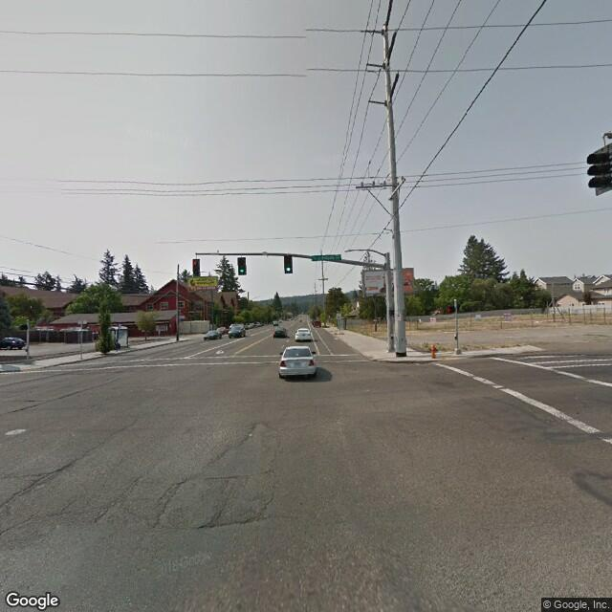
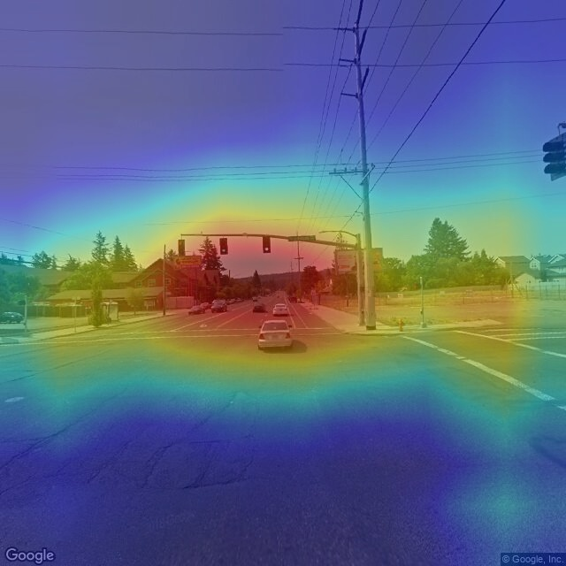
Bike-Designated
Not
Input
CAM
open area
man-made
natural light
Driving
Asphalt
Biking
Transporting
Pavement
sunny
open area
man-made
natural light
Driving
Asphalt
Biking
Transporting
Pavement
sunny
open area
man-made
natural light
Driving
Asphalt
Biking
Transporting
Pavement
sunny
open area
man-made
natural light
Driving
Asphalt
Biking
Transporting
Pavement
sunny
open area
man-made
natural light
Driving
Asphalt
Biking
Transporting
Pavement
sunny
open area
man-made
natural light
Driving
Asphalt
Biking
Transporting
Pavement
sunny
open area
man-made
natural light
Driving
Asphalt
Biking
Transporting
Pavement
sunny
open area
man-made
natural light
Driving
Asphalt
Biking
Transporting
Pavement
sunny
Attributes
Accuracy

