Slide 1

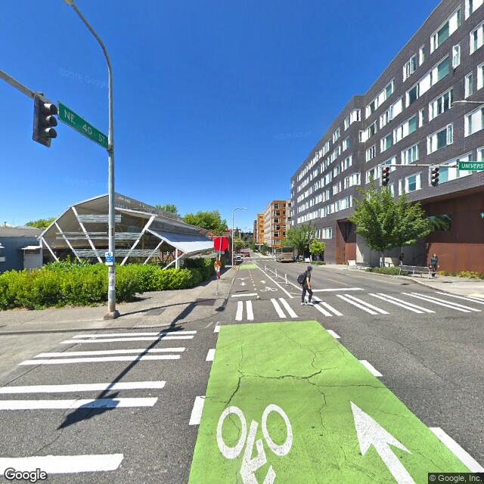
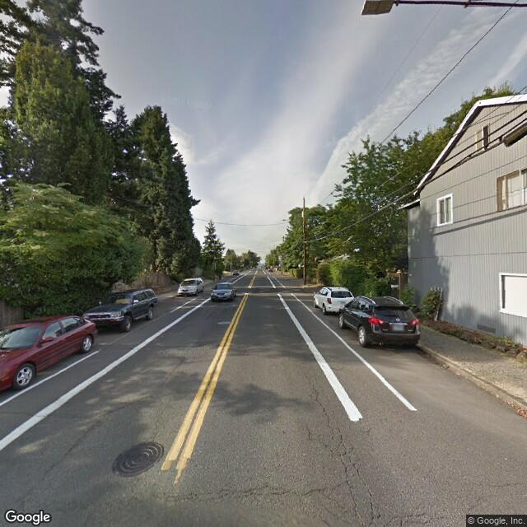
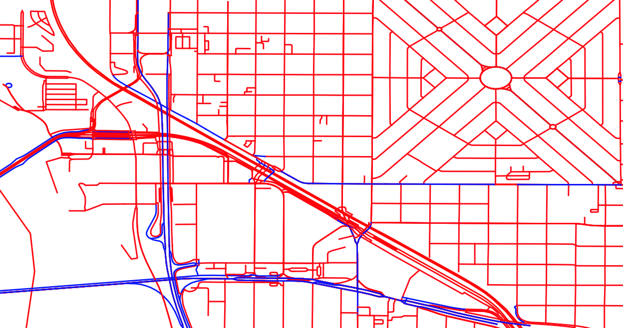
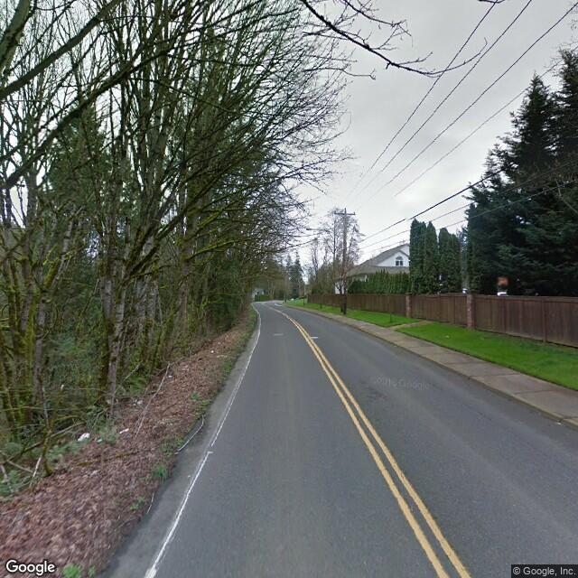
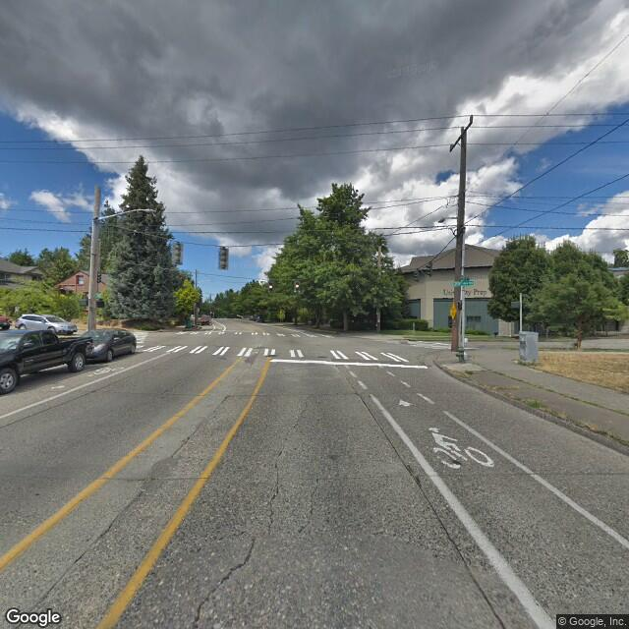
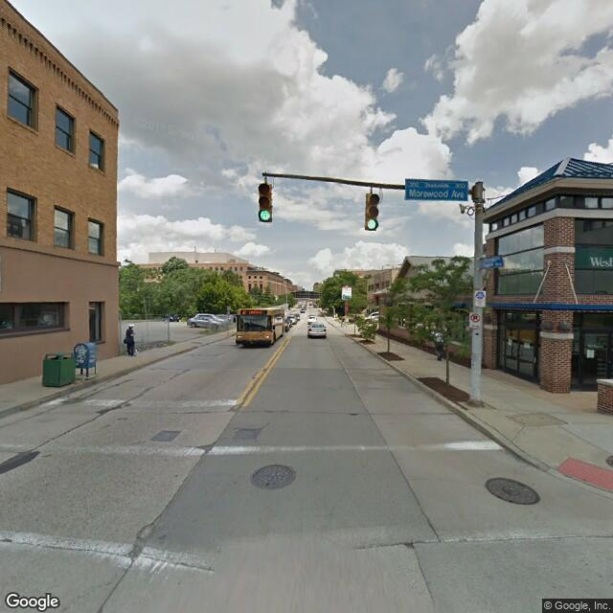
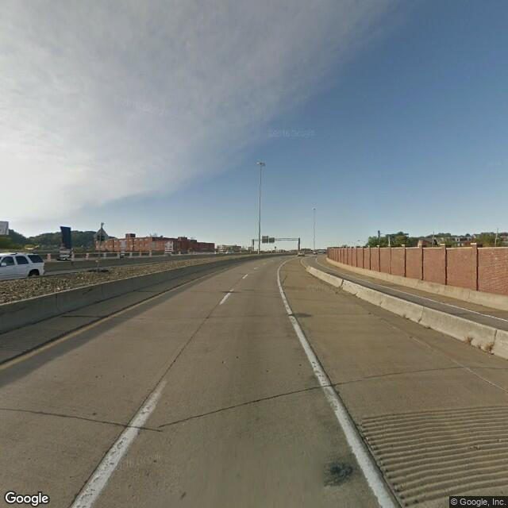
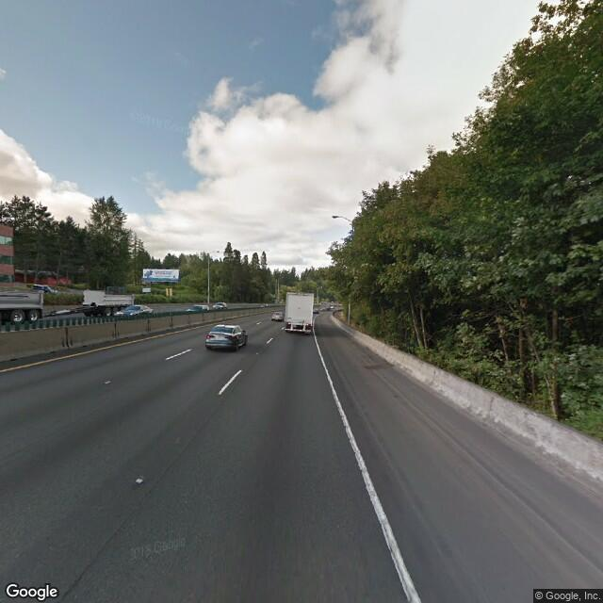
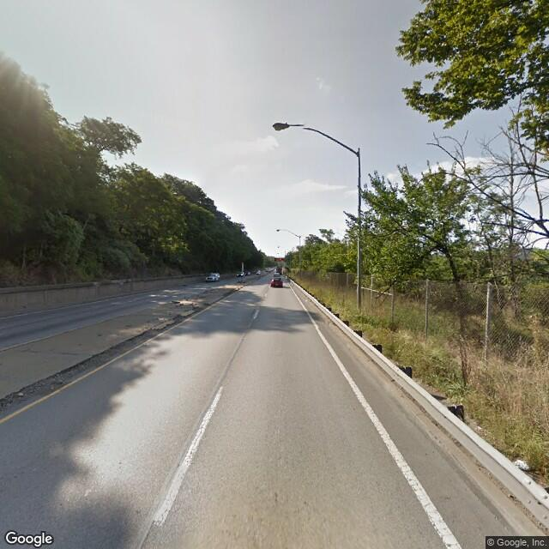
Friendly Streets: A Street Classifier For Cautious Cyclists
Josh Sennett, Evan Rourke
Motivation
Data
Mapping and routing software depends on road designation to provide cyclists with safe, accurate, and efficient bike routes.
“Bike-friendly” designation is unavailable, outdated or inaccurate.
Can we classify which roads are bike-designated using Street View images?
We generate a dataset of 17270 images labeled “bike-designated” or “not” within Portland, Seattle, Pittsburgh, and Boulder.
We exclude residential roads, which rarely include bike-designation tag
We capture a single image at road midpoint to increase image heterogeneity with a fixed budget
bike-designated
Google Street View API
not
Open Street Map
bike-designated
Architecture
Methodology
Results
Accuracy
References

