Slide 1

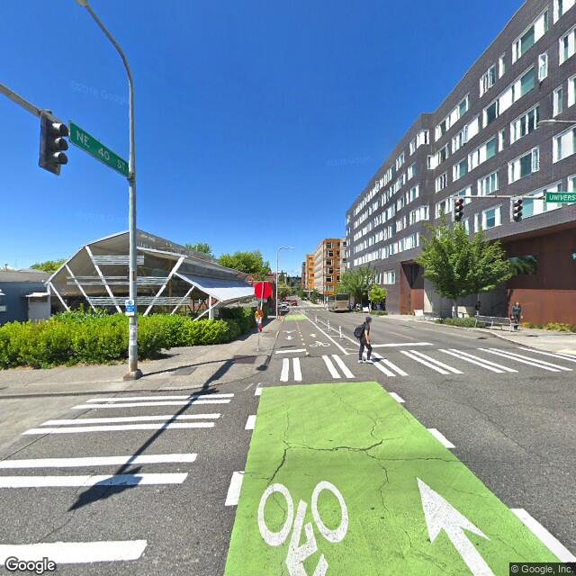
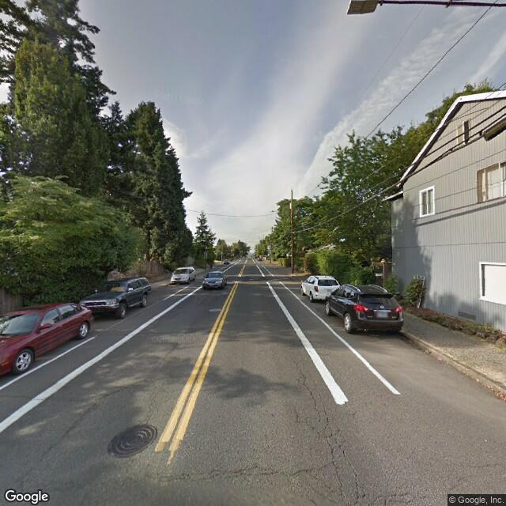
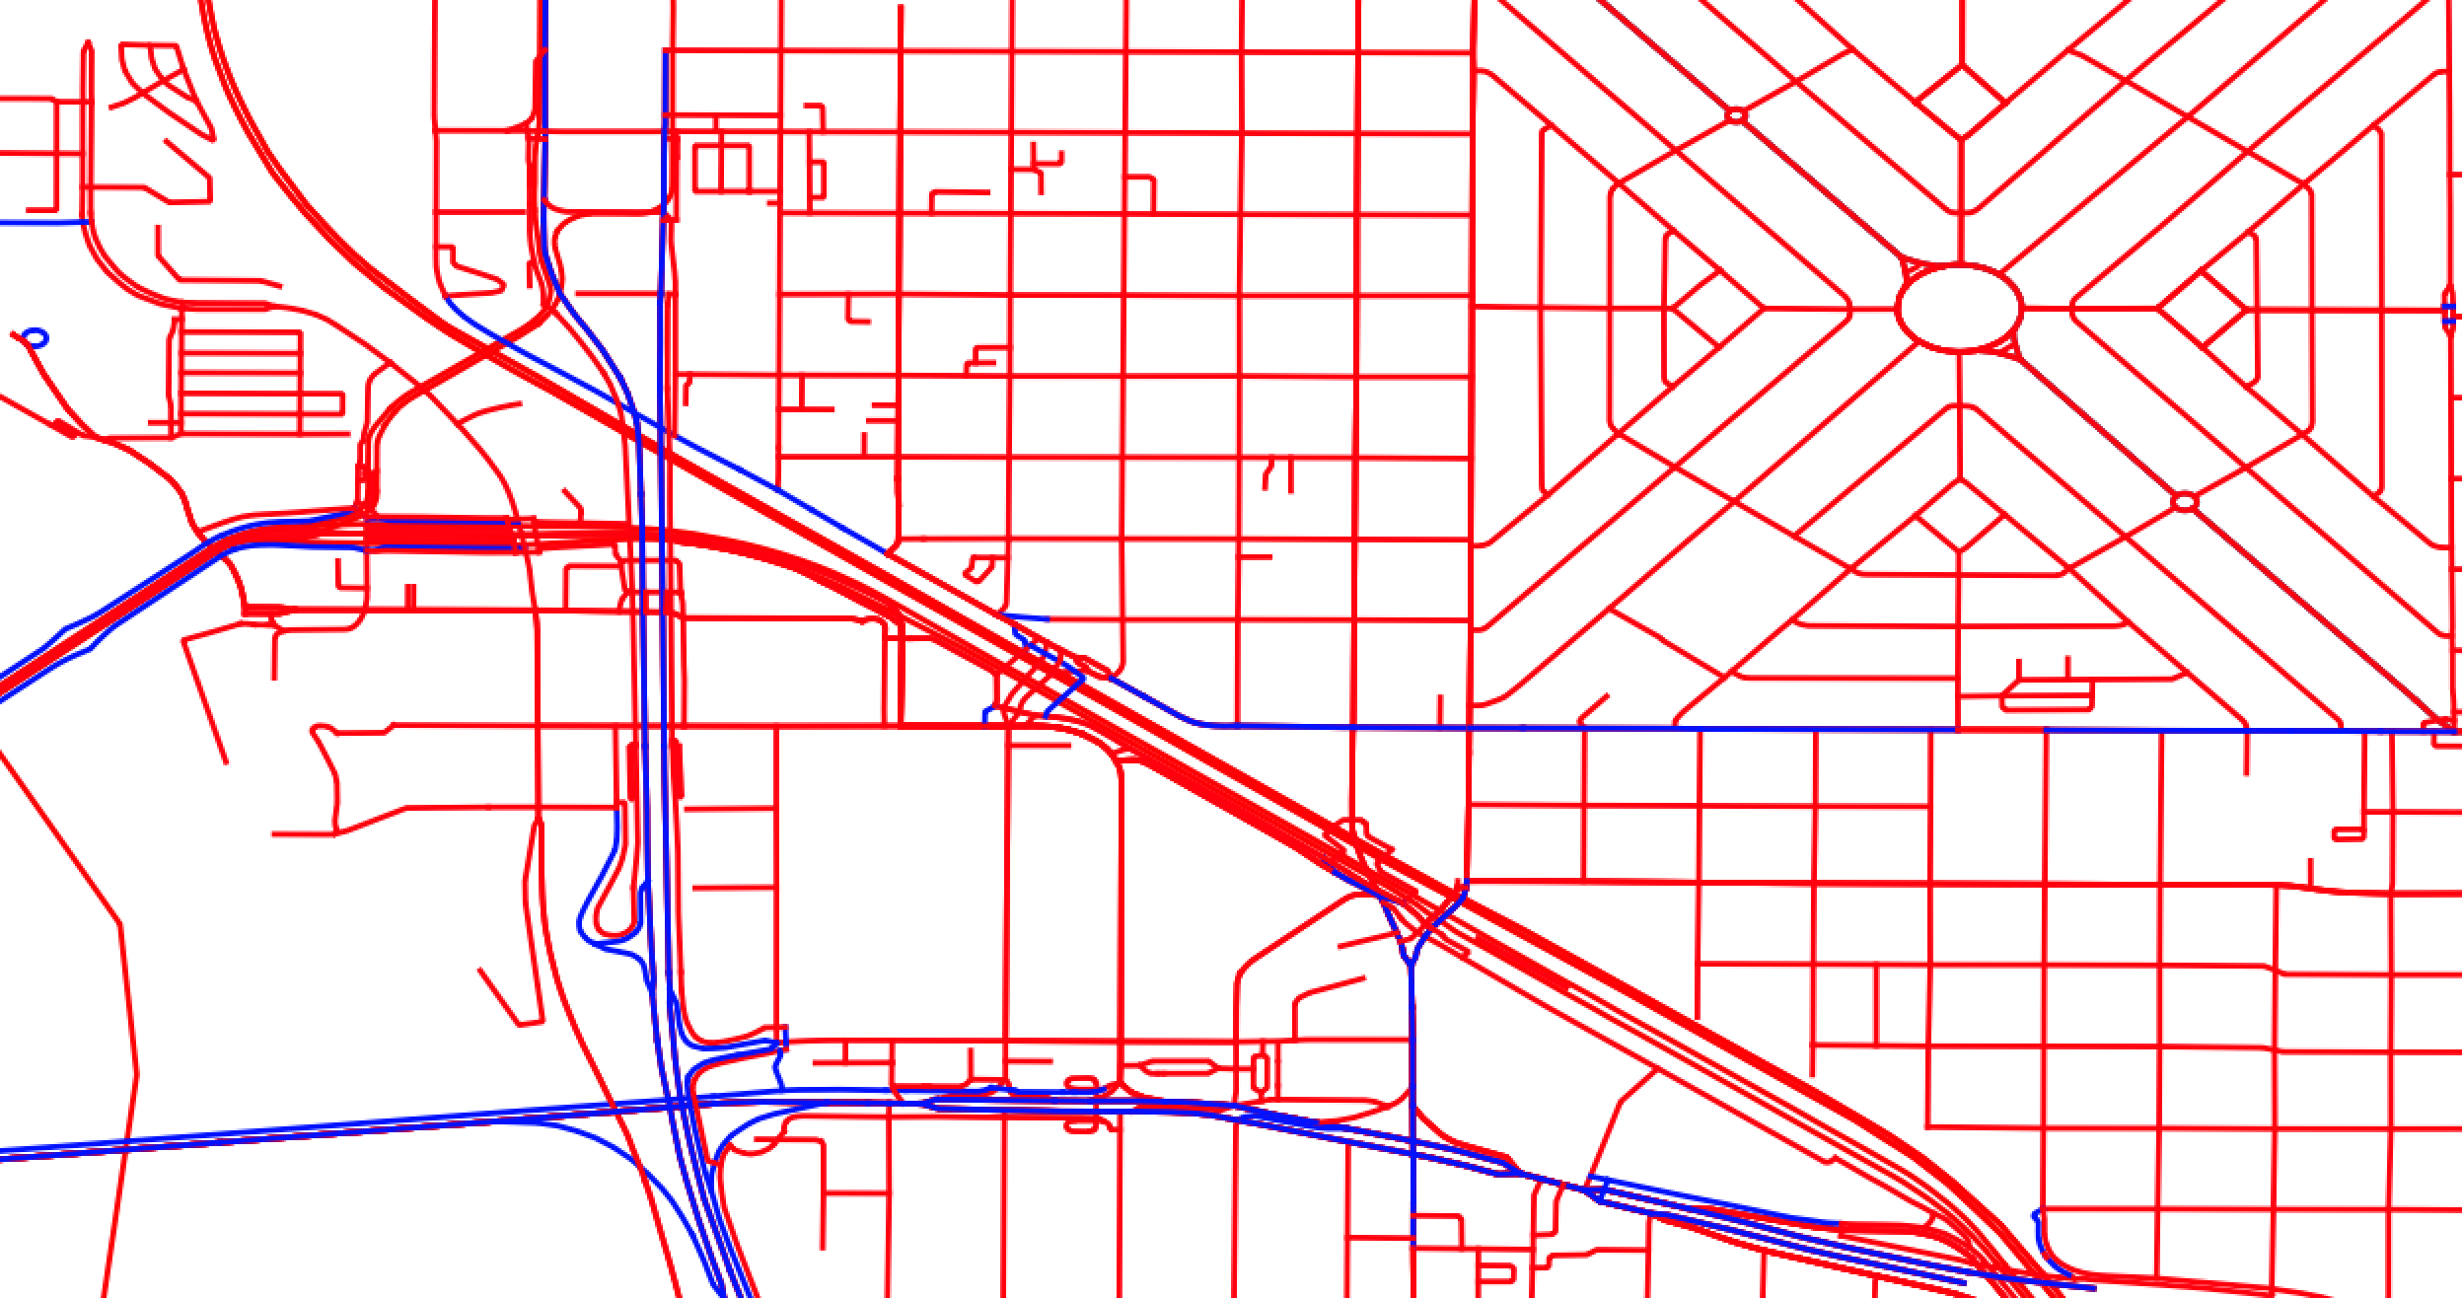
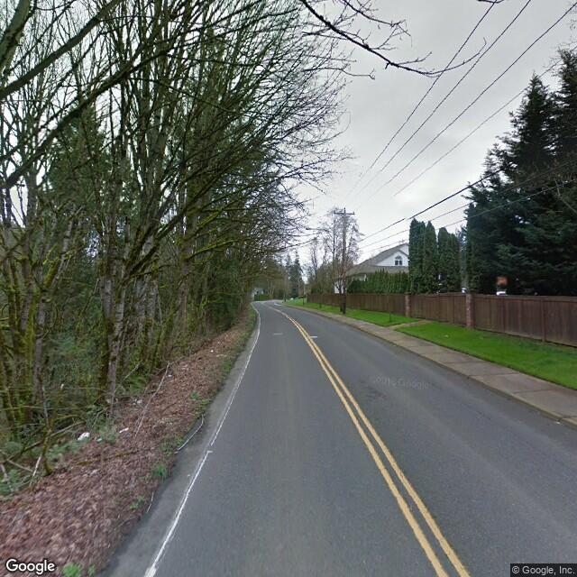
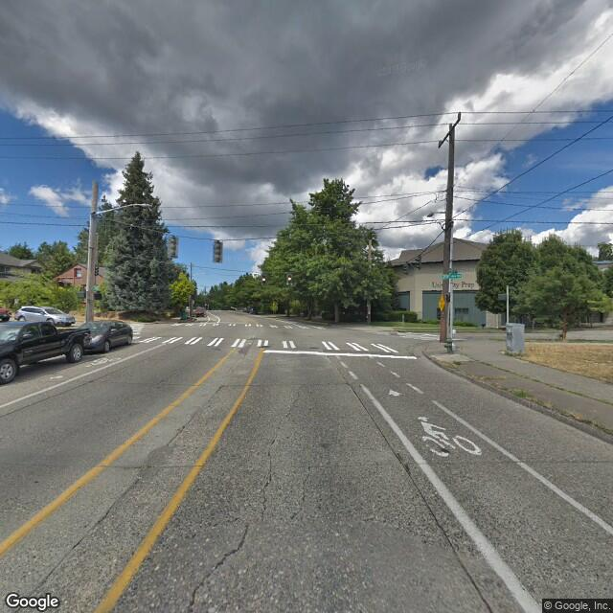
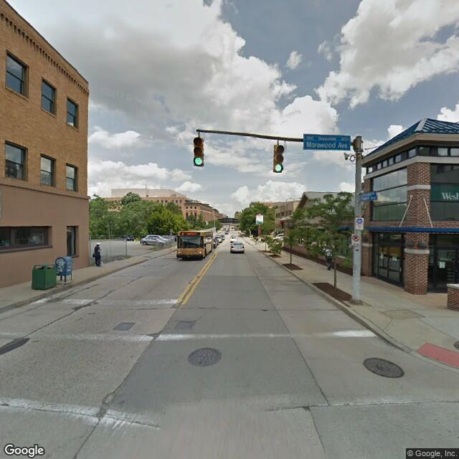
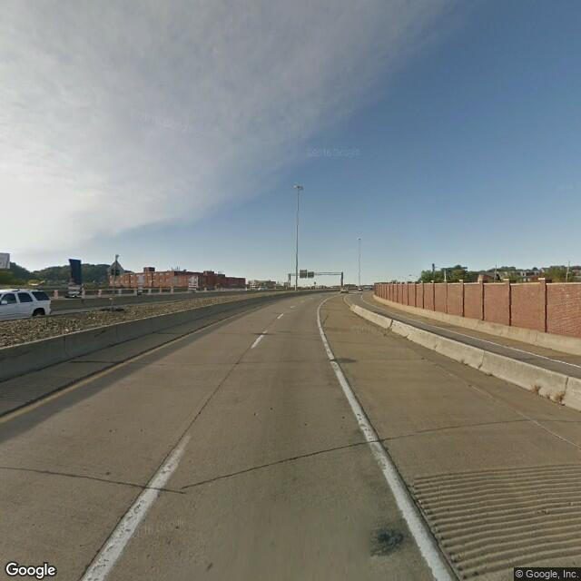
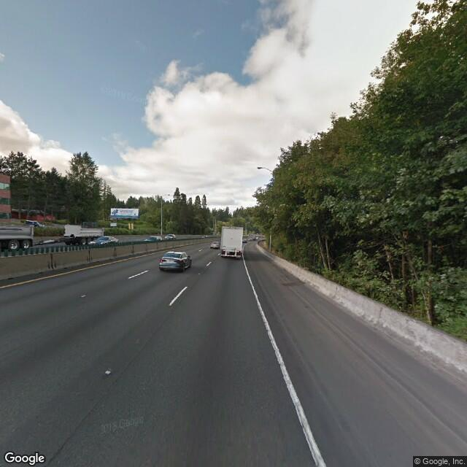
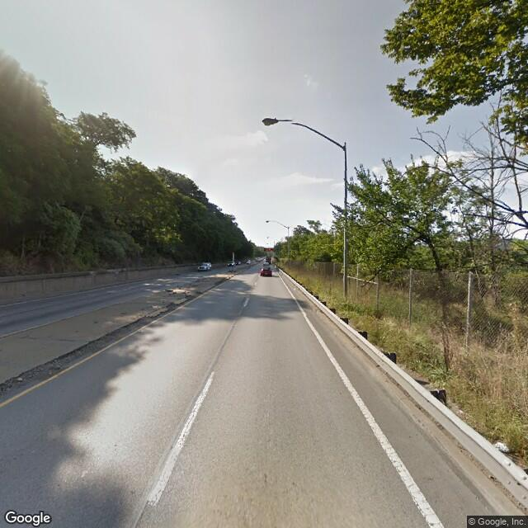
Friendly Streets: A Bike-Friendly Street Image Classifier
Josh Sennett, Evan Rourke
Motivation
Data
Mapping and routing software depends on road designation to provide cyclists with safe, accurate, and efficient bike routes.
“Bike-friendly” designation is unavailable, outdated or inaccurate.
Can we classify which roads are bike-designated using Street View images?
We generate a dataset of 17270 images labeled “bike-designated” or “not” within Portland, Seattle, Pittsburgh, and Boulder.
We exclude residential roads, which rarely include bike-designation tag
We capture a single image at road midpoint to increase image heterogeneity with a fixed budget
bike-designated
Google Street View API
not
Open Street Map
bike-designated
Architecture
Methodology
We use a wide ResNet18 pre-trained on Places365, a scene-recognition database with 365 scene classes and 102 SUN image attributes
pre-trained on the Places365
with Diagram
Additional FC Layers
Image pre-processing and data augmentation
Added hook for attribute detection, pre-trained on attributes
Added hook for CAM
Variations of fully connected models attached at end
Optimizers tried
Criterions tried
Text text text text text abc def ghisjlasdf
Bullet text
Bullet text
Tdfsdafdsafdsafdsafdsafdsafdsafdsafdsafdsafdsafdsafdsa
fdsa
Results
The classifier performs similarly across different cities
The classifier is better at detecting bike-designated roads.
Overall Accuracy: 75%
Results
 |  | Test Accuracy
 | N | Overall | “bike” | “not”
Boulder | 1234 | 60% | 60% | 60%
Pittsburgh | 1234 | 60% | 60% | 60%
Portland | 1234 | 60% | 60% | 60%
Seattle | 1234 | 60% | 60% | 60%
Overall | 17,270 | 60% | 60% | 60%
Best model was_____.
Text text text text text abc def ghisjlasdf
Bullet text
Bullet text
Tdfsdafdsafdsafdsafdsafdsafdsafdsafdsafdsafdsafdsafdsa
fdsa
Motivation
References
Text text text text text abc def ghisjlasdf
Bullet text
Bullet text
Text text text text text abc def ghisjlasdf
Bullet text
Bullet text
Tdfsdafdsafdsafdsafdsafdsafdsafdsafdsafdsafdsafdsafdsa
fdsa

