Slide 1

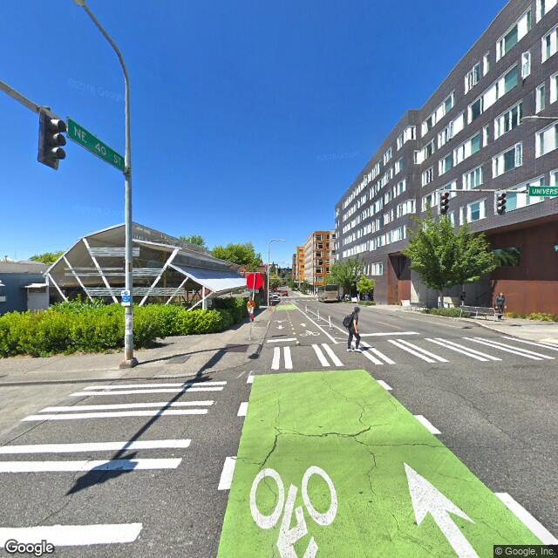
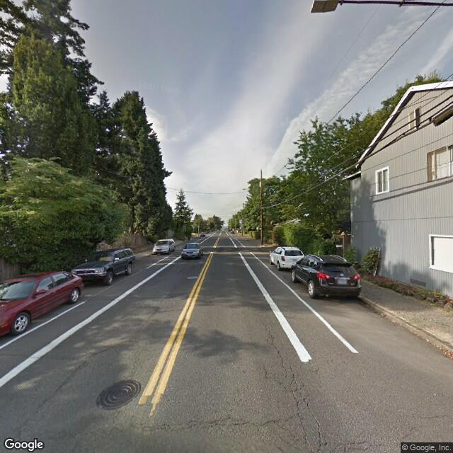
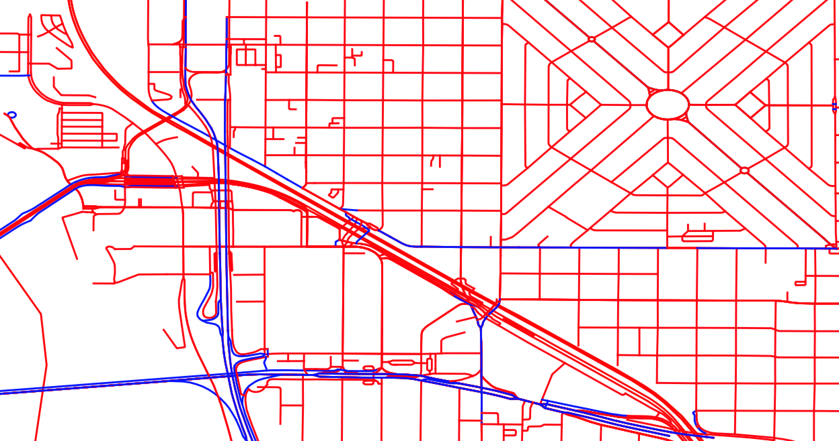
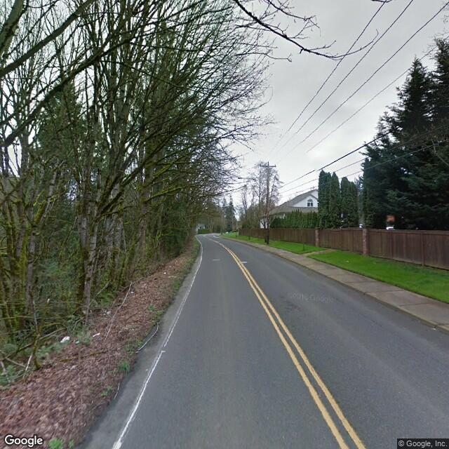
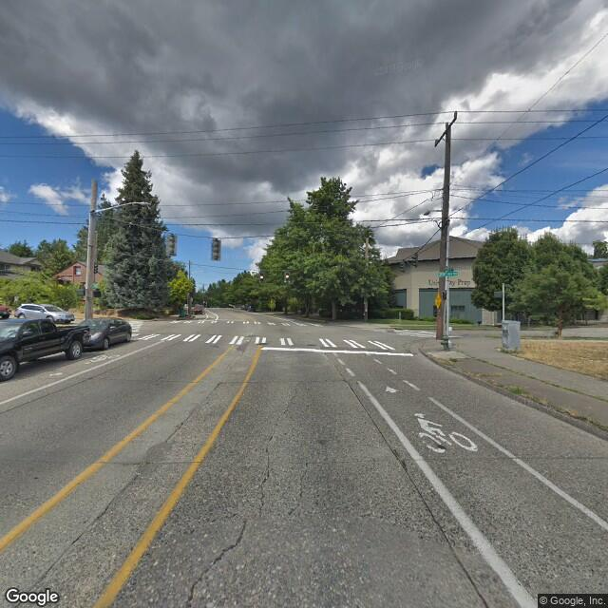
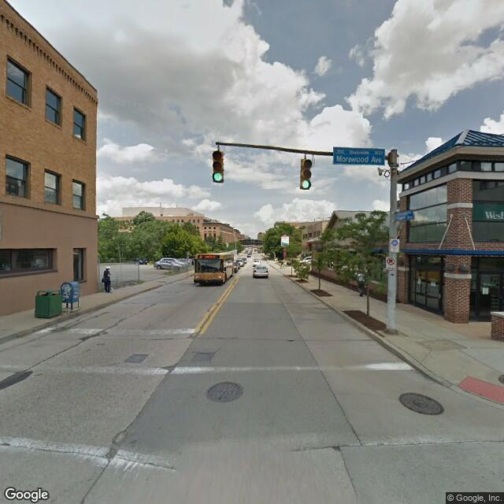
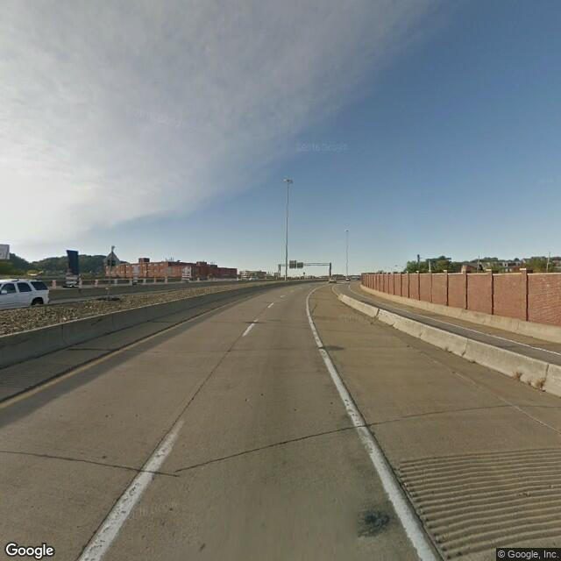
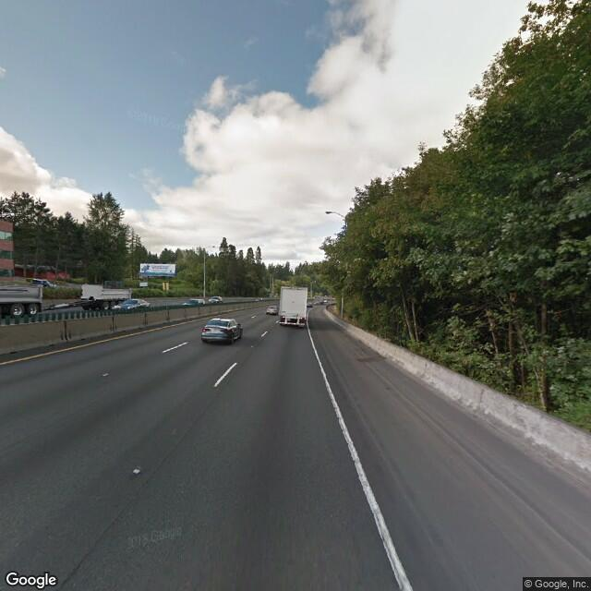
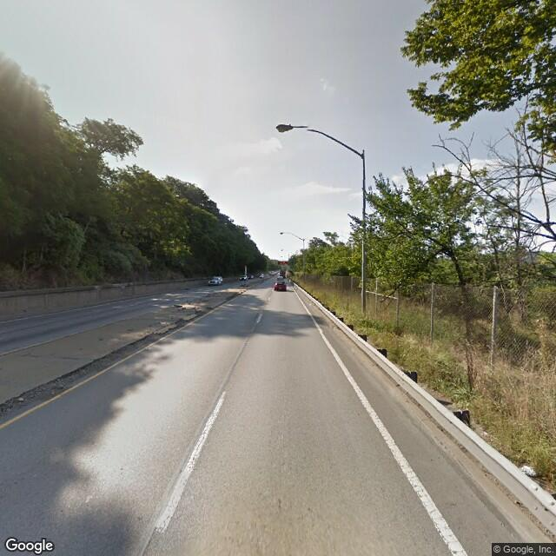
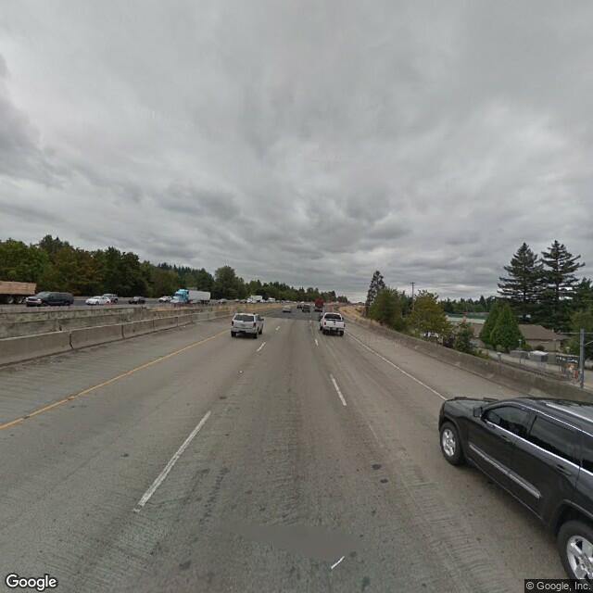
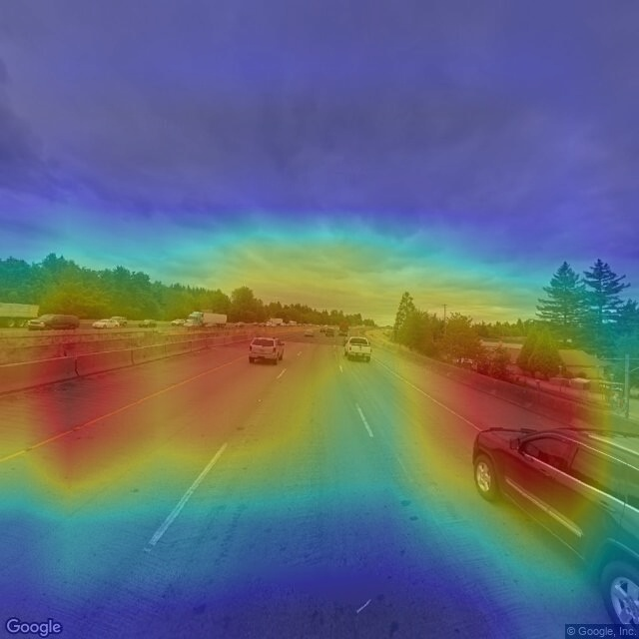
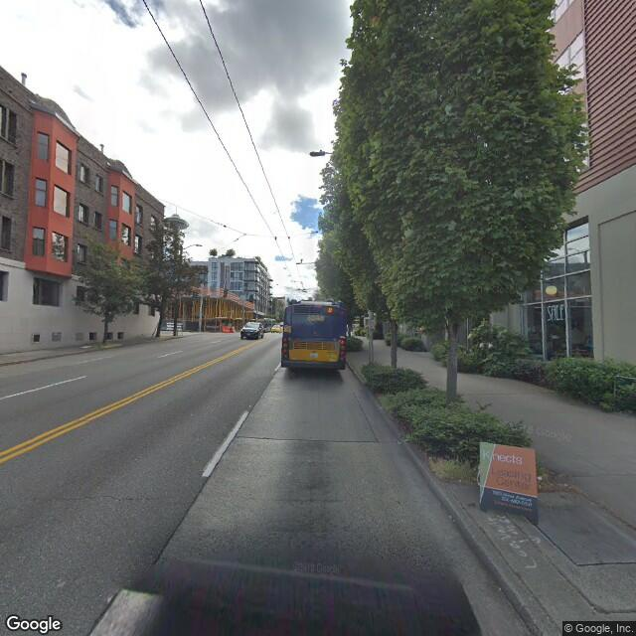
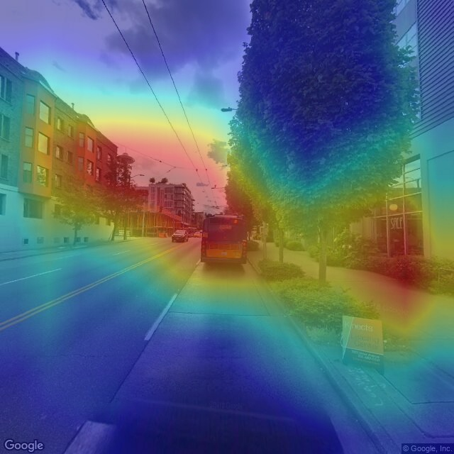
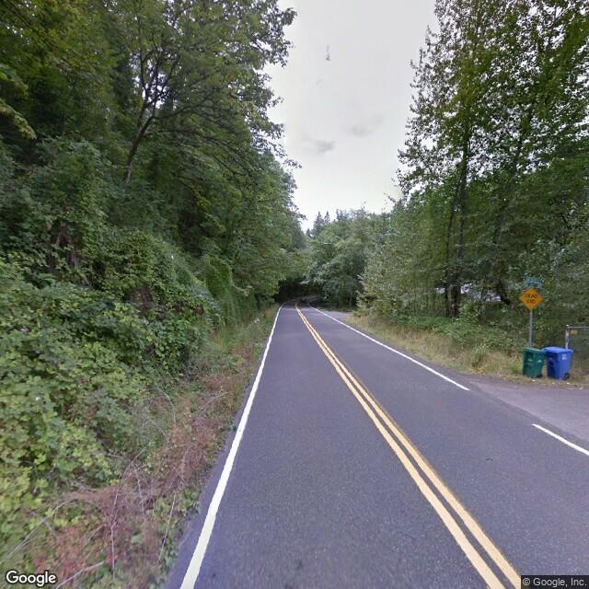
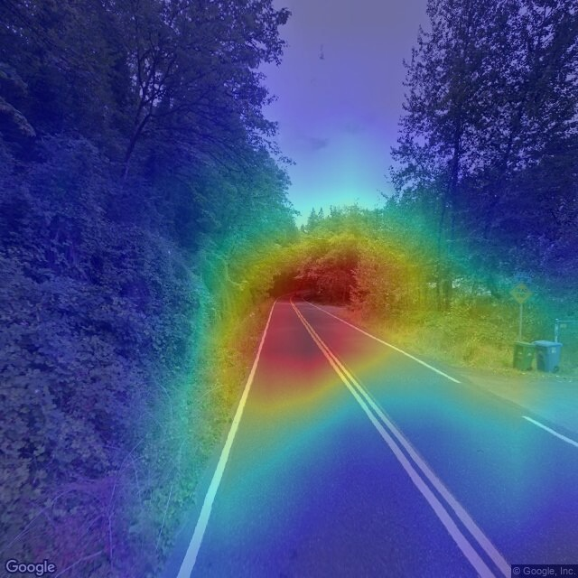
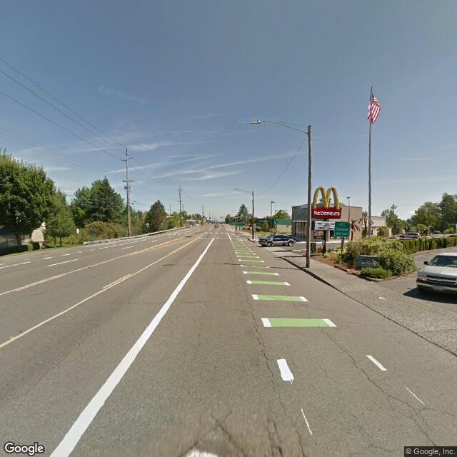
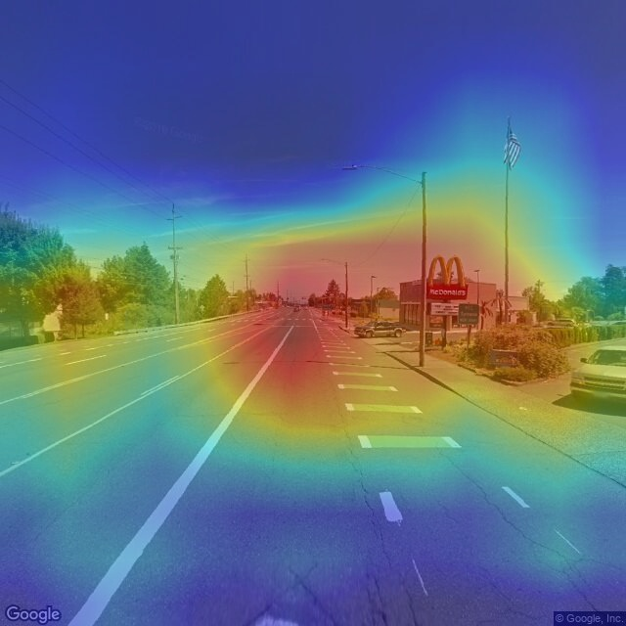
Friendly Streets: A Street Classifier For Cautious Cyclists
Josh Sennett, Evan Rourke
Motivation
Data
Mapping and routing software depends on road designation to provide cyclists with safe, accurate, and efficient bike routes.
“Bike-friendly” designation is unavailable, outdated or inaccurate.
Can we classify which roads are bike-designated using Street View images?
We generate a dataset of 17270 images labeled “bike-designated” or “not” within Portland, Seattle, Pittsburgh, and Boulder.
We exclude residential roads, which rarely include bike-designation tag
We capture a single image at road midpoint to increase image heterogeneity with a fixed budget
bike-designated
Google Street View API
not
Open Street Map
bike-designated
Architecture
Methodology
Results
--TYPE OF ENVIRONMENT: outdoor --SCENE CATEGORIES: 0.198 -> highway 0.100 -> desert_road 0.055 -> runway 0.051 -> residential_neighborhood 0.032 -> parking_lot | --SCENE ATTRIBUTES: open area natural light man-made far-away horizon driving clouds asphalt transporting biking
NOT Bike Friendly
--TYPE OF ENVIRONMENT: outdoor --SCENE CATEGORIES: 0.373 -> residential_neighborhood 0.215 -> street 0.087 -> parking_garage/outdoor 0.030 -> campus 0.030 -> crosswalk | --SCENE ATTRIBUTES: man-made natural light open area driving asphalt biking pavement transporting no horizon
Accuracy
--TYPE OF ENVIRONMENT: outdoor --SCENE CATEGORIES: 0.608 -> forest_road 0.241 -> highway 0.072 -> desert_road 0.016 -> field_road 0.008 -> forest_path | --SCENE ATTRIBUTES: natural light open area foliage trees driving vegetation biking leaves asphalt
Bike Friendly
--TYPE OF ENVIRONMENT: outdoor --SCENE CATEGORIES: 0.170 -> highway 0.096 -> residential_neighborhood 0.073 -> industrial_area 0.069 -> parking_lot 0.063 -> crosswalk | --SCENE ATTRIBUTES: open area man-made natural light asphalt driving biking transporting sunny clouds
References

