Slide 1
intRo application
server.R
ui.R
shinyServer(
Function(input, output, session) {
})
shinyUI(
})
inference/nonparametric/
inference/nonparametric/
helper.R
libraries.R
observe.R
reactive.R
output.R
ui.R
modules
nonparametrictable <-
function(intro.data, x, y, conflevel, althyp, hypval) {
interpolate(~(wilcox.test(x = df$x, y = df$y, conf.level = conf, alternative = althyp, mu = hypval)), df = quote(intro.data), x = x, y = y, conf = conflevel, althyp = althyp, hypval = hypval, mydir = userdir, `_env` = environment(), file = "code_nonparametric.R")
}
nonparametric_ui <- tabPanel("Nonparametric",
column(4, wellPanel(
selectizeInput("group1_non", …),
selectizeInput("group2_non", …),
hr(),
selectizeInput("althyp_non", …),
numericInput("hypval_non", …),
sliderInput("conflevel_non", …),
hr(),
tags$button("", id = store_nonparametric", …))),
column(8,
tags$b("Nonparametric Results"),
verbatimTextOutput("nonparametrictable")))
data/sources
data/transform
summaries/graphical
summaries/numerical
inference/contingency
inference/regression
inference/t_test
inference/nonparametric

Slide 2
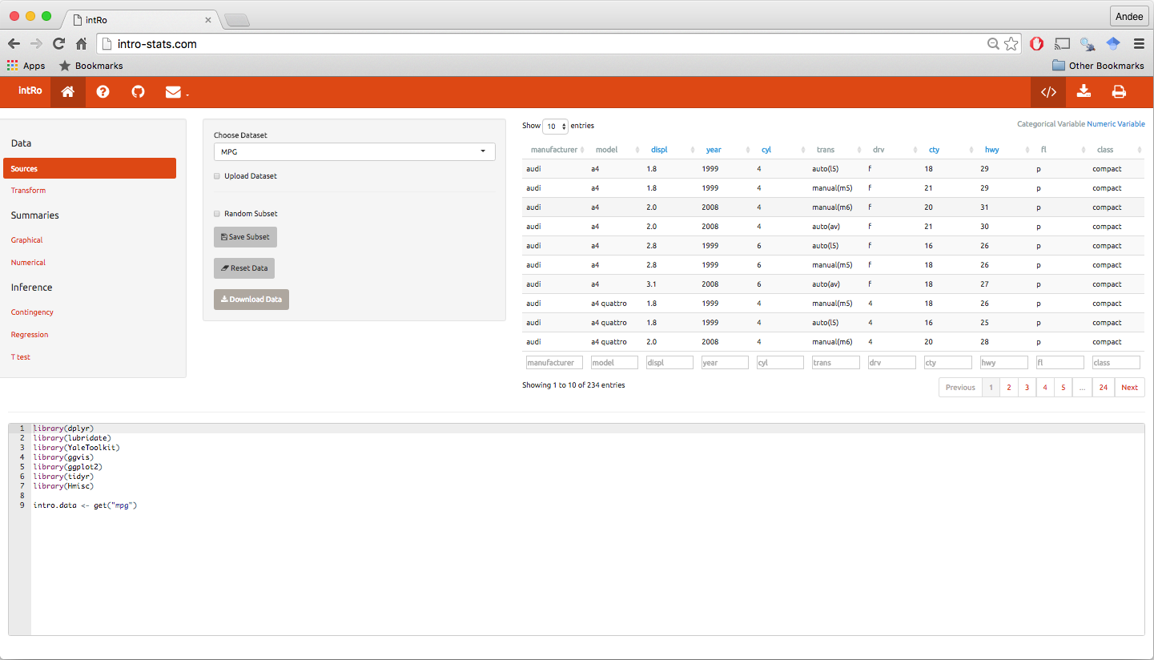
1
cv
2
3
4
cv
cv
5
cv

Slide 3
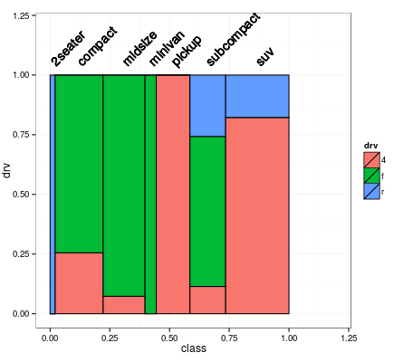

ggplot(plot_data, aes(x_center, y_height)) + …
Graphical
Options

