Slide 1
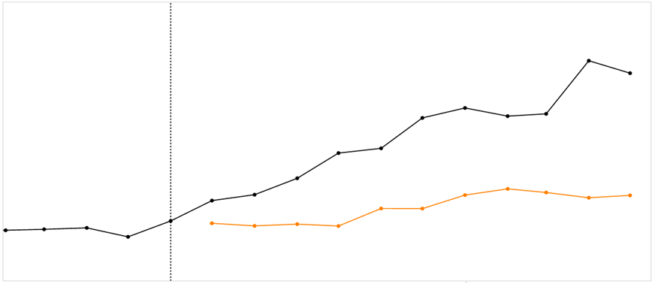
Training data
Validation data
Actuals
Forecast date
Forecast error
Forecast
3 months
ahead
6 months
ahead
9 months
ahead
Forecast horizon

