Slide 1
Tools
Salah Uddin Ahmed

Slide 2
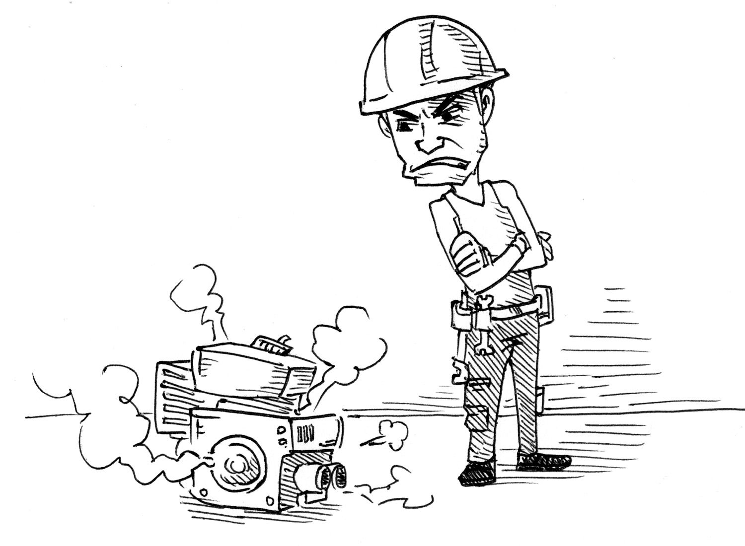
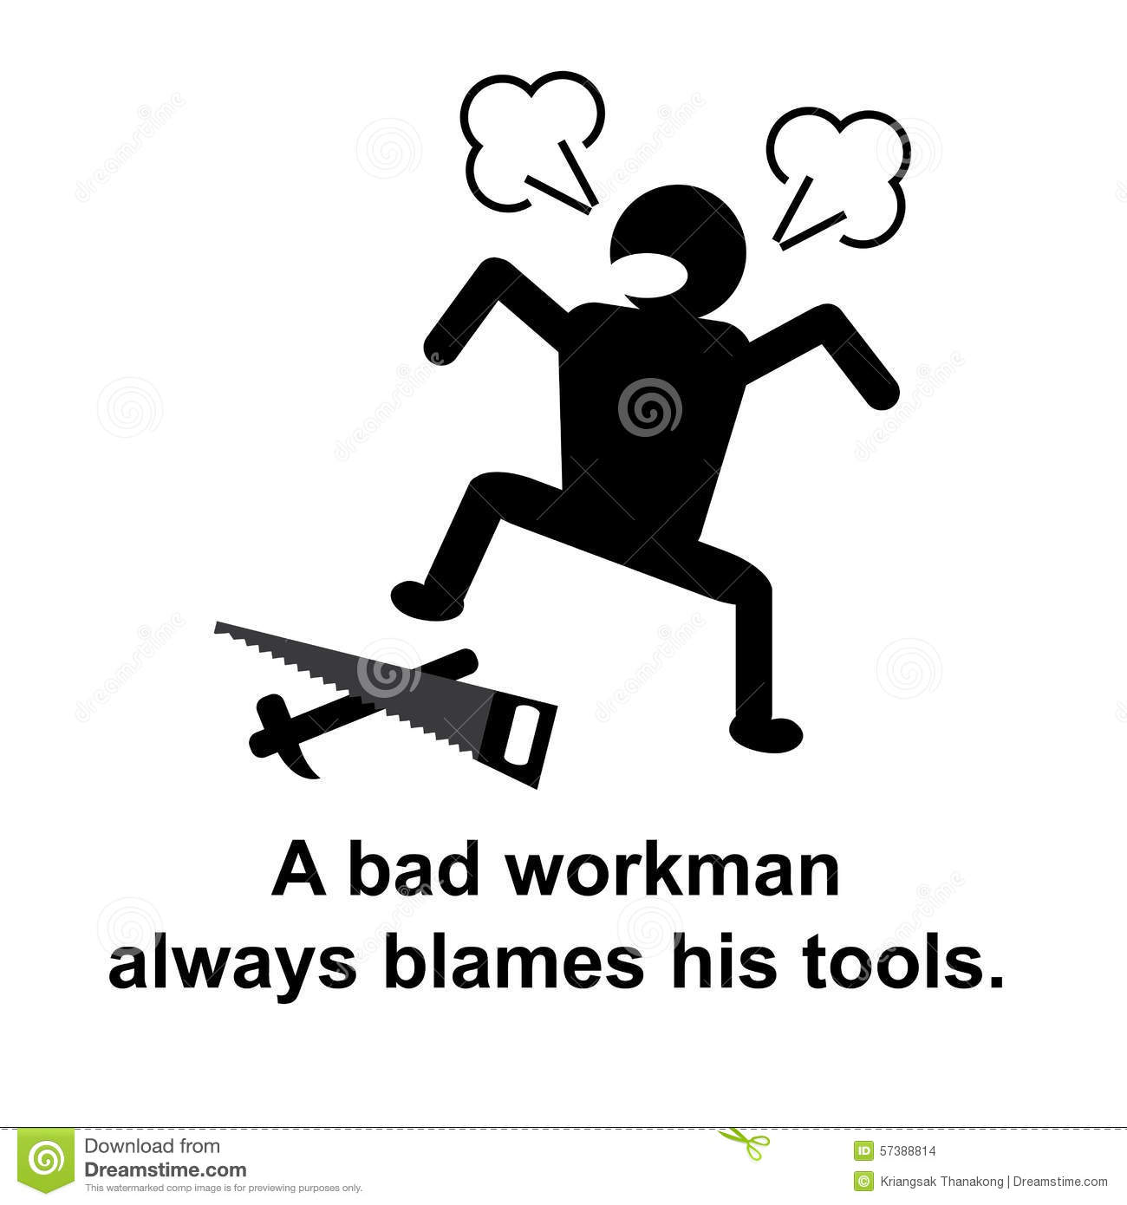

Slide 3
Tools and Technology
For Project Management
For Development of the system
For Documentation
Others…
Notes:
During the process of the project we will use many tools and technology which helps us to reach our goal. This tools and technology divided into to mains parts
PM
DS We bought a virtual Machin “Ubuntu operation system” on Microsoft Azure. We are using Putty To access to this virtual Machin.
On Ubuntu we install apache2, php, MySQL, and we will use some of HTML and CSS.

Slide 4






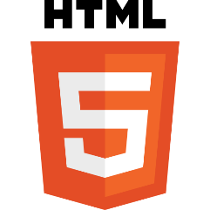

Tools and Technology
For the development of the system
Notes:
During the process of the project we will use many tools and technology which helps us to reach our goal. This tools and technology divided into to mains parts
PM
DS We bought a virtual Machin “Ubuntu operation system” on Microsoft Azure. We are using Putty To access to this virtual Machin.
On Ubuntu we install apache2, php, MySQL, and we will use some of HTML and CSS.

Slide 5
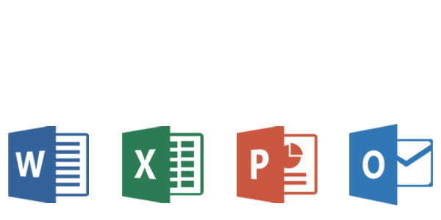
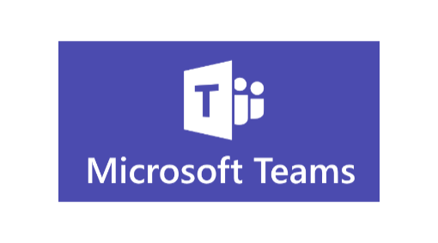

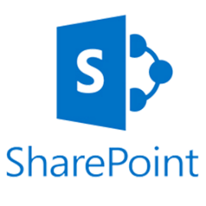


Tools and Technology
For Project Management
For Documentation
Notes:
During the process of the project we will use many tools and technology which helps us to reach our goal. This tools and technology divided into to mains parts
PM
DS We bought a virtual Machin “Ubuntu operation system” on Microsoft Azure. We are using Putty To access to this virtual Machin.
On Ubuntu we install apache2, php, MySQL, and we will use some of HTML and CSS.

Slide 6
Project Management Tools
“Project Management Tools” refers to general PM tools that can be used for a variety of project management activities like project planning, resource management, internal and external project communication, workflow management, and more…

Slide 7
Project Management Tools
Here are the core features that any project management tool should have:
Task management: This includes the ability to create, assign, and monitor tasks as they progress. Can you set due dates, group tasks and subtasks, and create checklists?
Project scheduling: The tool should allow users to set timelines and deadlines. Can you map out timelines on multiple views such as calendars, Gantt charts, and more?
File sharing: This includes the ability to upload and share files. Can you upload, organize, and share files amongst team members?
Communication: Users should be able to have project-specific conversations and discussions. Can you tag team members with @ mentions, create threaded discussions, and keep conversations organized?
Reporting: The tool should allow users to generate reports on project progress, budget usage, and resource usage. Can users easily generate and share reports using data from the software?

Slide 8
Programing Tools
A programming tool or software development tool is a computer program that software developers use to create, debug, maintain, or otherwise support other programs and applications.
Source code editor, compiler or interpreter,
Command line or integrated development environment (IDE).
Language – C, Java, Python
IDE – VSCode, Visual Studio, Android Studio
Platform – SDK Platform (Android SDK)
Frameworks – Django, Laravel, Angular, ASP.NET Core.

Slide 9
Programing Tools
Language – C, Java, Python
IDE – VSCode, Visual Studio, Android Studio
Platform – SDK Platform (Android SDK)
Frameworks – Django, Laravel, Angular, ASP.NET Core.
Supporting Tools for Programming?

Slide 10
Divisions of Tools
There could be many categories..
Here, to mention, Web development – we can divide as:
Frontend and Backend
There are tools and also frameworks for them:
Frontend Tools: React, Vue, Angular
Backend Tools: Express, Django, Rails, Spring

Slide 11
Enter the Project Tools here
https://uisn-my.sharepoint.com/:x:/g/personal/sah_usn_no/EWsqfoxVFSpKpuBT9C88niwBecCIkjU8nL6t1krSW8vqgA?e=ryefZ0

Slide 12
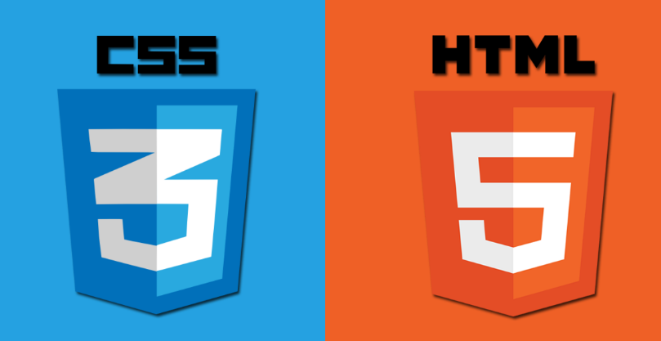
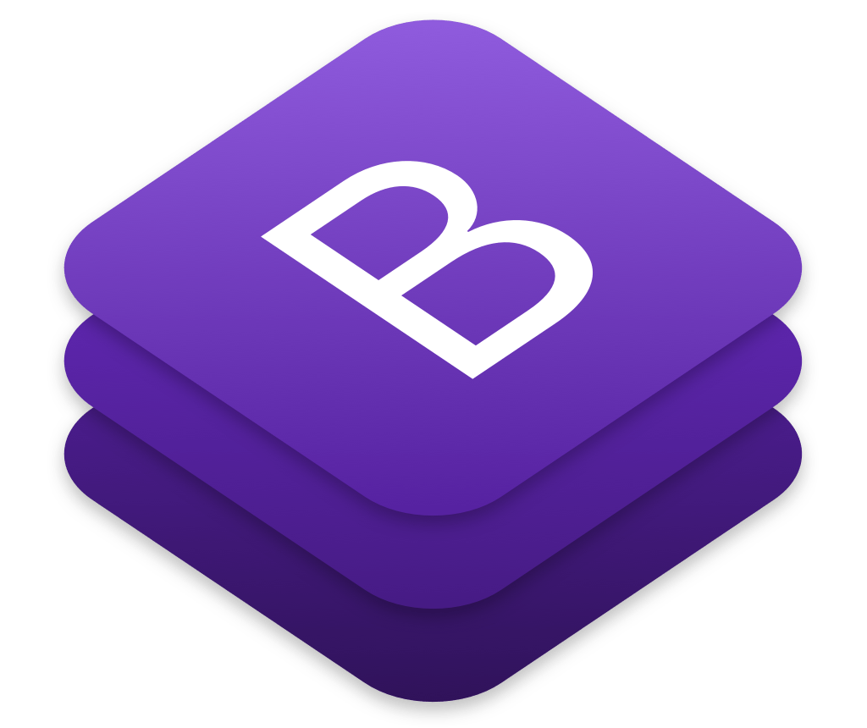
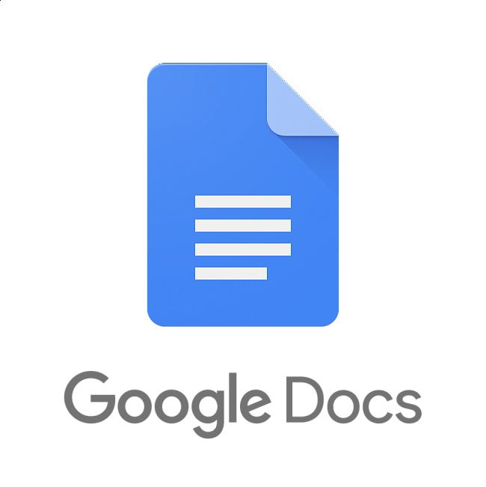

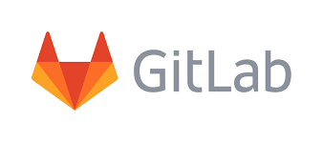

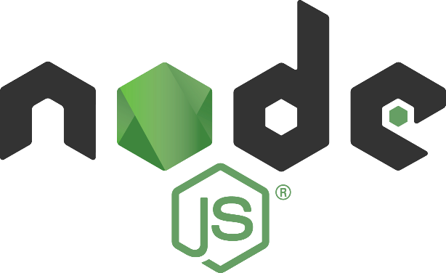




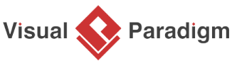
Tools

Slide 13
Client Meeting – fix Requirements
Gantt Chart – Trello / Excel (report has to have actual link)
Define Roles – detailed
Define the tasks – Assign the tasks

