Slide 1

Instructor Kick-off
Analyze A/B Test Results
© 2019 Udacity. All rights reserved.

Slide 2
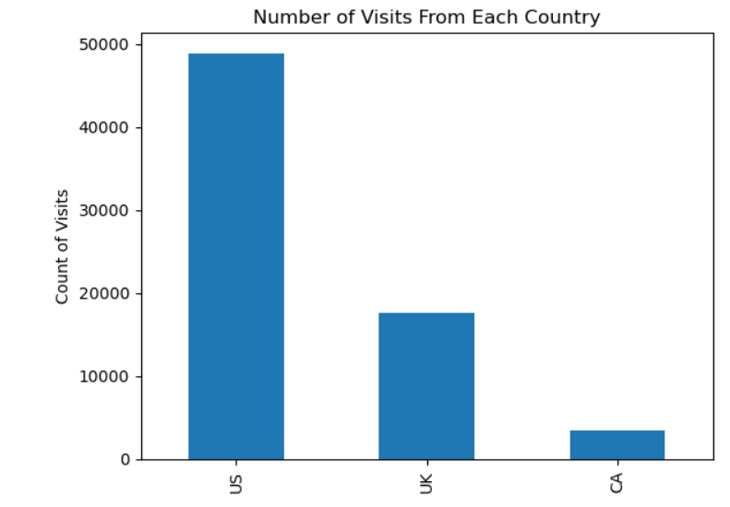
How Was The Experiment Implemented?​
Total Variant Visitors: 35211
Total Control Participants:​ 34678
​

Slide 3
Conversion Rates
 | U.S. | U.K. | CA
Control | 10.7% | 10.1% | 9.4%
Treatment | 15.8% | 14.8% | 15.4%
Executive Summary: Our conversion rates show that ‘Treatment’ page has higher conversion rates in all three countries therefore making it better than ‘Control’

Slide 4
Experiment Results
Treatment Conversion Rate: 0.1553
Control Conversion Rate:​ 0.1053
Delta in Treatment vs. Control Conversion Rate: 0.05
p-value:​ 0
Conclusion:​ Yes we have evidence that the ‘Treatment’ page has better conversion

Slide 5
Country Results
Conclusion:​ It was noticed that both US and UK Co-efficients are negative and overall it doesn’t matter cause the conversions seems quite small , if they were big it would have been different scenario.

