Slide 1

Instructor Kick-off
Analyze A/B Test Results
© 2019 Udacity. All rights reserved.

Slide 2
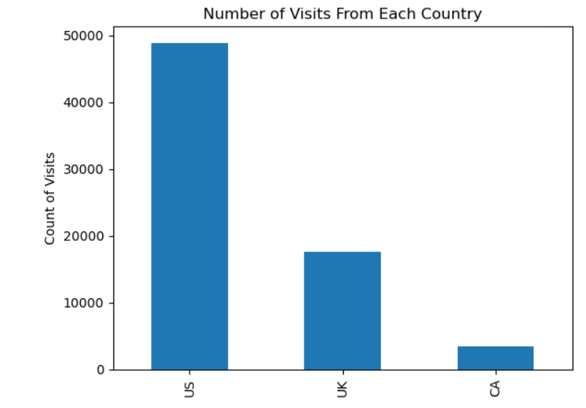
How Was The Experiment Implemented?​
Total Variant Visitors: 35211
Total Control Participants:​ 34678
​

Slide 3
Conversion Rates
 | U.S. | U.K. | CA
Control | 10.7% | 10.1% | 9.4%
Treatment | 15.8% | 14.8% | 15.4%
Executive Summary: Our conversion rates show that ‘Treatment’ page has higher conversion rates in all three countries therefore making it better than ‘Control’

Slide 4
Experiment Results
Treatment Conversion Rate: 0.1553
Control Conversion Rate:​ 0.1053
Delta in Treatment vs. Control Conversion Rate: 0.05
p-value:​ 0
Conclusion:​
The p-value of proportion_greater is less that 0.05 which implies that new page (Treatment) is more effective than old page (Control)
The difference between these two pages , which is 0.05 , states that new page leads to 5% increase compared to old page

Slide 5
Country Results
Conclusion:​
- For US, The p-value is 0.170
- For UK, The p-value is 0.905
- Both countries p-value is above 0.05, this suggests that neither of them are statistically significant when compared to CA
- We made total 3 models and with its summary, it was noticed that CA is not statistically significant

Slide 6
Overall Summary
In this A/B testing, we compared the conversion rates of users shown a new webpage versus an old webpage.
New page is slightly better than old page
Differences in conversion rates were not statistically significant (Proved by our model summaries)
The user's country also did not have a statistically significant impact on conversion rates.
If we were to improve or add new feature , we should focus and do it on new page As it was just a testing and i believe that changing and adding many things to new page will lead to higher clicks or so on

