Slide 1

Mini Art School for Technical Communicators

Slide 2
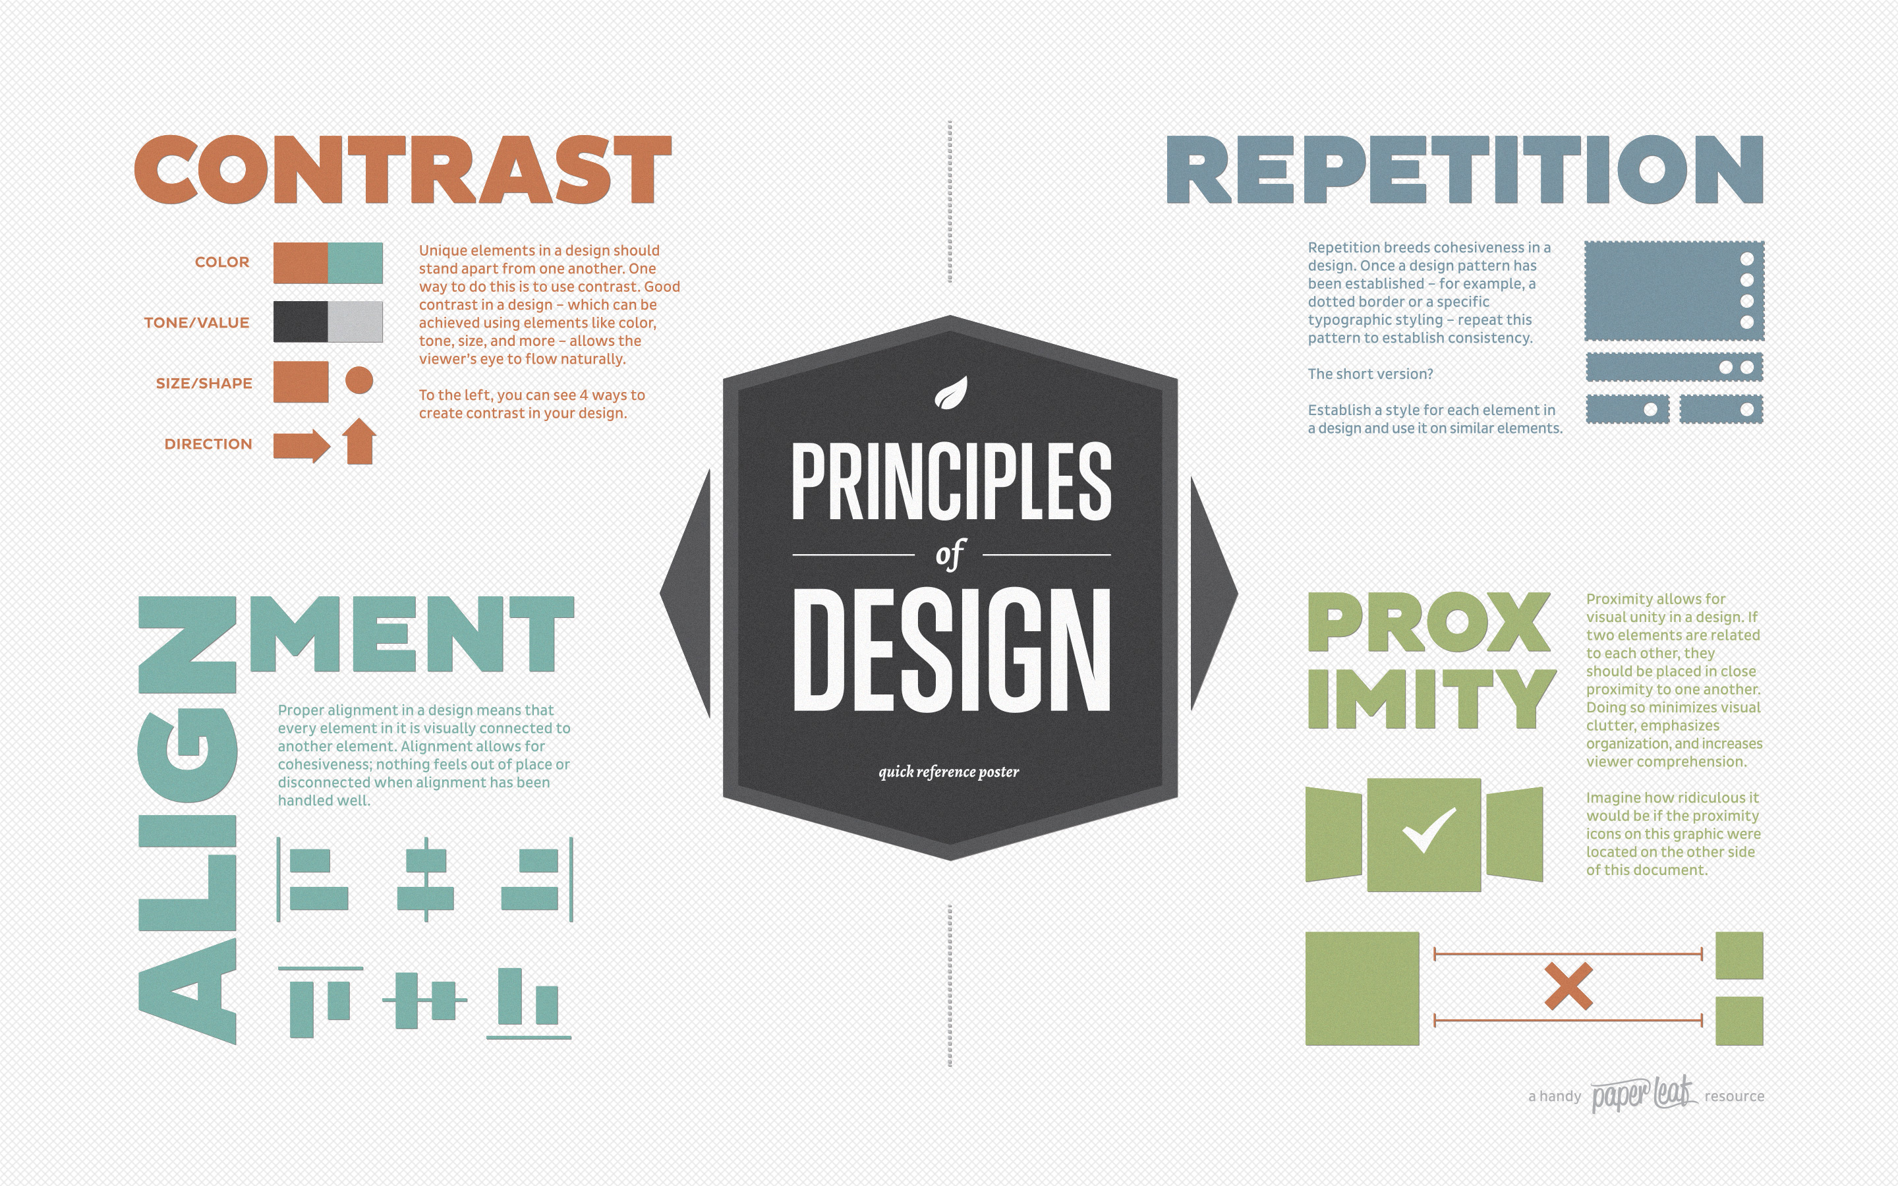
CRAP

Slide 3
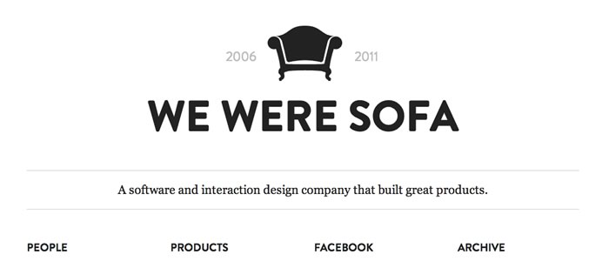
Space
Two types: positive and negative space.
Negative space is also called “white space” and it is not your enemy.

Slide 4

Line
If negative space is empty space, then to delineate the limits of space or to create positive space, the line is your primary tool.
Can be straight, angular, curvy, thick, thin.
Line creates perspective, which is the sense of moving into the distance.
Line control’s the eye’s movement.
Line evokes emotion.

Slide 5

Shape & Closure
Shape is the contours or profile of an object.
Inorganic shapes are those that are precisely geometric; organic shapes are those that are as they appear in nature.
This is an example of the Gestalt theory of closure

Slide 6
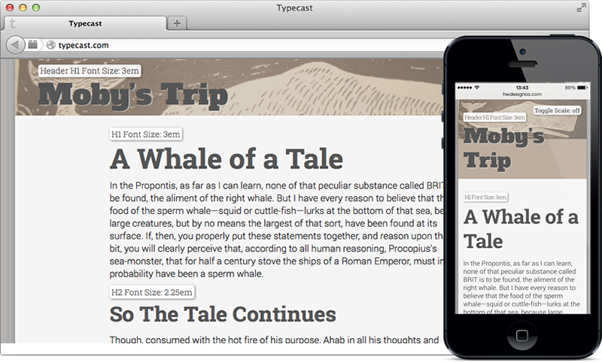
Size/Scale
Size matters in graphic design, too.
You can size all manner of objects: headlines, subheads, individual blocks of text, images, objects within images, letters, shapes of color, etc.
Size can make elements SHOUT or whisper.

Slide 7
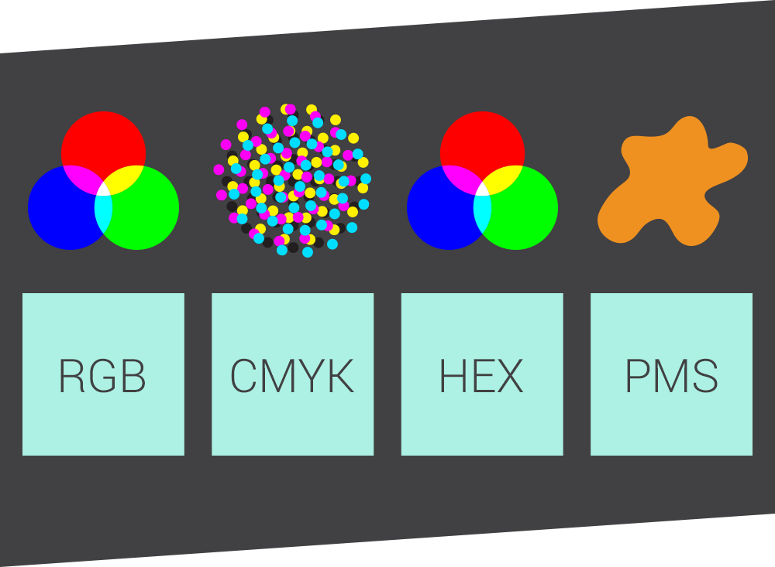
Color
Color is arguably the most powerful communication tool.
Color draws attention, organizes, orders, and evokes emotion.
There are three color spaces: RGB, CMYK, #HEX BUT there are many different ways to print color.
Color theory is the body of practical guidance to color mixing and the visual effects of a specific color combination.

Slide 8
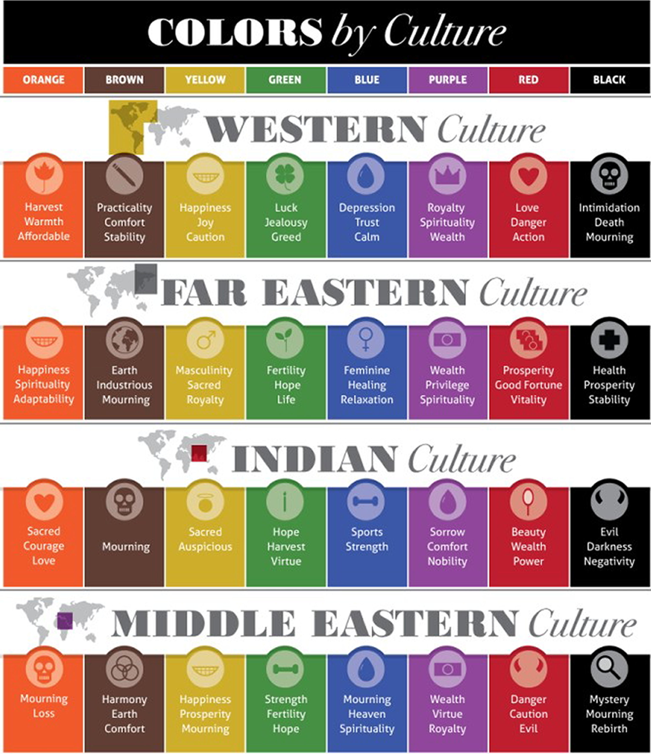
Color harmony =
f(Coll, 2,3,….,n) * (ID + CE + CX + P + T).
Colors seen together produce a pleasing affective response are said to be in harmony.
Color harmony is complicated: affective and cognitive
Factors that influence differences in color including age, gender, personal preference, affective state, and culture.
Context is equally important in how color is perceived.
Notes:
Wherein color harmony is a function (f) of the interaction between color/s (Col 1, 2,3) and the factors that influence positive aesthetic response to color: individual differences (ID) such as age, gender, personality and affective state; culture experiences (CE), the prevailing context (CX) which includes setting and ambient lighting; intervening perceptual effects (P) and the effects of time (TI in terms of prevailing social trends. There are over 2.8 million different hues, and so it is suggested there are an infinite number of color combinations implying that predicity color harmony formulaes like this are fundamentally unsound.

Slide 9

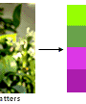

Color Theory - application
Analogous colors, colors to either side of primary color like yellow-green, yellow, and yellow-orange;
Complimentary colors, which are any two colors directly opposite each other on the color wheel like red and green or red-purple and yellow-green;
Colors found in Nature, such as red yellow and green.
Notes:
Wherein color harmony is a function (f) of the interaction between color/s (Col 1, 2,3) and the factors that influence positive aesthetic response to color: individual differences (ID) such as age, gender, personality and affective state; culture experiences (CE), the prevailing context (CX) which includes setting and ambient lighting; intervening perceptual effects (P) and the effects of time (TI in terms of prevailing social trends. There are over 2.8 million different hues, and so it is suggested there are an infinite number of color combinations implying that predicity color harmony formulaes like this are fundamentally unsound.

Slide 10
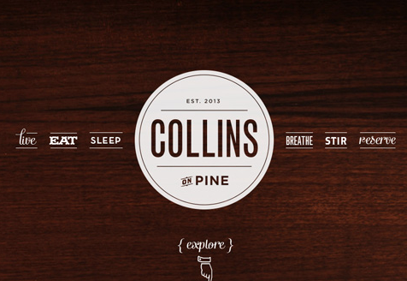
Texture
You can create the illusion of depth by using texture, mimicking textures in two dimensions.

Slide 11
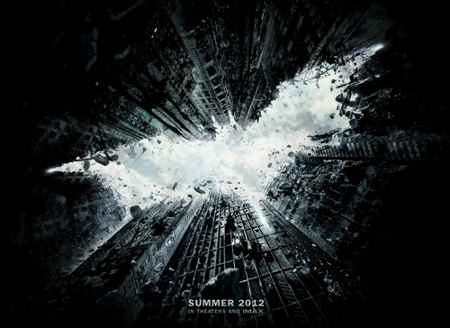
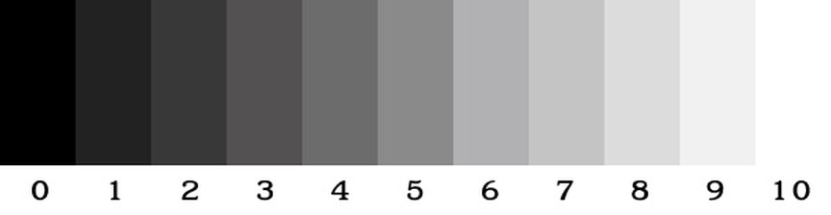
Value
Value refers to the tones of light and dark.

Slide 12
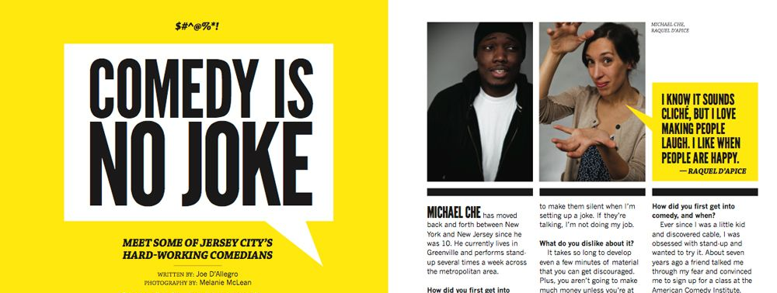
Contrast
Contrast can be employed in many ways: empty vs. filled space; lines vs. shape; size vs. size; hue vs. saturation; light vs. dark; serif vs. sans serif.

Slide 13

Balance
Balance is thought of in terms of visual weight. There are three kinds of balance: radial, symmetrical, and asymmetrical.

Slide 14

Movement
Good design directs the eye’s flow through the composition. The flow of lines can move the eye across the page or screen. Lines, then, create movement.
Curvy lines, in example, ca communicate distance or meandering movement.

Slide 15
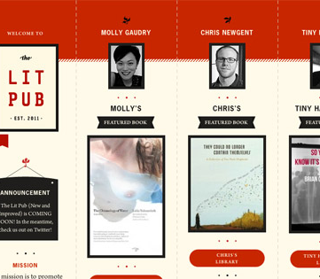
Rhythm
A pattern, whether regular or irregular, creates a sort of movement we might call rhythm.
Words can create rhythm, as can design elements that are strategically repeated like a backbeat.

Slide 16

Unity
You wouldn’t wear shorts and flip flops with a tuxedo top. There’s no unity between cargo shorts and the tux top. The same principle applies to graphic design.

Slide 17
Gestalt Theory
Proximity: objects that are closer together belong together.
Similarity: Our minds group things with similar properties like color or shape. Like goes with like.
Continuity: Our minds will continue a pattern beyond its end point and our eyes will follow the direction of a line.
Closure: Our minds will “fill the gaps” in order to complete a shape.
Applying Gestalt can help you control a user’s journey through your front end designs. Adding visual hierarchy along the way tells users what’s important.

Slide 18
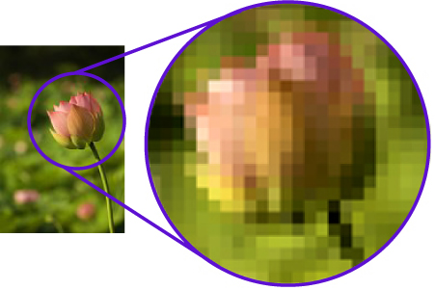
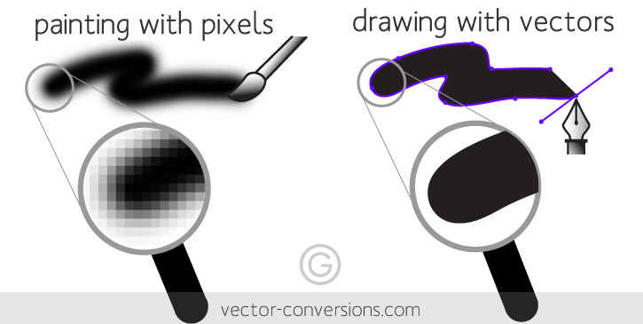
Vector, Raster, DPI
Vector Images: mathematically computed; lines and shapes; scalable
Raster Images: pixel-based; data; not scalable
DPI: stands for dots per inch
  300 print
  150/75 web/screen

Slide 19
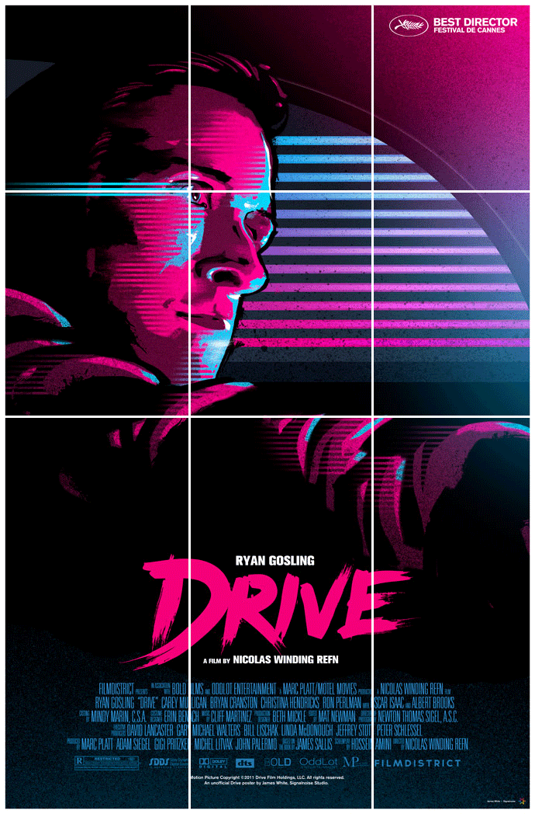
Focal Point
Every well-designed image has a focal point, which is the eye’s point of entry into the image.
Focal points are also sometimes called CVI for center of visual interest.
Rule 1: Only one focal point per page
Rule 2: Have a focal point for every page

Slide 20
The Rule of Thirds |
Golden Ratio
The Golden Proportion is a ratio 1:1.618.
What makes this special is the proportion of a to b is the same as the ratio of b to [a + b].
Do this: draw a perfect square. Then, increase the square’s width by *1.618. That’s a golden rectangle.
The golden proportion applied to a golden rectangle becomes a kind of compositional grid suggestion placement.
Rule of thirds: 3x3 grid that suggests layout placement in order to create visually interesting asymmetrical designs.
Focal point goes on one of four gridline intersections.

