Slide 1
Functional and non-functional requirements
Understanding the backbone of software development
?
Shahid Manzoor

Slide 2
Objectives
Discuss the Basic concepts of functional and non functional requirements.
Discuss the Importance and impact of both types of requirements on the software development lifecycle.
Discuss the techniques and best practices for specifying and documenting these requirements.
Discuss real-world examples and case studies to illustrate the application of functional and non-functional requirements.

Slide 3
Learning Outcomes
Should be able to clearly define the functional and non-functional requirements.
Should be able to analyze the impact of these requirements on the overall software design and user experience.
Should be able to document both types of requirements.
Should be able to apply the learned concepts to design a set of these requirements for a hypothetical project or case study.

Slide 4
What is a requirement?
Specifications of what a system should do and how it should perform.
It may range from a high-level abstract statement of a service or of a system constraint to a detailed mathematical functional specification.

Slide 5
Requirements engineering
The process of establishing the services that the customer requires from a system and the constraints under which it operates and is developed.
The requirements themselves are the descriptions of the system services and constraints that are generated during the requirements engineering process.

Slide 6
Requirements abstraction (Davis)
“If a company wishes to let a contract for a large software development project, it must define its needs in a sufficiently abstract way that a solution is not pre-defined. The requirements must be written so that several contractors can bid for the contract, offering, perhaps, different ways of meeting the client organization’s needs. Once a contract has been awarded, the contractor must write a system definition for the client in more detail so that the client understands and can validate what the software will do. Both of these documents may be called the requirements document for the system.”

Slide 7
Types of requirement
User requirements
Statements in natural language plus diagrams of the services the system provides and its operational constraints. Written for customers.
System requirements
A structured document setting out detailed descriptions of the system’s functions, services and operational constraints. Defines what should be implemented so may be part of a contract between client and contractor.

Slide 8
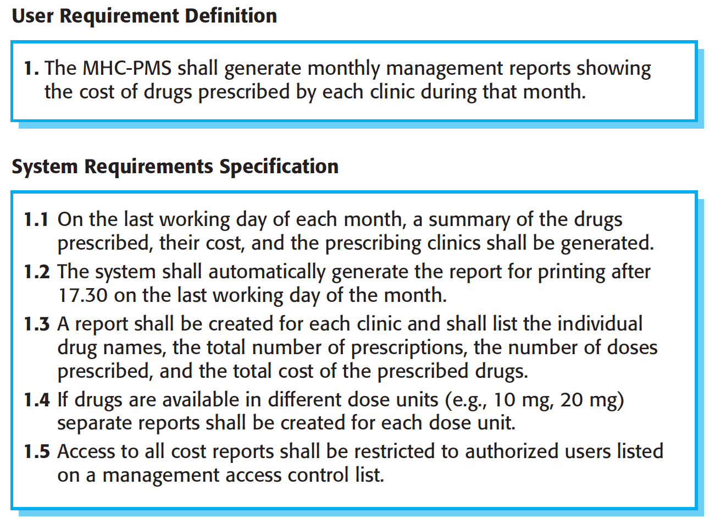
User and system requirements

Slide 9
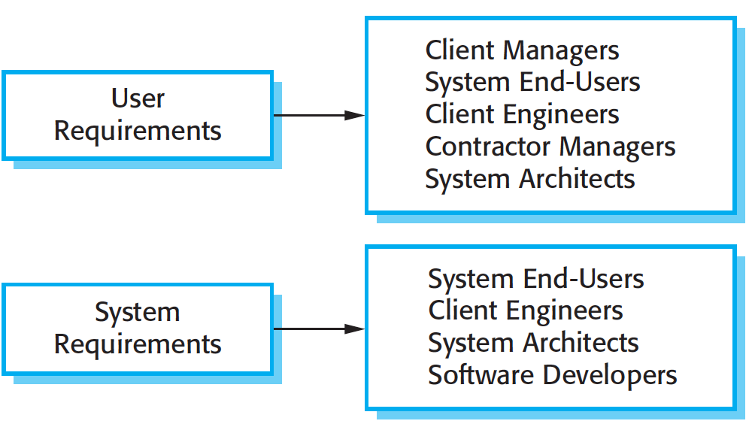
Readers of different types of requirements specification

Slide 10
Functional and non-functional requirements
Functional requirements
Statements of services the system should provide, how the system should react to particular inputs and how the system should behave in particular situations.
May state what the system should not do.
Non-functional requirements
Constraints on the services or functions offered by the system such as timing constraints, constraints on the development process, standards, etc.
Often apply to the system as a whole rather than individual features or services.

Slide 11
Functional requirements
Describe functionality or system services.
Depend on the type of software, expected users and the type of system where the software is used.
Functional user requirements may be high-level statements of what the system should do.
Functional system requirements should describe the system services in detail.

Slide 12
Functional requirements for the MHC-PMS
A user shall be able to search the appointments lists for all clinics.
The system shall generate each day, for each clinic, a list of patients who are expected to attend appointments that day.
Each staff member using the system shall be uniquely identified by his or her 8-digit employee number.

Slide 13
Requirements imprecision
Problems arise when requirements are not precisely stated.
Ambiguous requirements may be interpreted in different ways by developers and users.
Consider the term ‘search’ in requirement 1
User intention – search for a patient name across all appointments in all clinics.
Developer interpretation – search for a patient name in an individual clinic. User chooses clinic then search.

Slide 14
Requirements completeness and consistency
In principle, requirements should be both complete and consistent.
Complete
They should include descriptions of all facilities required.
Consistent
There should be no conflicts or contradictions in the descriptions of the system facilities.
In practice, it is impossible to produce a complete and consistent requirements document.

Slide 15
Non-functional requirements
These define system properties and constraints e.g. reliability, response time and storage requirements. Constraints are I/O device capability, system representations, etc.
Process requirements may also be specified mandating a particular IDE, programming language or development method.
Non-functional requirements may be more critical than functional requirements. If these are not met, the system may be useless.

Slide 16
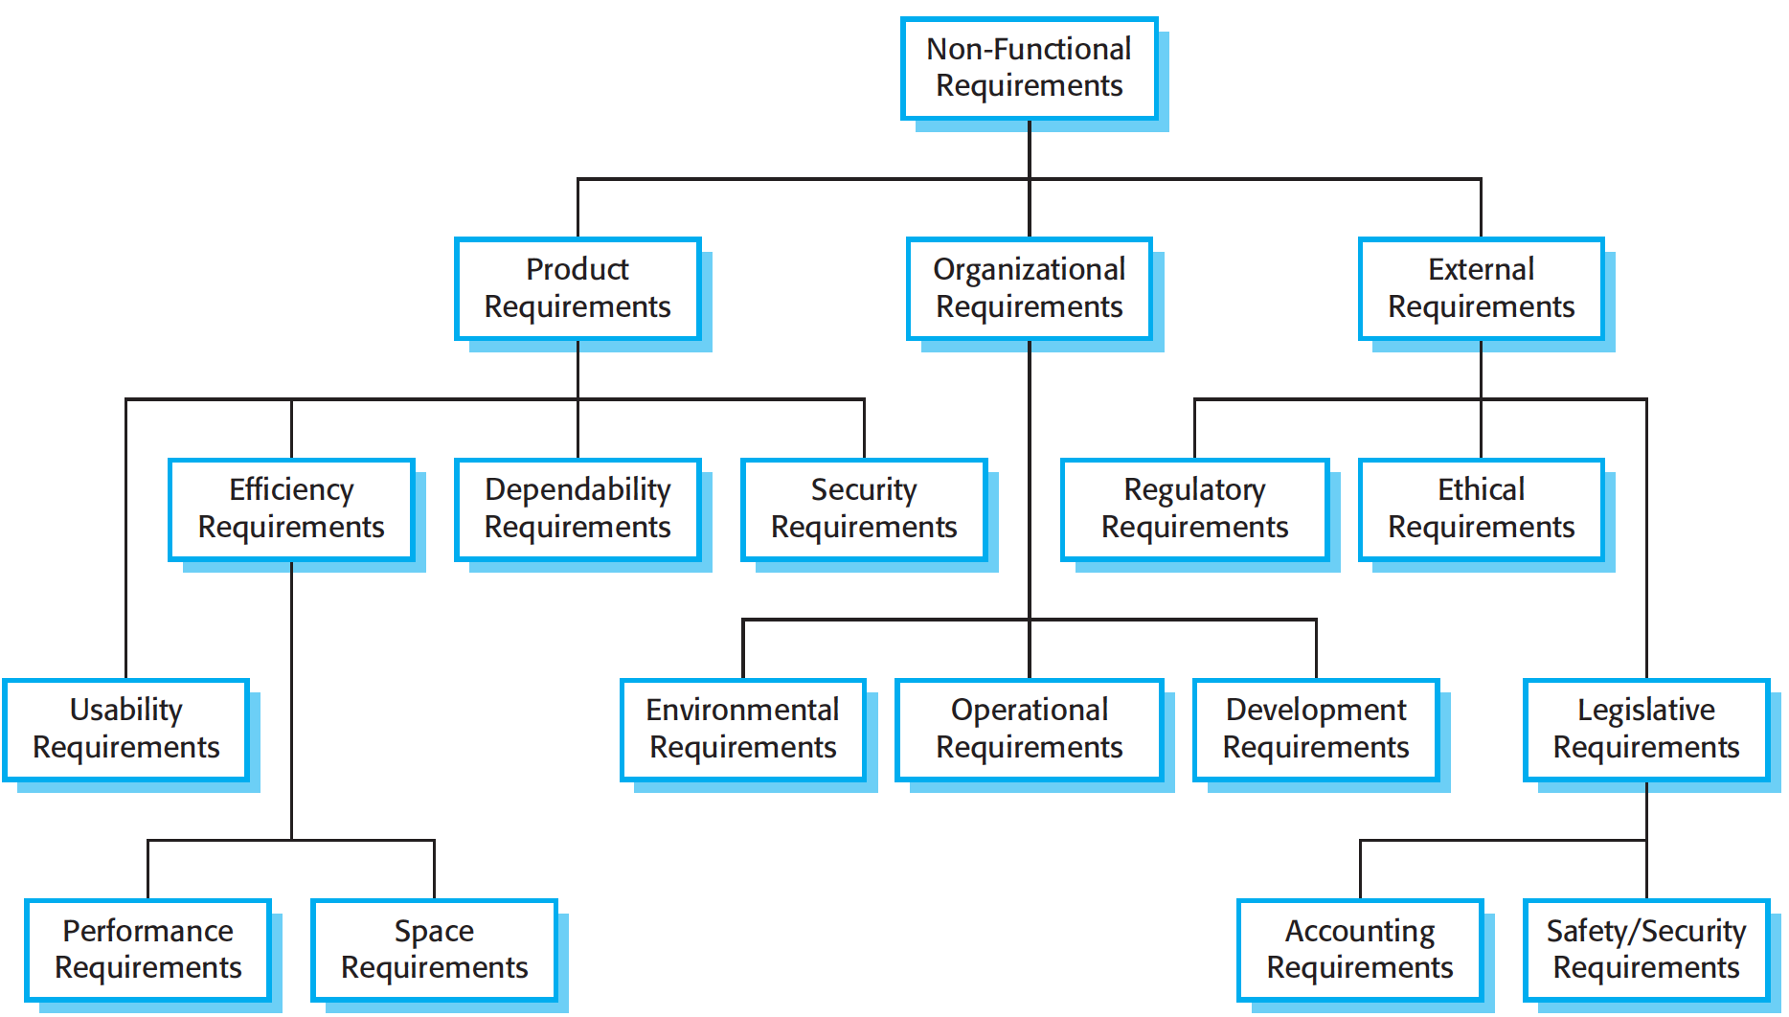
Types of nonfunctional requirement

Slide 17
Non-functional classifications
Product requirements
Requirements which specify that the delivered product must behave in a particular way e.g. execution speed, reliability, etc.
Organisational requirements
Requirements which are a consequence of organisational policies and procedures e.g. process standards used, implementation requirements, etc.
External requirements
Requirements which arise from factors which are external to the system and its development process e.g. interoperability requirements, legislative requirements, etc.

Slide 18
Non-functional requirements implementation
Non-functional requirements may affect the overall architecture of a system rather than the individual components.
For example, to ensure that performance requirements are met, you may have to organize the system to minimize communications between components.
A single non-functional requirement, such as a security requirement, may generate a number of related functional requirements that define system services that are required.
It may also generate requirements that restrict existing requirements.

Slide 19
Examples of nonfunctional requirements in the MHC-PMS
Product requirement The MHC-PMS shall be available to all clinics during normal working hours (Mon–Fri, 0830–17.30). Downtime within normal working hours shall not exceed five seconds in any one day. Organizational requirement Users of the MHC-PMS system shall authenticate themselves using their health authority identity card. External requirement The system shall implement patient privacy provisions as set out in HStan-03-2006-priv.

Slide 20
Metrics for specifying nonfunctional requirements
Property | Measure
Speed | Processed transactions/second User/event response time Screen refresh time
Size | Mbytes Number of ROM chips
Ease of use | Training time Number of help frames
Reliability | Mean time to failure Probability of unavailability Rate of failure occurrence Availability
Robustness | Time to restart after failure Percentage of events causing failure Probability of data corruption on failure
Portability | Percentage of target dependent statements Number of target systems

Slide 21
Comparison Table
Aspect | Functional Requirements | Non-Functional Requirements
Focus | What the system should do | How the system should be
Examples | Login feature, data retrieval | Speed, scalability, security
Measurement | Test cases, user stories | Benchmarks, metrics

Slide 22
Importance of Functional Requirements
Clarity: Ensures all stakeholders understand system capabilities.
Scope: Defines the boundaries of what the system will do.
Development: Guides developers in building the system.

Slide 23
Importance of Non-Functional Requirements
User Experience: Affects the usability and user satisfaction.
Performance: Ensures the system meets expected performance levels.
Security: Protects user data and system integrity.
Reliability: Ensures system availability and dependability.

Slide 24
Gathering Requirements
Techniques:
- Interviews
- Surveys
- Focus groups
- Observation
?
Best Practices:
- Involve stakeholders early and often
- Use clear and concise language
- Prioritize requirements

Slide 25
Documenting Requirements
Functional Requirements:
- Use cases
- User stories
- Detailed descriptions
Non-Functional Requirements:
- Performance benchmarks
- Security protocols
- Usability standards
Tools and Techniques
- Requirement Management Tools: JIRA, Trello, IBM Rational DOORS
- Modeling Techniques: Use case diagrams, user stories, scenarios

Slide 26
Example 1: E-commerce Website:- Functional Requirements
User Registration and Login:
Requirement: The system must allow users to register by providing a username, password, email, and other personal details.
Product Search:
Requirement: The system must provide a search functionality that allows users to search for products using keywords, categories, and filters (e.g., price range, brand).
Shopping Cart:
Requirement: The system must allow users to add and remove items from a shopping cart.
Requirement: The system must display the total price of items in the shopping cart.
Payment Processing:
Requirement: The system must process payments using credit cards, PayPal, and gift cards.
Requirement: The system must send a confirmation email to the user after a successful payment.
Order Tracking:
Requirement: The system must allow users to track the status of their orders (e.g., processing, shipped, delivered).

Slide 27
Non-Functional Requirements
Performance:
Requirement: The system must load the homepage within 2 seconds on a high-speed internet connection.
Requirement: The system must be able to handle up to 10,000 concurrent users during peak hours.
Security:
Requirement: The system must use HTTPS for all communications to ensure data security.
Usability:
Requirement: The system must have a user-friendly interface that is easy to navigate for users of all ages.
Reliability:
Requirement: The system must have an uptime of 99.9%, ensuring it is available to users 24/7.
Requirement: The system must have a backup and recovery mechanism in place to prevent data loss.
Scalability:
Requirement: The system must be able to scale horizontally to accommodate an increasing number of users and transactions.

Slide 28
Example 2: Banking Application :Functional Requirements
Account Management:
Requirement: The system must allow users to create new bank accounts, update account information, and close accounts.
Requirement: The system must provide account balance and transaction history.
Fund Transfer:
Requirement: The system must enable users to transfer funds between their own accounts and to other users' accounts within the same bank.
Requirement: The system must support external transfers to accounts at different banks.
Bill Payment:
Requirement: The system must allow users to pay utility bills, credit card bills, and other invoices directly from their bank account.
Requirement: The system must send a confirmation message after a successful bill payment.
Loan Applications:
Requirement: The system must allow users to apply for loans by filling out an online application form.
Alerts and Notifications:
Requirement: The system must send email and SMS alerts for low balance, large transactions, and account activity.

Slide 29
Non-Functional Requirements
Performance:
Requirement: The system must process fund transfers within 2 seconds.
Requirement: The system must handle up to 5,000 concurrent transactions during peak periods.
Security:
Requirement: The system must implement multi-factor authentication for all user logins.
Requirement: The system must encrypt all sensitive data, both at rest and in transit.
Compliance:
Requirement: The system must comply with relevant financial regulations.
Requirement: The system must maintain audit logs for all financial transactions
Reliability:
Requirement: The system must ensure 99.99% uptime to provide continuous access to banking services.
Requirement: The system must have a disaster recovery plan that ensures recovery within 1 hour of a critical failure.
Maintainability:
Requirement: The system must be modular, allowing for easy updates and maintenance without significant downtime.
Requirement: The system must provide clear documentation for all functionalities and interfaces.

Slide 30
Example 3: Online Learning Platform : Functional Requirements
User Authentication:
Requirement: The system must allow users to register, log in, and log out.
Requirement: The system must support password recovery through email.
Course Management:
Requirement: Instructors must be able to create, update, and delete courses.
Requirement: Instructors must be able to upload course materials, including videos, documents, and quizzes.
Enrollment:
Requirement: Students must be able to enroll in and drop courses.
Requirement: The system must send enrollment confirmation emails to students.
Content Delivery:
Requirement: The system must provide streaming of video lectures and downloadable course materials.
Requirement: The system must allow students to take quizzes and submit assignments online.
Progress Tracking:
Requirement: The system must track and display students' progress through their courses.
Requirement: The system must provide a grade book for instructors to record and manage student grades.

Slide 31
Non-Functional Requirements
Performance:
Requirement: The platform must load course pages within 3 seconds.
Requirement: The platform must support up to 10,000 concurrent users during peak usage times.
Security:
Requirement: The platform must use SSL encryption for all data transmissions.
Requirement: The platform must implement role-based access control to restrict access to sensitive information.
Usability:
Requirement: The user interface must be intuitive and easy to navigate for users of varying technical skills.
Scalability:
Requirement: The platform must be able to scale horizontally to accommodate increasing numbers of courses and users.
Requirement: The platform must allow for the easy addition of new features and functionalities.
Reliability:
Requirement: The platform must maintain 99.9% uptime to ensure continuous access to learning materials.

Slide 32
Case Study 1: Online Bookstore
Scenario:
You are tasked with developing an online bookstore. The bookstore should allow users to browse, search for, and purchase books. Users should be able to create accounts, save books to a wishlist, and write reviews for books they have purchased. The system should also handle payments and send notifications to users about their orders.
Task:
Identify functional and non-functional requirements for the online bookstore.

Slide 33
Functional Requirements:
User account creation and login.
Browsing and searching for books.
Adding books to a wishlist.
Purchasing books online.
Writing and displaying book reviews.
Payment processing.
Order notification system.
Non-Functional Requirements:
The system should be able to handle 10,000 simultaneous users.
Payment transactions should be completed within 3 seconds.
The system should be available 99.9% of the time.
Data encryption for user information and transactions.
The website should load within 2 seconds.
The user interface should be intuitive and accessible.

Slide 34
Case Study 2: E-Learning Platform
Scenario:
You are developing an e-learning platform for a university. The platform should allow students to enroll in courses, access course materials, submit assignments, take quizzes, and communicate with instructors and fellow students. Instructors should be able to create courses, upload materials, grade assignments, and track student progress.
Task:
Identify functional and non-functional requirements for the e-learning platform.

Slide 35
Functional Requirements:
Student enrollment and profile management.
Course creation and management by instructors.
Access to course materials (videos, documents, etc.).
Assignment submission and grading.
Quiz creation and taking.
Communication tools (forums, messaging, etc.).
Progress tracking and reporting.
Non-Functional Requirements:
The platform should support up to 1,000 concurrent users.
Video streaming should support HD quality without buffering.
The system should be accessible 24/7 with 99.9% uptime.
Data privacy and security measures in compliance with educational standards.
The platform should load within 3 seconds for any page.
User interface should be accessible for users with disabilities.

Slide 36
Case Study 3: Hospital Management System
Scenario:
You are developing a hospital management system that will be used to manage patient records, appointments, billing, and medical staff scheduling. The system needs to support multiple user roles such as doctors, nurses, administrative staff, and patients.
Task:
Identify functional and non-functional requirements for the hospital management system.

Slide 37
Functional Requirements:
User role management (doctors, nurses, administrative staff, patients).
Patient registration and record management.
Appointment scheduling and management.
Billing and payment processing.
Medical staff scheduling.
Prescription and medication management.
Reporting and analytics on patient data.
Non-Functional Requirements:
The system should comply with healthcare regulations such as HIPAA.
The system should be able to support up to 500 concurrent users.
System uptime should be 99.95%.
Patient data should be encrypted and backed up daily.
Response time for any user action should be less than 1 second.
The interface should be user-friendly and support multiple languages.

Slide 38
Challenges and Solutions
Challenges:
- Ambiguity in requirements
- Changing requirements
- Stakeholder disagreements
Solutions:
- Clear documentation
- Regular updates and reviews
- Effective communication channels

Slide 39
Key points
Requirements for a software system set out what the system should do and define constraints on its operation and implementation.
Functional requirements are statements of the services that the system must provide or are descriptions of how some computations must be carried out.
Non-functional requirements often constrain the system being developed and the development process being used.
They often relate to the emergent properties of the system and therefore apply to the system as a whole.

