Slide 1


Slide 2
AI-in-Action Heroes
Summer Academy Course offered by AISE program

Slide 3

The Objectives of the course
Get a glance of the big picture and the different aspects and components

Slide 4
Software program
Allow us to give instructions to a computer in order to solve a problem.
Instructions written in a language that the computer can understand
Needs and environment to get executed.

Slide 5
Cyber-Physical System
Cyber-Physical System
actuators
Hardware aspects
Sensors: collect input from the surroundings and send it to the program.
Actuators: take commands form the program and cause the device to take action.
Software aspects
OS, Libraries, …, etc.
Your programs
Software (cyber)
Hardware (physical)
sensors

Slide 6

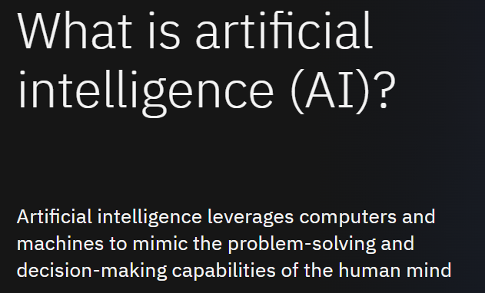
What is AI?
Source: https://www.ibm.com/topics/artificial-intelligence

Slide 7
Putting AI in Action AI applications in the context of different engineering disciplines
For example, if we are talking about robots
Building a robot is one thing.
Building a robot with AI capabilities is another thing.
Preparing the robot to utilize the capabilities for an AI system is another thing.
Putting these AI capabilities in action to fulfill a specific functionality is another thing.

Slide 8
Putting AI in Action AI applications in the context of different engineering disciplines
For example, if we are talking about robots
Building a robot is one thing.
Building a robot with AI capabilities is another thing.
Preparing the robot to utilize the capabilities for an AI system.
Putting these AI capabilities in action to fulfill a specific functionality is another thing.

Slide 9

Introduction to Programming

Slide 10
Any computer program consists of two components
Data
Processing

Slide 11
Any computer program consists of two components
Data
Processing
We write programs to tell the computer:
What are the data
How to process them to get the result

Slide 12
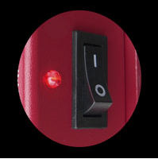
Machine language
Machines operate by electricity
1 = on
0 = off

Slide 13

Machine Language
Binary code
uses two different states, on and off, to translate instructions to its processors.

Slide 14
Programming
Human Language
“What’s the result of adding 5 to 7?”
Machine language
0110100101010
is to translate a solution of a problem from human language to a computer/machine language
Low Level Language

Slide 15
Assembly Language
Example problem:
Save the number 97 for later use
Data: the constant value 97
Process: save that value
Binary Language
10110000 01100001

Slide 16
Assembly Language
Example problem:
Save the number 97 for later use
Data: the constant value 97
Process: save that value
Binary Language
10110000 01100001
Binary representation of the number 97
Binary code for saving instruction
Code for the AL register where the value to be stored

Slide 17
Assembly Langage
Human Language
“What’s the result of adding 5 to 7?”
Machine language
0110100101010
Assembly Language
was introduced to make programming easier

Slide 18
Assembly Language
Example problem:
Save the number 97 for later use
Data: the constant value 97
Process: save that value
Binary Language
0’s and 1’s
Assembly Language
Abstracting using names and simpler data representation
10110000 01100001
MOV AL, 61h

Slide 19
Assembly Language
Example problem:
Save the number 97 for later use
Data: the constant value 97
Process: save that value
Binary Language
0’s and 1’s
Assembly Language
Abstracting using names and simpler data representation
10110000 01100001
A name of for the instruction instead of the binary code
MOV AL, 61h
The name of register instead of binary code
Hexadecimal representation of number 97

Slide 20
Assembly Language
Example problem:
Save the number 97 for later use
Data: the constant value 97
Process: save that value
Binary Language
0’s and 1’s
Assembly Language
Abstracting using names and simpler data representation
10110000 01100001
MOV AL, 61h
Translated back to machine language automatically

Slide 21
Even higher-level Languages
Human Language
“What’s the result of adding 5 to 7?”
Machine language
0110100101010
Assembly Language
Higher-Level languages
E.g. C , Pascal, C++, Java, Python
Higher level languages gradually started to emerge one after the other introducing more features that make programming easier and allow for more abstractions

Slide 22
Main Programming Constructs
Control Flow statements
Functions and Procedures
Passing and returning variables
for-loop, while-loop, if-statements, case-statement
Code Blocks
Begin-End , {}
Meaningful names
For data holders
For functions and procedures
Object-Oriented Features
Classes, objects
Reusable Code
Libraries
Modules
Data types
Range of values
Specific operations

Slide 23

Hello Python, Worlds!

Slide 24
Hello Python, Worlds!
It’s a common practice when learning a new language to start by printing “Hello, World!” using that language.
In order to execute the code you need an environment that includes the translator specific to this language + other helpful pre-written code.
The translator of python is called “Interpreter”.
There are different ways that you can write and execute your python code
You can write the code in a file with the extension “.py”
You can write and execute part by part in a Jupyter Notebook (usually used for experimentation)

Slide 25
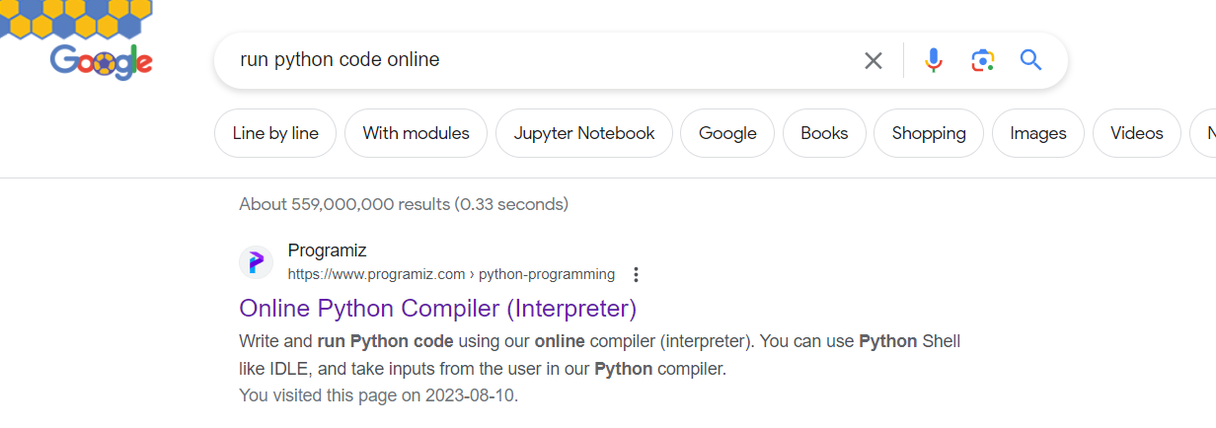
Python file
When we work with the Pi-Cars we’ll work with the interpreter directly, but for this section we just need to focus on the programing constructs so we’ll use an online environment that has the interpreter already available behind the scenes.
https://www.programiz.com/python-programming/online-compiler/

Slide 26
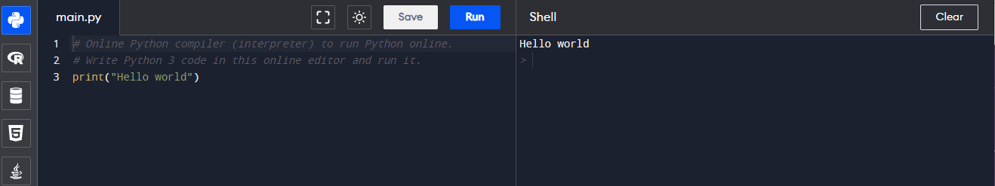
Hello, World!

Slide 27
Hello, World!
You’d write your code in a file that has .py extension

Slide 28
Hello, World!
A line that starts with a ‘#’ is a comment so it doesn’t need interpretation or execution

Slide 29
Hello, World!
This is the only line of code that we have in this script and it’s a function that print the text on the screen

Slide 30
Hello, World!
When you hit ‘run’ the lines of code are intereprted and executed one by one and if there’s any thing that should appear on this side of the screen

Slide 31
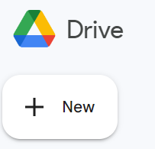
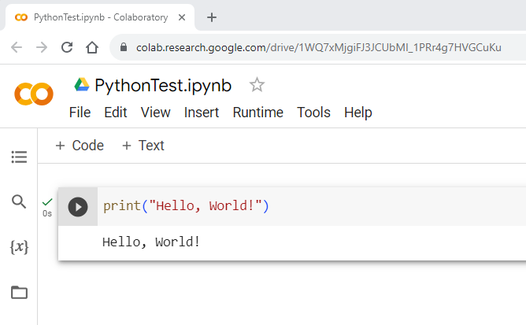
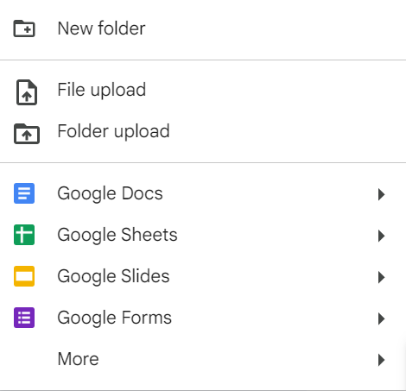
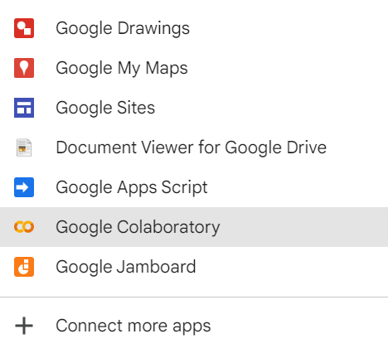
Jupyter Notebook – Example free environment is Google Colab

Slide 32
Basic Data Types & Operations

Slide 33
Main Built-In Data Types
Numeric Types
int, float
Boolean Type
bool
Text (sequence) type
str
Sequence Types
list, tuple, range
Mapping Type
dict
NoneType
Special value None

Slide 34
Main Built-In Data Types
Numeric Types
int, float
Boolean Type
bool
Text (sequence) type
str
Sequence Types
list, tuple, range
Mapping Type
dict
NoneType
Special value None

Slide 35
Main Built-In Data Types
Numeric Types
int – discrete numbers (e.g. 5)
Boolean Type
bool - True or False (case sensitive)
Text (sequence) type
str – Any sequence of characters surrounded by
float – numbers with fractions (e.g. 5.5)
Double quotes: "allows embedded 'single' quotes"
Triple quoted: '''Three single quotes''', """Three double quotes"""
Single quotes: 'allows embedded "double" quotes'

Slide 36
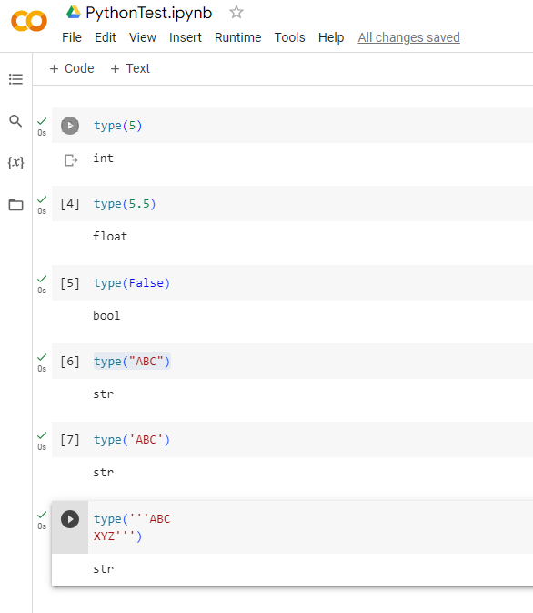
Main Built-In Data Types & Operations
A built-in function that returns the type of a given value
Numeric Types
int – discrete numbers (e.g. 5)
Boolean Type
bool - True or False (case sensitive)
Text (sequence) type
str – Any sequence of characters surrounded by
float – numbers with fractions (e.g. 5.5)
Double quotes: "allows embedded 'single' quotes"
Triple quoted: '''Three single quotes''', """Three double quotes"""
Single quotes: 'allows embedded "double" quotes'

Slide 37
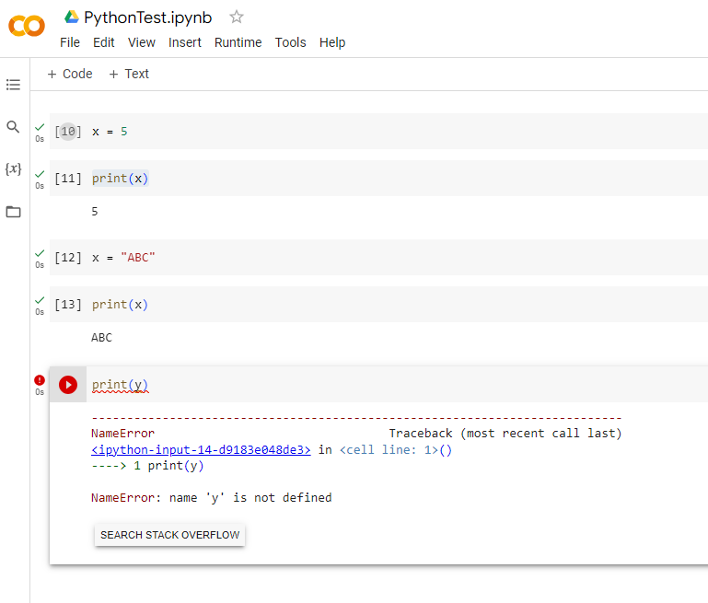
Variables
Named data holder
We can use the assignment operatory (=) to store data value in a named variable
Valid names
No special characters except the underscore (_)
Can contain any character or digits but cannot start with a digit
Cannot be a reserved word

Slide 38
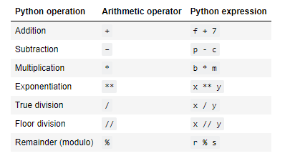
Main Built-In Data Types & Operations
Numeric Types
int – discrete numbers (e.g. 5)
Boolean Type
bool - True or False (case sensitive)
Text (sequence) type
str – Any sequence of characters surrounded by
float – numbers with fractions (e.g. 5.5)
Double quotes: "allows embedded 'single' quotes"
Triple quoted: '''Three single quotes''', """Three double quotes"""
Single quotes: 'allows embedded "double" quotes'

Slide 39
Main Built-In Data Types & Operations
Part of the code that results in a value
Numeric Types
int – discrete numbers (e.g. 5)
Boolean Type
bool - True or False (case sensitive)
Text (sequence) type
str – Any sequence of characters surrounded by
float – numbers with fractions (e.g. 5.5)
Double quotes: "allows embedded 'single' quotes"
Triple quoted: '''Three single quotes''', """Three double quotes"""
Single quotes: 'allows embedded "double" quotes'

Slide 40
Main Built-In Data Types & Operations
- ‘f‘ is replaced by the value stored in the variable
The value is added to 7
The whole expression results in (evaluates to the result of the addition)
Numeric Types
int – discrete numbers (e.g. 5)
Boolean Type
bool - True or False (case sensitive)
Text (sequence) type
str – Any sequence of characters surrounded by
float – numbers with fractions (e.g. 5.5)
Double quotes: "allows embedded 'single' quotes"
Triple quoted: '''Three single quotes''', """Three double quotes"""
Single quotes: 'allows embedded "double" quotes'

Slide 41
Main Built-In Data Types & Operations
Numeric Types
int – discrete numbers (e.g. 5)
Boolean Type
bool - True or False (case sensitive)
Text (sequence) type
str – Any sequence of characters surrounded by
float – numbers with fractions (e.g. 5.5)
Double quotes: "allows embedded 'single' quotes"
Triple quoted: '''Three single quotes''', """Three double quotes"""
Single quotes: 'allows embedded "double" quotes'
- ‘p’ is evaluated to the value stored in the variable
- ‘c’ is evaluated to the value stored in the variable
- The whole expression results in (evaluates to the result of the subtraction)

Slide 42
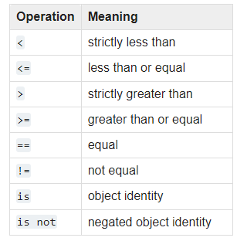
Main Built-In Data Types & Operations
Comparison operators result in a Boolean value
Numeric Types
int – discrete numbers (e.g. 5)
Boolean Type
bool - True or False (case sensitive)
Text (sequence) type
str – Any sequence of characters surrounded by
float – numbers with fractions (e.g. 5.5)
Double quotes: "allows embedded 'single' quotes"
Triple quoted: '''Three single quotes''', """Three double quotes"""
Single quotes: 'allows embedded "double" quotes'
P | Q | P or Q | P and Q | not P | not Q
True | True | True | True | False | False
True | False | True | False | False | True
False | True | True | False | True | False
False | False | False | False | True | True
Logical operators
There are some specifics of how these logical operators work on python, we won’t get into these specifics for now

Slide 43
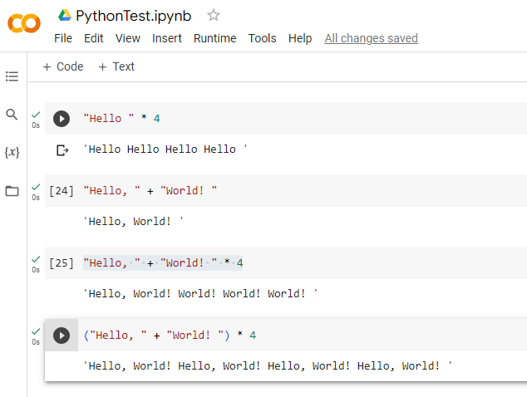
Main Built-In Data Types & Operations
Numeric Types
int – discrete numbers (e.g. 5)
Boolean Type
bool - True or False (case sensitive)
Text (sequence) type
str – Any sequence of characters surrounded by
float – numbers with fractions (e.g. 5.5)
Double quotes: "allows embedded 'single' quotes"
Triple quoted: '''Three single quotes''', """Three double quotes"""
Single quotes: 'allows embedded "double" quotes'
+ : concatenation
* : repetition

Slide 44
Flow Control – Conditional statements

Slide 45


if-statement
Syntax

Slide 46
if-statement
Syntax
Generally,
the expression
of the if statement is called the condition and it should result in a Boolean value

Slide 47





if-statement
Syntax
A new line is enough indication of the end of the statement
Indentation indicate a block of code

Slide 48
if-statement
Syntax
The ; is not necessary unless we are writing multiple statements in the same line
Indentation indicate a block of code

Slide 49


if-statement
Syntax
Indentation indicate a block of code
Indentation indicate a block of code

Slide 50
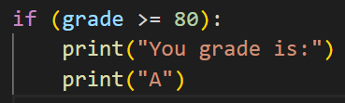
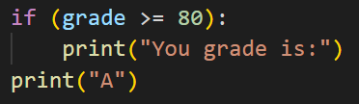

if-statement
Syntax
No error message here as it’ll assume that the second statement is not part of the block

Slide 51


if-statement
Syntax

Slide 52
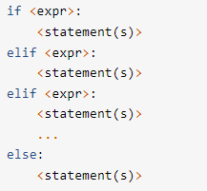
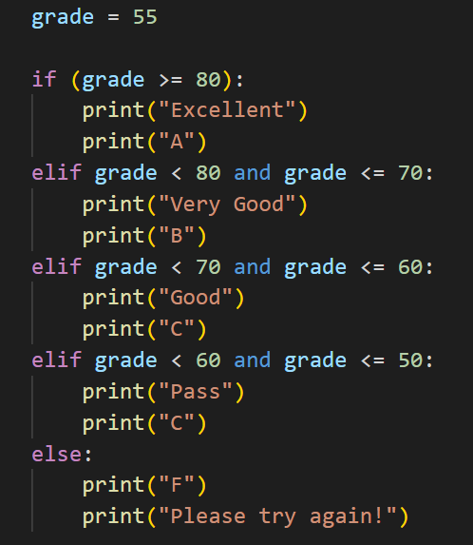
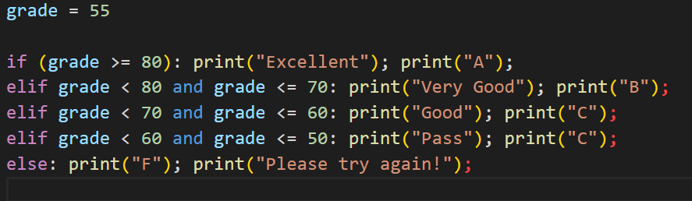
if-statement

Slide 53

Hands-ON

Slide 54
Sequence Types & operations

Slide 55
Main Built-In Data Types
Numeric Types
int, float
Boolean Type
bool
Text (string) type
str
Sequence Types
list, tuple, range
NoneType
Special value None
Mapping Type
dict

Slide 56
Main Built-In Data Types
Numeric Types
int, float
Boolean Type
bool
Text (string) type
str
Sequence Types
list, tuple, range
NoneType
Special value None
Mapping Type
dict

Slide 57
Main Built-In Data Types
Numeric Types
int, float
Boolean Type
bool
Text (string) type
str
Sequence Types
list, tuple, range
NoneType
Special value None
Mapping Type
dict
Store collections of data.

Slide 58
Main Built-In Data Types
Numeric Types
int, float
Boolean Type
bool
Text (string) type
str
Sequence Types
list, tuple, range
NoneType
Special value None
Mapping Type
dict
Strings has common features with Sequence types

Slide 59
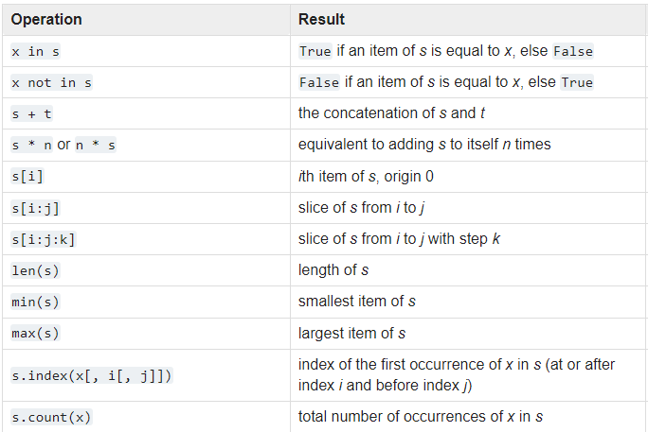
Sequence Types
Common Sequence Operations
Lists
Tuples
Strings
Ranges

Slide 60
Sequence Types
Common Sequence Operations
Lists
Tuples
Strings
Ranges
Elements of the sequence types are numbered starting from 0, this number is called the index

Slide 61
Sequence Types
Common Sequence Operations
Lists
Tuples
Strings
Ranges

Slide 62
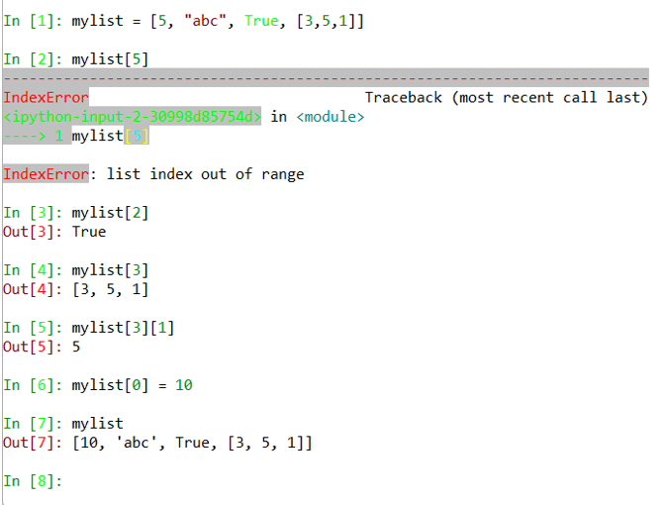
Sequence Types
Lists
A list is a mutable sequence of values, surrounded by square brackets and separated by commas.
Elements are ordered and accessible by a zero-based index
Tuples
Strings
Ranges

Slide 63
Sequence Types
Common Sequence Operations
Lists
A list is a mutable sequence of values, surrounded by square brackets and separated by commas.
Elements are ordered and accessible by a zero-based index
Tuples
Strings
Ranges
Hands On

Slide 64
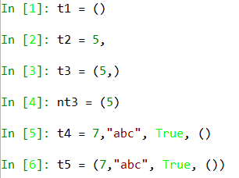
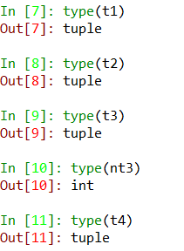
Sequence Types
Lists
Tuples
Strings
Ranges
A tuple is a sequence of comma separated elements
Maybe surrounded by round parentheses
The parentheses are only required for an empty tuple
Sigle element tuples must have a trailing comma

Slide 65
Sequence Types
Common Sequence Operations
Lists
Tuples
Strings
Ranges
A tuple is an immutable sequence of comma separated elements
Maybe surrounded by round parentheses
The parentheses are only required for an empty tuple
Sigle element tuples must have a trailing comma
Hands On

Slide 66
Sequence Types
Common Sequence Operations
Lists
Tuples
Strings
Ranges
Special type of sequences
Elements surrounded by quotes and NOT separated by commas
Elements are Unicode characters
Hands On

Slide 67

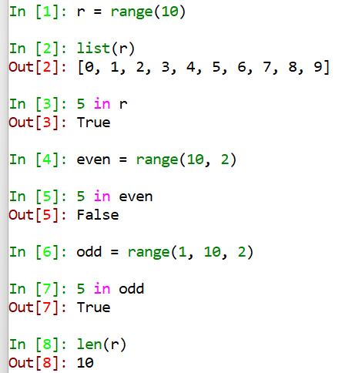
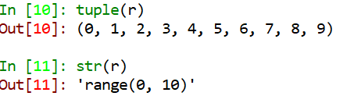
Sequence Types
increment value (default is 1)
Starting value (default is 0)
Lists
Tuples
Strings
Ranges
The range type represents an immutable sequence of numbers and is commonly used for looping a specific number of times in for loops.
implement all of the common sequence operations except concatenation and repetition to avoid violating the generation pattern.

Slide 68
Flow Control – Iterations / Loops

Slide 69
Loops
Are used to repeat executing a block of code.
A loop has three main components in addition to the block to execute
Initialization (starting point)
Stopping criteria
An update that move towards the stopping criteria
There are two main types of loops
A loop based on specified number of iterations (for loop)
A loop based on a condition (while loop)

Slide 70
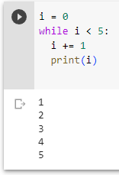
while loop Iterating based on a condition

Slide 71
while loop Iterating based on a condition
keyword

Slide 72
while loop Iterating based on a condition
To indicate that there’s a sub-block coming

Slide 73
while loop Iterating based on a condition
sub-block with consistent indentation

Slide 74
while loop Iterating based on a condition

Slide 75
while loop Iterating based on a condition
Initialization / starting point

Slide 76
while loop Iterating based on a condition
Condition to determine the stopping criteria
(will stop when the condition is False)

Slide 77
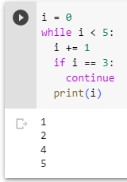
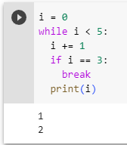
while loop Iterating based on a condition
Skips the rest of the block and go to the next iteration
Exists the entire loop

Slide 78
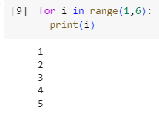
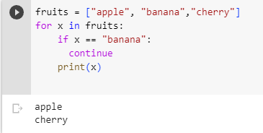
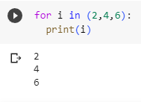
for loops
In python a for loop iterates over the elements of a given sequence
If we need to specify a number of iterations we can use a range.

Slide 79
Functions

Slide 80
Functions
A function is a block of code that has
Name
Used to call the function for execution
parameter list
To receive arguments to apply the code on
Optionally return value
Using the 'return' keywords

Slide 81
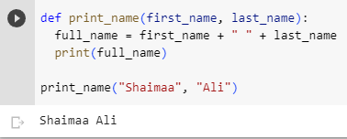
Functions
Function definition
Function call

Slide 82
Functions
keyword
Function definition

Slide 83
Functions
A name that we choose
Function definition

Slide 84
Functions
Whether we want the functions to receive parameters or not the parentheses are mandatory
Function definition

Slide 85
Functions
Function call

Slide 86
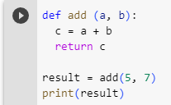
Functions

