Slide 1


Slide 2
AI-in-Action Heroes
Summer Academy Course offered by AISE program

Slide 3

Object-Oriented Features in Python

Slide 4
Object-Oriented Vs. Structured Paradigms
A programming paradigm determines the way the data and the processes are organized in the program.

Slide 5
Structured Programing
Processing
Input
Output

Slide 6
Structured Programing
Processing
Input
Output
Functions

Slide 7
Object-Oriented Paradigm

Slide 8
Object-Oriented Programming
Processing
Group the data and processes operating on them in one bundle
Data

Slide 9
Object-Oriented Programming
Methods
Group the data and processes operating on them in one bundle.
That bundle is called object
The data are called attributes / properties
The processing implemented in “methods”
Attributes
[OOP]Object

Slide 10
Object-Oriented Programming
-name: Alice
-dob: 1-1-2020
-gpa: 3.5
+ set/geGpa()
+ getAge()
Object :o1

Slide 11
Object-Oriented Programming
-name: Alice
-dob: 1-1-2020
-salary: 1000
-name: Bob
-dob: 1-2-2019
-salary: 1500
+ set/geSalary()
+ set/geSalary()
+ getAge()
+ getAge()
Object :o1
Object :o2

Slide 12
Object-Oriented Programming
Object :o1
-name
-dob
-salary
-name: Alice
-dob: 1-1-2020
-salary: 1000
+ set/getSalary()
+ getAge()
-name: Bob
-dob: 1-2-2019
-salary: 1500
Class Employee
[OOP] Class
A template for similar objects
[OOP] Instantiation
Creating an instance of a Class
Object :o2

Slide 13
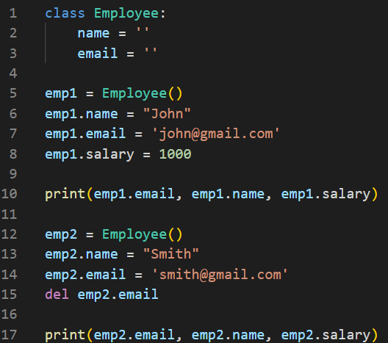
Class definition & Objects instantiation

Slide 14
Class definition & Objects instantiation
A new property is added to emp1 object
emp2 doesn’t have this property so this will give an error

Slide 15
Class definition & Objects instantiation
Sets the value back to the initial value
This doesn’t cause an error

Slide 16
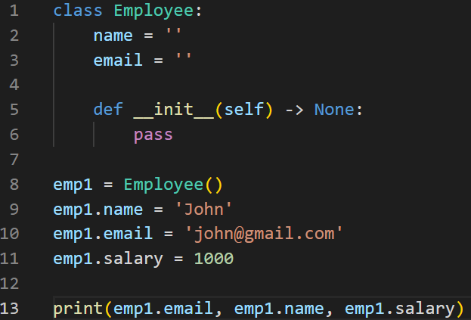
The __init__ built-in method
The built-in __init__ method is called automatically every time we create an instance of the class.
It has to have at least one parameter which is a reference to the object being created
‘self’ is just a name not a keyword, we can give it any other name
It containts the reference to the object

Slide 17
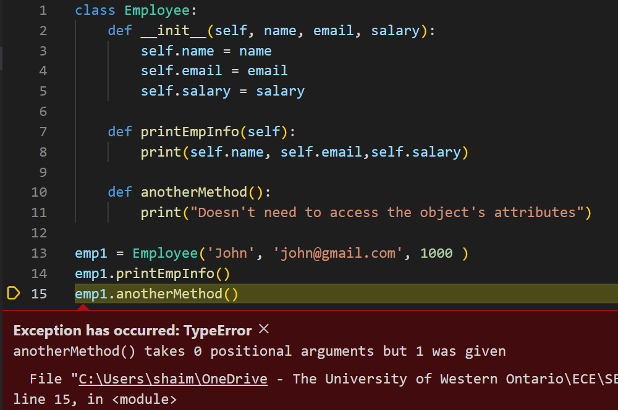
Defining Methods
When defining methods in the class we need to define the ‘self’ parameter even if it’s not needed in the body of the function

Slide 18
Python Modules & Libraries

Slide 19
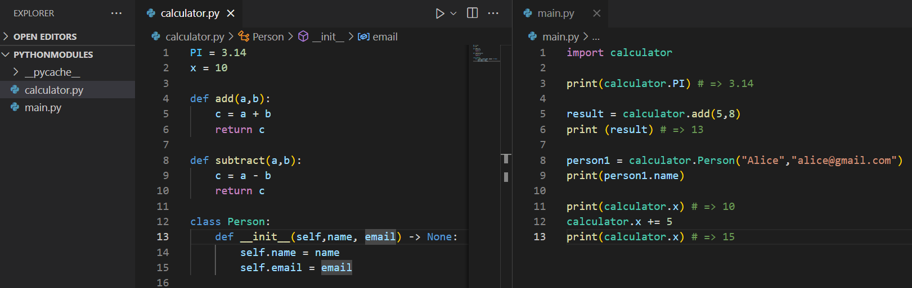
Python Modules
In Python a file is considered a module
The name of the file (without the .py extension) is the name of the module
Modules can be imported into other modules using the keyword ‘import’

Slide 20
Python Modules
In Python a file is considered a module
The name of the file (without the .py extension) is the name of the module
Modules can be imported into other modules using the keyword ‘import’
By importing a module we can have access to its content using the dot (.) operator following its name

Slide 21
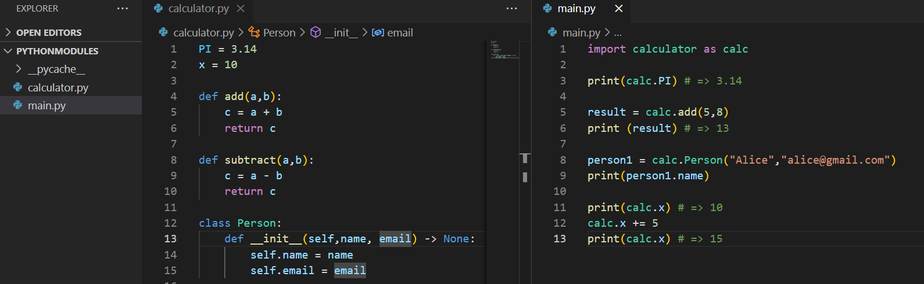
Python Modules
In Python a file is considered a module
The name of the file (without the .py extension) is the name of the module
Modules can be imported into other modules using the keyword ‘import’
Using the ‘as’ keyword we can define an alias for the module for convenience

Slide 22
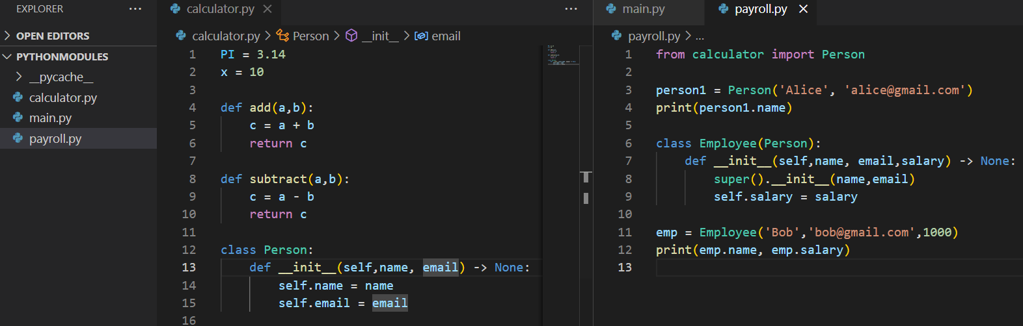
Python Modules
In Python a file is considered a module
The name of the file (without the .py extension) is the name of the module
Modules can be imported into other modules using the keyword ‘import’
We can import one (or more) element from the module and use there names directly without the dot (.) operator

Slide 23
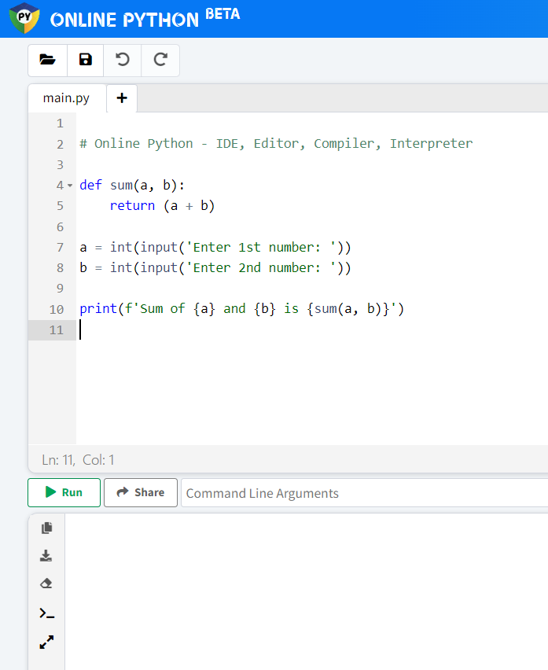
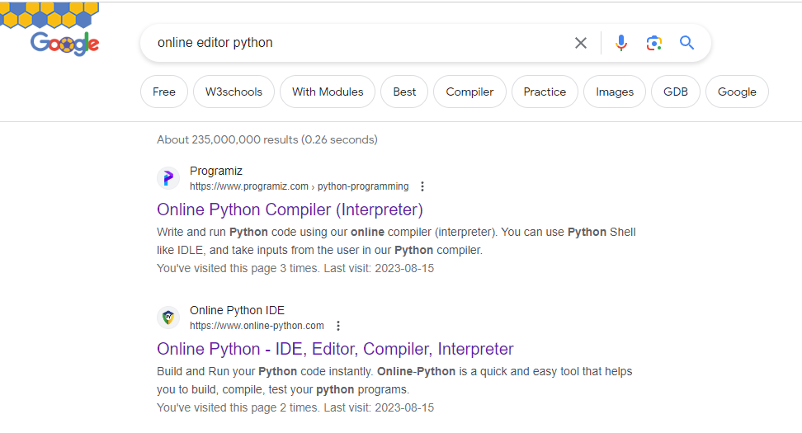
Let's use another editor for this exercise
Click here add a new file
Click here to execute the code

