Slide 1
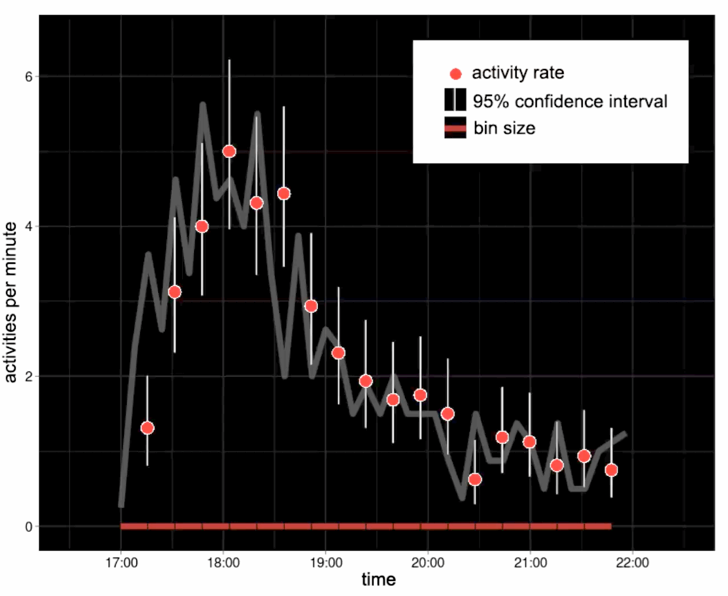
Confidence and bucket size

