Slide 1
AutoMR: Automated Marketing Research
Key buying factors and key competitor set
Paras Jain, Minha Hwang, Jay Shim
October 30, 2021

Slide 2
Project Details
Title
sentimental level analysis and key product attribute extraction
Goals
Automate the process of feature extraction and associated sentiment for marketing research
Amazon review data (2018)^{[1]}
Reviews (Data) duration: 23 years
Product focus: Digital Cameras
Survey data for cameras to be used as evaluation benchmark
[1] Ni, Jianmo, et al. “Justifying Recommendations Using Distantly-Labeled Reviews and Fine-Grained Aspects.” Proceedings of the 2019 Conference on Empirical Methods in Natural Language Processing and the 9th International Joint Conference on Natural Language Processing (EMNLP-IJCNLP), 2019, https://doi.org/10.18653/v1/d19-1018.

Slide 3
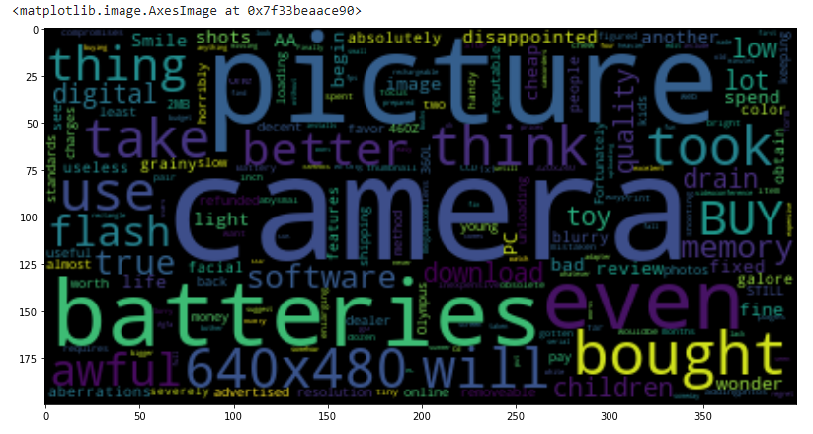
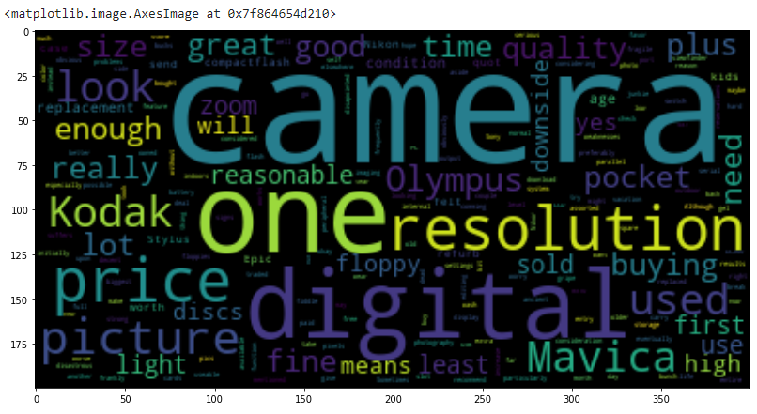
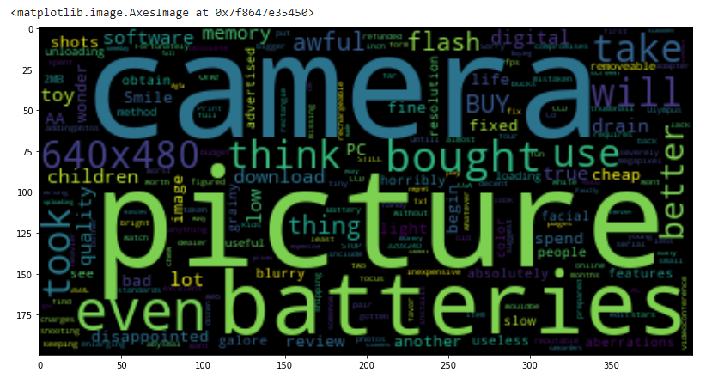
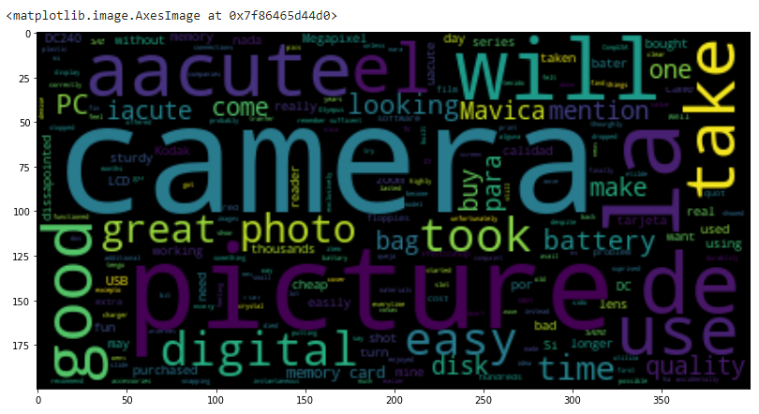
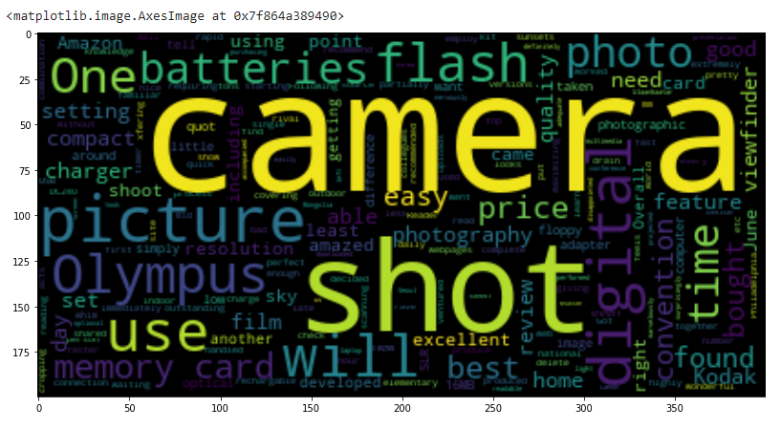
Findings
Questions?
Word cloud for different star ratings star ratings
picture quality very frequent across the board
Features of products generally found in nouns
e.g. battery life/picture quality
For sentiment analysis, using adjectives
e.g. disappointed, bad, awful, low

Slide 4
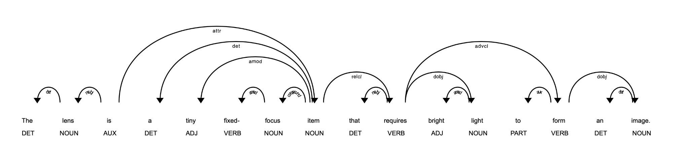

Slide 5
Questions?
Contact:
Jay Shim (jayshim0725@gmail.com)
Minha Hwang (minha.hwang@gmail.com)
Paras Jain (jain.paras@gmail.com)

