Slide 1

Sentence embedding and applications
Minha Hwang

Slide 2
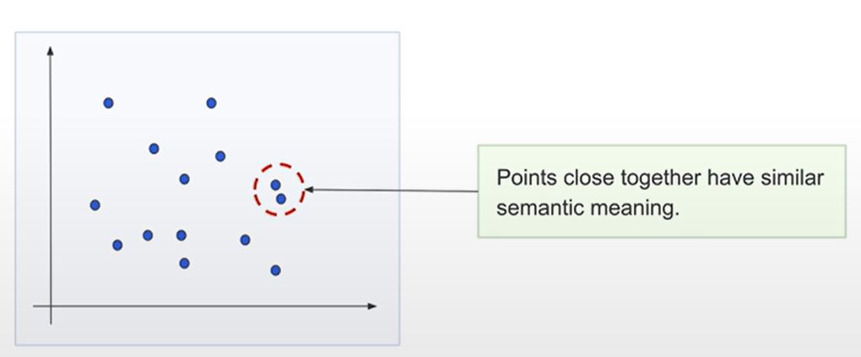
What are Vector Embedding?
Source: Deeplearning.ai – Embedding Models from Architecture to Implementation
https://learn.deeplearning.ai/courses/embedding-models-from-architecture-to-implementation

Slide 3
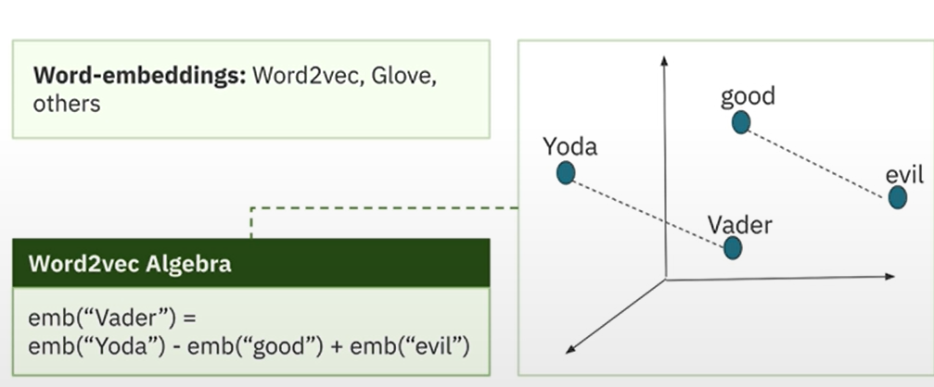
Word Embeddings
Source: Deeplearning.ai – Embedding Models from Architecture to Implementation
https://learn.deeplearning.ai/courses/embedding-models-from-architecture-to-implementation

Slide 4
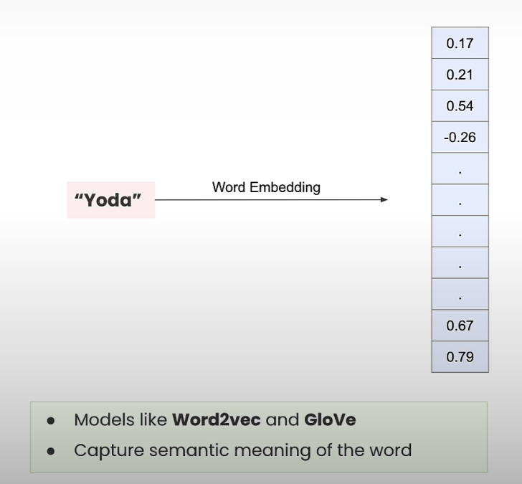
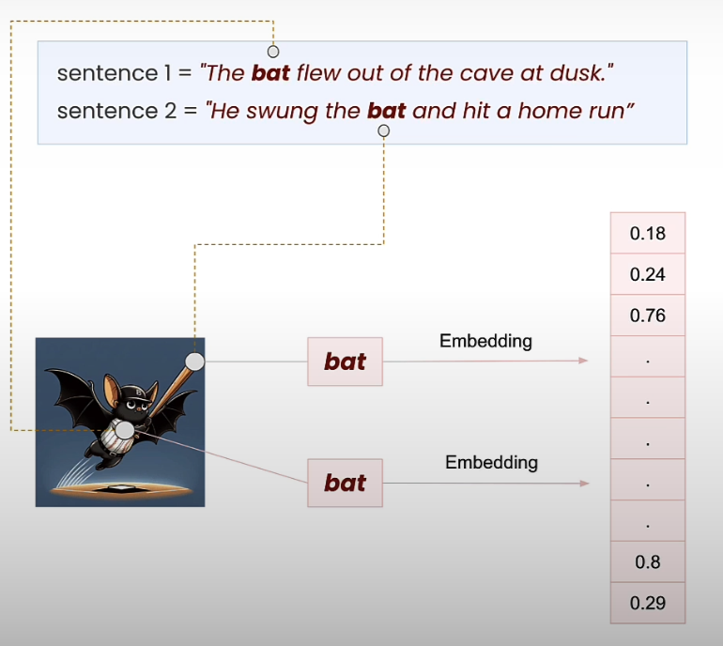
Problems with Word Embedding: Context are Lost!
Source: Deeplearning.ai – Embedding Models from Architecture to Implementation
https://learn.deeplearning.ai/courses/embedding-models-from-architecture-to-implementation

Slide 5
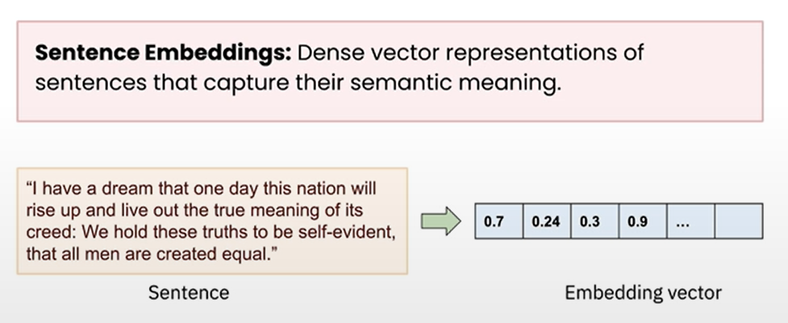
Sentence Embedding: Captures Semantic Meaning
Source: Deeplearning.ai – Embedding Models from Architecture to Implementation
https://learn.deeplearning.ai/courses/embedding-models-from-architecture-to-implementation

Slide 6
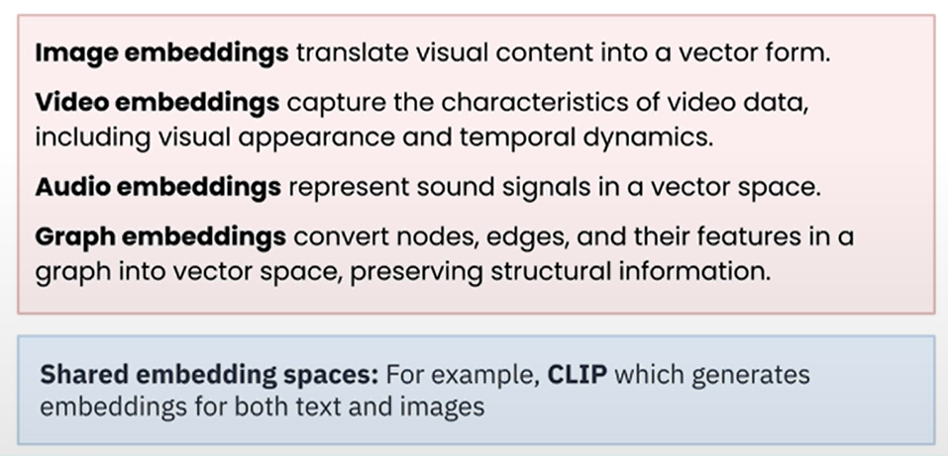
Embedding Vectors in Other Domains
Source: Deeplearning.ai – Embedding Models from Architecture to Implementation
https://learn.deeplearning.ai/courses/embedding-models-from-architecture-to-implementation

Slide 7
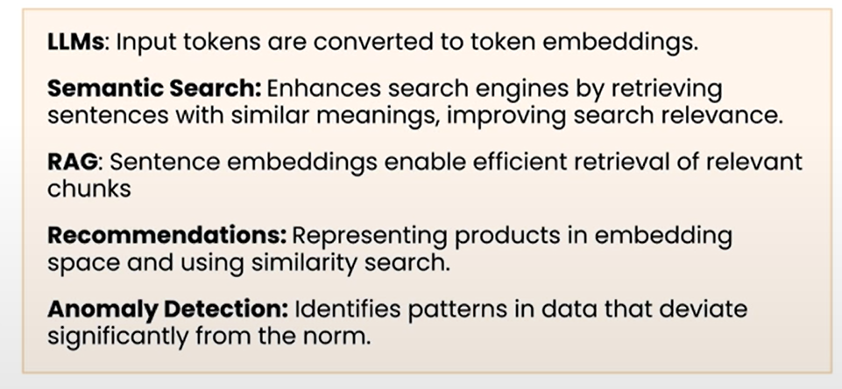
Applications of Embeddings
Source: Deeplearning.ai – Embedding Models from Architecture to Implementation
https://learn.deeplearning.ai/courses/embedding-models-from-architecture-to-implementation

Slide 8
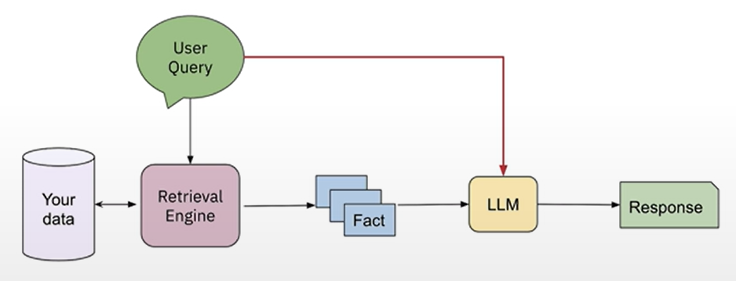
Sentence Embedding: Critical for RAG
Source: Deeplearning.ai – Embedding Models from Architecture to Implementation
https://learn.deeplearning.ai/courses/embedding-models-from-architecture-to-implementation

Slide 9
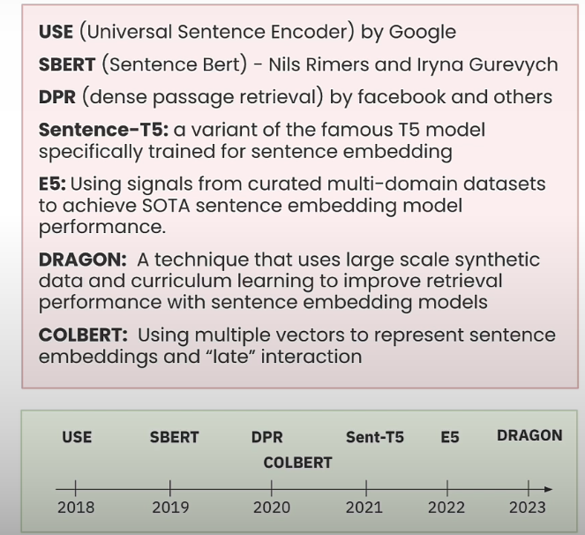
Sentence Embedding Models: SBERT, Short Sentence Transformer
Source: Deeplearning.ai – Embedding Models from Architecture to Implementation
https://learn.deeplearning.ai/courses/embedding-models-from-architecture-to-implementation

Slide 10
Demo
Online Metric: Semantic Reformulation
Topic Modeling: Query Clustering

