Slide 1
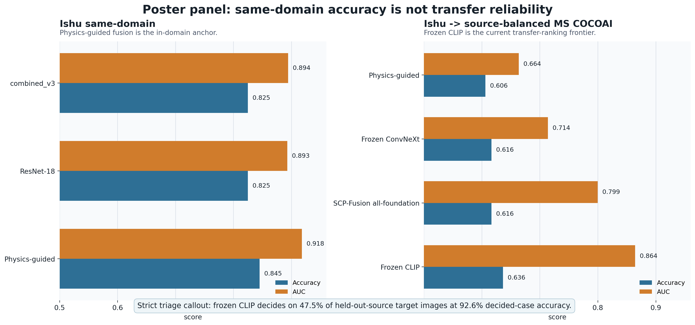
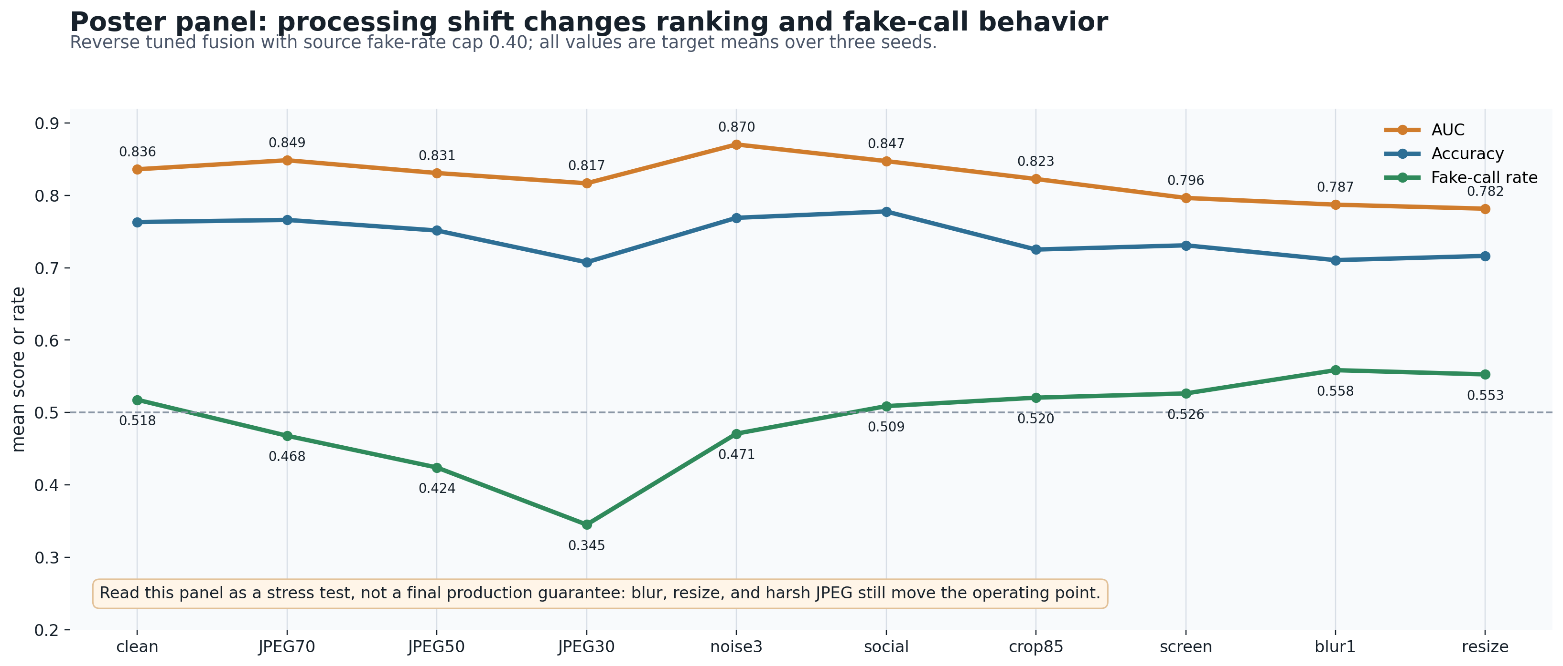
DFRWS POSTER DRAFT V2
When AI Image Detectors Travel
Source-heldout diagnostics for physical, neural, and frozen-encoder forensics
June 13, 2026
Key Evidence
What This Means
0.845 / 0.918
CLIP is the transfer frontier
The current strongest standalone cross-domain ranker is frozen CLIP, not score fusion.
Physics-guided Ishu
same-domain accuracy / AUC
Physics helps the anchor
0.636 / 0.864
Physics-guided ResNet improves the same-domain Ishu result and remains interpretable.
Frozen CLIP transfer
Ishu -> MS COCOAI accuracy / AUC
Triage is the forensic story
High-confidence two-threshold decisions are cleaner than forcing every image through 0.5.
47.5% @ 92.6%
Strict CLIP triage
Do not overclaim robustness
coverage / decided-case accuracy
JPEG30, blur, resize, and screenshots still move the operating point.
0.763 / 0.836
Reverse tuned fusion
best capped operating point
Next Paper-Critical Step
Run the full repeated-seed combined_v4 transfer check, then decide whether v4 joins the main method or stays an ablation.
Working claim: same-domain wins do not guarantee transfer reliability; ranking, calibration, fake-call rate, and triage split under source shift.
Sources: reports/assets/publication_core_results.csv; reports/dfrws_poster_native_figures_2026_06_13.md; public repo github.com/DrStrangel0ve/ai-image-forensics-comparison
Caveat: single-image photometric proxy, not true multi-light photometric stereo.

