Slide 1
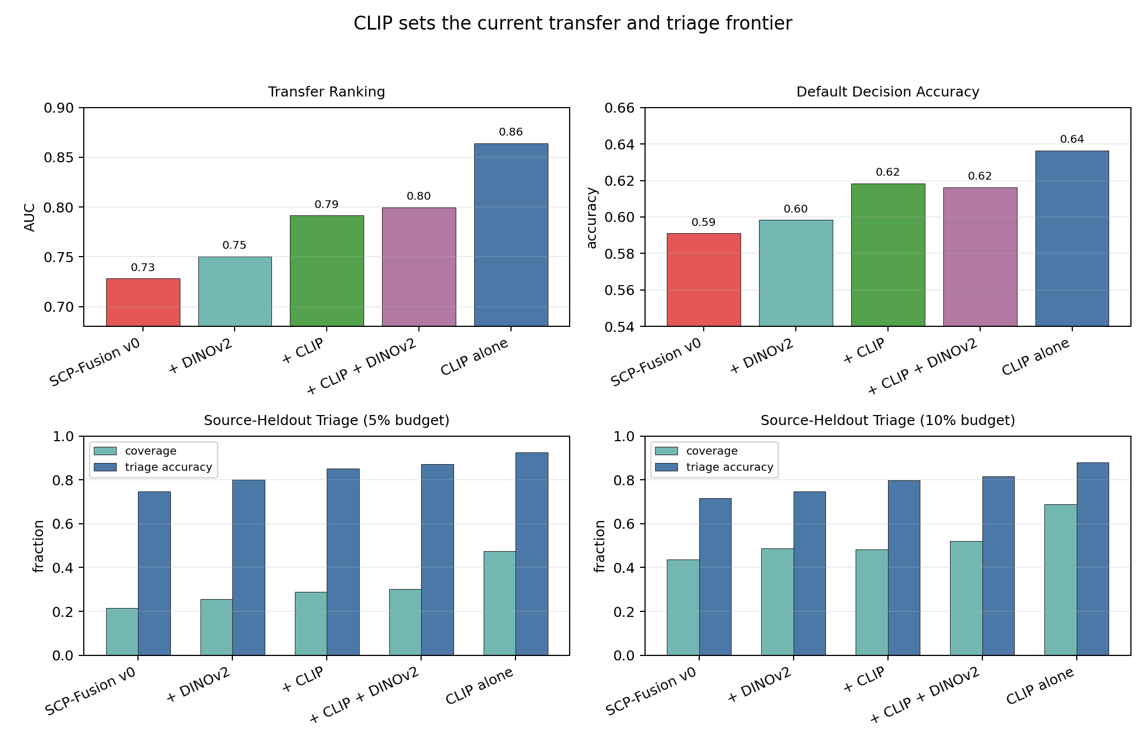
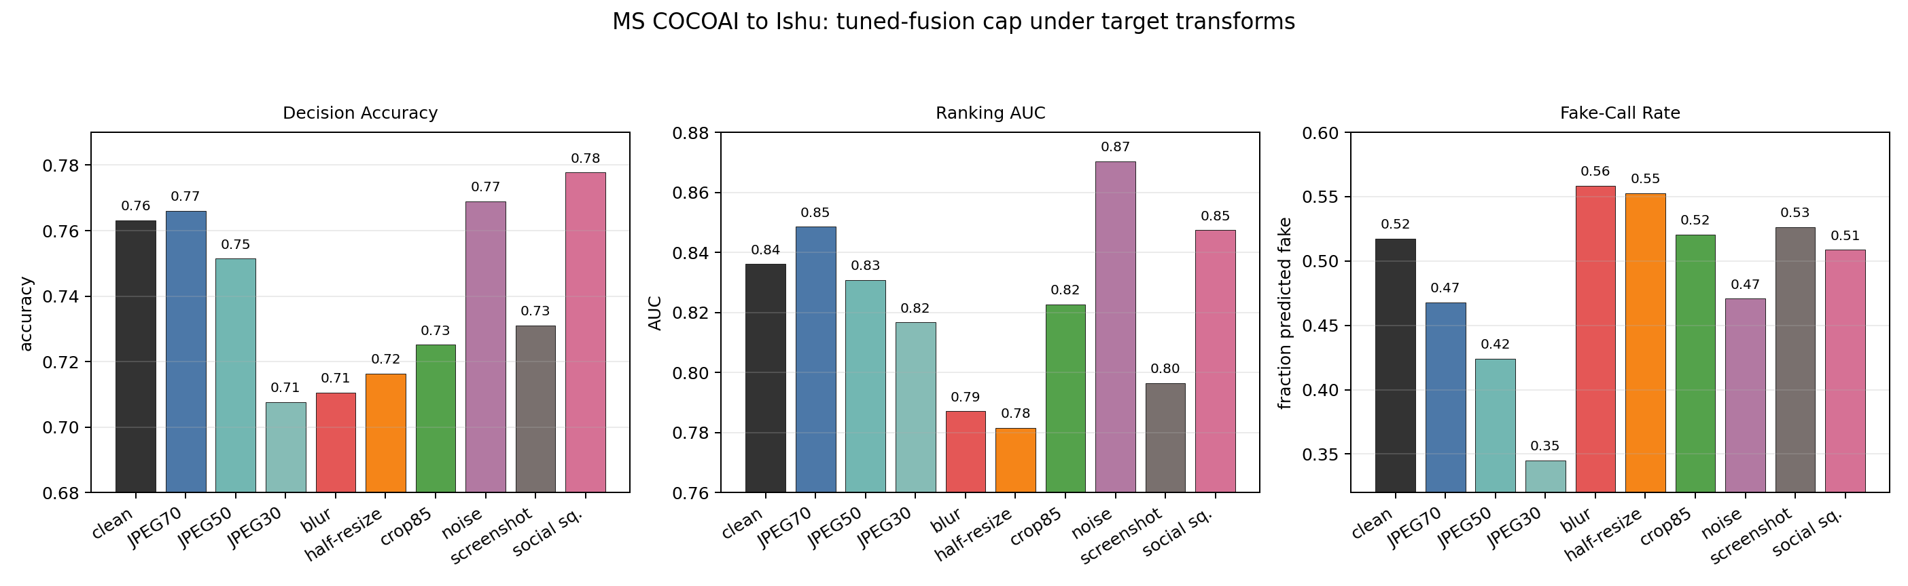
When AI Image Detectors Travel
DFRWS-USA 2026 poster draft
AI image forensics comparison
Source-heldout diagnostics for physical, neural, and frozen-encoder forensics
Same-domain accuracy is the warm-up. Under generator and processing shift, ranking, calibration, fake-call rate, and high-confidence triage separate.
KEY NUMBERS
TRANSFER FRONTIER: CLIP RANKS BEST, FUSION REMAINS DIAGNOSTIC
0.8450 / 0.9177
POSTER CLAIMS TO CARRY
physics-guided same-domain
Evaluate by source shift
beats combined_v3 and ResNet-18 on Ishu
Same-domain scores hide shifts in generator family, calibration, and default threshold behavior.
0.6363 / 0.8641
Use CLIP as the ranker to beat
CLIP transfer branch
Frozen CLIP is the current transfer frontier; SCP-Fusion should be framed as diagnostic, not leaderboard replacement.
strongest Ishu -> MS standalone ranker
47.5% @ 92.6%
Choose operating points explicitly
strict triage coverage / accuracy
Source fake-rate caps and triage thresholds make binary decisions more defensible than a universal 0.5 cutoff.
source-heldout 5% budget, CLIP branch
ROBUSTNESS: JPEG30, BLUR, RESIZE, AND SCREENSHOT SHIFT OPERATING POINTS
Keep robustness honest
0.7632 / 0.8361
JPEG30 under-calls generated images, while blur/resize/screenshot hurt ranking and calibration.
reverse tuned fusion cap
source fake-rate cap 0.40 balances decisions
Do not overclaim: the photometric branch is a single-image physical/signal proxy, not true multi-light photometric stereo.
Sources: reports/assets/publication_core_results.csv, reports/dfrws_poster_brief_2026_06_13.md, and checked-in publication figures. Repo: github.com/DrStrangel0ve/ai-image-forensics-comparison
Generated 2026-06-13

