Slide 1
Data Analytic Models
An Overview

Slide 2
Data Analytics - Business Values
Corrections
Reports
Diagnostic Analytics
Insight
Why did this happen?
Descriptive Analytics
Hindsight
What happened?
Recommends
Predicts
Predictive Analytics
Foresight
What will happen?
Prescriptive Analytics
Fore sight
How to make it happen?
Optimization

Slide 3
More on Predictive Analytics
Inference Specific Models
Predictive Only Models
Predictive Analytics
Foresight
What will happen?
Useful for interpretation of estimated weights
Useful for Prediction but may not be for interpretation
Flexible / Inflexible Models
Functional form convenience

Slide 4
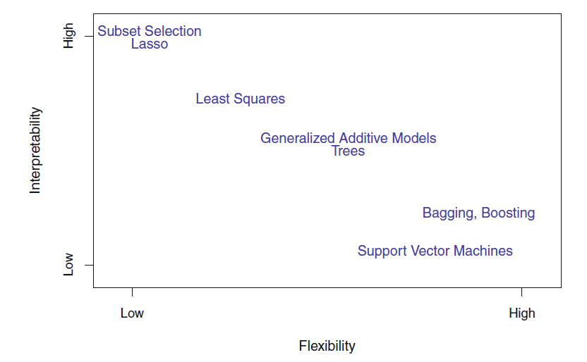
More on Predictive Analytics
Picture Courtesy:
An introduction to statistical learning
Hastie, T., Tibshirani, R., & Friedman, J. (2009).
p25

Slide 5
Road-map for Model Building
Set the objective
Interpretation / only prediction
Articulate a relation (function) between variables
Flexibility may be decided (Linearity Vs Non-Linear)
Build models (competing)
Understand the performance measures
Compare between competing models
Remark: We assume data is cleaned and structured
Essentially, all models are wrong, but some are useful. However, the approximate nature of the model must always be borne in mind - George Box (For more https://en.wikipedia.org/wiki/All_models_are_wrong)

Slide 6
Relations - Functions
Socioeconomic development through GDP per capita ~ infant mortality rate
Break even quantity ~ cost, sales
Volume created and sold ~ revenue, cost, and profit
Petrol and diesel prices ~ international market rates
Height ~ Weight (BMI)
Smoking ~ Alzheimer's disease
Smoking causes cancer
Enjoyment of a dinner ~ political identification and amount of wine consumed

Slide 7
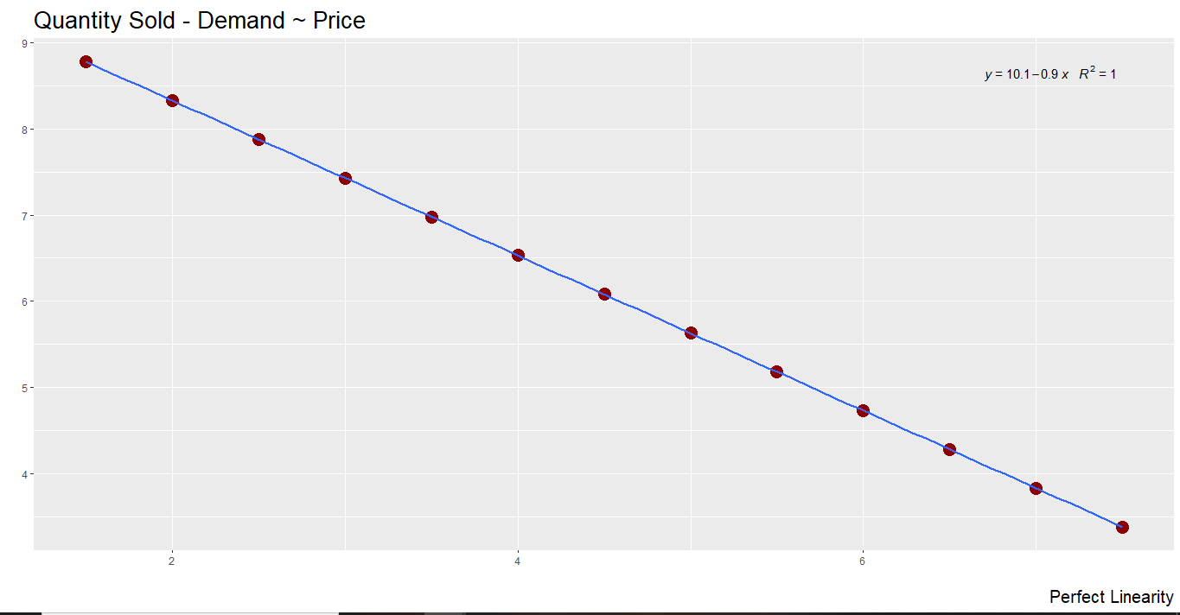
Relations - Functions

Slide 8
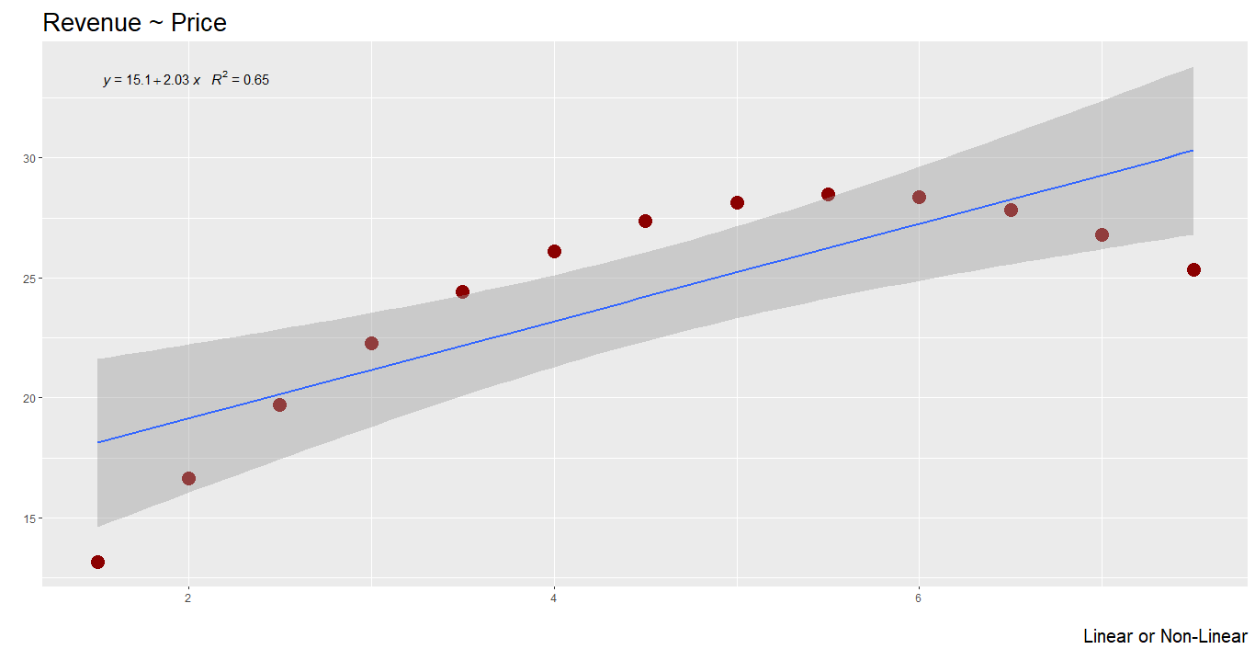
Relations - Functions

Slide 9
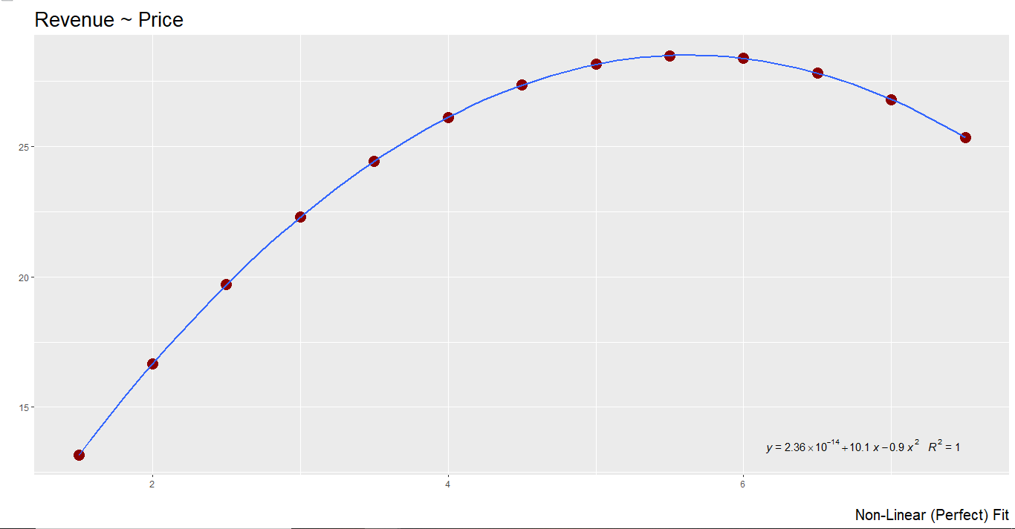
Relations - Functions

Slide 10
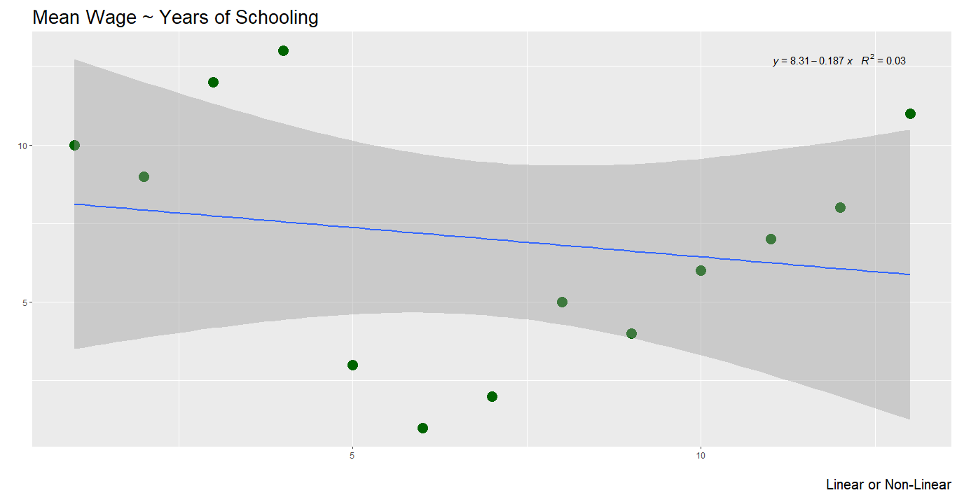
Relations - Functions

Slide 11
Functions - Competing Models
Descriptive Analytics
Hindsight
What happened?
A visual or symbolical relation indicates data support the intuitions or hypotheses or theory
Diagnostic Analytics
Insight
Why did this happen?
Direction and magnitude help to learn this process
Choices of Shape (linear / non-linear) can also be learnt
Predictive Analytics
Foresight
What will happen?
Recall
Task is to decide a model which "best" describes our problem
Essentially, all models are wrong, but some are useful. However, the approximate nature of the model must always be borne in mind - George Box (For more https://en.wikipedia.org/wiki/All_models_are_wrong)

Slide 12
Competing Models - Performance Measures
R²
MSE
Confusion matrix and derived quantities
Assumptions of LM
Information Criterions
Cross Validations

Slide 13
Inference - Prediction
Whole interest is to build a stochastic model y = f(x)
f(x) may be liner or non-linear
In general f(x) is an additive structure of predictive variables with some weights
y = f(x) = w₁x₁ + w₂x₂ + w₃x₃ + w₄x₄ +…………………………. + w_{k}x_{k}
Learning Algorithms help to "estimate" weights and / or f directly
Dependent / Response
Predictors
Question
Whether we are interested in learning about the weights or simply about f?

Slide 14
Inference From Models
Dependent / Response
Whole interest is to build a stochastic model y = f(x)
f(x) may be liner or non-linear
y = f(x) = w₁x₁ + w₂x₂ + w₃x₃ + w₄x₄ +…………………………………… + w_{k}x_{k}
In statistical inferential perspective, interest lies in estimating w₁, w₂,……w_{k} to know about population weights / coefficients
They provide information about population association between X and Y, both direction and magnitude
Also to learn about the statistical significance of these coefficients
Predictors

Slide 15
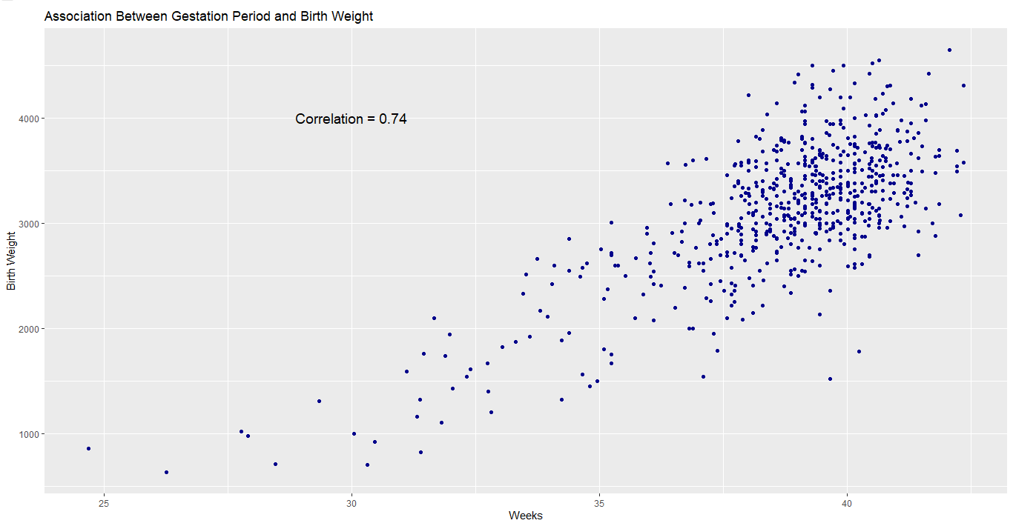
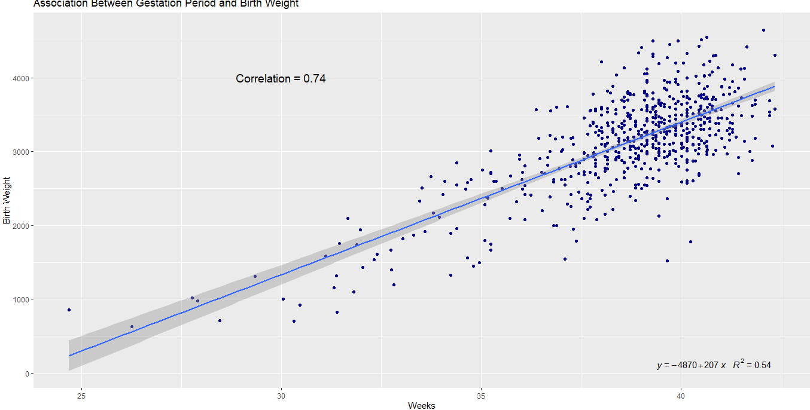
Inference From Models

Slide 16
Inference From Models
Model equation is
bweight = -4865.2 + 206.6 * gestwk and R² is 0.54
Interpretation
Coefficient of "gestwk": one week increase in gestwk will increase the mean "bweight" by 206.6 g
Plus sign indicates increment
Constant / Intercept: Initial week of gestation or when no gestation bweight is -4865.2

Slide 17
Inference From Models
What would be reason for such illogical interpretation?
Initial period of gestation may not be the right time to measure birth weight
Hence, "gestwk" = 0 is not a plausible value
Handling:
Centering - transform with a plausible value of the predictor, say its average
Subtract mean from each point of the predictor
Model with transformed variable
This will not alter the meaning / values of other measures

Slide 18
Inference From Models
Handling:
Centering: Subtract mean from each point of the predictor
First six values of actual and transformed predictor (gestwk)
Fit a model with this transformed variable
S No | Actual - gestwk | gestwk - mean(gestwk)
1 | 37.74 | -0.947
2 | 39.15 | 0.463
3 | 35.72 | -2.967
4 | 39.29 | 0.603
5 | 38.38 | -0.307
6 | 37.86 | -0.827

Slide 19
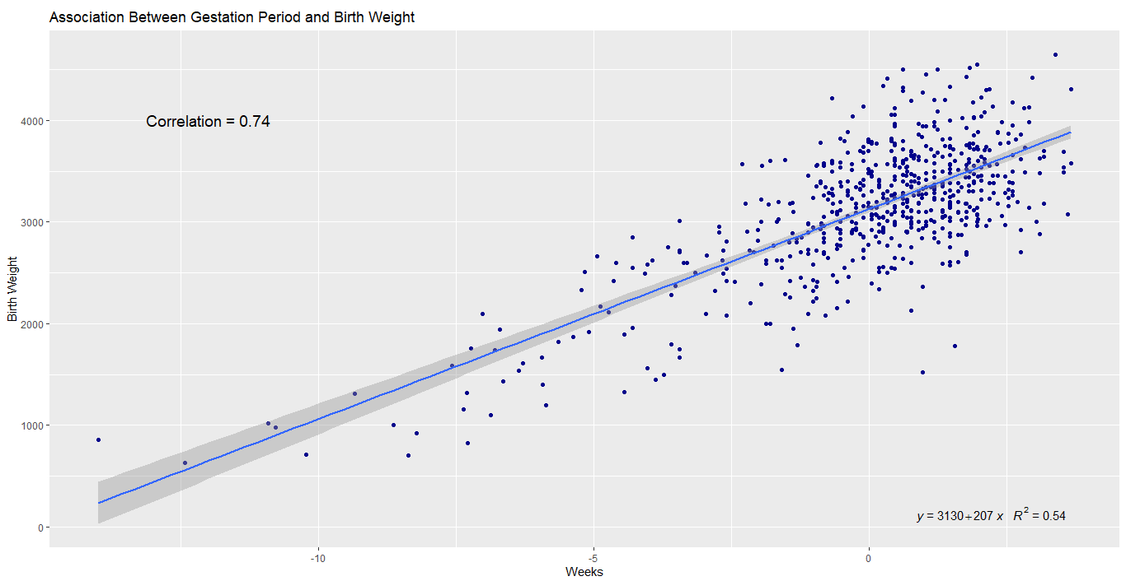
Inference From Models
No change in correlation, coefficient of predictor and R²

Slide 20
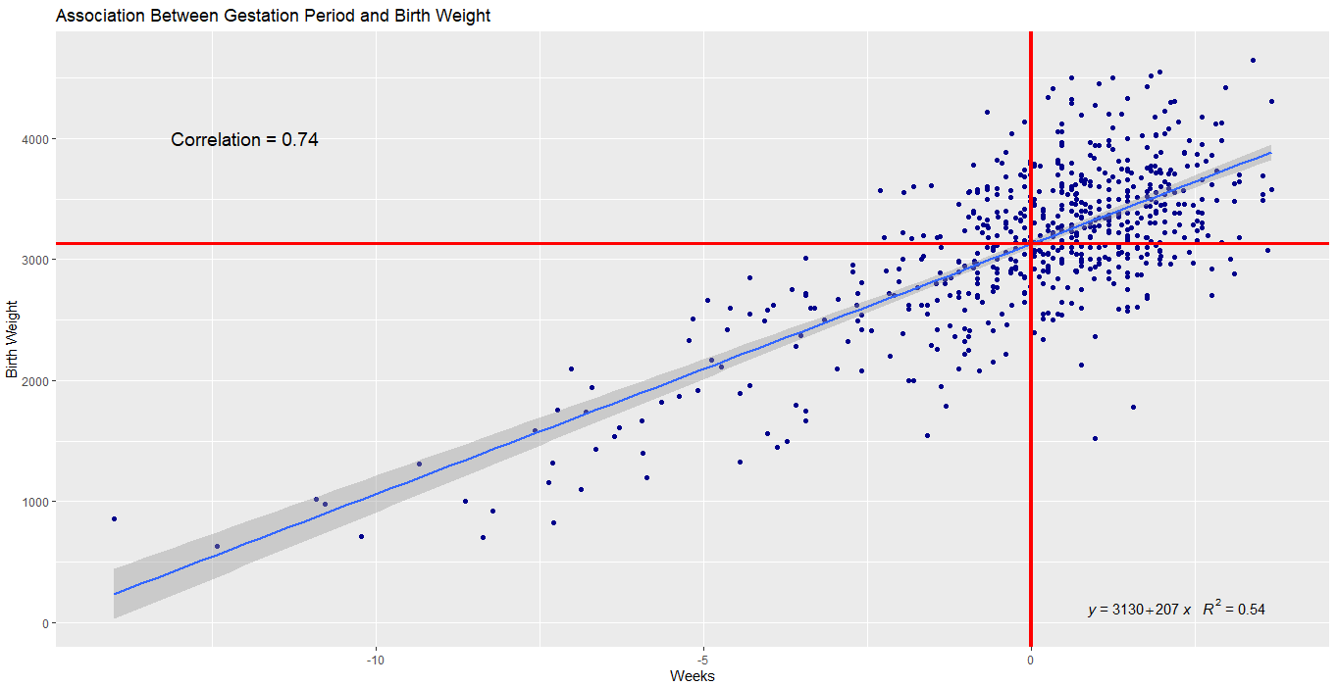
Inference From Models
Model equation is
bweight = 3130 + 206.6 * (gestwk - 38.687) and R² is 0.54
Interpretation
Coefficient of "gestwk": one week increase in gestwk will increase the mean "bweight" by 206.6 g
Plus sign indicates increment
Constant / Intercept: Average "bweight" when the "gestwk" is equal to its average value

Slide 21
Inference From Models
More than one numeric Predictors
Model equation is
bweight = 3129.14 + 206.55 * (gestwk - 38.687) + 3.808 *(matage - 33.972)
Interpretation
Constant / Intercept:
Average bweight is 3129.14 when gestwk and matage are in their average value
Coefficient of "gestwk":
Average bweight of will increase by 206.55 g for one unit increase of gestwk and matage is kept constant
Coefficient of "matage":
Average bweight of will increase by 3.808 g for one unit increase of matageand gestwk is kept constant

Slide 22
Inference From Models
We shall add a categorical Predictor
Recall: Levels of such variables - Dichotomous / Polychotomous
Interpretation of estimate of the regression coefficients of such variables will differ compared to numerical predictors
One of the levels will be considered Reference or Base level
way to declare this would be s/w specific; however, options may be provided to change / fix base level
Regression coefficients will indicate the effective changes in the mean of response when the levels are compared with base level
Changes in the predictor: Level of the variable is changed from base level

Slide 23
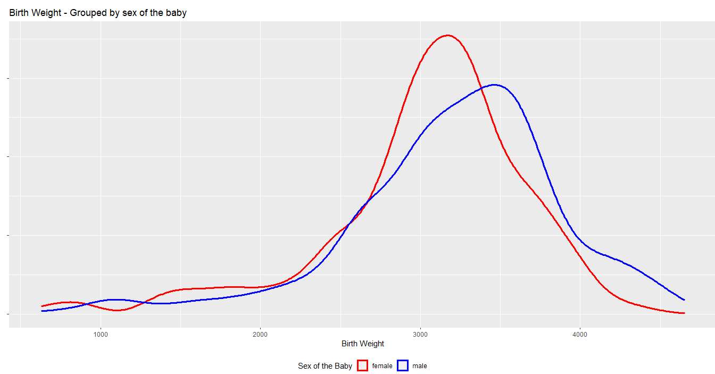
Inference From Models

Slide 24
Inference From Models
Categorical Predictors
Model equation is
bweight = 3044.13 + 167.15 * sexmale
Female is base level
Interpretation
Constant / Intercept:
Average bweight of female is 3044.13 (reference level)
Coefficient of "sexmale":
Average bweight of male babies will increase by 167.15 g compared to female babies (base level)
Plus sign indicates increment

Slide 25
Inference From Models
Categorical Predictors
Model equation is
bweight = 3044.13 + 167.15 * sexmale
Female is base level
More Observations
Mean bweight of male group: 3211.279
Mean bweight of female group: 3044.127
Difference: 3211.279 - 3044.127 = 167.152
Regression coefficient measures difference in mean of the response variable (bweight) between the two levels of categorical predictor

Slide 26
Inference From Models
Categorical Predictor (Polychotomous)
Model equation is
bweight = 3102.33 + 35.42*matagegp2 + 30.56*matagegp3 + 10.30*matagegp4
matagegp1 is base level
More Observations
Mean bweight of matagegp1 group: 3102.33
Mean bweight of matagegp2 group: 3102.33 + 35.42
Mean bweight of matagegp3 group: 3102.33 + 30.56
Mean bweight of matagegp4 group: 3102.33 + 10.30
Regression coefficient measures difference in mean of the response variable (bweight) between the two levels of categorical predictor

Slide 27
Inference From Models
Categorical & Numeric Predictors
Model equation is
bweight = 3046.90 + 206.445 * (gestwk - 38.687) + 161.71 * sexmale
Female is base level
Interpretation
Constant / Intercept:
when the "gestwk" is equal to its average value, average bweight of female is 3046.90 and average bweight of male is 3208.601 (3046.90 + 161.71)
Coefficient of "sexmale":
Average bweight of male babies will increase by 161.71 g compared to female babies (base level), when gestwk is constant
Coefficient of "gestwk":
Average bweight will increase by 206.445 g , when gestwk is increased by one unit and sex is kept constant

Slide 28
Inference From Models
Statistical Significance of a coefficient in a model
Recall: Statistical test of hypotheses
Here, the interest is whether the relation between response and predictor in the "population" is statistically significant
So the hypotheses are
Null: Coefficients = zero Vs Alternate: Coefficients ≠ zero
Decision can be made with p-values
Equally, checking the confidence interval "covers" zero
If CI does not include zero, then the association is significant

Slide 29
Best Fit Models
Measure 1: MSE
Find Error: computed for Response (bweight)
Actual - Fitted
Fitted: obtained from the "fitted" model (equation)
Square these errors
Find mean of these squared errors - Mean Squared Error
Least is desired (among competing models)

Slide 30
Best Fit Models
Measure 2: R² - Coefficient of determination
How best model explains the variability of response by the predictor
R-squared is always between 0 and 1
0: the model explains none of the variability of the response data around its mean
1: the model explains all the variability of the response data around its mean

Slide 31
Predictive Only Models
How this differs from previous?
Explicit functional relation is not desired
Statistical inference part is not included
However, measures for "best fit" are essential
This would indicate "better" predictive power of a model

Slide 32
Final Note
How Prediction Power is determined?
General intention of predictive power
Data
Learning
Model
Predicting "unseen" data with minimum errors
Practically, getting new "unseen" data may not be straightforward, in many situations
Hence, two data sets will be created from the sample
one to learn (Training sample)
Another one is to Predict (Testing Sample)

