Slide 1
Design of the GraphBLAS API for C
Aydin Buluç (LBNL), Tim Mattson (Intel), Scott McMillan (SEI-CMU), José Moreira (IBM), Carl Yang (UC, Davis)

Slide 2
The GraphBLAS C API

Slide 3
The Graph BLAS Forum
graphblas.org
“The Graph BLAS Forum is an open effort to define standard building blocks for graph algorithms in the language of linear algebra.”
On the website, you will find information on people, mathematical background, related projects, conferences/workshops of interest …
AND Version 1.0 of the C language GraphBLAS API which is being released at this workshop!
Brought to you by the GraphBLAS C API subcommittee

Slide 4
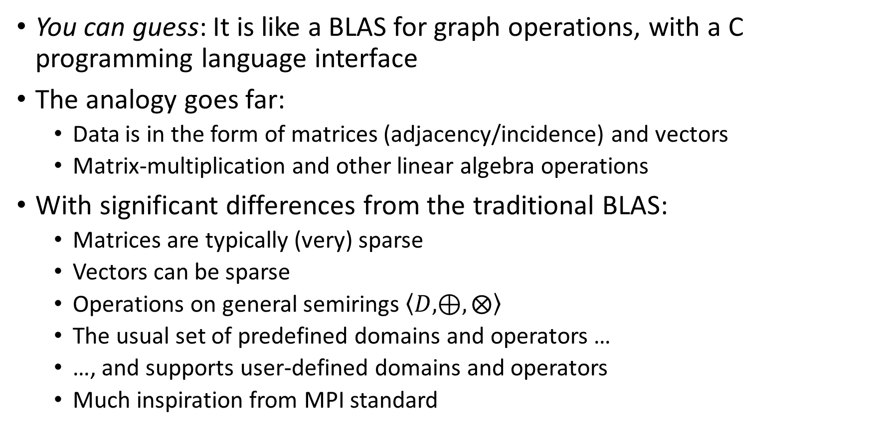
What is the GraphBLAS C API?
You can guess: It is like a BLAS for graph operations, with a C programming language interface
The analogy goes far:
Data is in the form of matrices (adjacency/incidence) and vectors
Matrix-multiplication and other linear algebra operations
With significant differences from the traditional BLAS:
Matrices are typically (very) sparse
Vectors can be sparse
Operations on general semirings $\left\langle D,⊕,⨂\right\rangle$
The usual set of predefined domains and operators …
…, and supports user-defined domains and operators
Much inspiration from MPI standard

Slide 5
Why start with a C API?
If you can make a usable interface in C, it only improves from there ☺
C interfaces can be easily called from other, higher level languages such as C++, Fortran, Java, Python …
What we require:
C99-compliant language support
C11’s “_Generic”-like support for type polymorphism
A nonpolymorphic version of the interface is also defined

Slide 6
Design principles of the GraphBLAS C API
Object-oriented
All objects are opaque, represented by handles
Only GraphBLAS methods can manipulate those objects
Separation of data (matrices and vectors) and operations
Only explicitly defined elements of a matrix or vector have values
The “structural zeros” are undefined
Any matrix/vector can be used with any semiring of compatible domain
Semantics are defined so that the “zero” value does not matter (most of time)
Blocking and nonblocking modes
Blocking: each method completes before returning
Nonblocking: methods may return early (must verify correctness of call)
Facilitated by opaqueness of objects
Procedural specification
Semantics of each method is defined through process to compute output
Any implementation that produces the same output is conforming

Slide 7
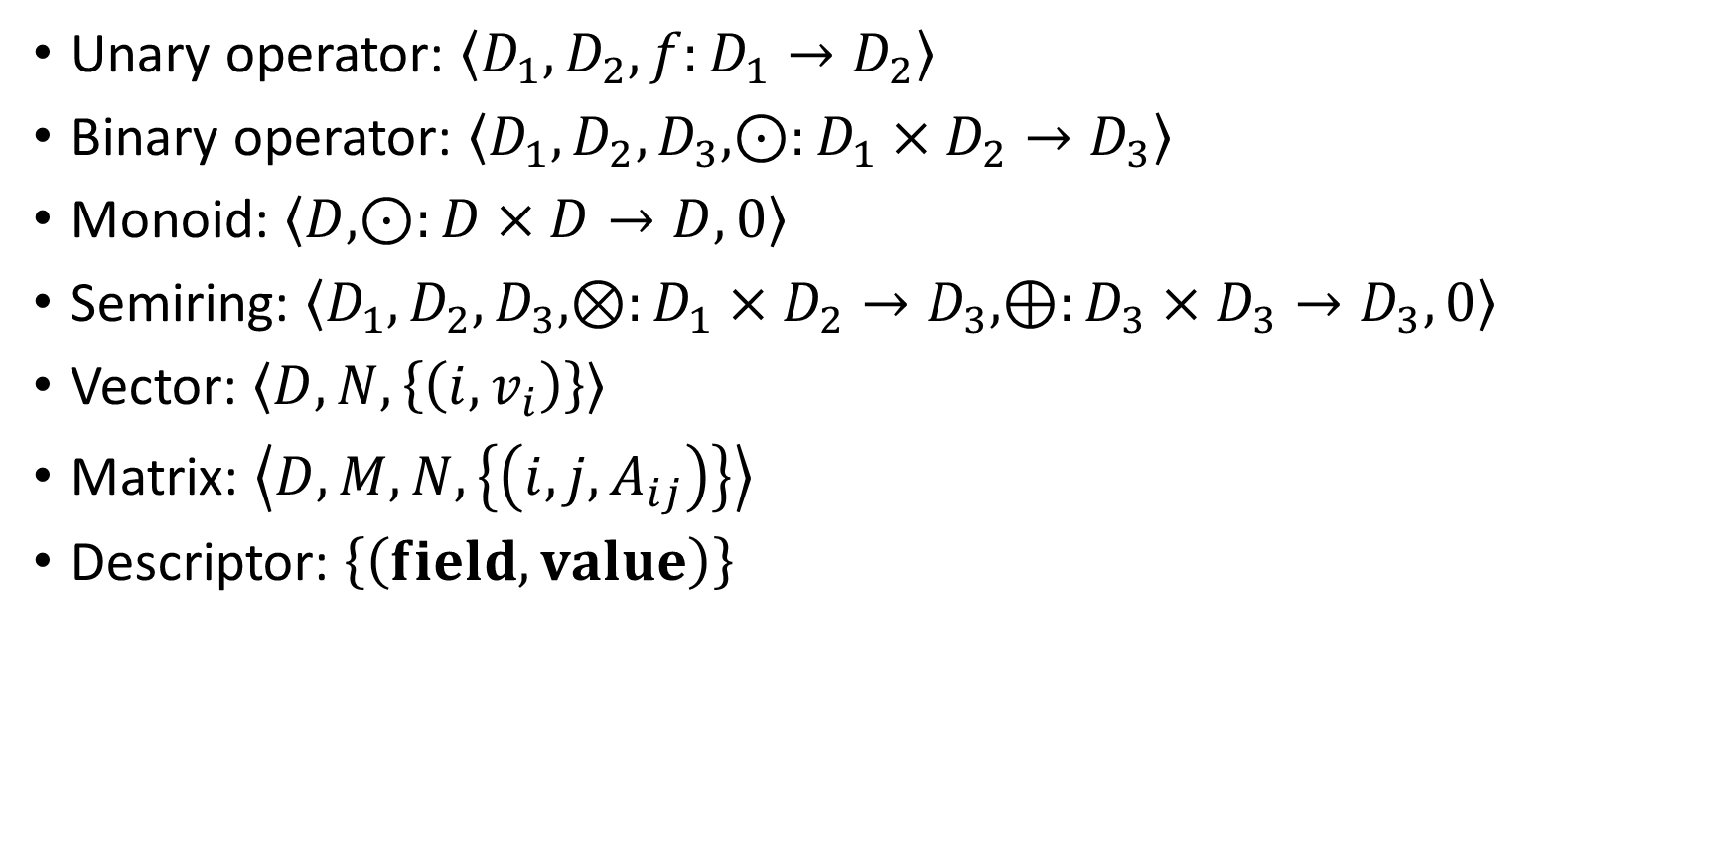
Objects
Unary operator: $\left\langle D_{1},D_{2},f:D_{1}→D_{2}\right\rangle$
Binary operator: $\left\langle D_{1},D_{2},D_{3},⊙:D_{1}×D_{2}→D_{3}\right\rangle$
Monoid: $\left\langle D,⊙:D×D→D,0\right\rangle$
Semiring: $\left\langle D_{1},D_{2},D_{3},⊗:D_{1}×D_{2}→D_{3},⊕:D_{3}×D_{3}→D_{3},0\right\rangle$
Vector: $\left\langle D,N,\left\{\left(i,v_{i}\right)\right\}\right\rangle$
Matrix: $\left\langle D,M,N,\left\{\left(i,j,A_{ij}\right)\right\}\right\rangle$
Descriptor: $\left\{\left(field,value\right)\right\}$

Slide 8
GraphBLAS methods: The math
Operation | Mathematical Description | Outputs | Inputs
mxm | C⟨¬M⟩ ⊕= A^{T} ⊕.⊗ B^{T} | C | ¬, M, ⊕, A, T, ⊕.⊗, B, T
mxv vxm | c⟨¬m⟩ ⊕= A^{T} ⊕.⊗ b c^{T}⟨¬m^{T}⟩ ⊕= b^{T} ⊕.⊗ A | c c | ¬, m, ⊕, A, T, ⊕.⊗, b ¬, m, ⊕, A, T, ⊕.⊗, b
eWiseMult | C⟨¬M⟩ ⊕= A^{T} ⊗ B^{T} c⟨¬m⟩ ⊕= a ⊗ b | C c | ¬, M, ⊕, A, T, ⊗, B, T ¬, m, ⊕, a, ⊗, b
eWiseAdd | C⟨¬M⟩ ⊕= A^{T} ⊕ B^{T} c⟨¬m⟩ ⊕= a ⊕ b | C c | ¬, M, ⊕, A, T, ⊕, B, T ¬, m, ⊕, a, ⊕, b
reduce (row) | c⟨¬m⟩ ⊕= ⊕_{j} A^{T}(:,j) | c | ¬, m, ⊕, A, T, ⊕
apply | C⟨¬M⟩ ⊕= f(A^{T}) c⟨¬m⟩ ⊕= f(a) | C c | ¬, M, ⊕, A, T, f ¬, m, ⊕, a, f
transpose | C⟨¬M⟩ ⊕= A^{T} | C | ¬, M, ⊕, A (T)
extract | C⟨¬M⟩ ⊕= A^{T}(i,j) c⟨¬m⟩ ⊕= a(i) | C c | ¬, M, ⊕, A, T, i, j ¬, m, ⊕, a, i
assign | C⟨¬M⟩ (i,j) ⊕= A^{T} c⟨¬m⟩ (i) ⊕= a | C c | ¬, M, ⊕, A, T, i, j ¬, m, ⊕, a, i
S. McMillan, et al., “Design and Implementation of the GraphBLAS Template Library (GBTL),” SIAM Annual Meeting (AN16), July 2016.
Notation: i,j – index arrays, v – scalar array, m – 1D mask, other bold-lower – vector (column), M – 2D mask, other bold-caps – matrix,
T – transpose, ¬ - structural complement, ⊕ monoid/binary function, ⊕.⊗ semiring, blue – optional parameters, red – optional modifiers

Slide 9
Matrix multiplication as parallel multiple source traversal
1
2
→
4
5
7
3
6
A^{T}
B
A^{T} • B
Sparse array representation => space efficient
Sparse matrix-matrix multiplication => work efficient
Three possible levels of parallelism: searches, vertices, edges
Highly-parallel implementation for Betweenness Centrality – A metric of the importance of a vertex, based on the fraction of shortest paths that go through it

Slide 10

General form of GraphBLAS operations
$$C\left\langle M\right\rangle =C⊙(A^{T}⨁.⨂B^{T})$$
$$Gr{B_Info}_{} GrB_mxm(C,M,⊙,\left\langle D,⊗,⊕\right\rangle ,A,B,desc)$$
status
Descriptor:
Transpose A and/or B
Complement mask
Replace/preserve output
Input matrices
Semiring (operation)
Output accumulation operator
Output mask
Output matrix

Slide 11
Common elements in (most) method calls
GrB_ “namespace”
Destination object is the first parameter
Mask and accumulation operator are next
Pass GrB_NULL if no mask or accumulation desired
Descriptor is optional and is always last (or use GrB_NULL)

Slide 12
Betweenness centrality in GraphBLAS C API (preliminaries)
#include "GraphBLAS.h"
GrB_Info BC_update(GrB_Vector *delta, GrB_Matrix A, GrB_Index *s, GrB_Index nsver)
{
GrB_Index n;
GrB_Matrix_nrows(&n, A); // n = # of vertices in graph
GrB_Vector_new(delta,GrB_FP32,n); // Vector<float> delta(n)
GrB_Monoid Int32Add; // Monoid <int32_t,+,0>
GrB_Monoid_new(&Int32Add,GrB_INT32,GrB_PLUS_INT32,0);
GrB_Semiring Int32AddMul; // Semiring <int32_t,int32_t,int32_t,+,*,0>
GrB_Semiring_new(&Int32AddMul,Int32Add,GrB_TIMES_INT32);
GrB_Descriptor desc_tsr; // Descriptor for BFS phase mxm
GrB_Descriptor_new(&desc_tsr);
GrB_Descriptor_set(desc_tsr,GrB_INP0,GrB_TRAN); // transpose of the adjacency matrix
GrB_Descriptor_set(desc_tsr,GrB_MASK,GrB_SCMP); // structural complement of the mask
GrB_Descriptor_set(desc_tsr,GrB_OUTP,GrB_REPLACE); // clear output before result is stored
…
Notes:
The forward sweep performs multiple simultaneous
breadth-first search traversals (one for each source vertex) and keeps track
of the number of independent shortest paths that reach every vertex from
the source.

Slide 13
Betweenness centrality in GraphBLAS C API (BFS phase)
...
GrB_Matrix frontier; // current frontier – values are path counts.
GrB_Matrix_new(&frontier, GrB_INT32, n, nsver); // Initialized: neighbors of each source
GrB_extract(&frontier,numsp,GrB_NULL,A,GrB_ALL,n,s,nsver,desc_tsr);
GrB_Matrix *sigmas = malloc(sizeof(GrB_Matrix)*n); // n is an upper bound on diameter
int32_t d = 0; // d is BFS level number
int32_t nvals = 0; // nvals == 0 when BFS phase is complete
do {
GrB_Matrix_new(&(sigmas[d]), GrB_BOOL, n, nsver); // sigmas[d](:,s) = d-th level frontier from source vertex s
GrB_apply(sigmas[d],GrB_NULL,GrB_NULL,GrB_IDENTITY_BOOL,frontier,GrB_NULL);
GrB_eWiseAdd(numsp,GrB_NULL,GrB_NULL,Int32Add,numsp,frontier,GrB_NULL); // numsp += frontier (path counts)
GrB_mxm(frontier,numsp,GrB_NULL,Int32AddMul,A,frontier,desc_tsr); // f<!numsp> = A' +.* f (update frontier)
GrB_Matrix_nvals(&nvals,frontier)
d++;
} while (nvals);
…
Notes:
The forward sweep performs multiple simultaneous
breadth-first search traversals (one for each source vertex) and keeps track
of the number of independent shortest paths that reach every vertex from
the source.

Slide 14
Betweenness centrality in GraphBLAS C API (BFS phase)
...
GrB_Matrix frontier; // current frontier – values are path counts.
GrB_Matrix_new(&frontier, GrB_INT32, n, nsver); // Initialized: neighbors of each source
GrB_extract(&frontier,numsp,GrB_NULL,A,GrB_ALL,n,s,nsver,desc_tsr);
GrB_Matrix *sigmas = malloc(sizeof(GrB_Matrix)*n); // n is an upper bound on diameter
int32_t d = 0; // d is BFS level number
int32_t nvals = 0; // nvals == 0 when BFS phase is complete
do {
GrB_Matrix_new(&(sigmas[d]), GrB_BOOL, n, nsver); // sigmas[d](:,s) = d-th level frontier from source vertex s
GrB_apply(sigmas[d],GrB_NULL,GrB_NULL,GrB_IDENTITY_BOOL,frontier,GrB_NULL);
GrB_eWiseAdd(numsp,GrB_NULL,GrB_NULL,Int32Add,numsp,frontier,GrB_NULL); // numsp += frontier (path counts)
GrB_mxm(frontier,numsp,GrB_NULL,Int32AddMul,A,frontier,desc_tsr); // f<!numsp> = A' +.* f (update frontier)
GrB_Matrix_nvals(&nvals,frontier)
d++;
} while (nvals);
…
Transpose adjacency matrix
Complement the mask
Replace the output
Mask those nodes already visitedb
Use an integer arithmetic semiring
Notes:
The forward sweep performs multiple simultaneous
breadth-first search traversals (one for each source vertex) and keeps track
of the number of independent shortest paths that reach every vertex from
the source.

Slide 15
Betweenness centrality in GraphBLAS C API (Tally phase)
...
for (int i=d-1; i>0; i--)
{
GrB_eWiseMult(w,sigmas[i],GrB_NULL,FP32Mul,bcu,nspinv,desc_r); // w<sigmas[i]>=(1 ./ nsp).*bcu
// add contributions by successors and mask with that BFS level's frontier
GrB_mxm(w,sigmas[i-1],GrB_NULL,FP32AddMul,A,w,desc_r); // w<sigmas[i-1]> = (A +.* w)
GrB_eWiseMult(&bcu,GrB_NULL,GrB_PLUS_FP32,FP32Mul,w,numsp,GrB_NULL); // bcu += w .* numsp
}
// subtract "nsver" from every entry in delta (1 extra value per bcu element crept in)
GrB_assign(delta,GrB_NULL,GrB_NULL,-(float)nsver,GrB_ALL,n,GrB_NULL); // fill with -nsver
GrB_reduce(delta,GrB_NULL,GrB_PLUS_FP32,GrB_PLUS_FP32,bcu,GrB_NULL); // add all updates to –nsver
…
Notes:
The forward sweep performs multiple simultaneous
breadth-first search traversals (one for each source vertex) and keeps track
of the number of independent shortest paths that reach every vertex from
the source.

Slide 16
Betweenness centrality in GraphBLAS C API (Tally phase)
...
for (int i=d-1; i>0; i--)
{
GrB_eWiseMult(w,sigmas[i],GrB_NULL,FP32Mul,bcu,nspinv,desc_r); // w<sigmas[i]>=(1 ./ nsp).*bcu
// add contributions by successors and mask with that BFS level's frontier
GrB_mxm(w,sigmas[i-1],GrB_NULL,FP32AddMul,A,w,desc_r); // w<sigmas[i-1]> = (A +.* w)
GrB_eWiseMult(&bcu,GrB_NULL,GrB_PLUS_FP32,FP32Mul,w,numsp,GrB_NULL); // bcu += w .* numsp
}
// subtract "nsver" from every entry in delta (1 extra value per bcu element crept in)
GrB_assign(delta,GrB_NULL,GrB_NULL,-(float)nsver,GrB_ALL,n,GrB_NULL); // fill with -nsver
GrB_reduce(delta,GrB_NULL,GrB_PLUS_FP32,GrB_PLUS_FP32,bcu,GrB_NULL); // add all updates to –nsver
…
Contribution to previous frontier
Use a floating-point arithmetic semiring
Replace the output
Notes:
The forward sweep performs multiple simultaneous
breadth-first search traversals (one for each source vertex) and keeps track
of the number of independent shortest paths that reach every vertex from
the source.

Slide 17
Important concepts
Masks avoids computation and materialization of intermediate objects
The BC example shows how we both expand the current frontier and prune the previously discovered vertices via a single call to mxm (or vxm) using masks
All masks are “write” masks (they apply to the output as opposed to any intermediate product)
Any matrix/vector (not just Boolean) can be passed as a mask
Check the spec for the intricate semantics of mixing masks and accumulation
Sparsity of matrix/vector objects are not declarative (runtime determines storage)
Mixed-type arithmetic is achieved via either by the user specified semirings or by relying on the type casting abilities of the underlying language
All objects are opaque, but opaque ≠ undefined – that is, opaque objects need to be “defined” by the implementation

Slide 18
Implementations under development
GraphBLAS Template Library (Zhang et al.)
Integration of GraphBLAS C API with Gunrock (Wang et al.)
GraphBLAS in C99 (Cook)
GraphBLAS C API for IBM’s GPI (Ekanadham et al.)
GraphBLAS in Chapel (Azad et al.)

Slide 19
Conclusions
The GraphBLAS C API is the first language binding of the mathematical definition of GraphBLAS
Version 1.0 released
Object-oriented, consistent look-and-feel for all methods
Blocking/nonblocking modes, user-defined types will require exploration
Reference implementations under development
Optimization, benchmarking will follow

