Slide 1
A Hands-On Introduction to the GraphBLAS http://graphblas.org
≡
Scott McMillan
CMU/SEI
Tim Mattson
Intel Labs
Brought to you by the “GraphBLAS C Specification Gang” (of Five):
Aydın Buluç (LBNL), Tim Mattson (Intel), Scott McMillan (CMU/SEI) Jose Moreira (IBM), Carl Yang (UC Davis)
… and a special thank you to Tim Davis (Texas A&M) for GraphBLAS support in SuiteSparse

Slide 2
Notes
We had up to 16 people at the tutorial. Most stayed all the way from the beginning to the end.
the tutorial had a two hour block followed by a 90 minute block. We had only one hour to cover the last two sections (Breadth-first and connected components).
Scott prepared a survey for students to fill out … to provide us with feedback. The following is a summary of the survey results.
The were asked to rate on a scale of 1 to 5 how much they liked the tutorial. Here are our scores. (note: 11 people filled in the survey form)
Tutorial Content | 4.5
Exercises | 4.2
Materials/Handouts | 4.4
Notes on the scores:
“Exercises” had two threes, “Materials” had one three
Instructor Style and effectiveness | 4.6
Overall Satisfaction | 4.5
Scott’s perceptions about the “3’s” on “Exercises”: they were correlated with comments about problems compiling the exercises on OSX which I believe comes down to the OMP symbols in the SuiteSparse GraphBLAS library that Mac compiler system did not support
4 people said that the tutorial should be a full day
7 said they preferred the tutorial in C. 4 people mentioned python. as a potential language C++, Matlab, and Julia were also mentioned as languages to use instead of C.
100% of the respondents said they would recommend the tutorial to others.
4 said that cloud instances should be provided to make setup for the tutorial easier.

Slide 3
Copyright 2019 Carnegie Mellon University and Intel Corporation.
This material is based upon work funded and supported by the Department of Defense under Contract No. FA8702-15-D-0002 with Carnegie Mellon University for the operation of the Software Engineering Institute, a federally funded research and development center.
The view, opinions, and/or findings contained in this material are those of the author(s) and should not be construed as an official Government position, policy, or decision, unless designated by other documentation.
NO WARRANTY. THIS CARNEGIE MELLON UNIVERSITY AND SOFTWARE ENGINEERING INSTITUTE MATERIAL IS FURNISHED ON AN "AS-IS" BASIS. CARNEGIE MELLON UNIVERSITY MAKES NO WARRANTIES OF ANY KIND, EITHER EXPRESSED OR IMPLIED, AS TO ANY MATTER INCLUDING, BUT NOT LIMITED TO, WARRANTY OF FITNESS FOR PURPOSE OR MERCHANTABILITY, EXCLUSIVITY, OR RESULTS OBTAINED FROM USE OF THE MATERIAL. CARNEGIE MELLON UNIVERSITY DOES NOT MAKE ANY WARRANTY OF ANY KIND WITH RESPECT TO FREEDOM FROM PATENT, TRADEMARK, OR COPYRIGHT INFRINGEMENT.
[DISTRIBUTION STATEMENT A] This material has been approved for public release and unlimited distribution. Please see Copyright notice for non-US Government use and distribution.
This material may be reproduced in its entirety, without modification, and freely distributed in written or electronic form without requesting formal permission. Permission is required for any other use. Requests for permission should be directed to the Software Engineering Institute at permission@sei.cmu.edu.
DM19-0946

Slide 4
Outline
Graphs and Linear Algebra
The GraphBLAS C API and Adjacency Matrices
GraphBLAS Operations
Breadth-First Traversal
Connected Components

Slide 5

Understanding relationships between items
Graph: A visual representation of a set of vertices and the connections between them (edges).
0
1
6
3
4
2
5
Graph: Two sets, one for the vertices ($v$) and one for the edges ($e$)
$$v∈[0, 1, 2, 3, 4, 5, 6]$$
$$e∈[\left(0,1\right), \left(0,3\right), \left(1,4\right), \left(1,6\right), \left(2,5\right),\left(3,0\right),\left(3,2\right), \left(4,5\right), \left(5,2\right), \left(6,2\right), \left(6,3\right), (6,4)]$$

Slide 6
A graph as a matrix
Adjacency Matrix: A square matrix (usually sparse) where rows and columns are labeled by vertices and non-empty values are edges from a row vertex to a column vertex
To vertex (columns)
0
1
- | ★ | - | ★ | - | - | -
- | - | - | - | ★ | - | ★
- | - | - | - | - | ★ | -
★ | - | ★ | - | - | - | -
- | - | - | - | - | ★ | -
- | - | ★ | - | - | - | -
- | - | ★ | ★ | ★ | - | -
6
3
4
A =
From vertex (rows)
2
5
By using a matrix, I can turn algorithms working with graphs into linear algebra.
Notes:
You can turn them into semi-ring algebra.
Tim answers … No, its linear algebra. The semi-ring is the algebraic structure used when defining the domain and operations in the linear vector space.

Slide 7
A Directed graph as a matrix
Adjacency Matrix: A square matrix (usually sparse) where rows and columns are labeled by vertices and non-empty values are edges from a row vertex to a column vertex
To vertex (columns)
0
1
- | ★ | - | ★ | - | - | -
- | - | - | - | ★ | - | ★
- | - | - | - | - | ★ | -
★ | - | ★ | - | - | - | -
- | - | - | - | - | ★ | -
- | - | ★ | - | - | - | -
- | - | ★ | ★ | ★ | - | -
6
3
4
A =
From vertex (rows)
2
5
This is a directed graph (the edges have arrows)
Notes:
You can turn them into semi-ring algebra.
Tim answers … No, its linear algebra. The semi-ring is the algebraic structure used when defining the domain and operations in the linear vector space.

Slide 8
An Undirected graph as a matrix
Adjacency Matrix: A square matrix (usually sparse) where rows and columns are labeled by vertices and non-empty values are edges from a row vertex to a column vertex
To vertex (columns)
0
1
- | ★ | - | ★ | - | - | -
★ | - | - | - | ★ | - | ★
- | - | - | ★ | - | ★ | ★
★ | - | ★ | - | - | - | ★
- | ★ | - | - | - | ★ | ★
- | - | ★ | - | ★ | - | -
- | ★ | ★ | ★ | ★ | - | -
6
3
4
A =
From vertex (rows)
2
5
This is an undirected graph (no arrows on the edges) and the Adjacency matrix is symmetric
Notes:
You can turn them into semi-ring algebra.
Tim answers … No, its linear algebra. The semi-ring is the algebraic structure used when defining the domain and operations in the linear vector space.

Slide 9
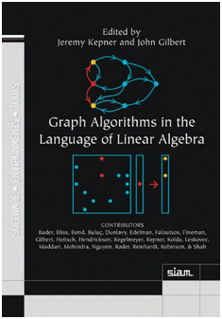
Graph Algorithms and Linear Algebra
Most common graph algorithms can be represented in terms of linear algebra.
This is a mature field … it even has a book.
Benefits of graphs as linear algebra
Well suited to memory hierarchies of modern microprocessors
Can utilize decades of experience in distributed/parallel computing from linear algebra in supercomputing.
Easier to understand … for some people.

Slide 10
How do linear algebra people write software?
They do so in terms of the BLAS:
The Basic Linear Algebra Subprograms: low-level building blocks from which any linear algebra algorithm can be written
BLAS 1 | Vector/vector | Lawson, Hanson, Kincaid and Krogh, 1979 | LINPACK
BLAS 2 | Matrix/vector | Dongarra, Du Croz, Hammarling and Hanson, 1988 | LINPACK on vector machines
BLAS 3 | Matrix/matrix | Dongarra, Du Croz, Hammarling and Hanson, 1990 | LAPACK on cache based machines
The BLAS supports a separation of concerns:
HW/SW optimization experts tuned the BLAS for specific platforms.
Linear algebra experts built software on top of the BLAS ... high performance “for free”.
It is difficult to over-state the impact of the BLAS … they revolutionized the practice of computational linear algebra.

Slide 11
GraphBLAS: building blocks for graphs as linear algebra
Basic objects
Matrix, vector, algebraic structures, and ”control objects”
Fundamental operations over these objects
Element-wise operations (eWiseAdd, eWiseMult)
Matrix multiplication
Matrix-vector multiplication
(vxm, mxv)
Extract (and Assign) submatrices
…plus reductions, transpose, and application of a function to each element of a matrix or vector

Slide 12
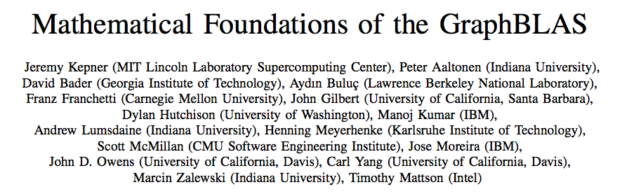
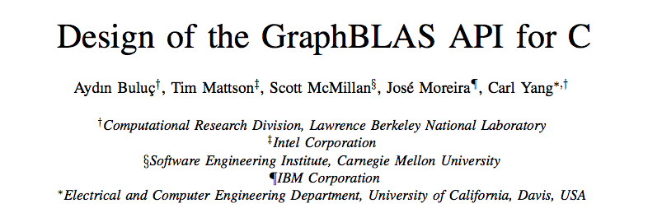
GraphBLAS References
IEEE HPEC 2016
GABB@IPDPS 2017
The official GraphBLAS C spec can be found at: www.graphblas.org

Slide 13
GraphBLAS Implementations
SuiteSparse library (Texas A&M): First fully conforming GraphBLAS release.
http://faculty.cse.tamu.edu/davis/suitesparse.html
GraphBLAS C (IBM): the second fully conforming release,
https://github.com/IBM/ibmgraphblas
GBTL: GraphBLAS Template Library (CMU/SEI): Pushing GraphBLAS into C++
https://github.com/cmu-sei/gbtl
GraphBLAST: A C++ implementations for GraphBLAS for GPUs (UC Davis),
https://github.com/gunrock/graphblast
Python bindings:
PyGraphBLAS: A Python Wrapper around SuiteSparse GraphBLAS
https://github.com/michelp
PyGB: A Python Wrapper around GBTL (UW/PNNL/CMU)
https://github.com/jessecoleman/gbtl-python-binding
pggraphblas: A PostgreSQL wrapper around Suite Sparse GraphBLAS
https://github.com/michelp
Matlab and Julia wrappers around SuiteSparse GraphBLAS
https://aldenmath.com
Third Party names are the property of their owners

Slide 14

GraphBLAS Implementations
SuiteSparse library (Texas A&M): First fully conforming GraphBLAS release.
http://faculty.cse.tamu.edu/davis/suitesparse.html
GraphBLAS C (IBM): the second fully conforming release,
https://github.com/IBM/ibmgraphblas
GBTL: GraphBLAS Template Library (CMU/SEI): Pushing GraphBLAS into C++
https://github.com/cmu-sei/gbtl
GraphBLAST: A C++ implementations for GraphBLAS for GPUs (UC Davis),
https://github.com/gunrock/graphblast
Python bindings:
PyGraphBLAS: A Python Wrapper around SuiteSparse GraphBLAS
https://github.com/michelp
PyGBTL: A Python Wrapper around GBTL (UW/PNNL/CMU)
https://github.com/jessecoleman/gbtl-python-binding
Pggraphblas: A PostgreSQL wrapper around Suite Sparse GraphBLAS
https://github.com/michelp
Matlab and Julia wrappers around SuiteSparse GraphBLAS
https://aldenmath.com
We will use SuiteSparse in this tutorial
Third Party names are the property of their owners

Slide 15
The GraphBLAS Vision
LAGraph

Slide 16
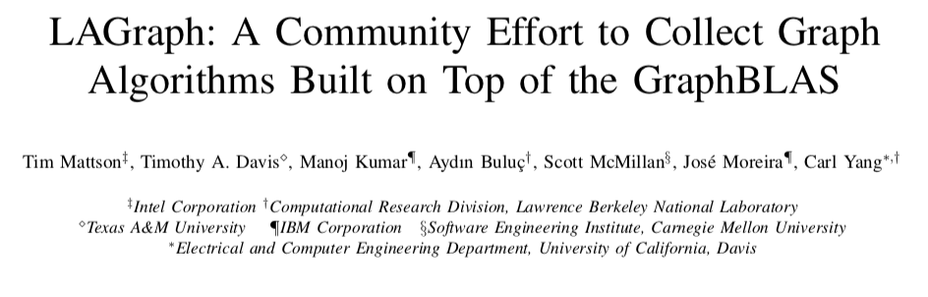
LAGraph: A curated collection of high level Graph Algorithms
Graph Algorithms built on top of the GraphBLAS.
GrAPL 2019
The LAGraph project’s official launch was at GrAPL’2019 in May’2019

Slide 17
Exercise 1: Build an LAGraph program
Clone our git repository
Includes the following components
Exercises and solutions
SuiteSparse library, binaries for Linux and OSX
LAGraph library, binaries for Linux and OSX
Load software onto your system, make sure you can build and run our test program
git clone https://github.com/tgmattso/GraphBLAS.git
cd GraphBLAS/src
git checkout hpec19
make AnalyzeGraph.exe
./AnalyzeGraph.exe Data/hpec_coauthors.mtx
Graph of coauthors: vertices are authors, edges connect authors who’ve published HPEC papers together
Notes:
The first program should load a larger graph (real data) and perform a few statistics on them like average degree, num_nodes, num_edges

Slide 18
Solution to Exercise 1:
If all goes well, output should look like this:
$ ./AnalyzeGraph.exe Data/hpec_coauthors.mtx
*** Step 1: loading input graph: Data/hpec_coauthors.mtx
*** Step 1: Elapsed time: 0.00531851 sec
*** Step 2: compute some basic statistics
*** Step 2: Elapsed time: 0.00181371 sec
Num nodes: 1747
Num edges: 10072
Avg degree: 5.765312
Max degree: 461
Min degree: 1
Node with max degree (target ID): 800
*** Step 3: Running LAGraph's connected components (LACC) algorithm.
*** Step 3: Elapsed time: 0.00678869 sec
Number of connected components: 246
ID for component containing target ID 800: 0
*** Step 4: Find all the nodes from the target ID's cluster.
*** Step 4: Elapsed time: 0.000114254 sec
Cluster mask nvals (after masking): 822
Component size: 822
*** Step 5: extract and perform PageRank on the target component.
*** Step 5: Elapsed time: 0.0198434 sec
Author with the highest rank: 800 (0.019374)
Author with the smallest rank: 1094 (0.000214)
...
Notes:
The first program should load a larger graph (real data) and perform a few statistics on them like average degree, num_nodes, num_edges

Slide 19
HPEC Authors Dataset and Connected Components
Data represents all pairs of HPEC authors that have coauthored papers. The edge value represents how many papers the pair have coauthored.
File: src/Data/hpec_authors.mtx
Graph (undirected):
1,747 vertices (unique authors)
10,072 edges (coauthor count)
Data directory contains index tables containing the mapping between vertex ID and author name, the raw publication data, and python scripts to perform various queries
Nancy
Aydin
11
3
5
3
Carl
Tim
2
Saday
Jose
3
1
7
Margaret
Scott
Connected components: a subgraph of vertices connected to each other by a path, but not to vertices outside the subgraph

Slide 20
Outline
Graphs and Linear Algebra
The GraphBLAS C API and Adjacency Matrices
GraphBLAS Operations
Breadth-First Traversal
Connected Components

Slide 21
GraphBLAS C API
A binding of the GraphBLAS math to the C programming language.
Requires C99 extended with function polymorphism based on static-types and number-of-parameters.
All modern C compilers in common use today support these extensions
Basic include file with function prototypes, types, and constants
#include <GraphBLAS.h>
Includes a few types and opaque objects (e.g. matrices and vectors) to give implementations maximum flexibility
GrB_Index | → An integer type used to set dimensions and index into arrays
GrB_Matrix | → A 2D sparse array, row indices, column indices and values
GrB_Vector | → A 1D sparse array
… plus additional opaque objects we’ll describe later (descriptors, semirings, binary operators, and unary operators)
Notes:
Remember that GrB_Index is not an opaque object

Slide 22
GraphBLAS C API: Basic definitions
Opaque object: An object manipulated strictly through the GraphBLAS API whose implementation is not defined by the GraphBLAS specification.
Transparent object: an object whose structure is fully exposed to the programmer. E.g.: an array of tuples <i, j, value>
Method: Any C function that manipulates a GraphBLAS opaque object.
Domain: the set of available values used for the elements of matrices, the elements of vectors, and when defining operators.
Examples are GrB_UINT64, GrB_INT32, GrB_BOOL, GrB_FP32
Operation: a method that corresponds to an operation defined in the GraphBLAS math spec. http://www.mit.edu/~kepner/GraphBLAS/GraphBLAS-Math-release.pdf
Examples: matrix multiply, matrix-vector multiply, reduction, apply

Slide 23
Code from our first example (EXERPTS)
#include <stdio.h>
#include "GraphBLAS.h"
#include "LAGraph.h"
#include "tutorial_utils.h"
int main(int argc, char** argv) {
LAGraph_init();
FILE *fd = fopen(argv[1], "r");
GrB_Matrix graph = NULL;
if (GrB_SUCCESS != LAGraph_mmread(&graph, fd))
exit(-1);
GrB_Index nrows, ncols, nvals;
GrB_Matrix_nrows(&nrows, graph);
GrB_Matrix_ncols(&ncols, graph);
GrB_Matrix_nvals(&nvals, graph);
printf("Num nodes: %ld\n", nrows);
printf("Num edges: %ld\n", nvals);
LAGraph_lacc(A, &components);
// Cleanup
GrB_free(&A);
LAGraph_finalize();
}
Initialize a LAGraph and GraphBLAS
Create and load a matrix object with data from a file.
Query the matrix for the dimensions and number of defined (stored) values
Find the connected components
Free memory used for our matrix
Close the context, release resources
Notes:
AnalyzeGraph.c

Slide 24
Execution modes
A GraphBLAS program defines a DAG of operations.
Objects are defined by the sequence of GraphBLAS method calls, but the value of the object is not assured until a GraphBLAS method queries its state.
This gives an implementation flexibility to optimize the execution (fusing methods, replacing method sequences by more efficient ones, etc.)
GrB_op1(A);
GrB_op2(B);
GrB_op1(A);
GrB_op2(B);
GrB_op3(C,A,B);
GrB_op3(C,A,B);
An execution of a GraphBLAS program defines a context for the library.
The execution runs in one of two modes:
Blocking mode … executes methods in program order with each method completing before the next is called
Non-Blocking mode … methods launched in order. Complete in any order consistent with the DAG. Objects do not exit in fully defined state until queried.
Most implementations only support blocking mode.
Notes:
Tim Davis says: “SuiteSparse:GraphBLAS uses non-blocking for assign and setElement”
Scott may disagree with the terminology.

Slide 25
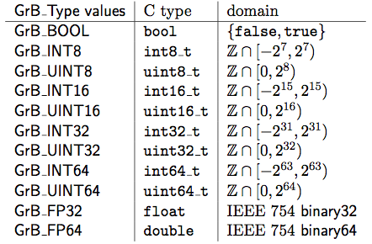
Predefined low-level types
Predefined types used to define domains in GraphBLAS

Slide 26
Exercise 2: Build a GraphBLAS program
Build your first GraphBLAS program
Build and run our BuildGraph.exe program
cd GraphBLAS/src
make BuildGraph.exe
./BuildGraph.exe
If all goes well, your output should look like this:
$ ./BuildGraph.exe
Matrix: GRAPH =
[ -, -, -]
[ -, -, 4]
[ -, -, -]
Notes:
It took us an hour to reach this tutorial when we taught this content at HPEC’19

Slide 27
Code from our BuildGraph exercise
#include <stdio.h>
#include <assert.h>
#include <GraphBLAS.h>
#include "tutorial_utils.h"
int main(int argc, char** argv) {
GrB_init(GrB_BLOCKING);
GrB_Index const NUM_NODES = 3;
GrB_Matrix graph;
GrB_Matrix_new(&graph, GrB_UINT64,
NUM_NODES, NUM_NODES);
GrB_Matrix_setElement(graph, 4, 1, 2);
pretty_print_matrix_UINT64(graph, "GRAPH");
GrB_Index nvals;
GrB_Matrix_nvals(&nvals, graph);
assert(nvals == 1);
// Cleanup
GrB_free(&graph);
GrB_finalize();
}
Initialize a context in BLOCKING mode
GrB_Index used for matrix dimension
Create a matrix object of order NUM_NODES and domain UINT64
Store the value 4 in element (1,2)
Our own “pretty print” routine (not part of GraphBLAS)
Query the matrix for the number of defined (stored) values and check for correctness
Free memory used for our matrix
Close the context, release resources
Notes:
BuildGraph.c

Slide 28
Exercise 3: Adjacency matrix
Draw a simple graph with 3 to 5 nodes.
Write a program to create the adjacency matrix.
Use BuildGraph.c as an example.
Output the result and verify that your adjacency graph is correct.
You will need the following types and methods from the GraphBLAS
GrB_Index, GrB_Matrix
GrB_init(); GrB_finalize();
GrB_Matrix_new(&graph, GrB_domain, Nrows, Ncols);
GrB_Matrix_setElement(graph, value, from_node, to_node);
GrB_Matrix_nvals(&nvals, graph);
GrB_free(&graph);
Hint: Save time and minimize typing
Copy BuildGraph.c into another file and modify it to build your adjacency matrix program.
Edit the makefile and add your new source file to the list in the definition of SOURCES. Then you can just type “make” to build your program.

Slide 29
Exercise 3: Adjacency matrix
Draw a simple graph with 3 to 5 nodes.
Write a program to create the adjacency matrix.
Use BuildGraph.c as an example.
Output the result and verify that your adjacency graph is correct.
You will need the following types and methods from the GraphBLAS
GrB_Index, GrB_Matrix
GrB_init(); GrB_finalize();
GrB_Matrix_new(&graph, GrB_domain, Nrows, Ncols);
GrB_Matrix_setElement(graph, value, from_node, to_node);
GrB_Matrix_nvals(&nvals, graph);
GrB_free(&graph);
Hint: Save time and minimize typing
Copy BuildGraph.c into another file and modify it to build your adjacency matrix program.
Edit the makefile and add your new source file to the list in the definition of SOURCES. Then you can just type “make” to build your program.
A quick API note … Opaque objects are passed around through a handle (e.g. graph).
When the handle itself changes, we pass by address (i.e. with a &).
When the object referenced by the handle is manipulated but the handle doesn’t change, we pass by value (i.e. without the &).

Slide 30
Solution to Exercise 3
Our three node graph with edge weights:
...
GrB_init(GrB_BLOCKING);
GrB_Index const NUM_NODES = 3;
GrB_Matrix graph;
GrB_Matrix_new(&graph, GrB_UINT64,
NUM_NODES, NUM_NODES);
GrB_Matrix_setElement(graph, 4, 1, 2);
GrB_Matrix_setElement(graph, 4, 2, 1);
GrB_Matrix_setElement(graph, 2, 0, 1);
GrB_Matrix_setElement(graph, 2, 1, 0);
pretty_print_matrix_UINT64(graph, "Graph");
GrB_free(&graph);
GrB_finalize();
0
2
2
1
4
4
2
Matrix: Graph:
[ -, 2, -]
[ 2, -, 4]
[ -, 4, -]
Notes:
src/Solutions/BuildAdjMatTuple.c
Look at dotty for visualizing (from graphviz?)

Slide 31
Building matrices
Building a matrix one edge at a time is awkward.
It is often more convenient to do it from vectors defining the indices and values for non-empty elements of the sparse matrix
GrB_Info GrB_Matrix_build( | GrB_Matrix | C,
 | const GrB_Index | *row_indices,
 | const GrB_Index | *col_indices,
 | const <type> | *values,
 | GrB_Index | n,
 | const GrB_BinaryOp | dup);
row_indices, col_indices, and values are transparent arrays.
<type> is a C type consistent with the domain of the matrix
n is the number of entries in the sparse matrix
dup is an associative, commutative function to apply to the values should duplicate locations be specified.
Typically use one of the GraphBLAS predefined operators
Notes:
Need to discuss return codes.
Tim Davis comment: setElement almost as fast as build because of lazy evaluation exploit

Slide 32
Building matrices
Building a matrix one edge at a time is awkward.
It is often more convenient to do it from vectors defining the indices and values for non-empty elements of the sparse matrix
GrB_Info GrB_Matrix_build( | GrB_Matrix | C,
 | const GrB_Index | *row_indices,
 | const GrB_Index | *col_indices,
 | const <type> | *values,
 | GrB_Index | n,
 | const GrB_BinaryOp | dup);
Return values:
GrB_SUCCESS if everything worked
Other values for problems with input arguments, memory issues, internal errors or other problems.
row_indices, col_indices, and values are transparent arrays.
<type> is a C type consistent with the domain of the matrix
n is the number of entries in the sparse matrix
dup is an associative, commutative function to apply to the values should duplicate locations be specified.
Typically use one of the GraphBLAS predefined operators
Notes:
Need to discuss return codes (will be showing code that checks these for clarity)
Tim Davis comment: setElement almost as fast as build because of lazy evaluation exploit

Slide 33
GraphBLAS predefined operators
A subset of operators from Table 2.3 of the GraphBLAS specification
Identifier | Domains | Description
GrB_LOR | bool x bool → bool | f(x,y) = x ∨ y | Logical OR
GrB_LAND | bool x bool → bool | f(x,y) = x ∧ y | Logical AND
GrB_EQ_T | T x T → bool | f(x,y) = (x==y) | Equal
GrB_MIN_T | T x T → T | f(x,y) =(x<y)?x:y | minimum
GrB_MAX_T | T x T → T | f(x,y) =(x>y)?x:y | maximum
GrB_PLUS_T | T x T → T | f(x,y) = x + y | addition
GrB_TIMES_T | T x T → T | f(x,y) = x * y | multiplication
GrB_FIRST_T | T x T → T | f(x,y) = x | First argument
GrB_SECOND_T | T x T → T | f(x,y) = y | Second argument
Where T is a suffix indicating type and includes FP32, FP64, INT32, UINT32, BOOL
Note: GrB_FIRST and GrB_SECOND are not commutative operators
This is a subset of the defined types and operators. See table 2.3 for the full list.

Slide 34
C code fragment using GrB_Matrix_build
GrB_Index const NUM_NODES = 3;
GrB_Index const NUM_EDGES = 4;
GrB_Index row_indices[] = {0, 1, 1, 2};
GrB_Index col_indices[] = {1, 0, 2, 1};
bool values[] = {true, true, true, true};
GrB_Matrix graph;
GrB_Matrix_new(&graph, GrB_BOOL, NUM_NODES, NUM_NODES);
GrB_Matrix_build(graph,
row_indices, col_indices, (bool*)values,
NUM_EDGES, GrB_LOR);

Slide 35
Exercise 4: Adjacency matrix
Write a program to create the adjacency matrix for the GraphBLAS “logo” graph using row, column and value arrays.
0
1
6
3
4
2
5
You will need the following types and methods from the GraphBLAS
GrB_Index, GrB_Matrix
GrB_init(); GrB_finalize();
GrB_Matrix_new(&graph, GrB_domain, Nrows, Ncols);
GrB_Matrix_build(graph, row_indices, col_indices, values,
NUM_EDGES, dup);
GrB_Matrix_nvals(&nvals, graph);
GrB_free(&graph);
pretty_print_matrix_UINT64(graph, "Graph");

Slide 36
Exercise 4: Adjacency matrix
Write a program to create the adjacency matrix for the GraphBLAS “logo” graph using row, column and value arrays.
0
1
6
3
4
2
5
You will need the following types and methods from the GraphBLAS
GrB_Index, GrB_Matrix
GrB_init(); GrB_finalize();
GrB_Matrix_new(&graph, GrB_domain, Nrows, Ncols);
GrB_Matrix_build(graph, row_indices, col_indices, values,
NUM_EDGES, dup);
GrB_Matrix_nvals(&nvals, graph);
GrB_free(&graph);
pretty_print_matrix_UINT64(graph, "Graph");
use GrB_BOOL for the domain
For now, let’s use GrB_LOR for dup

Slide 37
Summary of solution to exercise 4
0
1
Matrix: Graph =
[ -, 1, -, 1, -, -, -]
[ -, -, -, -, 1, -, 1]
[ -, -, -, -, -, 1, -]
[ 1, -, 1, -, -, -, -]
[ -, -, -, -, -, 1, -]
[ -, -, 1, -, -, -, -]
[ -, -, 1, 1, 1, -, -]
6
4
3
2
5
GrB_Index const NUM_NODES = 7;
GrB_Index const NUM_EDGES = 12;
GrB_Index row_indices[] = {0, 0, 1, 1, 2, 3, 3, 4, 5, 6, 6, 6};
GrB_Index col_indices[] = {1, 3, 4, 6, 5, 0, 2, 5, 2, 2, 3, 4};
bool values[] = {true, true, true, true, true, true,
true, true, true, true, true, true};
GrB_Matrix graph;
GrB_Matrix_new(&graph, GrB_BOOL, NUM_NODES, NUM_NODES);
GrB_Matrix_build(graph, row_indices, col_indices, (bool*)values,
NUM_EDGES, GrB_LOR);
pretty_print_matrix_UINT64(graph, "Graph");
Notes:
src/Solutions/BuildAdjMatIndVec.c

Slide 38
Outline
Graphs and Linear Algebra
The GraphBLAS C API and Adjacency Matrices
GraphBLAS Operations
Breadth-First Traversal
Connected Components

Slide 39
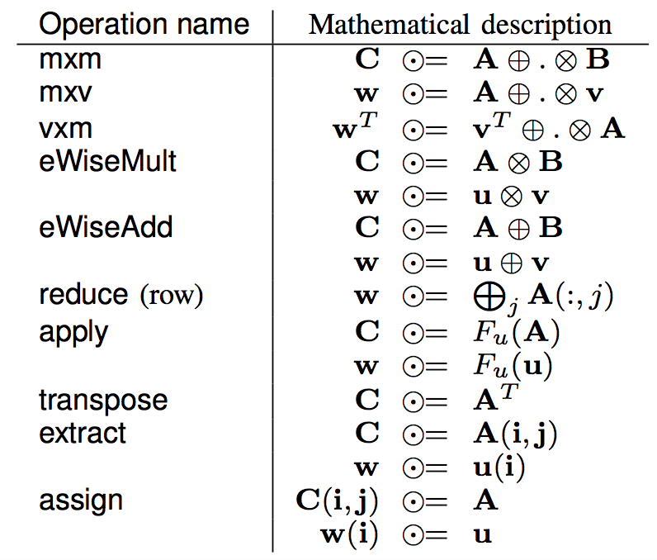
GraphBLAS Operations (from the Math Spec*)
We use ⊙, ⊕, and ⊗ since later on we’ll manipulate the algebraic structure to generalize them to other operations.
* Mathematical foundations of the GraphBLAS, Kepner et. al. HPEC’2016
Notes:
http://www.mit.edu/~kepner/GraphBLAS/GraphBLAS-Math-release.pdf

Slide 40

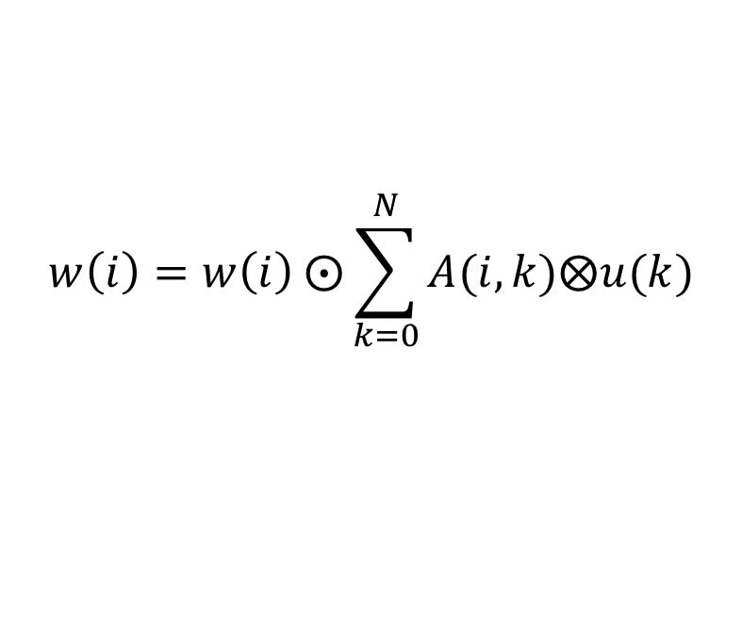



GrB_mxv()
$\text{w} ⨀$= A⊕.⊗u
Multiply a matrix times a vector to produce a vector
$$w\left(i\right)=w\left(i\right) ⨀\sum_{k=0}^{N}{A(i,k)⨂u(k)}$$
$$w∈S^{M}$$
$$u∈S^{N}$$
$$A∈S^{M×N}$$
Definitions:
S is the domain of the objects w, u, and A
⊙ is an optional accumulation operator (a binary operator)
⊗ and ⊕ are multiplication and addition (or generalizations thereof)
∑ uses the ⊕ operator

Slide 41


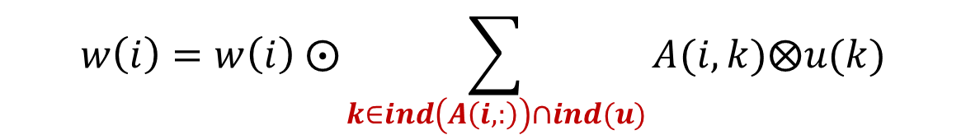

GrB_mxv()
$\text{w} ⨀$= A⊕.⊗u
Multiply a matrix times a vector to produce a vector
$$w\left(i\right)=w\left(i\right) ⨀\sum_{k∈ind\left(A\left(i,:\right)\right)∩ind(u)}{A(i,k)⨂u(k)}$$
The summation is over the intersection of the existing elements in the i^{th} row of A with u … which avoids exposing how empty elements (i.e. “zeros”) are represented. This becomes important when we change the semiring between operations
$$w∈S^{M}$$
$$u∈S^{N}$$
$$A∈S^{M×N}$$
Definitions:
S is the domain of the objects w, u, and A
⊙ is an optional accumulation operator (a binary operator)
⊗ and ⊕ are multiplication and addition (or generalizations thereof)
∑ uses the ⊕ operator
ind(u) returns the indices of the stored values of u

Slide 42
GrB_mxv()
$\text{w} ⨀$= A⊕.⊗u
Compute the product of a GraphBLAS sparse matrix with a GraphBLAS vector.
Returns error codes of type GrB_info. See the spec for details.
GrB_Info GrB_mxv( | GrB_Vector | w,
 | const GrB_Vector | mask,
 | const GrB_BinaryOp | accum,
 | const GrB_Semiring | op,
 | const GrB_Matrix | A,
 | const GrB_Vector | u,
 | const GrB_Descriptor | desc);

Slide 43
GrB_mxv()
$\text{w} ⨀$= A⊕.⊗u
Compute the product of a GraphBLAS sparse matrix with a GraphBLAS vector.
Returns error codes of type GrB_info. See the spec for details.
GrB_Info GrB_mxv( | GrB_Vector | w,
 | const GrB_Vector | mask,
 | const GrB_BinaryOp | accum,
 | const GrB_Semiring | op,
 | const GrB_Matrix | A,
 | const GrB_Vector | u,
 | const GrB_Descriptor | desc);
GrB_NULL
GrB_NULL
GrB_NULL
Let’s ignore mask, accum and desc for now and use default values (indicated by GrB_NULL)

Slide 44
GrB_mxv()
$\text{w} ⨀$= A⊕.⊗u
Compute the product of a GraphBLAS sparse matrix with a GraphBLAS vector.
Returns error codes of type GrB_info. See the spec for details.
GrB_Info GrB_mxv( | GrB_Vector | w,
 | const GrB_Vector | mask,
 | const GrB_BinaryOp | accum,
 | const GrB_Semiring | op,
 | const GrB_Matrix | A,
 | const GrB_Vector | u,
 | const GrB_Descriptor | desc);
GrB_NULL
GrB_NULL
GrB_NULL
Op defines the algebraic structure, a semiring in this case. This gives us ⊗ and ⊕ and the identity for ⊕. We’ll say much more about his later.
For our first exercises with bool objects, we’ll use a built-in SuiteSparse semiring
GxB_LOR_LAND_BOOL.

Slide 45
Exercise 5: Matrix Vector Multiplication
Use the adjacency matrix from exercise 4 and a vector with a single value to select one of the nodes in the graph.
Find the product mxv, print the result, and interpret its meaning.
In addition to those from Exercise 4, you’ll need the functions:
1
0
6
3
4
2
5
GrB_Vector result, vec;
GrB_Index NODE;
GrB_Vector_new(&vec, GrB_BOOL, NUM_NODES);
GrB_Vector_setElement(vec, true, NODE);
pretty_print_vector_UINT64(vec, ”Input node");
GrB_mxv(result, GrB_NULL, GrB_NULL,
GxB_LOR_LAND_BOOL, graph, vec, GrB_NULL);

Slide 46
Solution to exercise 5
0
1
pretty_print_matrix_UINT64(graph, "GRAPH");
// Build a vector with one node set.
GrB_Index const NODE = 2;
GrB_Vector vec, result;
GrB_Vector_new(&result, GrB_BOOL, NUM_NODES);
GrB_Vector_new(&vec, GrB_BOOL, NUM_NODES);
GrB_Vector_setElement(vec, true, NODE);
pretty_print_vector_UINT64(vec, "Target node");
GrB_mxv(result, GrB_NULL, GrB_NULL,
GxB_LOR_LAND_BOOL, graph, vec, GrB_NULL);
pretty_print_vector_UINT64(result, "sources");
6
4
3
2
5
Matrix: GRAPH =
[ -, 1, -, 1, -, -, -]
[ -, -, -, -, 1, -, 1]
[ -, -, -, -, -, 1, -]
[ 1, -, 1, -, -, -, -]
[ -, -, -, -, -, 1, -]
[ -, -, 1, -, -, -, -]
[ -, -, 1, 1, 1, -, -]
Vector: Target node =
[ -, -, 1, -, -, -, -]
Vector: sources =
[ -, -, -, 1, -, 1, 1]
The stored elements of the adjacency matrix, a(i,j) indicate an edge from vertex i to vertex j
So the matrix vector product scans over a row (from) to find when an edge lands at the destination
Notes:
src/Solutions/matvec.c
Todo: mention 1-hop in the explanation. This helps build to BFS. This is traversing edges backwards!

Slide 47
Finding neighbors
A more common operation is to input a vector selecting a source and find all the neighbors one hop away from that vertex.
Using mxv(), how would you do this?

Slide 48
Finding neighbors
A more common operation is to input a vector selecting a source and find all the neighbors one hop away from that vertex.
Using mxv(), how would you do this?
The adjacency matrix elements indicate edges
from a vertex (row index)
to another vertex (columns index)
Then the transpose of the adjacency matrix indicates edges
To a vertex (row index)
From other vertices (column index)
Therefore, we can find the neighbors of a vertex (marked by the non-empty elements of v)
Neighbors = A^{T}⊕.⊗v
The GraphBLAS defines a transpose operation, but given how often you need to do a transpose, there must be a better way

Slide 49
Changing the behavior of a GraphBLAS operation
Most GraphBLAS operations take an argument that is an opaque object called a “descriptor”. You declare an descriptor called ”desc” and create it as follows:
GrB_Descriptor desc;
GrB_Descriptor_new (&desc);
The descriptor controls the behavior of the method and how objects are handled inside the method.
The descriptor controls:
Do you transpose input matrices? (GrB_TRAN)
Does the computation replace existing values in the output object or combine with them? (GrB_REPLACE)
Take the structural complement of the mask object (swap empty/false ←→ filled/true values in a sparse object). (GrB_SCMP)
….To be discussed later

Slide 50
Using Descriptors
A descriptor is an opaque object so you set its values with a GraphBLAS method.
A descriptor field selects the object it impacts:
GrB_OUTP: The output GraphBLAS object
GrB_INP0: The first input GraphBLAS object (matrix or vector)
GrB_INP1: The second input GraphBLAS object (matrix or vector)
GrB_MASK: The GraphBLAS mask object (described later).
A descriptor value describes the action to be taken.
For example, to transpose the first input matrix, you’d call the operation and pass in the following descriptor
GrB_Descriptor desc;
GrB_Descriptor_new(&desc);
GrB_Descriptor_set(desc, GrB_INP0, GrB_TRAN);

Slide 51
Exercise 6: Matrix Vector Multiplication
Modify your program from exercise 5 to multiply by the transpose of the adjacency matrix.
Verify that you can use that to find the one-hop out-neighbors of any vertex
GrB_Vector result, vec;
GrB_Index NODE;
GrB_Vector_new(&vec, GrB_BOOL, NUM_NODES);
GrB_Vector_setElement(vec, true, NODE);
pretty_print_vector_UINT64(vec, ”Input node");
GrB_Descriptor desc;
GrB_Descriptor_new(&desc);
GrB_Descriptor_set(desc, FIELD, VALUE)
GrB_mxv(result, GrB_NULL, GrB_NULL,
GxB_LOR_LAND_BOOL, graph, vec, desc);
FIELD: GrB_INP0, GrB_INP1, GrB_OUTP, GrB_MASK
VALUE: GrB_TRAN, GrB_REPLACE, GrB_SCMP
Notes:
We ended up skipping this exercise to make up for lost time when we taught this at HPEC’19

Slide 52
Solution to exercise 6
0
1
6
4
3
// Build a vector with one node set.
GrB_Index const SRC_NODE = 6;
GrB_Vector vec;
GrB_Vector_new(&vec, GrB_BOOL, NUM_NODES);
GrB_Vector_setElement(vec, true, SRC_NODE);
GrB_Descriptor desc;
GrB_Descriptor_new(&desc);
GrB_Descriptor_set(desc, GrB_INP0, GrB_TRAN);
pretty_print_vector_UINT64(vec, "source node");
GrB_mxv(vec, GrB_NULL, GrB_NULL,
GxB_LOR_LAND_BOOL, graph, vec, desc);
pretty_print_vector_UINT64(vec, "neighbors");
2
5
Vector: source node =
[ -, -, -, -, -, -, 1]
Vector: neighbors =
[ -, -, 1, 1, 1, -, -]
GrB_mxv test passed.
The transposed matrix vector product scans over a columns (to) to find edges that start at the source node.
Notes:
matvecTrans.c

Slide 53

GrB_mxv()
$\text{w} ⨀$= A⊕.⊗u
Compute the product of a GraphBLAS Sparse Matrix with a GraphBLAS vector.
Returns error codes of type GrB_info. See the spec for details.
GrB_Info GrB_mxv( | GrB_Vector | w,
 | const GrB_Vector | mask,
 | const GrB_BinaryOp | accum,
 | const GrB_Semiring | op,
 | const GrB_Matrix | A,
 | const GrB_Vector | u,
 | const GrB_Descriptor | desc);
GrB_NULL
GrB_NULL
GrB_NULL
It’s time to explain semirings in GraphBLAS operations

Slide 54
Algebraic Semirings
Semiring: An Algebraic structure that generalizes real arithmetic by replacing (+,*) with binary operations (Op1, Op2)
Op1 and Op2 have identity elements sometimes called 0 and 1
Op1 and Op2 are associative.
Op1 is commutative, Op2 distributes over Op1 from both left and right
The Op1 identify is an Op2 annihilator.

Slide 55
Algebraic Semirings
Semiring: An Algebraic structure that generalizes real arithmetic by replacing (+,*) with binary operations (Op1, Op2)
Op1 and Op2 have identity elements sometimes called 0 and 1
Op1 and Op2 are associative.
Op1 is commutative, Op2 distributes over Op1 from both left and right
The Op1 identify is an Op2 annihilator.
(R, +, *, 0, 1) Real Field | Standard operations in linear algebra
({0,1}, |, &, 0, 1) Boolean Semiring | Graph traversal algorithms
(R U {∞},min, +, ∞, 0) Tropical semiring | Shortest path algorithms
(R U {∞}, min, x, ∞, 1) | Selecting a subgraph or contracting nodes to form a quotient graph.
Notation: (R, +, *, 0, 1)
Scalar type
Op1
Op2
Identity Op1
Identity Op2

Slide 56
Algebraic Semirings
Semiring: An Algebraic structure that generalizes real arithmetic by replacing (+,*) with binary operations (Op1, Op2)
Op1 and Op2 have identity elements sometimes called 0 and 1
Op1 and Op2 are associative.
Op1 is commutative, Op2 distributes over Op1 from both left and right
The Op1 identify is an Op2 annihilator.
(R, +, *, 0, 1) Real Field | Standard operations in linear algebra
(R U {∞},min, +, ∞, 0) Tropical semiring | Shortest path algorithms
({0,1}, |, &, 0, 1) Boolean Semiring | Graph traversal algorithms
(R U {∞}, min, *, ∞, 1) | Selecting a subgraph or contracting nodes to form a quotient graph.
Notes:
False and true for boolean semiring???

Slide 57
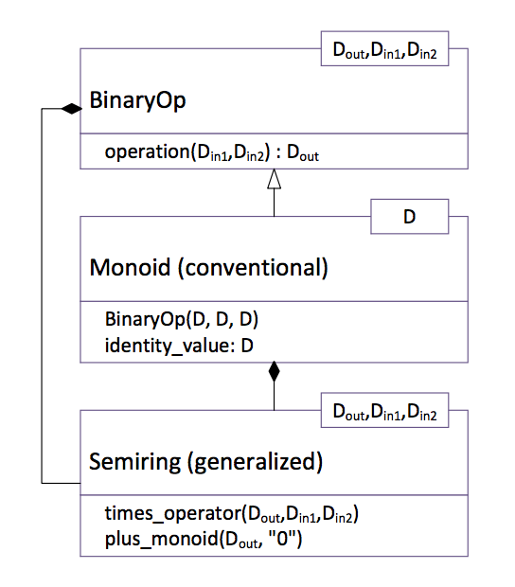
Algebraic structures in the GraphBLAS: Semirings and Monoids
The GraphBLAS semiring defines:
A set of allowed values (the domain)
Two commutative operators called addition and multiplication
An additive identity (called 0) that is the annihilator over multiplication.
A Monoid is used in defining a semiring:
Monoid: A domain, an associative binary operator and an identity corresponding to that operator
Hierarchy of algebraic object classes showing relationships between the various domains and the operators.
Notes:
UML notation; BLACK diamond shows a composition relationship … i.e. a semiring is a composition of a monoid and a binaryOp.
The open triangle shows and inheritance relationship … the Monoid inherits from BinaryOp

Slide 58





Building Semirings in the GraphBLAS
First you build the monoid (M) for a particular domain, D, the “addition” operator, and its identity:
$$M= <D, ⊕, 0>$$
Then define the semiring (S) in terms of the Monoid and the multiplications operator:
$$S= <D_{out},D_{in1}, D_{in2},M, ⨂>$$
The domains must be consistent:
$${⊗: D}_{in1}{ ×{ D}_{in2} →D}_{out}$$
$${⨁: D}_{out}{ ×{ D}_{out} →D}_{out}$$
$$0∈D_{out}$$

Slide 59
Building Semirings in the GraphBLAS
First you build the monoid (M) for the “addition” and its identity:
GrB_Info GrB_Monoid_new( | GrB_Monoid | *monoid,
 | GrB_BinaryOp | binary_op,
 | <type> | identity);
Where the type must be consistent with that of the binary operator which is either a built-in operator (Spec. Table 2.3) or a user-defined operator (not covered here)
Example:
GrB_Monoid UInt64Plus ; GrB_Monoid_new(&UInt64Plus, GrB_PLUS_UINT64, 0 ul);

Slide 60
Building Semirings in the GraphBLAS
Then you build the semiring pairing a monoid (“add”) with a binary operator (“mul”) :
GrB_Info GrB_Semiring_new( | GrB_Semiring | *semiring,
 | GrB_Monoid | add_op,
 | GrB_BinaryOp | mul_op);
The monoid’s identity should be the binary operator’s annihilator (not enforced).
Example using the monoid from the previous page:
GrB_Semiring UInt64Arith; GrB_Semiring_new(&UInt64Arith, UInt64Plus, GrB_TIMES_UINT64);

Slide 61
Common Semirings
semiring | Domain | Add | Add-identity | multiply
Boolean | GrB_BOOL | GrB_LOR | false | GrB_LAND
Int32 arithmetic | GrB_INT32 | GrB_PLUS_INT32 | 0 | GrB_TIMES_INT32
FP32 arithmetic | GrB_FP32 | GrB_PLUS_FP32 | 0.0f | GrB_TIMES_FP32
Max_second | GrB_FP32 | GrB_MAX_FP32 | -INFINITY | GrB_SECOND_FP32

Slide 62
Exercise 7: Changing semirings
Up to this point, we’ve used a built-in Boolean semiring that is included with SuiteSparse (GxB_LOR_LAND_BOOL).
Pick any of the past exercises and experiment with different semi-rings.
GrB_Monoid UInt64Plus;
GrB_Monoid_new(&UInt64Plus, GrB_PLUS_UINT64, 0ul);
GrB_Semiring UInt64Arith;
GrB_Semiring_new(&UInt64Arith, UInt64Plus, GrB_TIMES UINT64);
To save some time, we will skip this exercise

Slide 63
Outline
Graphs and Linear Algebra
The GraphBLAS C API and Adjacency Matrices
GraphBLAS Operations
Breadth-First Traversal
Connected Components

Slide 64
Breadth First Traversal
The Breadth First Traversal:
Start from one or more initial vertices
Visit all accessible one hop neighbors,
Visit all accessible unique two hop neighbors,
Continue until no more unique vertices to visit
Note: keep track of vertices visited so you don’t visit the same vertex more than once
Breadth first traversal is a common pattern used in a range of graph algorithms
Build a spanning tree that contains all vertices and minimal number of edges
Search for accessible vertices with certain properties.
Find shortest paths between vertices.
Other more advanced algorithms such as maxflow and betweenness centrality

Slide 65
Our Breadth First Traversal plan
We will build up this algorithm using the GraphBLAS through a series of exercises:
Wavefronts and how to move from one wavefront to the next.
Iteration across wavefronts
Track which vertices have been visited
Avoid revisiting vertices
Construct the Level Breadth first traversal algorithm (see HPEC18)
Construct a Connected Components algorithm
Notes:
Introduce the concept of a wavefront (which is the result of the first mxv that is fed in as input to the second (the initial source vertex vector is also a wavefront).
So you have to add a loop, the exit condition for the loop is an empty vector so using call to Vector_nvals
But without doing anything this will traverse back to previously visited vectors (infinite loop).
Need to create a visited vector which is boolean and ANDs with the results of each mxv (introduces eWiseMult)
GrB_eWiseAdd(visited, NULL, NULL, LAND, wavefront, visited, NULL);
(LEAP) you can use complement of the visited vector as a mask to the wavefront (in self-assignment
Need to introduce mask, SCMP descriptor, and apply:
wavefront = apply(IDENTITY) of wavefront masked by complement of visited (AND you need to use replace)
(Alternative) UGH
It is too hard to introduce a new binary op in order to avoid the use of mask
After step 4 it is easy to roll the SCMP mask into the mxv itself and avoid the assign.
Turning this into a level BFS means that the visited vector uses integer domain
Introduce a depth/level variable and use assign constant variant (before the mxv) to assign elements of visited with the depth variable: GrB_assign(levels, wavefront, NULL, depth, GrB_ALL, NUM_NODES, NULL)

Slide 66
Wavefronts
A subset of vertices accessed at one stage in a breadth first search pattern … for example ….
“You tell two friends and they tell two friends…”
0
1
0
1
6
6
3
4
3
4
2
5
2
5
A^{T} w = w’
A^{T} w’ = w’’
w = {0}
w’ = {1, 3}
w’’ = {0, 2, 4, 6}
Red=current wavefront and visited, Blue=next wavefront, Black=unvisited
A = Adjacency Matrix w = wavefront vector

Slide 67
Exercise 8: Traverse the graph
Modify your code from Exercises 6 to iterate from one wavefront to the next.
Output each wavefront
How long before you get a repeating pattern?
GrB_Vector result, vec;
GrB_Index NODE;
GrB_Vector_new(&vec, GrB_BOOL, NUM_NODES);
GrB_Vector_setElement(vec, true, NODE);
pretty_print_vector_UINT64(vec, "Input node");
GrB_Descriptor desc;
GrB_Descriptor_new(&desc);
GrB_Descriptor_set(desc, FIELD, VALUE)
GrB_mxv(result, GrB_NULL, GrB_NULL,
GxB_LOR_LAND_BOOL, graph, vec, desc);

Slide 68
Solution to exercise 8
0
1
// First wavefront has one node set.
GrB_Index const SRC_NODE = 0;
GrB_Vector w;
GrB_Vector_new(&w, GrB_BOOL, NUM_NODES);
GrB_Vector_setElement(w, true, SRC_NODE);
GrB_Descriptor desc;
GrB_Descriptor_new(&desc);
GrB_Descriptor_set(desc, GrB_INP0, GrB_TRAN);
pretty_print_vector_UINT64(w,"wavefront(src)");
for (int i = 0; i < NUM_NODES; ++i) {
GrB_mxv(w, GrB_NULL, GrB_NULL,
GxB_LOR_LAND_BOOL, graph, w, desc);
pretty_print_vector_UINT64(w, "wavefront");
}
6
4
3
2
5
Vector: wavefront(src) =
[ 1, -, -, -, -, -, -]
Vector: wavefront =
[ -, 1, -, 1, -, -, -]
Vector: wavefront =
[ 1, -, 1, -, 1, -, 1]
Vector: wavefront =
[ -, 1, 1, 1, 1, 1, -]
Vector: wavefront =
[ 1, -, 1, -, 1, 1, 1]
Vector: wavefront =
[ -, 1, 1, 1, 1, 1, -]
Vector: wavefront =
[ 1, -, 1, -, 1, 1, 1]
…
The same container can be used for both input and output
Starts repeating after only a few iterations. Why?
Notes:
src/Solutions/matvecTransIter (v2)
It should start repeating at about the diameter of the graph

Slide 69
Solution to exercise 8: wavefronts
“We tell a bunch, and they tell bunch…(rinse and repeat)”
0
1
0
1
6
6
3
4
3
4
2
5
2
5
A^{T} w = w’
A^{T} w’ = w
w = {0, 2, 4, 5, 6}
w = {1, 2, 3, 4, 5}
w = {0, 2, 4, 5, 6}
Red=current wavefront and visited, Blue=next wavefront, Black=unvisited

Slide 70
Visited lists
Breadth-first traversal requires that we only need to visit each node once.
First step is to keep track of a visited list.
You can do this by accumulating the wavefronts.
Use element-wise logical-OR.

Slide 71

Element-wise Operations: Mult and Add
⊗ assumes unstored values (-) are the binary operator’s annihilator:
⊕ assumes unstored values (-) are the binary operator’s identity:
u ⊗ v
u ⊕ v
⊗
⊕
-
-
-
-
=
=
⊗
⊕
-
-
-
-
-
-
-
-
-
-
Examples: (x,0), (and, false), (+, ∞)
Examples: (+,0), (or, false), (min, ∞)
The rules for element-wise addition also apply to the accumulation operator, $⊙$
Notes:
When performing \circleplus and \circletimes on the same containers the unstored element should be interpreted as the same.

Slide 72
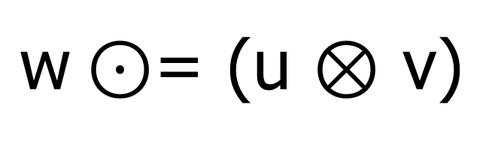
GrB_eWiseMult()
$\text{w}⊙$= (u ⊗ v)
Compute the element-wise “multiplication” of two GraphBLAS vectors.
Performs the specified operator (op) on the intersection of the sparse entries in each input vector , u and v.
op could be GrB_BinaryOp, GrB_Monoid, or GrB_Semiring
Returns error codes of type GrB_info. See the spec for details.
GrB_Info GrB_eWiseMult( | GrB_Vector | w,
 | const GrB_Vector | mask,
 | const GrB_BinaryOp | accum,
 | const GrB_BinaryOp | op,
 | const GrB_Vector | u,
 | const GrB_Vector | v,
 | const GrB_Descriptor | desc);
GrB_NULL
GrB_NULL
GrB_NULL
Use default values for mask, accum and desc (indicated by GrB_NULL)

Slide 73
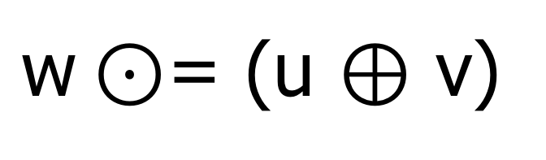
GrB_eWiseAdd()
$\text{w}⊙$= (u ⊕ v)
Compute the element-wise “addition” of two GraphBLAS vectors.
Performs the specified operator (op) on the union of the sparse entries in each input vector , u and v.
op could be GrB_BinaryOp, GrB_Monoid, or GrB_Semiring
Returns error codes of type GrB_info. See the spec for details.
GrB_Info GrB_eWiseAdd( | GrB_Vector | w,
 | const GrB_Vector | mask,
 | const GrB_BinaryOp | accum,
 | const GrB_BinaryOp | op,
 | const GrB_Vector | u,
 | const GrB_Vector | v,
 | const GrB_Descriptor | desc);
GrB_NULL
GrB_NULL
GrB_NULL
Use default values for mask, accum and desc (indicated by GrB_NULL)

Slide 74
Exercise 9: Keep track of ‘visited’ nodes
Modify code from Exercise 8 to compute the visited set as you iterate.
GrB_Vector result, vec;
GrB_Index NODE;
GrB_Vector_new(&vec, GrB_BOOL, NUM_NODES);
GrB_Vector_setElement(vec, true, NODE);
pretty_print_vector_UINT64(vec, ”Input node");
GrB_Descriptor desc;
GrB_Descriptor_new(&desc);
GrB_Descriptor_set(desc, ARG, OP)
GrB_eWiseAdd(vec, GrB_NULL, GrB_NULL, GrB_LOR, vec, wav, GrB_NULL);
GrB_mxv(result, GrB_NULL, GrB_NULL,
GxB_LOR_LAND_BOOL, graph, vec, desc);

Slide 75
Solution to exercise 9
0
1
// First wavefront has node 0 set.
GrB_Index const SRC_NODE = 0;
GrB_Vector w, v;
GrB_Vector_new(&w, GrB_BOOL, NUM_NODES);
GrB_Vector_new(&v, GrB_BOOL, NUM_NODES);
GrB_Vector_setElement(w, true, SRC_NODE);
GrB_Descriptor desc;
GrB_Descriptor_new(&desc);
GrB_Descriptor_set(desc, GrB_INP0, GrB_TRAN);
pretty_print_vector_UINT64(w, "wavefront(src)");
for (int i=0; i<NUM_NODES; ++i) {
GrB_eWiseAdd(v, GrB_NULL, GrB_NULL,
GrB_LOR, v, w, GrB_NULL);
pretty_print_vector_UINT64(v, "visited");
GrB_mxv(w, GrB_NULL, GrB_NULL,
GxB_LOR_LAND_BOOL, graph, w, desc);
pretty_print_vector_UINT64(w, "wavefront");
}
6
3
4
2
5
Vector: wavefront(src) =
[ 1, -, -, -, -, -, -]
Vector: visited =
[ 1, -, -, -, -, -, -]
Vector: wavefront =
[ -, 1, -, 1, -, -, -]
Vector: visited =
[ 1, 1, -, 1, -, -, -]
Vector: wavefront =
[ 1, -, 1, -, 1, -, 1]
Vector: visited =
[ 1, 1, 1, 1, 1, -, 1]
Vector: wavefront =
[ -, 1, 1, 1, 1, 1, -]
Vector: visited =
[ 1, 1, 1, 1, 1, 1, 1]
Vector: wavefront =
[ 1, -, 1, -, 1, 1, 1]
Vector: visited =
[ 1, 1, 1, 1, 1, 1, 1]
…
Notes:
src/Solutions/matvecTransIterVisited.c

Slide 76
Solution to exercise 9
0
1
// First wavefront has node 0 set.
GrB_Index const SRC_NODE = 0;
GrB_Vector w, v;
GrB_Vector_new(&w, GrB_BOOL, NUM_NODES);
GrB_Vector_new(&v, GrB_BOOL, NUM_NODES);
GrB_Vector_setElement(w, true, SRC_NODE);
GrB_Descriptor desc;
GrB_Descriptor_new(&desc);
GrB_Descriptor_set(desc, GrB_INP0, GrB_TRAN);
pretty_print_vector_UINT64(w, "wavefront(src)");
for (int i=0; i<NUM_NODES; ++i) {
GrB_eWiseAdd(v, GrB_NULL, GrB_NULL,
GrB_LOR, v, w, GrB_NULL);
pretty_print_vector_UINT64(v, "visited");
GrB_mxv(w, GrB_NULL, GrB_NULL,
GxB_LOR_LAND_BOOL, graph, w, tran);
pretty_print_vector_UINT64(w, "wavefront");
}
6
3
4
2
5
Vector: wavefront(src) =
[ 1, -, -, -, -, -, -]
Vector: visited =
[ 1, -, -, -, -, -, -]
Vector: wavefront =
[ -, 1, -, 1, -, -, -]
Vector: visited =
[ 1, 1, -, 1, -, -, -]
Vector: wavefront =
[ 1, -, 1, -, 1, -, 1]
Vector: visited =
[ 1, 1, 1, 1, 1, -, 1]
Vector: wavefront =
[ -, 1, 1, 1, 1, 1, -]
Vector: visited =
[ 1, 1, 1, 1, 1, 1, 1]
Vector: wavefront =
[ 1, -, 1, -, 1, 1, 1]
Vector: visited =
[ 1, 1, 1, 1, 1, 1, 1]
…
What should the exit condition be?
Notes:
Obvious answer: when visited list becomes full.
Correct but hard: when visited doesn’t change.
matvecTransIterVisited(v2)
Notes from the tutorial itself … to show how Scott talked about it.
He asked “what should the exit condition be?
Perhaps it should be “when the visited is full”. When you start from 5 and 2, you never get a full visited list.
So a better exit condition is that nvals is not changing. It is possible, however, to have nval that doesn’t change but its cycling to different nodes.
So what you really want is to track that values do not change at all in the visited list, but that is not easy to implement. There has to be a better way … and it uses a mask (go to the next slide)

Slide 77
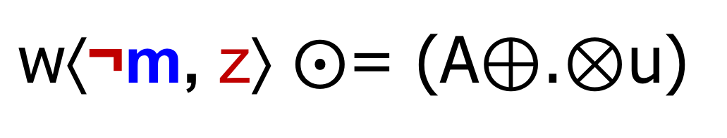
GrB_mxv()
$\text{w}\text{⟨}\text{¬}\text{m}\text{, }\text{z}\text{⟩} ⨀$= (A⊕.⊗u)
…say something
Say something else....
GrB_Info GrB_mxv( | GrB_Vector | w,
 | const GrB_Vector | mask,
 | const GrB_BinaryOp | accum,
 | const GrB_Semiring | op,
 | const GrB_Matrix | A,
 | const GrB_Vector | u,
 | const GrB_Descriptor | desc);
GrB_NULL
It’s time to explain masking and REPLACE in GraphBLAS operations.

Slide 78
Masking
Every GraphBLAS operation that computes an opaque matrix or vector supports a “write mask”
A mask, m, controls which elements of the output can be written:
Same size as output object (mask vectors or mask matrices)
Any location in the mask that evaluates to ‘true’ can be written in the output object
w⟨m⟩ = (A⊕.⊗u)
w(in)
A*u
m
w(out)
-
-
-
→
-
→
-
-
-
-
-
-
-

Slide 79
REPLACE vs. “MERGE”
When a mask is used and the output container is not empty when the operation is called…what do you do to the “masked out” elements?
REPLACE (z): all unwritten locations are cleared (zeroed out).
MERGE: all unwritten locations are left alone.
Behaviour defaults to MERGE; otherwise, use a descriptor:
GrB_Descriptor_set(desc, GrB_OUTP, GrB_REPLACE)
w⟨m, z⟩ = (A⊕.⊗u)
w(in)
A*u
m
w(out)
w(out)
REPLACE (z)
MERGE
-
-
-
-
→
→
-
-
-
-
-
-
-
-
-

Slide 80
Structural Complement (mask)
Specified with a descriptor:
GrB_Descriptor_set(desc, GrB_MASK, GrB_SCMP)
Inverts the logic of mask (write enabled on false)
A mask, m, is interpreted as a logical ‘stencil’ that controls which elements of the output can be written:
Any location in the mask that evaluates to ‘true’ can be written
w⟨¬m, z⟩ = (A⊕.⊗u)
w(in)
A*u
m
w(out)
w(out)
-
-
REPLACE, z
MERGE
-
→
-
→
-
¬
-
-
-
-
-
-
-

Slide 81
Using Descriptors (summary)
A descriptor field selects the object it impacts:
GrB_INP0: The first input GraphBLAS object
GrB_INP1: The second input GraphBLAS object
GrB_MASK: The GraphBLAS mask object
GrB_OUTP: The output GraphBLAS object
Each field supports one value (currently):
GrB_INP0: GrB_TRAN (transpose)
GrB_INP1: GrB_TRAN (transpose)
GrB_MASK: GrB_SCMP (structural complement, GrB_COMP in v1.3)
GrB_OUTP: GrB_REPLACE (clear the output before writing result)

Slide 82
Exercise 10: Avoid revisiting
Use the visited list as a mask prevent revisiting previous nodes
Exit the loop when there is no more ‘work’ to be done
You will need the following types and methods from the GraphBLAS
GrB_Vector_new(&vec, GrB_BOOL, NUM_NODES);
GrB_Vector_setElement(vec, true, NODE);
GrB_Vector_nvals(&nvals, vec);
GrB_eWiseAdd(vec, GrB_NULL, GrB_NULL, GrB_LOR, vec, wav, GrB_NULL);
GrB_mxv(result, mask, GrB_NULL,
GxB_LOR_LAND_BOOL, graph, vec, desc);
GrB_Descriptor desc;
GrB_Descriptor_new(&desc);
GrB_Descriptor_set(desc, FIELD, VALUE)
FIELD: GrB_INP0, GrB_INP1, GrB_OUTP, GrB_MASK
VALUE: GrB_TRAN, GrB_REPLACE, GrB_SCMP

Slide 83
Solution to exercise 10
0
1
...
GrB_Vector_setElement(w, true, SRC_NODE);
GrB_Descriptor desc;
GrB_Descriptor_new(&desc);
GrB_Descriptor_set(desc, GrB_INP0, GrB_TRAN);
GrB_Descriptor_set(desc, GrB_MASK, GrB_SCMP);
GrB_Descriptor_set(desc, GrB_OUTP, GrB_REPLACE);
pretty_print_vector_UINT64(w, "wavefront(src)");
GrB_Index nvals = 0;
do {
GrB_eWiseAdd(v, GrB_NULL, GrB_NULL,
GrB_LOR, v, w, GrB_NULL);
pretty_print_vector_UINT64(v, "visited");
GrB_mxv(w, v, GrB_NULL,
GxB_LOR_LAND_BOOL, graph, w, desc);
pretty_print_vector_UINT64(w, "wavefront");
GrB_Vector_nvals(&nvals, w);
} while (nvals > 0);
6
4
3
2
5
Vector: wavefront(src) =
[ 1, -, -, -, -, -, -
Vector: visited =
[ 1, -, -, -, -, -, -]
Vector: wavefront =
[ -, 1, -, 1, -, -, -]
Vector: visited =
[ 1, 1, -, 1, -, -, -]
Vector: wavefront =
[ -, -, 1, -, 1, -, 1]
Vector: visited =
[ 1, 1, 1, 1, 1, -, 1]
Vector: wavefront =
[ -, -, -, -, -, 1, -]
Vector: visited =
[ 1, 1, 1, 1, 1, 1, 1]
Vector: wavefront =
[ -, -, -, -, -, -, -]
Notes:
src/Solutions/matvecTransIterVisitedExitFlag.c

Slide 84
Breadth-First Traversal
0
1
0
1
6
6
3
4
3
4
2
5
2
5
0
1
0
1
6
6
3
4
3
4
2
5
2
5
Red=current wavefront and visited, Blue=next wavefront, Gray=visited, Black=unvisited

Slide 85
Outline
Graphs and Linear Algebra
The GraphBLAS C API and Adjacency Matrices
GraphBLAS Operations
Breadth-First Traversal
Connected Components

Slide 86
Connected Components
Connected Components
Identify groups of vertices with paths to one another.
Identify how many of these groups (components) exist in the data.
Goal: assign all vertices within a component with the same unique ID.
Graph
Consists of undirected edges
Note: applying this to directed graphs by converting to undirected is called “weakly connected components.”
Nancy
Aydin
1
11
Saday
Jose
3
5
Scott
3
3
1
Carl
2
Tim
7
Margaret

Slide 87
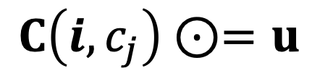
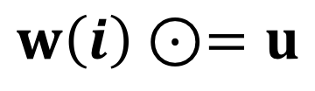
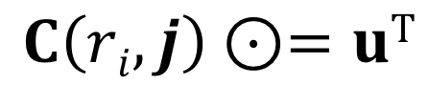
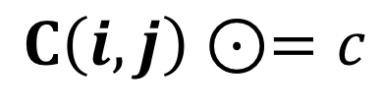
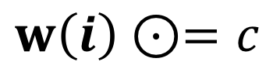
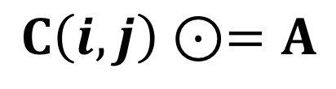
GrB_assign()
There are several variants of assign
Standard vector assignment
Standard matrix assignment
Assign a vector to the elements of column c_{j} of a matrix
Assign a vector to the elements of row r_{i} of a matrix
Assign a constant to a subset of a vector.
Assign a constant to a subset of a matrix.
$$w\left(i\right)⊙=u$$
$$C\left(i,j\right)⊙=A$$
$$C\left(i,c_{j}\right)⊙=u$$
$$C\left(ri,j\right)⊙=uT$$
$$w\left(i\right)⊙=c$$
$$C\left(i,j\right)⊙=c$$
A and C are GraphBLAS matrices. u and w are GraphBLAS vectors i and j are index arrays

Slide 88

GrB_assign() from vector
$$w\left(i\right)⊙=u$$
Assign a vector to a subset of the output vector.
Values to be assigned selected by an output index vector, i
w(indices[j]) = u(j), ∀ j : 0 ≤ j < nindices,
w(indices[j]) = w(indices[j]) ⊙ u(j), ∀ j : 0 ≤ j < nindices.
GrB_Info GrB_assign( | GrB_Vector | w,
 | const GrB_Vector | mask,
 | const GrB_BinaryOp | accum,
 | const GrB_Vector | u,
 | const GrB_Index | *indices,
 | const GrB_Index | nindices,
 | const GrB_Descriptor | desc);
Use a constant GrB_ALL in place of the indices argument to select that all elements of u are to be assigned in order to w.

Slide 89

GrB_assign() from constant
$$w\left(i\right)⊙=c$$
Assign a constant to a subset of the output vector.
Locations to be assigned selected by an output index vector, indices:
w(indices[j]) = c, ∀ j : 0 ≤ j < nindices,
w(indices[j]) = w(indices[j]) ⊙ c, ∀ j : 0 ≤ j < nindices.
GrB_Info GrB_assign( | GrB_Vector | w,
 | const GrB_Vector | mask,
 | const GrB_BinaryOp | accum,
 | <type> | c,
 | const GrB_Index | *indices,
 | const GrB_Index | nindices,
 | const GrB_Descriptor | desc);
Use a constant GrB_ALL in place of the indices argument to select that all elements of w are to be assigned to (in order 0 to 1-nindices).

Slide 90
Our Connected Components plan
Strategy:
Create a new vector and Initialize all vertex IDs to “unassigned”
While there are unassigned vertices:
Pick an unassigned vertex
Perform BFS marking all reachable vertices
Assign all reachable vertices with a unique 'component number'.
Component '1'
Component '42'
Nancy
Aydin
1
11
Saday
Jose
3
5
Scott
3
3
1
Carl
2
Tim
7
Margaret

Slide 91
Our Connected Components plan
We need an undirected graph with disconnected components to play with:
row_ind: {0, 0, 0, 1, 1, 2, 3, 3, 4, 4, 5, 5, 6, 7, 7, 8, 8, 8};
col_ind: {1, 4, 8, 0, 8, 6, 5, 7, 0, 8, 3, 7, 2, 3, 5, 0, 1, 4};
values: {1, 2, 1, 1, 3, 4, 1, 2, 2, 5, 1, 2, 4, 2, 2, 1, 3, 5};
Matrix: GRAPH =
[ -, 1, -, -, 2, -, -, -, 1]
[ 1, -, -, -, -, -, -, -, 3]
[ -, -, -, -, -, -, 4, -, -]
[ -, -, -, -, -, 1, -, 2, -]
[ 2, -, -, -, -, -, -, -, 5]
[ -, -, -, 1, -, -, -, 2, -]
[ -, -, 4, -, -, -, -, -, -]
[ -, -, -, 2, -, 2, -, -, -]
[ 1, 3, -, -, 5, -, -, -, -]

Slide 92
Our Connected Components plan
We need an undirected graph with disconnected components to play with:
row_ind: {0, 0, 0, 1, 1, 2, 3, 3, 4, 4, 5, 5, 6, 7, 7, 8, 8, 8};
col_ind: {1, 4, 8, 0, 8, 6, 5, 7, 0, 8, 3, 7, 2, 3, 5, 0, 1, 4};
values: {1, 2, 1, 1, 3, 4, 1, 2, 2, 5, 1, 2, 4, 2, 2, 1, 3, 5};
Matrix: GRAPH =
[ -, 1, -, -, 2, -, -, -, 1]
[ 1, -, -, -, -, -, -, -, 3]
[ -, -, -, -, -, -, 4, -, -]
[ -, -, -, -, -, 1, -, 2, -]
[ 2, -, -, -, -, -, -, -, 5]
[ -, -, -, 1, -, -, -, 2, -]
[ -, -, 4, -, -, -, -, -, -]
[ -, -, -, 2, -, 2, -, -, -]
[ 1, 3, -, -, 5, -, -, -, -]
How many components are there?

Slide 93
Exercise 11: Connected Components
Wrap the code from Exercise 10 in a function:
GrB_Info BFS(GrB_Matrix const graph,
GrB_Index src_node,
GrB_Vector visited); // return GrB_SUCCESS
Call this function to compute the membership of each connected component (CC):
Create a vector of size NUM_NODES to hold CC ID for each node.
Each CC consists of all reachable (visited) nodes from a given root.
Use the following undirected, weighted graph, with multiple components:
Challenge: use GrB_assign to assign component IDs
GrB_Vector_new(&vec, GrB_UINT64, NUM_NODES);
GrB_Vector_setElement(w, true, SRC_NODE);
GrB_Vector_extractElement(&s, w, index);
pretty_print_vector_UINT64(vec, "CC IDS");
GrB_assign(u, mask, accum, s, GrB_ALL, NUM_NODES, desc);
GrB_mxv(w, mask, accum, GxB_LOR_LAND_BOOL, graph, w, desc);
GrB_Vector_nvals(&nvals, w);
row_ind: {0, 0, 0, 1, 1, 2, 3, 3, 4, 4, 5, 5, 6, 7, 7, 8, 8, 8};
col_ind: {1, 4, 8, 0, 8, 6, 5, 7, 0, 8, 3, 7, 2, 3, 5, 0, 1, 4};
values: {1, 2, 1, 1, 3, 4, 1, 2, 2, 5, 1, 2, 4, 2, 2, 1, 3, 5}; // pub. count
Notes:
src/Solutions/connected_components.c
Add signature for GrB_Vector_clear()?

Slide 94
Solution to exercise 11 (part1)
2
0
4
1
1
5
GrB_Info BFS(GrB_Matrix const graph,
GrB_Index src_node,
GrB_Vector v)
{
GrB_Index num_nodes;
GrB_Matrix_nrows(&num_nodes, graph);
GrB_Vector w;
GrB_Vector_new(&w, GrB_BOOL, NUM_NODES);
GrB_Vector_setElement(w, true, src_node);
GrB_Descriptor desc;
...
GrB_Index nvals = 0;
do {
//GrB_eWiseAdd(v, GrB_NULL, GrB_NULL, GrB_LOR, v, w, GrB_NULL);
GrB_assign(v, w, GrB_NULL, true, GrB_ALL, num_nodes, GrB_NULL);
GrB_mxv(w, v, GrB_NULL, GxB_LOR_LAND_BOOL, graph, w, desc);
GrB_Vector_nvals(&nvals, w);
} while (nvals > 0);
return GrB_SUCCESS;
}
1
3
8
2
4
6
3
1
5
2
2
7
Notes:
src/Solutions/connected_components.c

Slide 95
Solution to exercise 11 (part2)
2
0
4
1
1
5
GrB_Index tmp = 0, num_ccs = 0;
GrB_Vector cc_ids, visited;
GrB_Vector_new(&cc_ids, GrB_UINT64, NUM_NODES);
GrB_Vector_new(&visited, GrB_BOOL, NUM_NODES);
for (GrB_Index src = 0; src < NUM_NODES; ++src) {
// find next unassigned node
if (GrB_NO_VALUE == GrB_Vector_ExtractElement(
&tmp, cc_ids, src)) {
BFS(graph, src, visited);
// cc_ids[visited] = src
GrB_assign(cc_ids, visited, GrB_NULL,
src, GrB_ALL, NUM_NODES, GrB_NULL);
}
GrB_Vector_clear(visited);
}
printf("Number of connected components: %ld\n", num_ccs);
pretty_print_vector_UINT64(components, "CC IDs");
1
3
8
2
4
6
3
1
5
2
2
7
Number of connected components: 3
Vector: CC IDs =
[ 0, 0, 2, 3, 0, 3, 2, 3, 0]
Output:
Notes:
src/Solutions/connected_components.c

Slide 96
Putting it all together…
Comparing with LAGraph’s CC algorithm* on HPEC dataset
$ Solutions/AnalyzeGraph_final.exe ../Data/hpec_coauthors.mtx
.
.
.
*** Step 3: Running Tutorial connected components algorithm.
Largest component #0 (size = 822)
*** Step 3: Elapsed time: 0.0189476 sec
Number of connected components: 246
ID for component containing target ID 800: 0
.
.
.
*** Step 3: Running LAGraph's connected components (LACC) algorithm.
*** Step 3: Elapsed time: 0.0066211 sec
Number of connected components: 246
ID for component containing target ID 800: 0
Platform: Dell Precision 7510, Intel Xeon CPU E3-1505M v5, 64GB RAM, VMWare 14.1.7, Ubuntu 16.0.4LTS, g77 7 debug build
*Azad, Buluç. “LACC: a linear-algebraic algorithm for finding connected components in distributed memory” (IPDPS 2019).
Notes:
src/Solutions/AnalyzeGraph_final.c
vs.
src/AnalyzeGraph.c

Slide 97
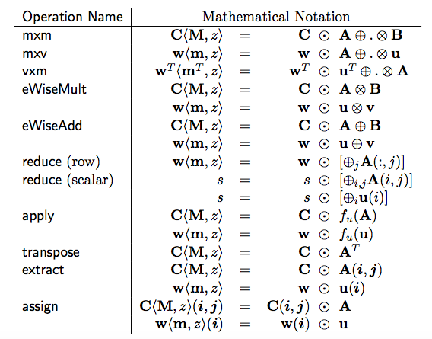
The GraphBLAS Operations
We’ve covered only a small fraction of the GraphBLAS Operations
The same conventions are used across all operations so the operations we did not cover are straightforward to pick up

Slide 98
Conclusion and next steps
The GraphBLAS define a standard API for “Graph Algorithms in the Language of Linear Algebra”.
A wide range of algorithms are variations of the basic breadth first traversal for a graph.
To reach GraphBLAS mastery
Attend the Graph Architectures Programming and Learning (GrAPL) workshop at IPDPS
Attend GraphBLAS BoFs at HPEC and Supercomputing
Explore the challenge problems included with this tutorial
Work through the algorithms in the Graph book →

Slide 99
GraphBLAS at HPEC 2019
GraphBLAS is a community effort. Join the community:
Go to graphblas.org and join our mailing list
Attend the HPEC GraphBLAS Birds of a Feather (BOF) Wednesday from 6 PM to 7 PM, Eden Vale C1.
Please give us feedback about the tutorial by filling out the survey or sending email:
timothy.g.mattson@intel.com
smcmillan@sei.cmu.edu
Tell us what you really liked.
Tell us what we should change
Tell us what you wish we’d covered but didn’t
Plus anything else that might help us improve

Slide 100
Appendices
MxM: the low-level details of the GraphBLAS operations
Challenge Problems: Some key algorithms with the GraphBLAS
SuiteSparse: usage notes, extensions and future plans
Reference material

Slide 101
GraphBLAS: details of operations
When you read the GraphBLAS C API specification, the operations are described in a manner that may seem obtuse.
The definitions, however, are presented in this way for good reasons:
to cover the full range of variations exposed by the various arguments and to express the operation without ever specifying the undefined elements (i.e. the “zeros” of the semiring).
To avoid any reference to the non-stored elements of the sparse matrix. In sparse arrays, the undefined elements are usually assumed to be the ”zero of the semiring”. By defining the operations without any reference to those “un-stored values”, we can freely change the semirings between operations without having to update the un-stored elements.

Slide 102

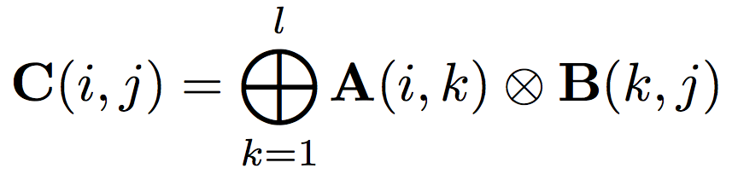
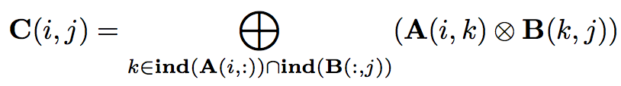
GrB_mxm()
Matrix Multiplication … the way we learned it in school
Matrix Multiplication … set notation to ignore un-stored elements
With set notation, it’s easier to define the operations over a matrix as the semi-ring changes

Slide 103
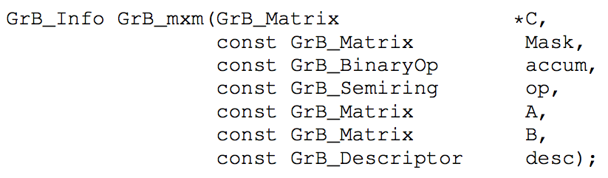
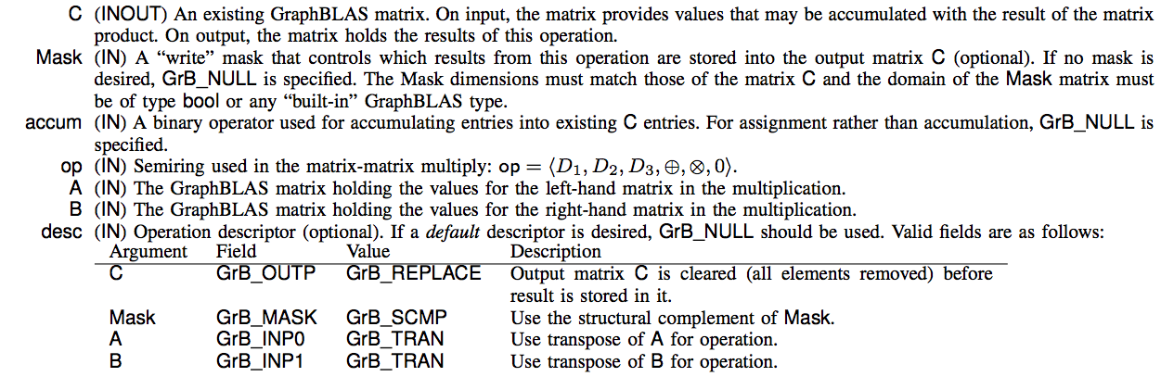
GrB_mxm(): Function Signature

Slide 104
GrB_mxm(): Function Signature
GrB_Info return values:
GrB_SUCCESS | Blocking mode: Operations completed successfully. Nonblocking mode: consistency tests passed on dimensions and domains for input arguments
GrB_PANIC | Unknown Internal error
GrB_OUTOFMEM | Not enough memory for the operation
GrB_DIMENSION_MISMATCH | Matrix dimensions are incompatible.
GrB_DOMAIN_MISMATCH | Domains of matrices are incompatible with the domains of the accumulator, semiring, or mask.

Slide 105
Standard function behavior
Consider the following code:
GrB_Descriptor_new(&desc);
GrB_Descriptor_set(desc, GrB_OUTP, GrB_REPLACE);
GrB_Descriptor_set(desc, GrB_INP0, GrB_TRANS);
GrB_mxm(&C, M, Int32Add, Int32AddMul, A, B, desc);
int32AddMul semiring
int32Add accumulation
Form input operands and mask based on descriptor | C, B, M, A ← A^{T}
Test the domains and sizes for consistency. | int32, dims match
Carry out the indicated operation | T ← A *.+ B, Z ← C + T
Apply the write-mask to select output values | Z ← Z ∩ M
Replace mode: delete elements in output object and replace with output values | C ← Z
Merge mode: Assign output value (i,j) to element (i,j) of output object, but leave other elements of the output object alone.

Slide 106
MXM flowchart
To understand what happens inside a graphBLAS operation, consider matrix multiply.
All the operations follow this basic format
GrB_Info GrB_mxm(
GrB_Matrix C,
const GrB_Matrix M,
const GrB_BinaryOp accum,
const GrB_Semiring op,
const GrB_Matrix A,
const GrB_Matrix B,
const GrB_Descriptor desc);

Slide 107
Exercise: Matrix Matrix Multiplication
Multiply the adjacency matrix from our “logo graph” by itself.
Print resulting matrix and interpret the result
Hint: Do the multiply again and compare results. Do you see the pattern?
0
1
6
4
3
2
5

Slide 108
Appendices
MxM: the low-level details of the GraphBLAS operations
Challenge Problems: Some key algorithms with the GraphBLAS
SuiteSparse: usage notes, extensions and future plans
Reference material

Slide 109
Challenge problems
Triangle counting
PageRank
Betweenness Centrality
Maximal Independent Set
Work in Progress: We should make a slide for each problem defining the algorithm in enough detail so students can implement the GraphBLAS implementation on their own

Slide 110
Counting Triangles (once) with GraphBLAS
Given:
Undirected graph G = {V, E}
L: boolean, lower-triangular portion of adjacency matrix
# triangles = ||L ⊗ (L ⊕.⊗ L^{T})||₁
Semiring can be Plus-AND or Plus-Times
Element-wise multiplication is equivalent to a mask operation
uint64_t triangle_count(GrB_Matrix L) // L: NxN, lower-triangular, boolean
{
GrB_Index N;
GrB_Matrix_nrows(&N, L);
GrB_matrix C;
GrB_Matrix_new(&C, GrB_UINT64, N, N);
GrB_mxm(C, L, GrB_NULL, GrB_UInt64AddMul, L, L, GrB_TB); // C<L> = L * L^{T}
uint64_t count;
GrB_reduce(&count, GrB_NULL, GrB_UInt64Add, C, GrB_NULL);// 1-norm of C
return count;
}

Slide 111
Appendices
MxM: the low-level details of the GraphBLAS operations
Challenge Problems: Some key algorithms with the GraphBLAS
SuiteSparse: usage notes, extensions and future plans
Reference material

Slide 112
SuiteSparse:GraphBLAS
Full implementation of GraphBLAS Specification written by Tim Davis, Texas A&M University
Easy-to-read User Guide with lots of examples
Already in Ubuntu, Debian, Mac HomeBrew, ...
Most operations just as fast as MATLAB (like C=A*B)
assign and setElement can be 1000x faster (or more!) than MATLAB, by exploiting non-blocking mode
V2.1: matrices by-row and by-column; by-row is often faster than by-column when A(i,j) is the edge (i,j). Compile with –DBYROW or use GxB_set(…)
Graph algorithms in GraphBLAS typically faster than novice-level graph algorithm without GraphBLAS, and easier to write
http://faculty.cse.tamu.edu/davis/GraphBLAS
Content provided by Tim Davis

Slide 113
SuiteSparse:GraphBLAS extensions
MATLAB-like colon notation for GrB_assign, extract
unary operators ONE, ABS, LNOT_[type]
ISEQ, ISNE, ISLT, ... return same type as inputs (e.g. PLUS monoid cannot be combined with Boolean EQ, but PLUS-ISEQ can, to count the number of equal pairs)
query: size of type, type of matrix, ...
GxB_select: like MATLAB L=tril(A,k), d=diag(A), ...
GxB_get/set: to change matrix format (by row, by col, hypersparse)
44 built-in monoids
960 built-in semirings (like GxB_LOR_LAND_BOOL)
GxB_resize: change size of matrix or vector
GxB_subassign: variation of GrB_assign
GxB_kron: Kronecker product
Thread-safe if called by user application threads, in parallel
Content provided by Tim Davis

Slide 114
SuiteSparse:GraphBLAS future
Multicore parallelism via OpenMP
Variable-sized types (imagine matrix of matrices, or a matrix of arbitrary-sized integers with 10’s or 1000’s of digits)
Solvers: Ax=b over a group (double, GF(2), ...)
Better performance: e.g. many monoids could terminate quickly:
OR (x1, x2, x3, ...) becomes true as soon as any xi = true
also for AND, and reduction ops FIRST and SECOND
Iterators for algorithms like depth-first-search
Reduction to vector or scalar: could also return the index for some operators (MAX, MIN, FIRST, SECOND): argmin, argmax
Pretty-print methods
Serialization to/from a binary string: for binary file I/O, or sending/receiving a GrB_Matrix in an MPI message; with compression
Priority queue: a GrB_Vector acting like a heap
Concatenate: like C=[A;B] in MATLAB
Interface to MATLAB, Julia, Python, ...
Faster C=A*B for user-defined types and operators
Content provided by Tim Davis

Slide 115
Appendices
MxM: the low-level details of the GraphBLAS operations
Challenge Problems: Some key algorithms with the GraphBLAS
SuiteSparse: usage notes, extensions and future plans
Reference material

Slide 116
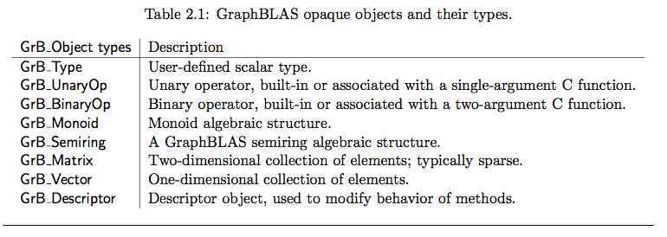
Full set of GraphBLAS opaque objects

Slide 117
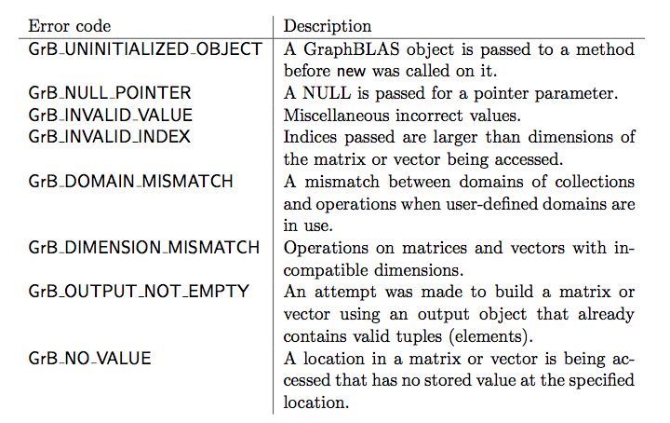
Error codes returned by GraphBLAS methods API Errors

Slide 118
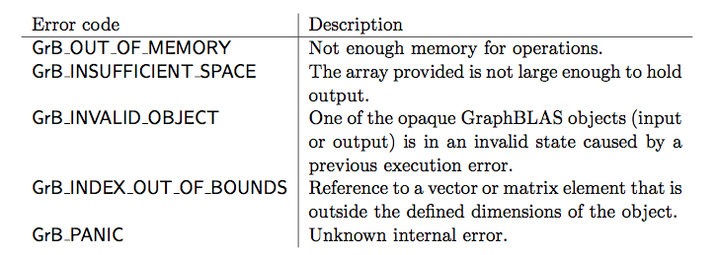
Error codes returned by GraphBLAS methods Execution Errors

