Slide 1
A Hands-On Introduction to the GraphBLAS http://graphblas.org
This version includes notes and updates from our first run of this tutorial at HPEC’18
≡
Scott McMillan
CMU/SEI
Tim Mattson
Intel Labs
Brought to you by the “GraphBLAS C Specification Gang” (of Five):
Aydın Buluç (LBNL), Tim Mattson (Intel), Scott McMillan (CMU/SEI) Jose Moreira (IBM), Carl Yang (UC Davis)
… and a special thank you to Tim Davis (Texas A&M) for GraphBLAS support in SuiteSparse

Slide 2
Copyright 2018 Carnegie Mellon University and Intel Corporation. All Rights Reserved.
This material is based upon work funded and supported by the Department of Defense under Contract No. FA8702-15-D-0002 with Carnegie Mellon University for the operation of the Software Engineering Institute, a federally funded research and development center.
The view, opinions, and/or findings contained in this material are those of the author(s) and should not be construed as an official Government position, policy, or decision, unless designated by other documentation.
NO WARRANTY. THIS CARNEGIE MELLON UNIVERSITY AND SOFTWARE ENGINEERING INSTITUTE MATERIAL IS FURNISHED ON AN "AS-IS" BASIS. CARNEGIE MELLON UNIVERSITY MAKES NO WARRANTIES OF ANY KIND, EITHER EXPRESSED OR IMPLIED, AS TO ANY MATTER INCLUDING, BUT NOT LIMITED TO, WARRANTY OF FITNESS FOR PURPOSE OR MERCHANTABILITY, EXCLUSIVITY, OR RESULTS OBTAINED FROM USE OF THE MATERIAL. CARNEGIE MELLON UNIVERSITY DOES NOT MAKE ANY WARRANTY OF ANY KIND WITH RESPECT TO FREEDOM FROM PATENT, TRADEMARK, OR COPYRIGHT INFRINGEMENT.
[DISTRIBUTION STATEMENT A] This material has been approved for public release and unlimited distribution. Please see Copyright notice for non-US Government use and distribution.
This material may be reproduced in its entirety, without modification, and freely distributed in written or electronic form without requesting formal permission. Permission is required for any other use. Requests for permission should be directed to the Software Engineering Institute at permission@sei.cmu.edu.
DM18-1037

Slide 3
HPEC tutorial
We had 16 students by the end of the day.
Two of them had Windows systems and were not able to fully participate. They stayed through the whole tutorial (I guess they did the exercises but didn’t compiler or run them).
One person (not included in that count of 16) at the beginning of the tutorial when he heard we do not support windows, left to attend a different tutorial.
We took about two hours to get up to the section on Breadth first traversal which is pretty much exactly what we expected. We did skip exercise 6 which was just fine.
We made it to the end of the tutorial. Some students actually finished the BFS levels exercise.

Slide 4
Outline
Graphs and Linear Algebra
The GraphBLAS C API and Adjacency Matrices
GraphBLAS Operations
Breadth-First Traversal

Slide 5

Understanding relationships between items
Graph: A visual representation of a set of vertices and the connections between them (edges).
0
1
6
3
4
2
5
Graph: Two sets, one for the vertices ($v$) and one for the edges ($e$)
$$v∈[0, 1, 2, 3, 4, 5, 6]$$
$$e∈[\left(0,1\right), \left(0,3\right), \left(1,4\right), \left(1,6\right), \left(2,5\right),\left(3,0\right),\left(3,2\right), \left(4,5\right), \left(5,2\right), \left(6,2\right), \left(6,3\right), (6,4)]$$

Slide 6
A graph as a matrix
Adjacency Matrix: A square matrix (usually sparse) where rows and columns are labeled by vertices and non-empty values are edges from a row vertex to a column vertex
To vertex (columns)
0
1
- | ★ | - | ★ | - | - | -
- | - | - | - | ★ | - | ★
- | - | - | - | - | ★ | -
★ | - | ★ | - | - | - | -
- | - | - | - | - | ★ | -
- | - | ★ | - | - | - | -
- | - | ★ | ★ | ★ | - | -
6
3
4
A =
From vertex (rows)
2
5
By using a matrix, I can turn algorithms working with graphs into linear algebra.
Notes:
You can turn them into semi-ring algebra.
Tim answers … No, its linear algebra. The semi-ring is the algebraic structure used when defining the domain and operations in the linear vector space.

Slide 7

Graph Algorithms and Linear Algebra
Most common graph algorithms can be represented in terms of linear algebra.
This is a mature field … it even has a book.
Benefits of graphs as linear algebra
Well suited to memory hierarchies of modern microprocessors
Can utilize decades of experience in distributed/parallel computing from linear algebra in supercomputing.
Easier to understand … for some people.

Slide 8
How do linear algebra people write software?
They do so in terms of the BLAS:
The Basic Linear Algebra Subprograms: low-level building blocks from which any linear algebra algorithm can be written
BLAS 1 | Vector/vector | Lawson, Hanson, Kincaid and Krogh, 1979 | LINPACK
BLAS 2 | Matrix/vector | Dongarra, Du Croz, Hammarling and Hanson, 1988 | LINPACK on vector machines
BLAS 3 | Matrix/matrix | Dongarra, Du Croz, Hammarling and Hanson, 1990 | LAPACK on cache based machines
The BLAS supports a separation of concerns:
HW/SW optimization experts tuned the BLAS for specific platforms.
Linear algebra experts built software on top of the BLAS ... high performance “for free”.
It is difficult to over-state the impact of the BLAS … they revolutionized the practice of computational linear algebra.

Slide 9
GraphBLAS: building blocks for graphs as linear algebra
Basic objects
Matrix, vector, algebraic structures, and ”control objects”
Fundamental operations over these objects
Element-wise operations (eWiseAdd, eWiseMult)
Matrix multiplication
Matrix-vector multiplication
(vxm, mxv)
Extract (and Assign) submatrices
…plus reductions, transpose, and application of a function to each element of a matrix or vector

Slide 10
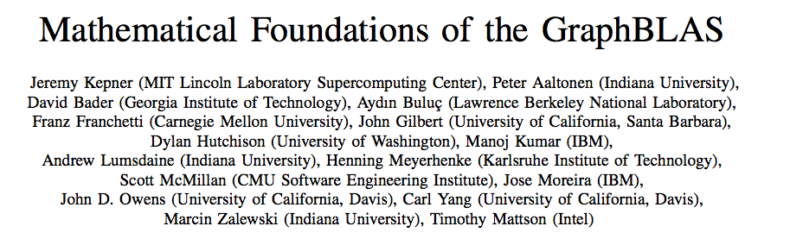
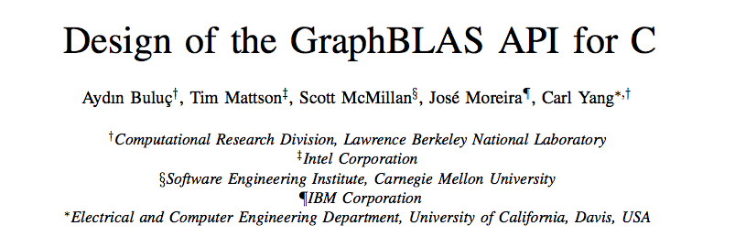
GraphBLAS References
IEEE HPEC 2016
IEEE HPEC 2017
The official GraphBLAS C spec can be found at: www.graphblas.org

Slide 11

GraphBLAS Implementations
Multiple implementation projects:
SuiteSparse library, http://faculty.cse.tamu.edu/davis/suitesparse.html
A C-wrapper around the GPU Gunrock library from UC Davis, http://adsabs.harvard.edu/abs/2017arXiv170101170W
The IBM GraphBLAS C implementation, https://github.com/IBM/ibmgraphblas
CMU/SEI C++ GraphBLAS Template Library https://github.com/cmu-sei/gbtl (there is also a python wrapper called pyGB with UW/PNNL).
We’ll use SuiteSparse:GraphBLAS in this tutorial
SuiteSparse:GraphBLAS: graph algorithms in the language of sparse linear algebra, T. A. Davis, Texas A&M U, submitted to TOMS
Notes:
Need to add PNNL to CMU/SEI

Slide 12
Exercise 1: Build a GraphBLAS program
Clone our git repository
Includes the following components
Exercises and solutions
SuiteSparse library, binaries for Linux and OSX and source
Load software onto your system, make sure you can build and run our test program
git clone https://github.com/tgmattso/GraphBLAS.git
cd GraphBLAS/src
make BuildGraph.exe
./BuildGraph.exe
If all goes well, your output should look like this:
$ ./BuildGraph.exe
Matrix: GRAPH =
[ -, -, -]
[ -, -, 4]
[ -, -, -]

Slide 13
Outline
Graphs and Linear Algebra
The GraphBLAS C API and Adjacency Matrices
GraphBLAS Operations
Breadth-First Traversal

Slide 14
GraphBLAS C API
A binding of the GraphBLAS math to the C programming language.
Requires C99 extended with function polymorphism based on static-types and number-of-parameters.
All modern C compilers in common use today support these extensions
Basic include file with function prototypes, types, and constants
#include <GraphBLAS.h>
Includes a few types and opaque objects (e.g. matrices and vectors) to give implementations maximum flexibility
GrB_Index | → An integer type used to set dimensions and index into arrays
GrB_Matrix | → A 2D sparse array, row indices, column indices and values
GrB_Vector | → A 1D sparse array
… plus additional opaque objects we’ll describe later (descriptors, semirings, binary operators, and unary operators)

Slide 15
GraphBLAS C API: Basic definitions
Opaque object: An object manipulated strictly through the GraphBLAS API whose implementation is not defined by the GraphBLAS specification.
Transparent object: an object whose structure is fully exposed to the programmer. E.g.: an array of tuples <i, j, value>
Method: Any C function that manipulates a GraphBLAS opaque object.
Domain: the set of available values used for the elements of matrices, the elements of vectors, and when defining operators.
Examples are GrB_UINT64, GrB_INT32, GrB_BOOL, GrB_FP32
Operation: a method that corresponds to an operation defined in the GraphBLAS math spec. http://www.mit.edu/~kepner/GraphBLAS/GraphBLAS-Math-release.pdf
Examples: matrix multiply, matrix-vector multiply, reduction, apply

Slide 16
Execution modes
A GraphBLAS program defines a DAG of operations.
Objects are defined by the sequence of GraphBLAS method calls, but the value of the object is not assured until a GraphBLAS method queries its state.
This gives an implementation flexibility to optimize the execution (fusing methods, replacing method sequences by more efficient ones, etc.)
GrB_op1(A);
GrB_op2(B);
GrB_op1(A);
GrB_op2(B);
GrB_op3(C,A,B);
GrB_op3(C,A,B);
An execution of a GraphBLAS program defines a context for the library.
The execution runs in one of two modes:
Blocking mode … executes methods in program order with each method completing before the next is called
Non-Blocking mode … methods launched in order. Complete in any order consistent with the DAG. Objects do not exit in fully defined state until queried.
Most implementations only support blocking mode.
Notes:
Tim Davis says: “SuiteSparse:GraphBLAS uses non-blocking for assign and setElement”
Scott may disagree with the terminology.

Slide 17
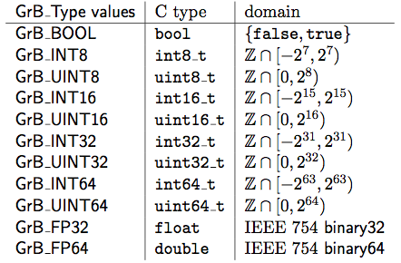
Predefined low-level types
Predefined types used to define domains in GraphBLAS

Slide 18
Code from our first example
#include <stdio.h>
#include <assert.h>
#include <GraphBLAS.h>
#include "tutorial_utils.h"
int main(int argc, char** argv) {
GrB_init(GrB_BLOCKING);
GrB_Index const NUM_NODES = 3;
GrB_Matrix graph;
GrB_Matrix_new(&graph, GrB_UINT64,
NUM_NODES, NUM_NODES);
GrB_Matrix_setElement(graph, 4, 1, 2);
pretty_print_matrix_UINT64(graph, "GRAPH");
GrB_Index nvals;
GrB_Matrix_nvals(&nvals, graph);
assert(nvals == 1);
// Cleanup
GrB_free(&graph);
GrB_finalize();
}
Initialize a context in BLOCKING mode
GrB_Index used for matrix dimension
Create a matrix object of order NUM_NODES and domain UINT64
Store the value 4 in element (1,2)
Our own “pretty print” routine (not part of GraphBLAS)
Query the matrix for the number of defined (stored) values and check for correctness
Free memory used for our matrix
Close the context, release resources
Notes:
BuildGraph.c

Slide 19
Exercise 2: Adjacency matrix
Draw a simple graph with 3 to 5 nodes.
Write a program to create the adjacency matrix.
Use BuildGraph.c as an example.
Output the result and verify that your adjacency graph is correct.
You will need the following types and methods from the GraphBLAS
GrB_Index, GrB_Matrix
GrB_init(); GrB_finalize();
GrB_Matrix_new(&graph, GrB_domain, Nrows, Ncols);
GrB_Matrix_setElement(graph, value, from_node, to_node);
GrB_Matrix_nvals(&nvals, graph);
GrB_free(&graph);
Hint: Save time and minimize typing
Copy BuildGraph.c into another file (e.g. exercise2.c) and modify it to build your adjacency matrix program.
Edit the makefile and add your new source file to the list in the definition of SOURCES. Then you can just type “make” to build your program.

Slide 20
Exercise 2: Adjacency matrix
Draw a simple graph with 3 to 5 nodes.
Write a program to create the adjacency matrix.
Use BuildGraph.c as an example.
Output the result and verify that your adjacency graph is correct.
You will need the following types and methods from the GraphBLAS
GrB_Index, GrB_Matrix
GrB_init(); GrB_finalize();
GrB_Matrix_new(&graph, GrB_domain, Nrows, Ncols);
GrB_Matrix_setElement(graph, value, from_node, to_node);
GrB_Matrix_nvals(&nvals, graph);
GrB_free(&graph);
Hint: Save time and minimize typing
Copy BuildGraph.c into another file (e.g. exercise1.c) and modify it to build your adjacency matrix program.
Edit the makefile and add your new source file to the list in the definition of SOURCES. Then you can just type “make” to build your program.
A quick API note … Opaque objects are passed around through a handle (e.g. graph).
When the handle itself changes, we pass by address (i.e. with a &).
When the object referenced by the handle is manipulated but the handle doesn’t change, we pass by value (i.e. without the &).

Slide 21
Solution to Exercise 2
Our three node graph with edge weights:
...
GrB_init(GrB_BLOCKING);
GrB_Index const NUM_NODES = 3;
GrB_Matrix graph;
GrB_Matrix_new(&graph, GrB_UINT64,
NUM_NODES, NUM_NODES);
GrB_Matrix_setElement(graph, 4, 1, 2);
GrB_Matrix_setElement(graph, 4, 2, 1);
GrB_Matrix_setElement(graph, 2, 0, 1);
GrB_Matrix_setElement(graph, 2, 1, 0);
pretty_print_matrix_UINT64(graph, "Graph");
GrB_free(&graph);
GrB_finalize();
0
2
2
1
4
4
2
Matrix: Graph:
[ -, 2, -]
[ 2, -, 4]
[ -, 4, -]
Notes:
BuildAdjMatTuple
Look at dotty for visualizing (from graphviz?)

Slide 22
Building matrices
Building a matrix one edge at a time is awkward.
It is often more convenient to do it from vectors defining the indices and values for non-empty elements of the sparse matrix
GrB_Info GrB_Matrix_build( | GrB_Matrix | C,
 | const GrB_Index | *row_indices,
 | const GrB_Index | *col_indices,
 | const <type> | *values,
 | GrB_Index | n,
 | const GrB_BinaryOp | dup);
row_indices, col_indices, and values are transparent arrays.
<type> is a C type consistent with the domain of the matrix
n is the number of entries in the sparse matrix
dup is an associative, commutative function to apply to the values should duplicate locations be specified.
Typically use one of the GraphBLAS predefined operators
Notes:
Need to discuss return codes.
Tim Davis comment: setElement almost as fast as build because of lazy evaluation exploit

Slide 23
Building matrices
Building a matrix one edge at a time is awkward.
It is often more convenient to do it from vectors defining the indices and values for non-empty elements of the sparse matrix
GrB_Info GrB_Matrix_build( | GrB_Matrix | C,
 | const GrB_Index | *row_indices,
 | const GrB_Index | *col_indices,
 | const <type> | *values,
 | GrB_Index | n,
 | const GrB_BinaryOp | dup);
Return values:
GrB_SUCCESS if everything worked
Other values for problems with input arguments, memory issues, internal errors or other problems.
row_indices, col_indices, and values are transparent arrays.
<type> is a C type consistent with the domain of the matrix
n is the number of entries in the sparse matrix
dup is an associative, commutative function to apply to the values should duplicate locations be specified.
Typically use one of the GraphBLAS predefined operators
Notes:
Need to discuss return codes (will be showing code that checks these for clarity)
Tim Davis comment: setElement almost as fast as build because of lazy evaluation exploit

Slide 24
GraphBLAS predefined operators
A subset of operators from Table 2.3 of the GraphBLAS specification
Identifier | Domains | Description
GrB_LOR | bool x bool → bool | f(x,y) = x ∨ y | Logical OR
GrB_LAND | bool x bool → bool | f(x,y) = x ∧ y | Logical AND
GrB_EQ_T | T x T → bool | f(x,y) = (x==y) | Equal
GrB_MIN_T | T x T → T | f(x,y) =(x<y)?x:y | minimum
GrB_MAX_T | T x T → T | f(x,y) =(x>y)?x:y | maximum
GrB_PLUS_T | T x T → T | f(x,y) = x + y | addition
GrB_TIMES_T | T x T → T | f(x,y) = x * y | multiplication
GrB_FIRST_T | T x T → T | f(x,y) = x | First argument
GrB_SECOND_T | T x T → T | f(x,y) = y | Second argument
Where T is a suffix indicating type and includes FP32, FP64, INT32, UINT32, BOOL
Note: GrB_FIRST and GrB_SECOND are not commutative operators
This is a subset of the defined types and operators. See table 2.3 for the full list.

Slide 25
C code fragment using GrB_Matrix_build
GrB_Index const NUM_NODES = 3;
GrB_Index const NUM_EDGES = 4;
GrB_Index row_indices[] = {0, 1, 1, 2};
GrB_Index col_indices[] = {1, 0, 2, 1};
bool values[] = {true, true, true, true};
GrB_Matrix graph;
GrB_Matrix_new(&graph, GrB_BOOL, NUM_NODES, NUM_NODES);
GrB_Matrix_build(graph,
row_indices, col_indices, (bool*)values,
NUM_EDGES, GrB_LOR);

Slide 26
Exercise 3: Adjacency matrix
Write a program to create the adjacency matrix for the GraphBLAS “logo” graph using row, column and value arrays.
0
1
6
3
4
2
5
You will need the following types and methods from the GraphBLAS
GrB_Index, GrB_Matrix
GrB_init(); GrB_finalize();
GrB_Matrix_new(&graph, GrB_domain, Nrows, Ncols);
GrB_Matrix_build(graph, row_indices, col_indices, values,
NUM_EDGES, dup);
GrB_Matrix_nvals(&nvals, graph);
GrB_free(&graph);

Slide 27
Summary of solution to exercise 3
0
1
Matrix: Graph =
[ -, 1, -, 1, -, -, -]
[ -, -, -, -, 1, -, 1]
[ -, -, -, -, -, 1, -]
[ 1, -, 1, -, -, -, -]
[ -, -, -, -, -, 1, -]
[ -, -, 1, -, -, -, -]
[ -, -, 1, 1, 1, -, -]
6
4
3
2
5
GrB_Index const NUM_NODES = 7;
GrB_Index const NUM_EDGES = 12;
GrB_Index row_indices[] = {0, 0, 1, 1, 2, 3, 3, 4, 5, 6, 6, 6};
GrB_Index col_indices[] = {1, 3, 4, 6, 5, 0, 2, 5, 2, 2, 3, 4};
bool values[] = {true, true, true, true, true, true,
true, true, true, true, true, true};
GrB_Matrix graph;
GrB_Matrix_new(&graph, GrB_BOOL, NUM_NODES, NUM_NODES);
GrB_Matrix_build(graph, row_indices, col_indices, (bool*)values,
NUM_EDGES, GrB_LOR);
pretty_print_matrix_UINT64(graph, "Graph");
Notes:
BuildAdjMatIndVec.c

Slide 28
Outline
Graphs and Linear Algebra
The GraphBLAS C API and Adjacency Matrices
GraphBLAS Operations
Breadth-First Traversal

Slide 29
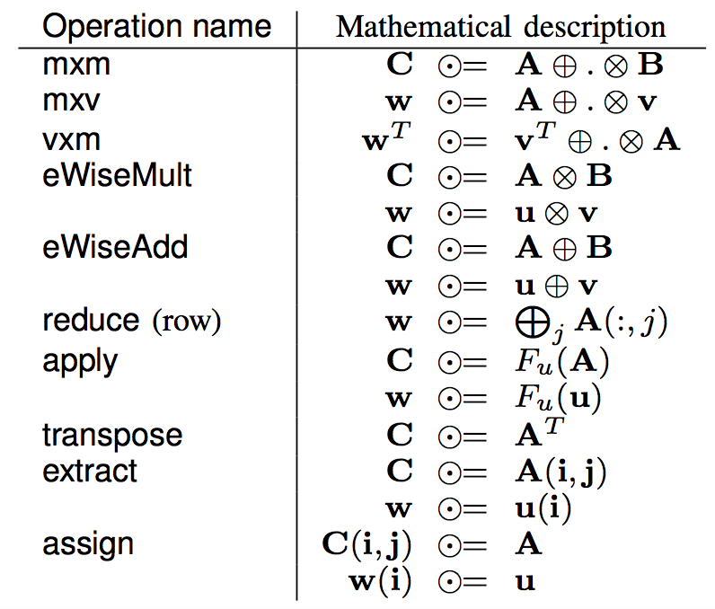
GraphBLAS Operations (from the Math Spec*)
We use ⊙, ⊕, and ⊗ since later on we’ll manipulate the algebraic structure to generalize them to other operations.
* Mathematical foundations of the GraphBLAS, Kepner et. al. HPEC’2016
Notes:
http://www.mit.edu/~kepner/GraphBLAS/GraphBLAS-Math-release.pdf

Slide 30

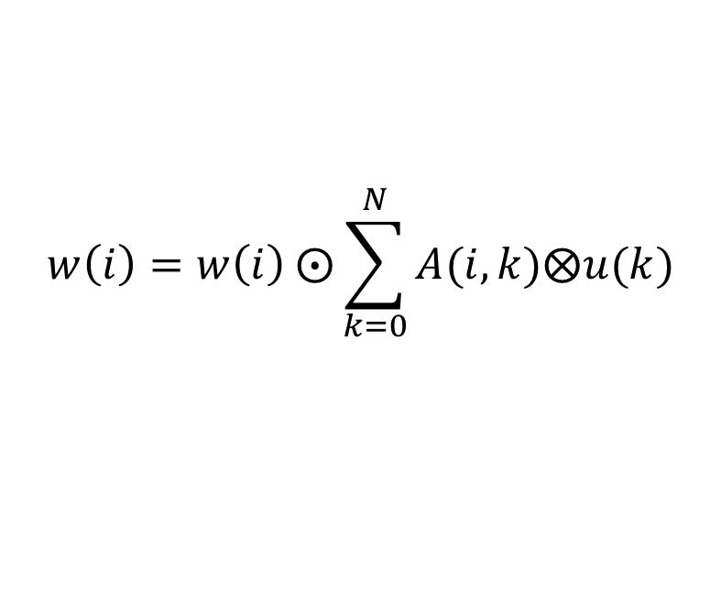



GrB_mxv()
$\text{w} ⨀$= A⊕.⊗u
Multiply a matrix times a vector to produce a vector
$$w\left(i\right)=w\left(i\right) ⨀\sum_{k=0}^{N}{A(i,k)⨂u(k)}$$
$$w∈S^{M}$$
$$u∈S^{N}$$
$$A∈S^{M×N}$$
Definitions:
S is the domain of the objects w, u, and A
⊙ is an optional accumulation operator (a binary operator)
⊗ and ⊕ are multiplication and addition (or generalizations thereof)
∑ uses the ⊕ operator

Slide 31


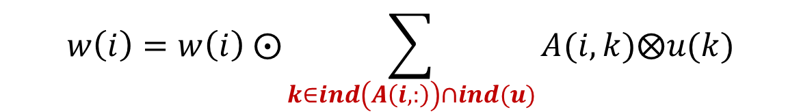

GrB_mxv()
$\text{w} ⨀$= A⊕.⊗u
Multiply a matrix times a vector to produce a vector
$$w\left(i\right)=w\left(i\right) ⨀\sum_{k∈ind\left(A\left(i,:\right)\right)∩ind(u)}{A(i,k)⨂u(k)}$$
The summation is over the intersection of the existing elements in the i^{th} row of A with u … which avoids exposing how empty elements (i.e. “zeros”) are represented. This becomes important when we change the semiring between operations
$$w∈S^{M}$$
$$u∈S^{N}$$
$$A∈S^{M×N}$$
Definitions:
S is the domain of the objects w, u, and A
⊙ is an optional accumulation operator (a binary operator)
⊗ and ⊕ are multiplication and addition (or generalizations thereof)
∑ uses the ⊕ operator
ind(u) returns the indices of the stored values of u

Slide 32
GrB_mxv()
$\text{w} ⨀$= A⊕.⊗u
Compute the product of a GraphBLAS sparse matrix with a GraphBLAS vector.
Returns error codes of type GrB_info. See the spec for details.
GrB_Info GrB_mxv( | GrB_Vector | w,
 | const GrB_Vector | mask,
 | const GrB_BinaryOp | accum,
 | const GrB_Semiring | op,
 | const GrB_Matrix | A,
 | const GrB_Vector | u,
 | const GrB_Descriptor | desc);

Slide 33
GrB_mxv()
$\text{w} ⨀$= A⊕.⊗u
Compute the product of a GraphBLAS sparse matrix with a GraphBLAS vector.
Returns error codes of type GrB_info. See the spec for details.
GrB_Info GrB_mxv( | GrB_Vector | w,
 | const GrB_Vector | mask,
 | const GrB_BinaryOp | accum,
 | const GrB_Semiring | op,
 | const GrB_Matrix | A,
 | const GrB_Vector | u,
 | const GrB_Descriptor | desc);
GrB_NULL
GrB_NULL
GrB_NULL
Let’s ignore mask, accum and desc for now and use default values (indicated by GrB_NULL)

Slide 34
GrB_mxv()
$\text{w} ⨀$= A⊕.⊗u
Compute the product of a GraphBLAS sparse matrix with a GraphBLAS vector.
Returns error codes of type GrB_info. See the spec for details.
GrB_Info GrB_mxv( | GrB_Vector | w,
 | const GrB_Vector | mask,
 | const GrB_BinaryOp | accum,
 | const GrB_Semiring | op,
 | const GrB_Matrix | A,
 | const GrB_Vector | u,
 | const GrB_Descriptor | desc);
GrB_NULL
GrB_NULL
GrB_NULL
Op defines the algebraic structure, a semiring in this case. This gives us ⊗ and ⊕ and the identity for ⊕. We’ll say much more about his later.
For our first exercises with bool objects, we’ll use a built-in SuiteSparse semiring
GxB_LOR_LAND_BOOL.

Slide 35
Exercise 4: Matrix Vector Multiplication
Use the adjacency matrix from exercise 3 and a vector with a single value to select one of the nodes in the graph.
Find the product mxv, print the result, and interpret its meaning.
In addition to those from Exercise 3, you’ll need the functions:
1
0
6
3
4
2
5
GrB_Vector result, vec;
GrB_Index NODE;
GrB_Vector_new(&vec, GrB_BOOL, NUM_NODES);
GrB_Vector_setElement(vec, true, NODE);
pretty_print_vector_UINT64(vec, ”Input node");
GrB_mxv(result, GrB_NULL, GrB_NULL,
GxB_LOR_LAND_BOOL, graph, vec, GrB_NULL);

Slide 36
Solution to exercise 4
0
1
pretty_print_matrix_UINT64(graph, "GRAPH");
// Build a vector with one node set.
GrB_Index const NODE = 2;
GrB_Vector vec, result;
GrB_Vector_new(&result, GrB_BOOL, NUM_NODES);
GrB_Vector_new(&vec, GrB_BOOL, NUM_NODES);
GrB_Vector_setElement(vec, true, NODE);
pretty_print_vector_UINT64(vec, "Target node");
GrB_mxv(result, GrB_NULL, GrB_NULL,
GxB_LOR_LAND_BOOL, graph, vec, GrB_NULL);
pretty_print_vector_UINT64(result, "sources");
6
4
3
2
5
Matrix: GRAPH =
[ -, 1, -, 1, -, -, -]
[ -, -, -, -, 1, -, 1]
[ -, -, -, -, -, 1, -]
[ 1, -, 1, -, -, -, -]
[ -, -, -, -, -, 1, -]
[ -, -, 1, -, -, -, -]
[ -, -, 1, 1, 1, -, -]
Vector: Target node =
[ -, -, 1, -, -, -, -]
Vector: sources =
[ -, -, -, 1, -, 1, 1]
The stored elements of the adjacency matrix, a(i,j) indicate an edge from vertex i to vertex j
So the matrix vector product scans over a row (from) to find when an edge lands at the destination
Notes:
matvec.c
Todo: mention 1-hop in the explanation. This helps build to BFS. This is traversing edges backwards!

Slide 37
Finding neighbors
A more common operation is to input a vector selecting a source and find all the neighbors one hop away from that vertex.
Using mxv(), how would you do this?

Slide 38
Finding neighbors
A more common operation is to input a vector selecting a source and find all the neighbors one hop away from that vertex.
Using mxv(), how would you do this?
The adjacency matrix elements indicate edges
from a vertex (row index)
to another vertex (columns index)
Then the transpose of the adjacency matrix indicates edges
To a vertex (row index)
From other vertices (column index)
Therefore, we can find the neighbors of a vertex (marked by the non-empty elements of v)
Neighbors = A^{T}⊕.⊗v
The GraphBLAS defines a transpose operation, but given how often you need to do a transpose, there must be a better way

Slide 39
Changing the behavior of a GraphBLAS operation
Most GraphBLAS operations take an argument that is an opaque object called a “descriptor”. You declare an descriptor called ”desc” and create it as follows:
GrB_Descriptor desc;
GrB_Descriptor_new (&desc);
The descriptor controls the behavior of the method and how objects are handled inside the method.
The descriptor controls:
Do you transpose input matrices? (GrB_TRAN)
Does the computation replace existing values in the output object or combine with them? (GrB_REPLACE)
Take the structural complement of the mask object (swap empty/false ←→ filled/true values in a sparse object). (GrB_SCMP)
….To be discussed later

Slide 40
Using Descriptors
A descriptor is an opaque object so you set its values with a GraphBLAS method.
A descriptor field selects the object it impacts:
GrB_OUTP: The output GraphBLAS object
GrB_INP0: The first input GraphBLAS object (matrix or vector)
GrB_INP1: The second input GraphBLAS object (matrix or vector)
GrB_MASK: The GraphBLAS mask object (described later).
A descriptor value describes the action to be taken.
For example, to transpose the first input matrix, you’d call the operation and pass in the following descriptor
GrB_Descriptor desc;
GrB_Descriptor_new(&desc);
GrB_Descriptor_set(desc, GrB_INP0, GrB_TRAN);

Slide 41
Exercise 5: Matrix Vector Multiplication
Modify your program from exercise 4 to multiply by the transpose of the adjacency matrix.
Verify that you can use that to find the one-hop neighbors of any vertex
GrB_Vector result, vec;
GrB_Index NODE;
GrB_Vector_new(&vec, GrB_BOOL, NUM_NODES);
GrB_Vector_setElement(vec, true, NODE);
pretty_print_vector_UINT64(vec, ”Input node");
GrB_Descriptor desc;
GrB_Descriptor_new(&desc);
GrB_Descriptor_set(desc, FIELD, VALUE)
GrB_mxv(result, GrB_NULL, GrB_NULL,
GxB_LOR_LAND_BOOL, graph, vec, desc);
FIELD: GrB_INP0, GrB_INP1, GrB_OUTP, GrB_MASK
VALUE: GrB_TRAN, GrB_REPLACE, GrB_SCMP

Slide 42
Solution to exercise 5
0
1
6
4
3
// Build a vector with one node set.
GrB_Index const SRC_NODE = 6;
GrB_Vector vec;
GrB_Vector_new(&vec, GrB_BOOL, NUM_NODES);
GrB_Vector_setElement(vec, true, SRC_NODE);
GrB_Descriptor desc;
GrB_Descriptor_new(&desc);
GrB_Descriptor_set(desc, GrB_INP0, GrB_TRAN);
pretty_print_vector_UINT64(vec, "source node");
GrB_mxv(vec, GrB_NULL, GrB_NULL,
GxB_LOR_LAND_BOOL, graph, vec, desc);
pretty_print_vector_UINT64(vec, "neighbors");
2
5
Vector: source node =
[ -, -, -, -, -, -, 1]
Vector: neighbors =
[ -, -, 1, 1, 1, -, -]
GrB_mxv test passed.
The transposed matrix vector product scans over a columns (to) to find edges that start at the source node.
Notes:
matvecTrans.c

Slide 43

GrB_mxv()
$\text{w} ⨀$= A⊕.⊗u
Compute the product of a GraphBLAS Sparse Matrix with a GraphBLAS vector.
Returns error codes of type GrB_info. See the spec for details.
GrB_Info GrB_mxv( | GrB_Vector | w,
 | const GrB_Vector | mask,
 | const GrB_BinaryOp | accum,
 | const GrB_Semiring | op,
 | const GrB_Matrix | A,
 | const GrB_Vector | u,
 | const GrB_Descriptor | desc);
GrB_NULL
GrB_NULL
GrB_NULL
It’s time to explain semirings in GraphBLAS operation

Slide 44
Algebraic Semirings
Semiring: An Algebraic structure that generalizes real arithmetic by replacing (+,*) with binary operations (Op1, Op2)
Op1 and Op2 have identity elements sometimes called 0 and 1
Op1 and Op2 are associative.
Op1 is commutative, Op2 distributes over Op1 from both left and right
The Op1 identify is an Op2 annihilator.

Slide 45
Algebraic Semirings
Semiring: An Algebraic structure that generalizes real arithmetic by replacing (+,*) with binary operations (Op1, Op2)
Op1 and Op2 have identity elements sometimes called 0 and 1
Op1 and Op2 are associative.
Op1 is commutative, Op2 distributes over Op1 from both left and right
The Op1 identify is an Op2 annihilator.
(R, +, *, 0, 1) Real Field | Standard operations in linear algebra
({0,1}, |, &, 0, 1) Boolean Semiring | Graph traversal algorithms
(R U {∞},min, +, ∞, 0) Tropical semiring | Shortest path algorithms
(R U {∞}, min, x, ∞, 1) | Selecting a subgraph or contracting nodes to form a quotient graph.
Notation: (R, +, *, 0, 1)
Scalar type
Op1
Op2
Identity Op1
Identity Op2

Slide 46
Algebraic Semirings
Semiring: An Algebraic structure that generalizes real arithmetic by replacing (+,*) with binary operations (Op1, Op2)
Op1 and Op2 have identity elements sometimes called 0 and 1
Op1 and Op2 are associative.
Op1 is commutative, Op2 distributes over Op1 from both left and right
The Op1 identify is an Op2 annihilator.
(R, +, *, 0, 1) Real Field | Standard operations in linear algebra
(R U {∞},min, +, ∞, 0) Tropical semiring | Shortest path algorithms
({0,1}, |, &, 0, 1) Boolean Semiring | Graph traversal algorithms
(R U {∞}, min, *, ∞, 1) | Selecting a subgraph or contracting nodes to form a quotient graph.
Notes:
False and true for boolean semiring???

Slide 47
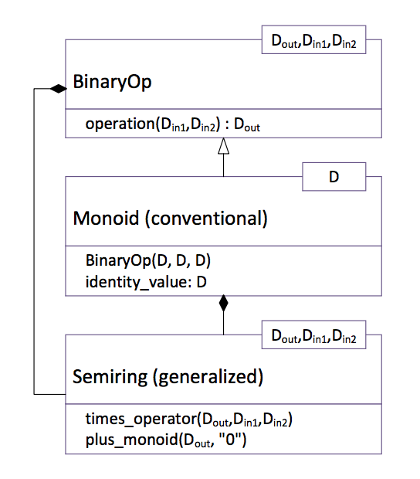
Algebraic structures in the GraphBLAS: Semirings and Monoids
The GraphBLAS semiring defines:
A set of allowed values (the domain)
Two commutative operators called addition and multiplication
An additive identity (called 0) that is the annihilator over multiplication.
A Monoid is used in defining a semiring:
Monoid: A domain, an associative binary operator and an identity corresponding to that operator
Hierarchy of algebraic object classes showing relationships between the various domains and the operators.

Slide 48





Building Semirings in the GraphBLAS
First you build the monoid (M) for a particular domain, D, the “addition” operator, and its identity:
$$M= <D, ⊕, 0>$$
Then define the semiring (S) in terms of the Monoid and the multiplications operator:
$$S= <D_{out},D_{in1}, D_{in2},M, ⨂>$$
The domains must be consistent:
$${⊗: D}_{in1}{ ×{ D}_{in2} →D}_{out}$$
$${⨁: D}_{out}{ ×{ D}_{out} →D}_{out}$$
$$0∈D_{out}$$

Slide 49
Building Semirings in the GraphBLAS
First you build the monoid (M) for the “addition” and its identity:
GrB_Info GrB_Monoid_new( | GrB_Monoid | *monoid,
 | GrB_BinaryOp | binary_op,
 | <type> | identity);
Where the type must be consistent with that of the binary operator which is either a built-in operator (Spec. Table 2.3) or a user-defined operator (not covered here)
Example:
GrB_Monoid UInt64Plus ; GrB_Monoid_new(&UInt64Plus, GrB_PLUS_UINT64, 0 ul);

Slide 50
Building Semirings in the GraphBLAS
Then you build the semiring pairing a monoid (“add”) with a binary operator (“mul”) :
GrB_Info GrB_Semiring_new( | GrB_Semiring | *semiring,
 | GrB_Monoid | add_op,
 | GrB_BinaryOp | mul_op);
The monoid’s identity should be the binary operator’s annihilator (not enforced).
Example using the monoid from the previous page:
GrB_Semiring UInt64Arith; GrB_Semiring_new(&UInt64Arith, UInt64Plus, GrB_TIMES_UINT64);

Slide 51
Common Semirings
semiring | Domain | Add | Add-identity | multiply
Boolean | GrB_BOOL | GrB_LOR | false | GrB_LAND
Int32 arithmetic | GrB_INT32 | GrB_PLUS_INT32 | 0 | GrB_TIMES_INT32
FP32 arithmetic | GrB_FP32 | GrB_PLUS_FP32 | 0.0f | GrB_TIMES_FP32
Max_second | GrB_FP32 | GrB_MAX_FP32 | 0.0f | GrB_SECOND_FP32

Slide 52
Exercise 6: Changing semirings
Up to this point, we’ve used a built-in Boolean semiring that is included with SuiteSparse (GxB_LOR_LAND_BOOL).
Pick any of the past exercises and experiment with different semi-rings.
GrB_Monoid UInt64Plus;
GrB_Monoid_new(&UInt64Plus, GrB_PLUS_UINT64, 0ul);
GrB_Semiring UInt64Arith;
GrB_Semiring_new(&UInt64Arith, UInt64Plus, GrB_TIMES UINT64);

Slide 53
Outline
Graphs and Linear Algebra
The GraphBLAS C API and Adjacency Matrices
GraphBLAS Operations
Breadth-First Traversal

Slide 54
Breadth First Traversal
The Breadth First Traversal:
Start from one or more initial vertices
Visit all accessible one hop neighbors,
Visit all accessible unique two hop neighbors,
Continue until no more unique vertices to visit
Note: keep track of vertices visited so you don’t visit the same vertex more than once
Breadth first traversal is a common pattern used in a range of graph algorithms
Build a spanning tree that contains all vertices and minimal number of edges
Search for accessible vertices with certain properties.
Find shortest paths between vertices.
Other more advanced algorithms such as maxflow and betweenness centrality

Slide 55
Our Breadth First Traversal plan
We will build up this algorithm using the GraphBLAS through a series of exercises:
Wavefronts and how to move from one wavefront to the next.
Iteration across wavefronts
Track which vertices have been visited
Avoid revisiting vertices
Construct the Level Breadth first traversal algorithm
Notes:
Introduce the concept of a wavefront (which is the result of the first mxv that is fed in as input to the second (the initial source vertex vector is also a wavefront).
So you have to add a loop, the exit condition for the loop is an empty vector so using call to Vector_nvals
But without doing anything this will traverse back to previously visited vectors (infinite loop).
Need to create a visited vector which is boolean and ANDs with the results of each mxv (introduces eWiseMult)
GrB_eWiseAdd(visited, NULL, NULL, LAND, wavefront, visited, NULL);
(LEAP) you can use complement of the visited vector as a mask to the wavefront (in self-assignment
Need to introduce mask, SCMP descriptor, and apply:
wavefront = apply(IDENTITY) of wavefront masked by complement of visited (AND you need to use replace)
(Alternative) UGH
It is too hard to introduce a new binary op in order to avoid the use of mask
After step 4 it is easy to roll the SCMP mask into the mxv itself and avoid the assign.
Turning this into a level BFS means that the visited vector uses integer domain
Introduce a depth/level variable and use assign constant variant (before the mxv) to assign elements of visited with the depth variable: GrB_assign(levels, wavefront, NULL, depth, GrB_ALL, NUM_NODES, NULL)

Slide 56
Wavefronts
A subset of vertices accessed at one stage in a breadth first search pattern … for example ….
“You tell two friends and they tell two friends…”
0
1
0
1
6
6
3
4
3
4
2
5
2
5
w = {0}
w = {1, 3}
w = {0, 2, 4, 6}
Red=current wavefront and visited, Blue=next wavefront, Black=unvisited

Slide 57
Exercise 7: Traverse the graph
Modify your code from Exercises 5 to iterate from one wavefront to the next.
Output each wavefront
How long before you get a repeating pattern?
GrB_Vector result, vec;
GrB_Index NODE;
GrB_Vector_new(&vec, GrB_BOOL, NUM_NODES);
GrB_Vector_setElement(vec, true, NODE);
pretty_print_vector_UINT64(vec, "Input node");
GrB_Descriptor desc;
GrB_Descriptor_new(&desc);
GrB_Descriptor_set(desc, FIELD, VALUE)
GrB_mxv(result, GrB_NULL, GrB_NULL,
GxB_LOR_LAND_BOOL, graph, vec, desc);

Slide 58
Solution to exercise 7
0
1
// First wavefront has one node set.
GrB_Index const SRC_NODE = 0;
GrB_Vector w;
GrB_Vector_new(&w, GrB_BOOL, NUM_NODES);
GrB_Vector_setElement(w, true, SRC_NODE);
GrB_Descriptor desc;
GrB_Descriptor_new(&desc);
GrB_Descriptor_set(desc, GrB_INP0, GrB_TRAN);
pretty_print_vector_UINT64(w,"wavefront(src)");
for (int i = 0; i < NUM_NODES; ++i) {
GrB_mxv(w, GrB_NULL, GrB_NULL,
GxB_LOR_LAND_BOOL, graph, w, desc);
pretty_print_vector_UINT64(w, "wavefront");
}
6
4
3
2
5
Vector: wavefront(src) =
[ 1, -, -, -, -, -, -]
Vector: wavefront =
[ -, 1, -, 1, -, -, -]
Vector: wavefront =
[ 1, -, 1, -, 1, -, 1]
Vector: wavefront =
[ -, 1, 1, 1, 1, 1, -]
Vector: wavefront =
[ 1, -, 1, -, 1, 1, 1]
Vector: wavefront =
[ -, 1, 1, 1, 1, 1, -]
Vector: wavefront =
[ 1, -, 1, -, 1, 1, 1]
…
The same container can be used for both input and output
Starts repeating after only a few iterations. Why?
Notes:
matvecTransIter (v2)

Slide 59
Solution to exercise 7: wavefronts
“We tell a bunch, and they tell bunch…(rinse and repeat)”
0
1
0
1
6
6
3
4
3
4
2
5
2
5
w = {0, 2, 4, 5, 6}
w = {1, 2, 3, 4, 5}
w = {0, 2, 4, 5, 6}
Red=current wavefront and visited, Blue=next wavefront, Black=unvisited

Slide 60
Visited lists
Breadth-first traversal requires that we visit each node once.
First step is to keep track of a visited list.
You can do this by accumulating the wavefronts.
Use element-wise logical-OR.

Slide 61

Element-wise Operations: Mult and Add
⊗ assumes unstored values (-) are the binary operator’s annihilator:
⊕ assumes unstored values (-) are the binary operator’s identity:
u ⊗ v
u ⊕ v
⊗
⊕
-
-
-
-
=
=
⊗
⊕
-
-
-
-
-
-
-
-
-
-
Examples: (x,0), (and, false), (+, ∞)
Examples: (+,0), (or, false), (min, ∞)
The rules for element-wise addition also apply to the accumulation operator, $⊙$
Notes:
When performing \circleplus and \circletimes on the same containers the unstored element should be interpreted as the same.

Slide 62
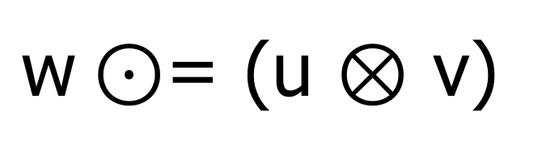
GrB_eWiseMult()
$\text{w}⊙$= (u ⊗ v)
Compute the element-wise “multiplication” of two GraphBLAS vectors.
Performs the specified operator (op) on the intersection of the sparse entries in each input vector , u and v.
op could be GrB_BinaryOp, GrB_Monoid, or GrB_Semiring
Returns error codes of type GrB_info. See the spec for details.
GrB_Info GrB_eWiseMult( | GrB_Vector | w,
 | const GrB_Vector | mask,
 | const GrB_BinaryOp | accum,
 | const GrB_BinaryOp | op,
 | const GrB_Vector | u,
 | const GrB_Vector | v,
 | const GrB_Descriptor | desc);
GrB_NULL
GrB_NULL
GrB_NULL
Use default values for mask, accum and desc (indicated by GrB_NULL)

Slide 63
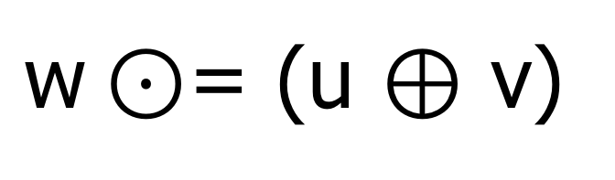
GrB_eWiseAdd()
$\text{w}⊙$= (u ⊕ v)
Compute the element-wise “addition” of two GraphBLAS vectors.
Performs the specified operator (op) on the union of the sparse entries in each input vector , u and v.
op could be GrB_BinaryOp, GrB_Monoid, or GrB_Semiring
Returns error codes of type GrB_info. See the spec for details.
GrB_Info GrB_eWiseAdd( | GrB_Vector | w,
 | const GrB_Vector | mask,
 | const GrB_BinaryOp | accum,
 | const GrB_BinaryOp | op,
 | const GrB_Vector | u,
 | const GrB_Vector | v,
 | const GrB_Descriptor | desc);
GrB_NULL
GrB_NULL
GrB_NULL
Use default values for mask, accum and desc (indicated by GrB_NULL)

Slide 64
Exercise 8: Keep track of ‘visited’ nodes
Modify code from Exercise 7 to compute the visited set as you iterate.
GrB_Vector result, vec;
GrB_Index NODE;
GrB_Vector_new(&vec, GrB_BOOL, NUM_NODES);
GrB_Vector_setElement(vec, true, NODE);
pretty_print_vector_UINT64(vec, ”Input node");
GrB_Descriptor desc;
GrB_Descriptor_new(&desc);
GrB_Descriptor_set(desc, ARG, OP)
GrB_eWiseAdd(vec, GrB_NULL, GrB_NULL, GrB_LOR, vec, wav, GrB_NULL);
GrB_mxv(result, GrB_NULL, GrB_NULL,
GxB_LOR_LAND_BOOL, graph, vec, desc);

Slide 65
Solution to exercise 8
0
1
// First wavefront has node 0 set.
GrB_Index const SRC_NODE = 0;
GrB_Vector w, v;
GrB_Vector_new(&w, GrB_BOOL, NUM_NODES);
GrB_Vector_new(&v, GrB_BOOL, NUM_NODES);
GrB_Vector_setElement(w, true, SRC_NODE);
GrB_Descriptor desc;
GrB_Descriptor_new(&desc);
GrB_Descriptor_set(desc, GrB_INP0, GrB_TRAN);
pretty_print_vector_UINT64(w, "wavefront(src)");
for (int i=0; i<NUM_NODES; ++i) {
GrB_eWiseAdd(v, GrB_NULL, GrB_NULL,
GrB_LOR, v, w, GrB_NULL);
pretty_print_vector_UINT64(v, "visited");
GrB_mxv(w, GrB_NULL, GrB_NULL,
GxB_LOR_LAND_BOOL, graph, w, desc);
pretty_print_vector_UINT64(w, "wavefront");
}
6
3
4
2
5
Vector: wavefront(src) =
[ 1, -, -, -, -, -, -]
Vector: visited =
[ 1, -, -, -, -, -, -]
Vector: wavefront =
[ -, 1, -, 1, -, -, -]
Vector: visited =
[ 1, 1, -, 1, -, -, -]
Vector: wavefront =
[ 1, -, 1, -, 1, -, 1]
Vector: visited =
[ 1, 1, 1, 1, 1, -, 1]
Vector: wavefront =
[ -, 1, 1, 1, 1, 1, -]
Vector: visited =
[ 1, 1, 1, 1, 1, 1, 1]
Vector: wavefront =
[ 1, -, 1, -, 1, 1, 1]
Vector: visited =
[ 1, 1, 1, 1, 1, 1, 1]
…
Notes:
matvecTransIterVisited(v2)

Slide 66
Solution to exercise 8
0
1
// First wavefront has node 0 set.
GrB_Index const SRC_NODE = 0;
GrB_Vector w, v;
GrB_Vector_new(&w, GrB_BOOL, NUM_NODES);
GrB_Vector_new(&v, GrB_BOOL, NUM_NODES);
GrB_Vector_setElement(w, true, SRC_NODE);
GrB_Descriptor desc;
GrB_Descriptor_new(&desc);
GrB_Descriptor_set(desc, GrB_INP0, GrB_TRAN);
pretty_print_vector_UINT64(w, "wavefront(src)");
for (int i=0; i<NUM_NODES; ++i) {
GrB_eWiseAdd(v, GrB_NULL, GrB_NULL,
GrB_LOR, v, w, GrB_NULL);
pretty_print_vector_UINT64(v, "visited");
GrB_mxv(w, GrB_NULL, GrB_NULL,
GxB_LOR_LAND_BOOL, graph, w, tran);
pretty_print_vector_UINT64(w, "wavefront");
}
6
3
4
2
5
Vector: wavefront(src) =
[ 1, -, -, -, -, -, -]
Vector: visited =
[ 1, -, -, -, -, -, -]
Vector: wavefront =
[ -, 1, -, 1, -, -, -]
Vector: visited =
[ 1, 1, -, 1, -, -, -]
Vector: wavefront =
[ 1, -, 1, -, 1, -, 1]
Vector: visited =
[ 1, 1, 1, 1, 1, -, 1]
Vector: wavefront =
[ -, 1, 1, 1, 1, 1, -]
Vector: visited =
[ 1, 1, 1, 1, 1, 1, 1]
Vector: wavefront =
[ 1, -, 1, -, 1, 1, 1]
Vector: visited =
[ 1, 1, 1, 1, 1, 1, 1]
…
What should the exit condition be?
Notes:
Obvious answer: when visited list becomes full.
Correct but hard: when visited doesn’t change.
matvecTransIterVisited(v2)
Notes from the tutorial itself … to show how Scott talked about it.
He asked “what should the exit condition be?
Perhaps it should be “when the visited is full”. When you start from 5 and 2, you never get a full visited list.
So a better exit condition is that nvals is not changing. It is possible, however, to have nval that doesn’t change but its cycling to different nodes.
So what you really want is to track that values do not change at all in the visited list, but that is not easy to implement. There has to be a better way … and it uses a mask (go to the next slide)

Slide 67
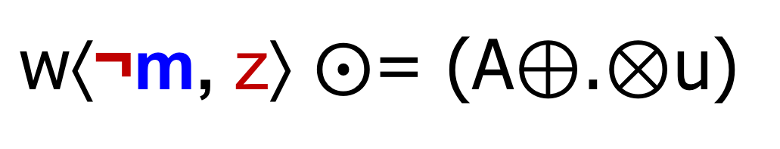
GrB_mxv()
$\text{w}\text{⟨}\text{¬}\text{m}\text{, }\text{z}\text{⟩} ⨀$= (A⊕.⊗u)
…say something
Say something else....
GrB_Info GrB_mxv( | GrB_Vector | w,
 | const GrB_Vector | mask,
 | const GrB_BinaryOp | accum,
 | const GrB_Semiring | op,
 | const GrB_Matrix | A,
 | const GrB_Vector | u,
 | const GrB_Descriptor | desc);
GrB_NULL
It’s time to explain masking and REPLACE in GraphBLAS operations.

Slide 68
Masking
Every GraphBLAS operation that computes an opaque matrix or vector supports a “write mask”
A mask, m, controls which elements of the output can be written:
Same size as output object (mask vectors or mask matrices)
Any location in the mask that evaluates to ‘true’ can be written in the output object
w⟨m⟩ = (A⊕.⊗u)
w(in)
A*u
m
w(out)
-
-
-
→
-
→
-
-
-
-
-
-
-

Slide 69
REPLACE vs. “MERGE”
When a mask is used and the output container is not empty when the operation is called…what do you do to the “masked out” elements?
REPLACE (z): all unwritten locations are cleared (zeroed out).
MERGE: all unwritten locations are left alone.
Behaviour defaults to MERGE; otherwise, use a descriptor:
GrB_Descriptor_set(desc, GrB_OUTP, GrB_REPLACE)
w⟨m, z⟩ = (A⊕.⊗u)
w(in)
A*u
m
w(out)
w(out)
REPLACE (z)
MERGE
-
-
-
-
→
→
-
-
-
-
-
-
-
-
-

Slide 70
Structural Complement (mask)
Specified with a descriptor:
GrB_Descriptor_set(desc, GrB_MASK, GrB_SCMP)
Inverts the logic of mask (write enabled on false)
A mask, m, is interpreted as a logical ‘stencil’ that controls which elements of the output can be written:
Any location in the mask that evaluates to ‘true’ can be written
w⟨¬m, z⟩ = (A⊕.⊗u)
w(in)
A*u
m
w(out)
w(out)
-
-
REPLACE, z
MERGE
-
→
-
→
-
¬
-
-
-
-
-
-
-

Slide 71
Using Descriptors (summary)
A descriptor field selects the object it impacts:
GrB_INP0: The first input GraphBLAS object
GrB_INP1: The second input GraphBLAS object
GrB_MASK: The GraphBLAS mask object
GrB_OUTP: The output GraphBLAS object
Each field supports one value (currently):
GrB_INP0: GrB_TRAN (transpose)
GrB_INP1: GrB_TRAN (transpose)
GrB_MASK: GrB_SCMP (structural complement)
GrB_OUTP: GrB_REPLACE (clear the output before writing result)

Slide 72
Exercise 9: Avoid revisiting
Use the visited list as a mask prevent revisiting previous nodes
Exit the loop when there is no more ‘work’ to be done
You will need the following types and methods from the GraphBLAS
GrB_Vector_new(&vec, GrB_BOOL, NUM_NODES);
GrB_Vector_setElement(vec, true, NODE);
GrB_eWiseAdd(vec, GrB_NULL, GrB_NULL, GrB_LOR, vec, wav, GrB_NULL);
GrB_mxv(result, GrB_NULL, GrB_NULL,
GxB_LOR_LAND_BOOL, graph, vec, desc);
GrB_Descriptor desc;
GrB_Descriptor_new(&desc);
GrB_Descriptor_set(desc, FIELD, VALUE)
FIELD: GrB_INP0, GrB_INP1, GrB_OUTP, GrB_MASK
VALUE: GrB_TRAN, GrB_REPLACE, GrB_SCMP

Slide 73
Solution to exercise 9
0
1
...
GrB_Vector_setElement(w, true, SRC_NODE);
GrB_Descriptor desc;
GrB_Descriptor_new(&desc);
GrB_Descriptor_set(desc, GrB_INP0, GrB_TRAN);
GrB_Descriptor_set(desc, GrB_MASK, GrB_SCMP);
GrB_Descriptor_set(desc, GrB_OUTP, GrB_REPLACE);
pretty_print_vector_UINT64(w, "wavefront(src)");
GrB_Index nvals = 0;
do {
GrB_eWiseAdd(v, GrB_NULL, GrB_NULL,
GrB_LOR, v, w, GrB_NULL);
pretty_print_vector_UINT64(v, "visited");
GrB_mxv(w, v, GrB_NULL,
GxB_LOR_LAND_BOOL, graph, w, desc);
pretty_print_vector_UINT64(w, "wavefront");
GrB_Vector_nvals(&nvals, w);
} while (nvals > 0);
6
4
3
2
5
Vector: wavefront(src) =
[ 1, -, -, -, -, -, -
Vector: visited =
[ 1, -, -, -, -, -, -]
Vector: wavefront =
[ -, 1, -, 1, -, -, -]
Vector: visited =
[ 1, 1, -, 1, -, -, -]
Vector: wavefront =
[ -, -, 1, -, 1, -, 1]
Vector: visited =
[ 1, 1, 1, 1, 1, -, 1]
Vector: wavefront =
[ -, -, -, -, -, 1, -]
Vector: visited =
[ 1, 1, 1, 1, 1, 1, 1]
Vector: wavefront =
[ -, -, -, -, -, -, -]
Notes:
matvecTransIterExitFlag(v2)

Slide 74
Breadth-First Traversal
0
1
0
1
6
6
3
4
3
4
2
5
2
5
0
1
0
1
6
6
3
4
3
4
2
5
2
5
Red=current wavefront and visited, Blue=next wavefront, Gray=visited, Black=unvisited

Slide 75
Breadth-First Traversal
0
1
0
1
6
6
3
4
3
4
2
How would we keep track of when each vertex is visited (becomes red)?
5
2
5
0
1
0
1
6
6
3
4
3
4
2
5
2
5
Red=current wavefront and visited, Blue=next wavefront, Gray=visited, Black=unvisited

Slide 76

GrB_assign() from constant
$$w\left(i\right)⊙=c$$
Assign a constant to a subset of the output vector.
Locations to be assigned selected by an output index vector, indices:
w(indices[j]) = c, ∀ j : 0 ≤ j < nindices,
w(indices[j]) = w(indices[j]) ⊙ c, ∀ j : 0 ≤ j < nindices.
GrB_Info GrB_assign( | GrB_Vector | w,
 | const GrB_Vector | mask,
 | const GrB_BinaryOp | accum,
 | const GrB_Vector | u,
 | const GrB_Index | *indices,
 | const GrB_Index | nindices,
 | const GrB_Descriptor | desc);
Use a constant GrB_ALL in place of the indices argument to select that all elements of w are to be assigned to (in order 0 to 1-nindices).

Slide 77
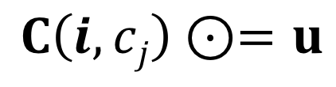
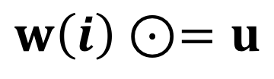
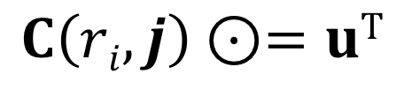
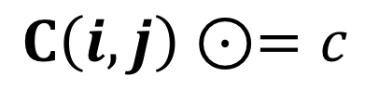
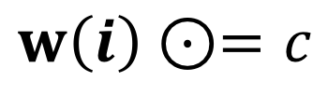
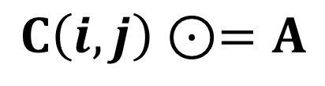
GrB_assign()
There are several variants of assign
Standard vector assignment
Standard matrix assignment
Assign a vector to the elements of column c_{j} of a matrix
Assign a vector to the elements of row r_{i} of a matrix
Assign a constant to a subset of a vector.
Assign a constant to a subset of a matrix.
$$w\left(i\right)⊙=u$$
$$C\left(i,j\right)⊙=A$$
$$C\left(i,cj\right)⊙=u$$
$$C\left(ri,j\right)⊙=uT$$
$$w\left(i\right)⊙=c$$
$$C\left(i,j\right)⊙=c$$
A and C are GraphBLAS matrices. u and w are GraphBLAS vectors i and j are index vectors

Slide 78

GrB_assign() from vector
$$w\left(i\right)⊙=u$$
Assign a vector to a subset of the output vector.
Values to be assigned selected by an output index vector, i
w(indices[j]) = u(j), ∀ j : 0 ≤ j < nindices,
w(indices[j]) = w(indices[j]) ⊙ u(j), ∀ j : 0 ≤ j < nindices.
GrB_Info GrB_assign( | GrB_Vector | w,
 | const GrB_Vector | mask,
 | const GrB_BinaryOp | accum,
 | const GrB_Vector | u,
 | const GrB_Index | *indices,
 | const GrB_Index | nindices,
 | const GrB_Descriptor | desc);
Use a constant GrB_ALL in place of the indices argument to select that all elements of u are to be assigned in order to w.

Slide 79
Exercise 10: level BFS
Modify the code from Exercise 9 to compute the level at which each node is encountered:
SRC_NODE is level 1, Its neighbors are level 2, … and so forth
Challenge: use assign in place of eWiseAdd
GrB_Vector_new(&w, GrB_BOOL, NUM_NODES);
GrB_Vector_setElement(w, true, SRC_NODE);
GrB_Descriptor desc;
GrB_Descriptor_new(&desc);
GrB_Descriptor_set(desc, FIELD, VALUE);
pretty_print_vector_UINT64(vec, "levels");
GrB_assign(u, mask, accum, c, GrB_ALL, NUM_NODES, desc);
GrB_mxv(w, mask, accum, GxB_LOR_LAND_BOOL, graph, w, desc);
GrB_Vector_nvals(&nvals, w);
FIELD: GrB_INP0, GrB_INP1, GrB_OUTP, GrB_MASK
VALUE: GrB_TRAN, GrB_REPLACE, GrB_SCMP

Slide 80
Solution to exercise 10
0
1
GrB_Vector_new(&levels, GrB_UINT64, NUM_NODES);
GrB_Vector_new(&w, GrB_BOOL, NUM_NODES);
GrB_Vector_setElement(w, true, SRC_NODE);
GrB_Descriptor desc;
GrB_Descriptor_new(&desc);
GrB_Descriptor_set(desc, ...);
pretty_print_vector_BOOL(w, "wavefront(src)");
GrB_Index nvals = 0, lvl = 0;
do {
++lvl;
GrB_assign(levels, w, GrB_NULL,
lvl, GrB_ALL, NUM_NODES, GrB_NULL);
pretty_print_vector_UINT64(levels, "levels");
GrB_mxv(w, levels, GrB_NULL,
GxB_LOR_LAND_BOOL, graph, w, desc);
pretty_print_vector_BOOL(w, "wavefront");
GrB_Vector_nvals(&nvals, w);
} while (nvals > 0);
6
4
3
2
5
Vector: wavefront(src) =
[ 1, -, -, -, -, -, -]
Vector: levels =
[ 1, -, -, -, -, -, -]
Vector: wavefront =
[ -, 1, -, 1, -, -, -]
Vector: levels =
[ 1, 2, -, 2, -, -, -]
Vector: wavefront =
[ -, -, 1, -, 1, -, 1]
Vector: levels =
[ 1, 2, 3, 2, 3, -, 3]
Vector: wavefront =
[ -, -, -, -, -, 1, -]
Vector: levels =
[ 1, 2, 3, 2, 3, 4, 3]
Vector: wavefront =
[ -, -, -, -, -, -, -]
Notes:
matvecTransIterLevels(v2)

Slide 81
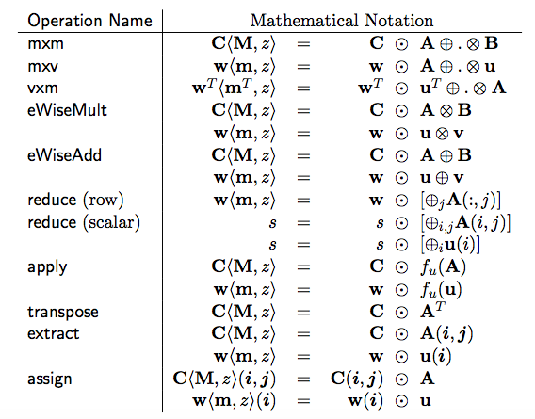
The GraphBLAS Operations
We’ve covered only a small fraction of the GraphBLAS Operations
The same conventions are used across all operations so the operations we did not cover are straightforward to pick up

Slide 82
Conclusion and next steps
The GraphBLAS define a standard API for “Graph Algorithms in the Language of Linear Algebra”.
A wide range of algorithms are variations of the basic breadth first traversal for a graph.
To reach GraphBLAS mastery
Attend the Graph Algorithms Building Blocks workshop at IPDPS
Explore the challenge problems included with this tutorial
Work through the algorithms in the Graph book →

Slide 83
GraphBLAS at HPEC 2018
GraphBLAS is a community effort. Join the community:
Go to graphblas.org and join our mailing list
Attend the HPEC GraphBLAS Birds of a Feather (BOF) 6 PM to 7 PM, Eden Vale C1/C2.
Please send us feedback about the tutorial
timothy.g.mattson@intel.com
smcmillan@sei.cmu.edu
Tell us what you really liked.
Tell us what we should change
Tell us what you wish we’d covered but didn’t
Plus anything else that might help us improve

Slide 84
Appendices
MxM: the low-level details of the GraphBLAS operations
Challenge Problems: Some key algorithms with the GraphBLAS
SuiteSparse: usage notes, extensions and future plans
Reference material

Slide 85
GraphBLAS: details of operations
When you read the GraphBLAS C API specification, the operations are described in a manner that may seem obtuse.
The definitions, however, are presented in this way for good reasons:
to cover the full range of variations exposed by the various arguments and to express the operation without ever specifying the undefined elements (i.e. the “zeros” of the semiring).
To avoid any reference to the non-stored elements of the sparse matrix. In sparse arrays, the undefined elements are usually assumed to be the ”zero of the semiring”. By defining the operations without any reference to those “un-stored values”, we can freely change the semirings between operations without having to update the un-stored elements.

Slide 86

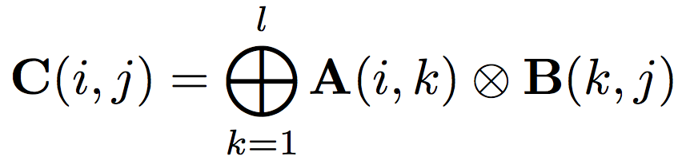
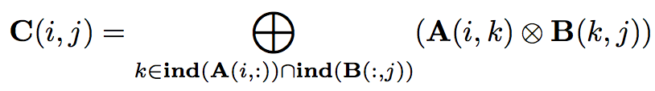
GrB_mxm()
Matrix Multiplication … the way we learned it in school
Matrix Multiplication … set notation to ignore un-stored elements
With set notation, it’s easier to define the operations over a matrix as the semi-ring changes

Slide 87
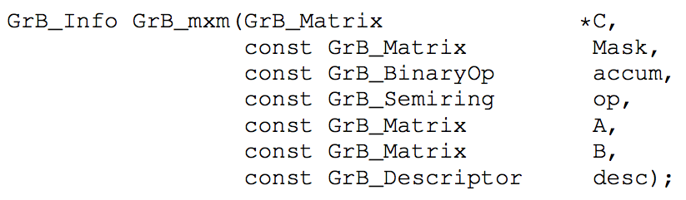
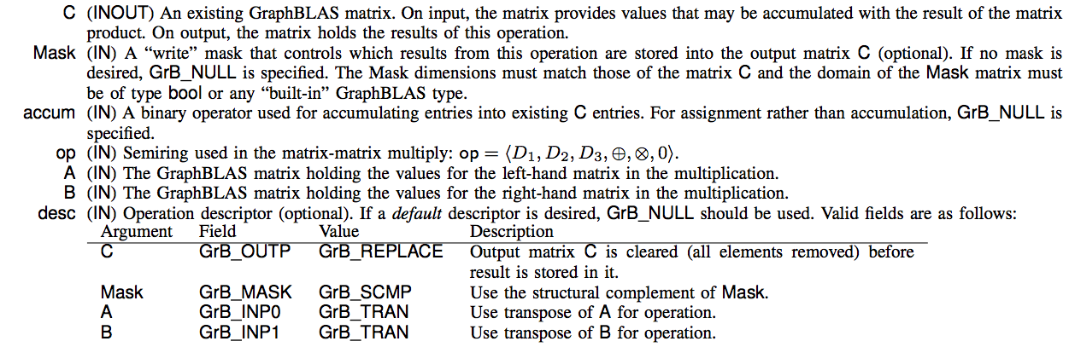
GrB_mxm(): Function Signature

Slide 88
GrB_mxm(): Function Signature
GrB_Info return values:
GrB_SUCCESS | Blocking mode: Operations completed successfully. Nonblocking mode: consistency tests passed on dimensions and domains for input arguments
GrB_PANIC | Unknown Internal error
GrB_OUTOFMEM | Not enough memory for the operation
GrB_DIMENSION_MISMATCH | Matrix dimensions are incompatible.
GrB_DOMAIN_MISMATCH | Domains of matrices are incompatible with the domains of the accumulator, semiring, or mask.

Slide 89
Standard function behavior
Consider the following code:
GrB_Descriptor_new(&desc);
GrB_Descriptor_set(desc, GrB_OUTP, GrB_REPLACE);
GrB_Descriptor_set(desc, GrB_INP0, GrB_TRANS);
GrB_mxm(&C, M, Int32Add, Int32AddMul, A, B, desc);
int32AddMul semiring
int32Add accumulation
Form input operands and mask based on descriptor | C, B, M, A ← A^{T}
Test the domains and sizes for consistency. | int32, dims match
Carry out the indicated operation | T ← A *.+ B, Z ← C + T
Apply the write-mask to select output values | Z ← Z ∩ M
Replace mode: delete elements in output object and replace with output values | C ← Z
Merge mode: Assign output value (i,j) to element (i,j) of output object, but leave other elements of the output object alone.

Slide 90
MXM flowchart
To understand what happens inside a graphBLAS operation, consider matrix multiply.
All the operations follow this basic format
GrB_Info GrB_mxm(
GrB_Matrix C,
const GrB_Matrix M,
const GrB_BinaryOp accum,
const GrB_Semiring op,
const GrB_Matrix A,
const GrB_Matrix B,
const GrB_Descriptor desc);

Slide 91
Exercise: Matrix Matrix Multiplication
Multiply the adjacency matrix from our “logo graph” by itself.
Print resulting matrix and interpret the result
Hint: Do the multiply again and compare results. Do you see the pattern?
0
1
6
4
3
2
5

Slide 92
Appendices
MxM: the low-level details of the GraphBLAS operations
Challenge Problems: Some key algorithms with the GraphBLAS
SuiteSparse: usage notes, extensions and future plans
Reference material

Slide 93
Challenge problems
Triangle counting
PageRank
Betweenness Centrality
Maximal Independent Set
Work in Progress: We should make a slide for each problem defining the algorithm in enough detail so students can implement the GraphBLAS implementation on their own

Slide 94
Counting Triangles (once) with GraphBLAS
Given:
Undirected graph G = {V, E}
L: boolean, lower-triangular portion of adjacency matrix
# triangles = ||L ⊗ (L ⊕.⊗ L^{T})||₁
Semiring can be Plus-AND or Plus-Times
Element-wise multiplication is equivalent to a mask operation
uint64_t triangle_count(GrB_Matrix L) // L: NxN, lower-triangular, boolean
{
GrB_Index N;
GrB_Matrix_nrows(&N, L);
GrB_matrix C;
GrB_Matrix_new(&C, GrB_UINT64, N, N);
GrB_mxm(C, L, GrB_NULL, GrB_UInt64AddMul, L, L, GrB_TB); // C<L> = L * L^{T}
uint64_t count;
GrB_reduce(&count, GrB_NULL, GrB_UInt64Add, C, GrB_NULL);// 1-norm of C
return count;
}

Slide 95
Appendices
MxM: the low-level details of the GraphBLAS operations
Challenge Problems: Some key algorithms with the GraphBLAS
SuiteSparse: usage notes, extensions and future plans
Reference material

Slide 96
SuiteSparse:GraphBLAS
Full implementation of GraphBLAS Specification written by Tim Davis, Texas A&M University
Easy-to-read User Guide with lots of examples
Already in Ubuntu, Debian, Mac HomeBrew, ...
Most operations just as fast as MATLAB (like C=A*B)
assign and setElement can be 1000x faster (or more!) than MATLAB, by exploiting non-blocking mode
V2.1: matrices by-row and by-column; by-row is often faster than by-column when A(i,j) is the edge (i,j). Compile with –DBYROW or use GxB_set(…)
Graph algorithms in GraphBLAS typically faster than novice-level graph algorithm without GraphBLAS, and easier to write
http://faculty.cse.tamu.edu/davis/GraphBLAS
Content provided by Tim Davis

Slide 97
SuiteSparse:GraphBLAS extensions
MATLAB-like colon notation for GrB_assign, extract
unary operators ONE, ABS, LNOT_[type]
ISEQ, ISNE, ISLT, ... return same type as inputs (e.g. PLUS monoid cannot be combined with Boolean EQ, but PLUS-ISEQ can, to count the number of equal pairs)
query: size of type, type of matrix, ...
GxB_select: like MATLAB L=tril(A,k), d=diag(A), ...
GxB_get/set: to change matrix format (by row, by col, hypersparse)
44 built-in monoids
960 built-in semirings (like GxB_LOR_LAND_BOOL)
GxB_resize: change size of matrix or vector
GxB_subassign: variation of GrB_assign
GxB_kron: Kronecker product
Thread-safe if called by user application threads, in parallel
Content provided by Tim Davis

Slide 98
SuiteSparse:GraphBLAS future
Multicore parallelism via OpenMP
Variable-sized types (imagine matrix of matrices, or a matrix of arbitrary-sized integers with 10’s or 1000’s of digits)
Solvers: Ax=b over a group (double, GF(2), ...)
Better performance: e.g. many monoids could terminate quickly:
OR (x1, x2, x3, ...) becomes true as soon as any xi = true
also for AND, and reduction ops FIRST and SECOND
Iterators for algorithms like depth-first-search
Reduction to vector or scalar: could also return the index for some operators (MAX, MIN, FIRST, SECOND): argmin, argmax
Pretty-print methods
Serialization to/from a binary string: for binary file I/O, or sending/receiving a GrB_Matrix in an MPI message; with compression
Priority queue: a GrB_Vector acting like a heap
Concatenate: like C=[A;B] in MATLAB
Interface to MATLAB, Julia, Python, ...
Faster C=A*B for user-defined types and operators
Content provided by Tim Davis

Slide 99
Appendices
MxM: the low-level details of the GraphBLAS operations
Challenge Problems: Some key algorithms with the GraphBLAS
SuiteSparse: usage notes, extensions and future plans
Reference material

Slide 100
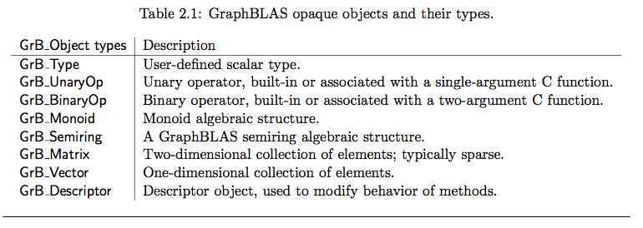
Full set of GraphBLAS opaque objects

Slide 101
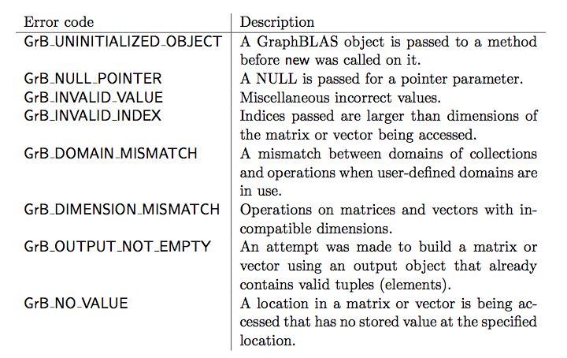
Error codes returned by GraphBLAS methods API Errors

Slide 102
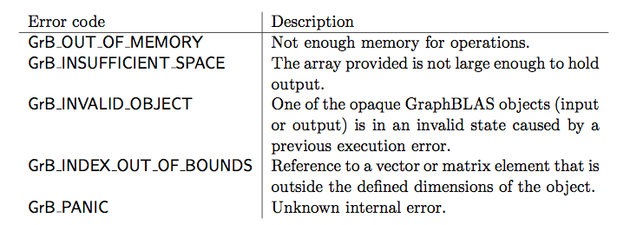
Error codes returned by GraphBLAS methods Execution Errors

