Slide 1
DESIGN AND IMPLEMENTATION OF E-LEARNING SYSTEM (A CASE STUDY OF DEPARTMENT OF COMPUTER SCIENCE, NUHU BAMALLI POLYTECHNIC, ZARIA) BY LAWAN MUKHTAR MUHAMMAD BU/21C/IT/5894 JANUARY, 2024

Slide 2
INTRODUCTION
The concept of e-learning has evolved significantly over the past few decades, enabled by advancements in technology and internet connectivity. As early as the 1960s, Stanford University experimented with using computers for instructional purposes, developing the Computer Curriculum Corporation (CCC) system for elementary schools (Harasim, 2000). In the 1970s and 1980s, e-learning took the form of providing course content via teleconferencing and educational television (Bates, 2005).

Slide 3
MOTIVATION
The motivation behind designing and implementing an e-learning system at Nuhu Bamalli Polytechnic stems from recognizing the limitations of traditional classroom teaching methods and the need to leverage technology to enhance the learning experience.

Slide 4
STATEMENT OF THE PROBLEM
The traditional classroom-based learning approach has limitations that hinder the effectiveness of education. These limitations include rigid scheduling, limited access to resources, and lack of interactive learning opportunities. Moreover, the COVID-19 pandemic has highlighted the importance of having a reliable and scalable e-learning system in place to ensure uninterrupted education during crises. Therefore, the statement of the problem revolves around the need to design and implement an e-learning system that addresses these challenges and meets the specific requirements of the Department of Computer Science at Nuhu Bamalli Polytechnic.

Slide 5
AIMS AND OBJECTIVES
The aim of this project is to design and implement an e-learning system for the Department of Computer Science at Nuhu Bamalli Polytechnic, Zaria. To achieve this aim, the following objectives have been defined:
To design and implement a user-friendly interface that facilitates seamless navigation and interaction.
To provide a comprehensive platform for accessing course materials, lecture notes, and resources.
To integrate assessment tools like online quizzes and auto-graded assignments.
To integrate the e-learning system with the existing academic infrastructure and systems used by the department.

Slide 6
SIGNIFICANCE OF THE STUDY
The design and implementation of an e-learning system for the Department of Computer Science at Nuhu Bamalli Polytechnic have several significant implications. Firstly, it will enable students to access course materials and resources anytime and anywhere, fostering a self-paced learning environment. Secondly, the interactive features of the system will promote student engagement and collaboration, leading to a deeper understanding of the subject matter. Thirdly, the e-learning system will serve as a valuable tool for remote learning, allowing students to continue their education during unexpected disruptions like the COVID-19 pandemic. Finally, the project will contribute to the advancement of digital learning practices within the university and pave the way for future technological enhancements in education.

Slide 7
PROJECT RISK ASSESSMENT
Table 1.1 Project Risk Assessment
Risk | Impact | Likelihood | Mitigation Strategy
Resistance from faculty | High | Medium | Conduct training sessions and demos to demonstrate benefits and ease of use. Involve early adopters to promote system.
Technical issues during development | High | Medium | Thoroughly test code, follow security best practices, and use version control.
Budget overruns | High | Low | Carefully estimate costs and utilize student developers where possible.

Slide 8
PROJECT RISK ASSESSMENT CON’T
Table 1.1 Risk Assessment
Poor user experience | Medium | Low | Conduct usability studies and iterate interface design based on feedback.
Security breaches | High | Low | Implement encryption, access controls, and regular security audits.
Compatibility issues | Medium | Medium | Support cross-platform and mobile access. Gracefully degrade on older browsers.
Lack of reliable infrastructure | High | Low | Use cloud hosting and redundant internet connections.
Student enrollment issues | Medium | Low | Enable self-enrollment and automated course registration.

Slide 9
SCOPE OF THE STUDY
The scope of this project focuses specifically on the Department of Computer Science at Nuhu Bamalli Polytechnic, Zaria. The e-learning system will be designed and implemented to cater to the needs and requirements of the department's courses and curriculum. The project will involve the collaboration of various stakeholders, including faculty members, students, and IT personnel. The project will be organized into several phases, including requirements gathering, system design, development, testing, and deployment. Regular communication, feedback, and evaluation will be integral parts of the project management approach to ensure the successful completion of the e-learning system implementation.

Slide 10
LITERATURE REVIEW
This chapter provides an overview of existing literature related to the design and implementation of e-learning systems. First, a historical background is presented to understand the evolution of e-learning technologies over time. The chapter then covers related works on e-learning system design considerations, implementation approaches, challenges, and best practices. The literature review helps situate this project within the broader context of research and implementation efforts in this domain.

Slide 11
HISTORICAL OVERVIEW
The origins of e-learning can be traced back to the 1960s when mainframe computers were first used for instructional purposes (Harasim, 2000). As computers became more accessible in the 1970s and 1980s, e-learning took the form of providing course content through teleconferencing, satellite TV, and early online platforms (Bates, 2005). The real growth in online education came in the 1990s with the rise of the World Wide Web and the first learning management systems (LMS) like WebCT and Blackboard (Paulsen, 2002). This allowed instructors to deliver course materials and monitor student progress through a centralized online platform accessible anytime, anywhere.

Slide 12
REVIEW OF RELATED WORKS
Lakhal et al. (2013) examines student usage patterns on an e-learning platform using web analytics. Findings showed peaks in learning activity around assessment due dates indicating procrastination behaviors. This demonstrates how data analytics can provide insights to improve e-learning designs.
Llamas-Nistal et al. (2013) evaluated multiple gamification plugins like LevelUp, Game and Coins for Moodle. Elements like badges, leaderboards, rewards and avatars were found to increase participation, engagement and social connections among students. Gamification caters to millennial learners.
Rafi et al. (2015) employed data mining techniques to detect usage patterns and diagnose problems faced by students in an e-learning system. Predictive analytics enabled personalized interventions to support struggling learners.

Slide 13
REVIEW OF RELATED WORKS CON’T
Alwi & Fan (2010) emphasize designing a clean, simple, and consistent user interface optimized for the learning process. Navigation, multimedia inclusion, and content structure are key considerations. Mustafa & Sharif (2011) examine how adapting content for different learning styles can improve the effectiveness of instructional materials.
Al-Busaidi and Al-Shihi (2012) developed a modular LMS architecture consisting of user management, content management, assessment management, and collaboration modules. This separation of concerns promotes reusability, flexibility, and interoperability. They implemented the system using an open source stack of MySQL, Apache, PHP and jQuery.

Slide 14
REVIEW OF RELATED WORKS CON’T
Rodriguez et al. (2017) designed mobile support for Moodle to extend e-learning access to mobile devices. Their app provided key system functions like course browsing, content access, forums, and messaging. Adoption was higher among students owning smartphones. This highlights the importance of omni-channel access.
Sanga et al. (2019) developed an integrated e-learning system connecting LMS platforms with university enterprise systems for enrollment, grades, calendars etc. Single sign-on and APIs reduced duplication. This underscores the need for enterprise integration.
Brown et al. (2020) propose a modular framework for developing customizable e-learning platforms. Their approach separates the system into core functional modules like course authoring, assessment, collaboration, and learner management. This modular architecture allows new features to be added without disrupting existing components. While flexible, their framework maymake it challenging to maintain tight integration between modules.

Slide 15
SUMMARY
This literature review provides a strong foundation to guide the development of the proposed e-learning system for the Computer Science department at Nuhu Bamalli Polytechnic. The project can build on existing evidence-based best practices while addressing context-specific requirements. The next chapter presents the methodology for the system design and implementation.

Slide 16
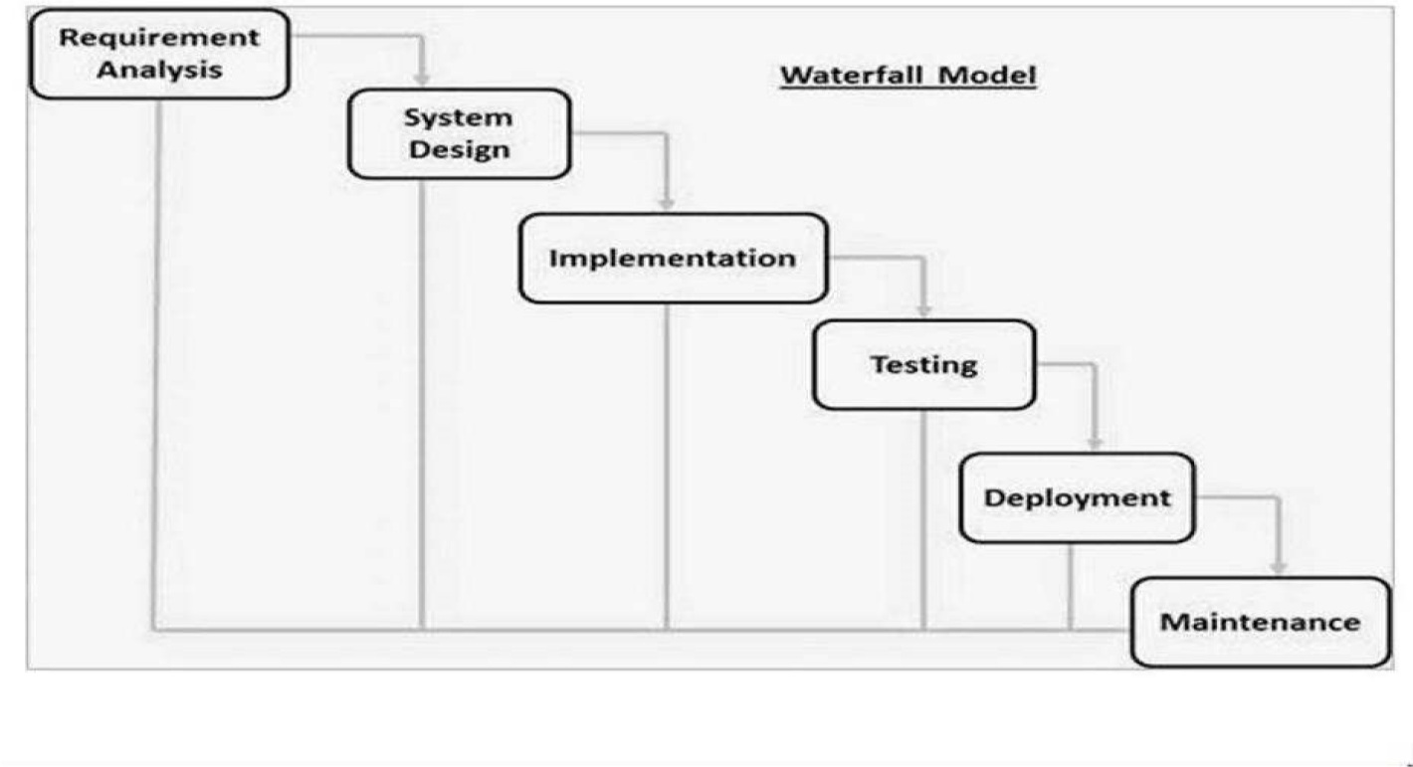
REQUIREMENT, ANALYSIS AND DESIGN
PROPOSED MODEL
This project's proposed model of choice is the waterfall model. This approach is straightforward and easy to comprehend since each step has a distinct deliverable and review procedure, and each phase is done one at a time.
Figure 3.2 Waterfall Model (Wikipedia, 2013)

Slide 17
TOOLS AND TECHNIQUES
HTML, CSS, and JavaScript are used on the front-end for structure, styling, and interactivity. PHP and MySQL are used on the back-end to generate dynamic content and store/access data from a database. Together these tools allow for complete web application development.
SOFTWARE REQUIREMENTS
Operating System: Windows, Database: MySQL, Server: Xampp, Integrated Development Environment: Notepad ++ , PHP and Java Script
HARDWARE REQUIREMENTS
HP15 PC, 2GB RAM, 500GB hard disk and Browser

Slide 18
REQUIREMENT SPECIFICATION
Table 3.1 Functional Specification Requirement
ID | Description
FR1 | Students can register and create user accounts
FR2 | Instructors can add/edit/delete course materials
FR3 | Students can access course materials based on enrollment
FR4 | Instructors can add graded assignments and quizzes
FR5 | Students can view grades and feedback for assignments/quizzes

Slide 19
REQUIREMENT SPECIFICATION CON’T
Table 3.2 Non-Functional Specification Requirement
ID | Description
NFR1 | User credentials and course data will be encrypted
NFR2 | The system will have an uptime of 99%
NFR3 | Maximum 2 seconds page load time for students
NFR4 | Concurrent support for at least 100 active users
NFR5 | User interface optimized for desktop and mobile access
NFR6 | System can scale to support up to 500 concurrent users
NFR7 | 99.5% uptime SLA outside scheduled maintenance windows
NFR8 | Load balanced and auto-scaling architecture
NFR9 | Secured student access using LDAP/OAuth integration

Slide 20
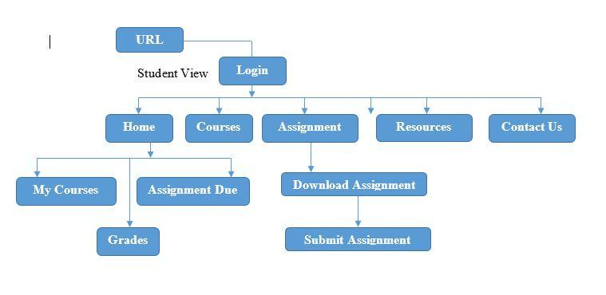
SYSTEM DESIGN
Figure 3.3 System Architecture (Student View)

Slide 21
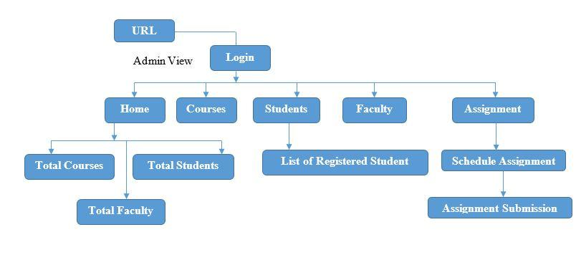
SYSTEM DESIGN CON’T
Figure 3.4 System Architecture (Admin View)

Slide 22
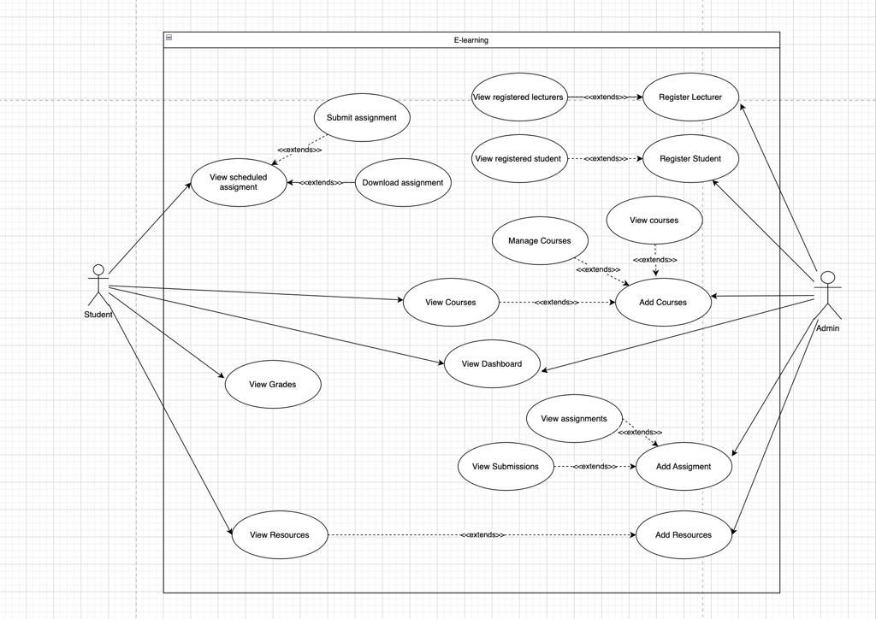
USECASE DIAGRAM
Figure 3.5 Use Case Diagram

Slide 23
USECASE DESCRIPTION
Use Case | User Login
Scenario: | The user logs into the e-learning system
Brief Description: | This use case describes how a user logs into the e-learning system
Actors: | Student, Lecturer, System Administrator
Stakeholders: | Department of Computer Science
Preconditions: | User is already registered in the system
Postconditions: | If login succeeds, user is logged into the system. If login fails, system state is unchanged.
Exception Conditions: | Invalid login credentials result in an error message. User can retry or cancel, ending the case.

Slide 24
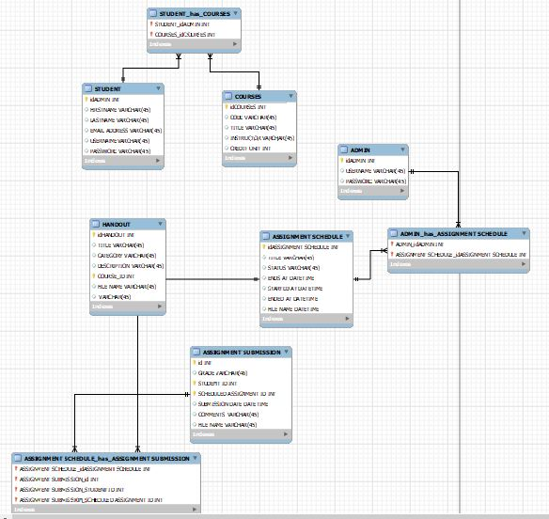
ENTITY RELATIONSHIP DIAGRAM
Figure 3.6 Entity Relationship Diagram

Slide 25
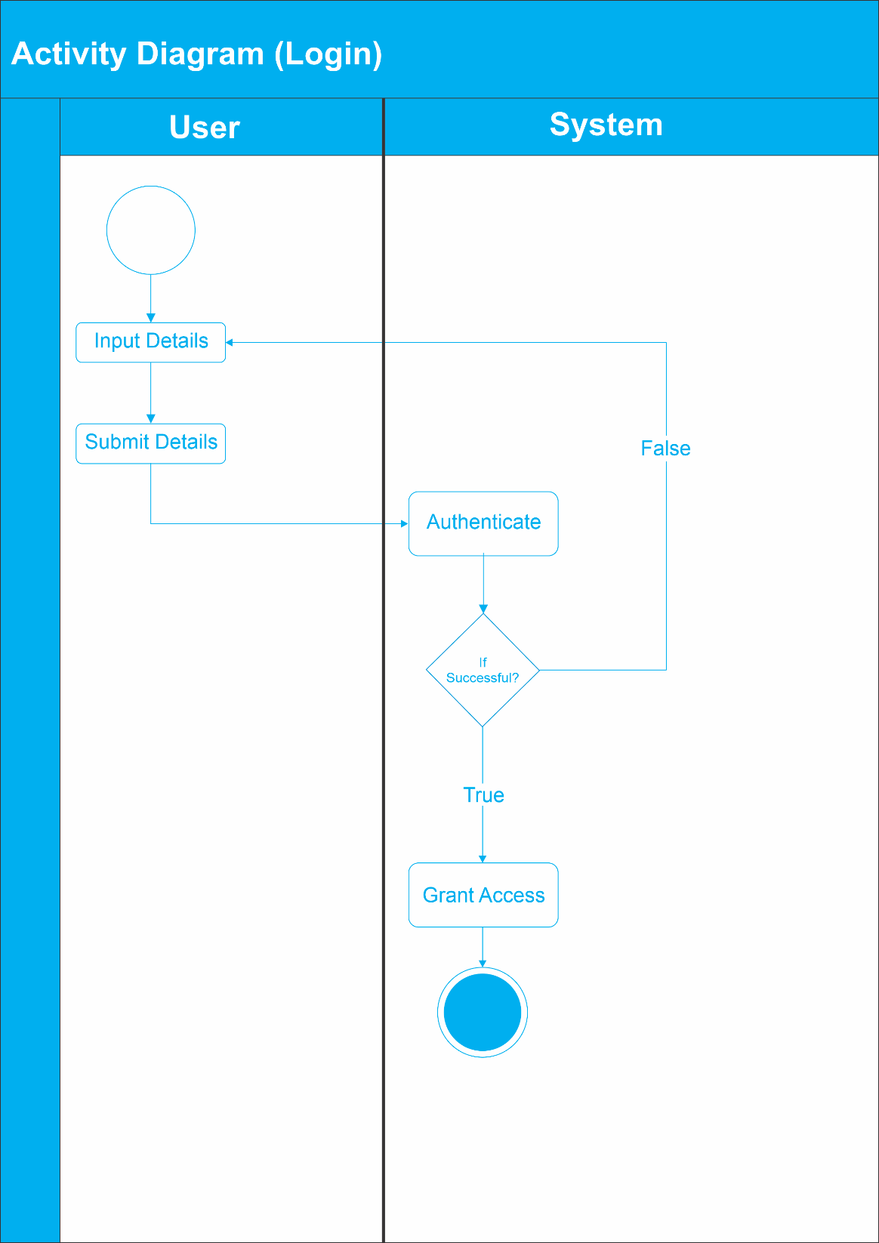
ACTIVITY DIAGRAM
Figure 3.7 Activity Diagram (Register/Login)

Slide 26
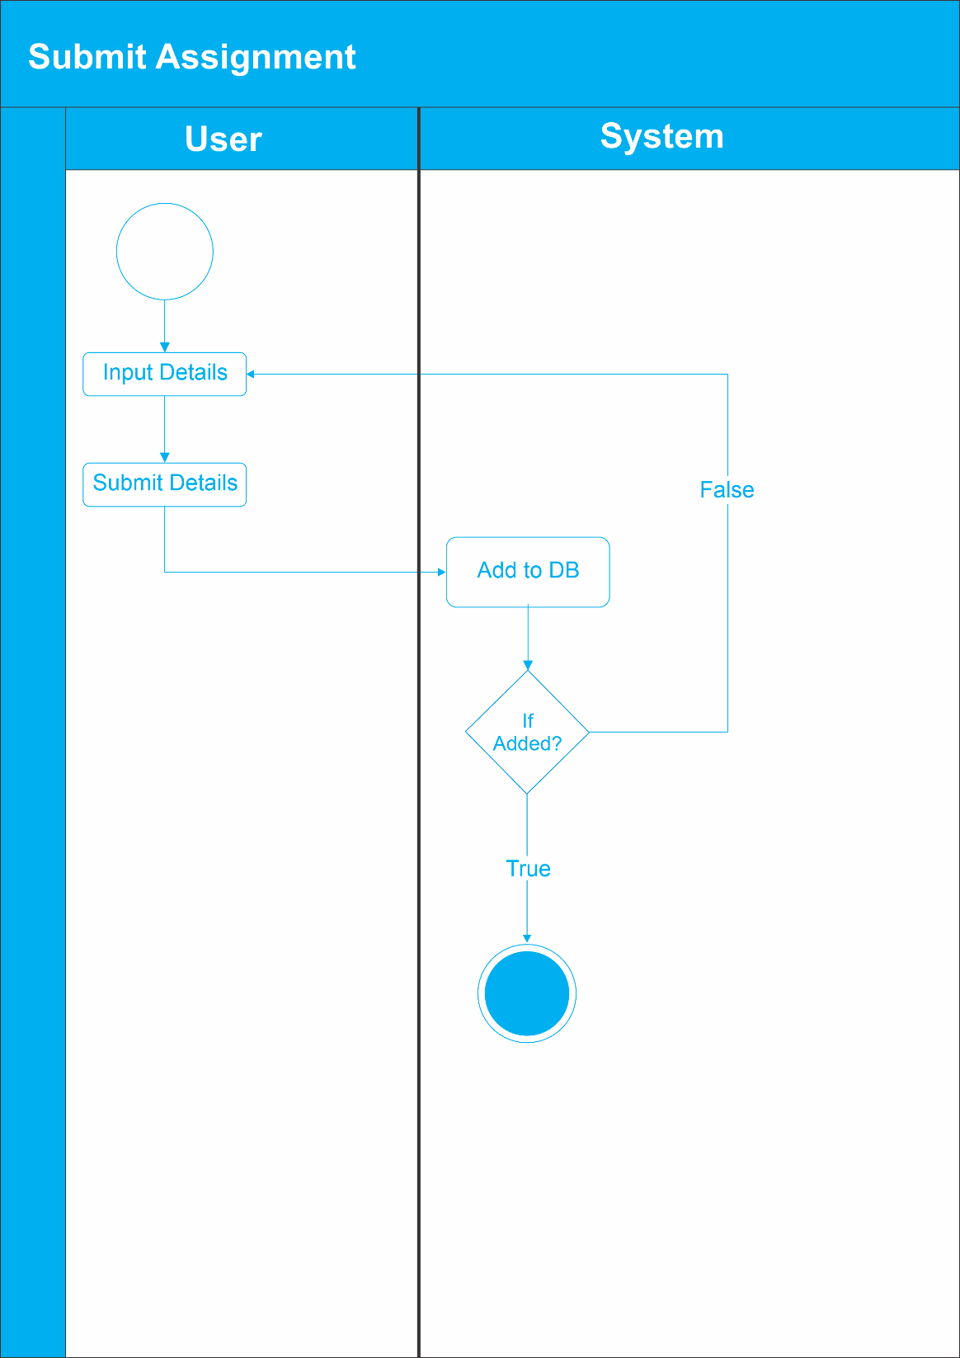
ACTIVITY DIAGRAM
Figure 3.8 Activity Diagram (Submit Assignment)

Slide 27
TESTING FOR ACCESSING COURSE MATERIAL
Test Case | The system shall allow students to access course materials and take online tests
Related Requirement | FR01
Prerequisites | A computer with internet access Valid student login credentials
Test Procedure | 1. Open web browser 2. Navigate to eLearning system URL 3. Enter valid student credentials and login 4. Click on a course to access materials
Test Data | Valid student username and password Course materials
Expected Result | Student is able to access course materials
Actual Result | Student successfully accessed course materials
Status | Pass
Remarks | None
Created By | Lawan Mukhtar
Date of Creation | 18/Jan/2024
Executed By | Lawan Mukhtar
Date of Execution | 18/Jan/2024
Test Environment | Windows 10 computer with Chrome browser

Slide 28
TESTING FOR SUBMISSION ASSIGNMENT
Test Case | The system shall allow students to submit assignments
Related Requirement | FR02
Prerequisites | A computer with internet access Valid student login credentials
Test Procedure | 1. Open web browser 2. Navigate to eLearning system URL 3. Enter valid student credentials and login 4. Click on Assignment 5. Select the assignment to submit 6. Upload the assignment file 7. Click on the submit button
Test Data | Valid student username and password Assignment file
Expected Result | Student is able to submit the assignment successfully
Actual Result | Student successfully submitted the assignment
Status | Pass
Remarks | None
Created By | Lawan Mukhtar
Date of Creation | 18/Jan/2024
Executed By | Lawan Mukhtar
Date of Execution | 18/Jan/2024
Test Environment | Windows 10 computer with Chrome browser

Slide 29
TESTING FOR ACCESSING COURSE REGISTRATION
Test Case | The system shall allow students to register for courses
Related Requirement | FR03
Prerequisites | A computer with internet access Valid student login credentials
Test Procedure | 1. Open web browser 2. Navigate to eLearning system URL 3. Enter valid student credentials and login 4. Go to the course registration section 5. Select the desired course from the available options 6. Click on the register button
Test Data | Valid student username and password
Expected Result | Student is able to register for the course successfully
Actual Result | Student successfully registered for the course
Status | Pass
Remarks | None
Created By | Lawan Mukhtar
Date of Creation | 18/Jan/2024
Executed By | Lawan Mukhtar
Date of Execution | 18/Jan/2024
Test Environment | Windows 10 computer with Chrome browser

Slide 30
SUMMARY/CONCLUSION
In summary, the implementation of the e-learning system for Department of Computer Science, Nuhu Bamalli Polytechnic, Zaria has been successfully completed. the system is designed to improve and facilitate e-learning activities by enabling online access to course materials, assignment submissions, exams, grading, communication and overall remote learning.
The testing of the system was done in phases, including unit testing, integration testing, and system testing. The testing phase ensured that the system met the required specifications and was free of errors. The implementation process faced some challenges, including technical limitations, data security concerns and user adoption issues. However, these challenges were mitigated through training, system security measures and stakeholder engagement.

Slide 31
REFERENCES
Al-Ajlan, A., & Zedan, H. (2008). Why Moodle. Future trends in computing system, 52.
Allen, I.E. and Seaman, J. (2017). Digital Learning Compass: Distance Education Enrollment Report 2017. Babson Survey Research Group.
Alwi, N. H. M., & Fan, I. S. (2010). E-learning and information technology in education system: A literature review. International Journal of Business Information Systems, 5(4), 351-371.
Bates, A. (2005). Technology, e-learning and distance education. Routledge.
Bates, T. (2005). Technology, e-learning and distance education. Routledge.
Cho, V., Cheng, T. E., & Lai, W. M. J. (2010). The role of perceived user-interface design in continued usage intention of self-paced e-learning tools. Computers & Education, 53(2), 216-227.
Davies, J., Mullan, J., and Feldman, P. (2017). Rebooting learning for the digital age: What next for technology-enhanced higher education?. Higher Education Policy Institute.
Dhawan, S. (2020). Online learning: A panacea in the time of COVID-19 crisis. Journal of Educational Technology Systems, 49(1), 5-22.
Ghavifekr, S., and Athirah, W. (2015). Teaching and learning with technology: Effectiveness of ICT integration in schools. International Journal of Research in Education and Science, 1(2), 175-191.
Harasim, L. (2000). Shift happens: online education as a new paradigm in learning. The Internet and Higher Education, 3(1-2), 41-61.
Jegede, O. (2002). Taking the distance out of higher education in 21st century Nigeria. Turkish Online Journal of Distance Education, 3(1).

Slide 32
REFERENCES
Lam, P., & Bordia, S. (2008). Factors affecting student choice of elearning over traditional learning: Student and teacher perspectives. International Journal of Instructional Technology & Distance Learning, 5(3), 21-34.
Lao, T., and Gonzales, C. (2005). Understanding online learning through a qualitative description of professors' and students' experiences. Journal of Technology and Teacher Education, 13(3), 459-474.
Mircea, M., & Andreescu, A. I. (2011). Using cloud computing in higher education: A strategy to improve agility in the current financial crisis. Communications of the IBIMA, 2011, 1-15.
Mustafa, S. E., & Sharif, S. M. (2011). An approach to adaptive e-learning hypermedia system based on learning styles (AEHS-LS): Implementation and evaluation. International Journal of Library and Information Science, 3(1), 15-28.
Odunayo, O. T., Oyelere, S. S., and Olaniyi, O. K. (2020). Leveraging e-learning and online teaching during and after COVID-19 crisis: The need for structured teacher professional development in Nigeria. Research and Practice in Technology Enhanced Learning, 15(1), 1-9.
Olaniran, B.A. (2006). Applying synchronous computer-mediated communication into course design: Some considerations and practical guides. Campus-Wide Information Systems, 23(3), 210-220.
Paulsen, M. F. (2002). Online education systems: Discussion and definition of terms. NKI Distance Education, 1-8.
Paulsen, M. F. (2002). Online education systems: Discussion and definition of terms. NKI Distance Education, 1-8.
Selim, H. M. (2007). Critical success factors for e-learning acceptance: Confirmatory factor models. Computers & Education, 49(2), 396-413.
Tuomi, I. (2018). The impact of artificial intelligence on learning, teaching, and education. Policies for the future, 157.
Yuan, L., & Powell, S. (2013). MOOCs and open education: Implications for higher education. JISC Cetis, 1-21.

Slide 33
THANK YOU

