Slide 1
Software Engineering I
Object-Oriented Design
Instructor: Dr. Hany H. Ammar
Dept. of Computer Science and Electrical Engineering, WVU

Slide 2
Outline
UML Development – Overview
The Requirements, Analysis, and Design Models
More on Relationship Between Models
Examples
Object Oriented Design (OOD)
  The Static Design Model
    How can we Identify Classes?
    How can we develop Class Diagrams?
  The Dynamic Design Model
    Design Sequence Diagrams Notation

Slide 3
Development Process - Overview
ACTORS
REQUIREMENTS
ELICITATION
USE CASES
Time
SCENARIOS
D
SEQUENCE
DIAGRAMS
A
T
ANALYSIS
CLASS DIAGRAM(S)
StateChart
DIAGRAMs
A
OO ANALYSIS
Specify Domain
Objects
D
OPERATION CONTRACTS
I
C
T
Architecture/
OO Design
I
SUBSYSTEM/CLASS
DIAGRAMS
DEPLOYMENT DIAGRAM
DESIGN SEQUENCE DIAG.
O
N
DESIGN DIAGRAMS
A
Detailed DESIGN
R
Object
Design
IMPLEMENTATION
CHOICES
IMPLEMENTATION
Activity DIAGRAMS
Y
IMPLEMENTATION
PROGRAM

Slide 4
The Requirements, Analysis, and Design Models
Requirements
Elicitation
Process
Use Case Diagrams/
System Sequence Diagrams
(the system level)
Functional/
Nonfunctional
Requirements
- Analysis Class Diagrams
- StateChart Diagrams/
Refined Sequence
Diagrams (The domain object level)
The Analysis
Process
Static Analysis
Dynamic Analysis
The Design
Process
Design Class Diagrams,
StateChart Diagrams
Design Sequence/
Collaboration Diagrams
Static Design,
Dynamic Design

Slide 5
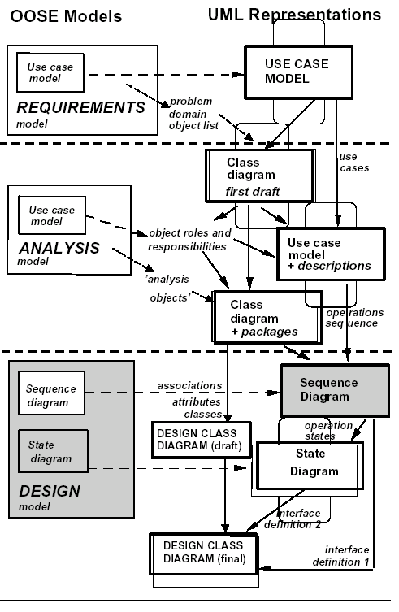
More on Relationship Between Models

Slide 6
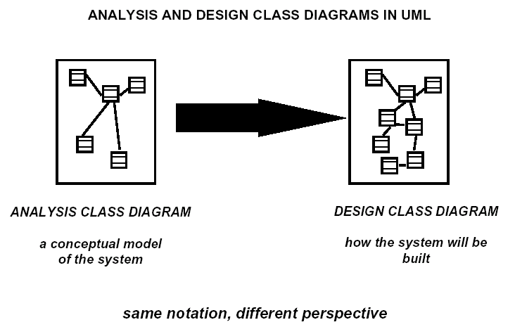
More on Relationship Between Models

Slide 7
Example: A Digital Sound Recorder (DSR)
From Requirements-to-Analysis-to-Design
The main function of the DSR is to record and playback speech.
The messages are recorded using a built-in microphone and they are stored in a digital memory.
The DSR contains an alarm clock with a calendar. The user can set a daily alarm. The alarm beeps until the user presses a key, or after 60 seconds.

Slide 8
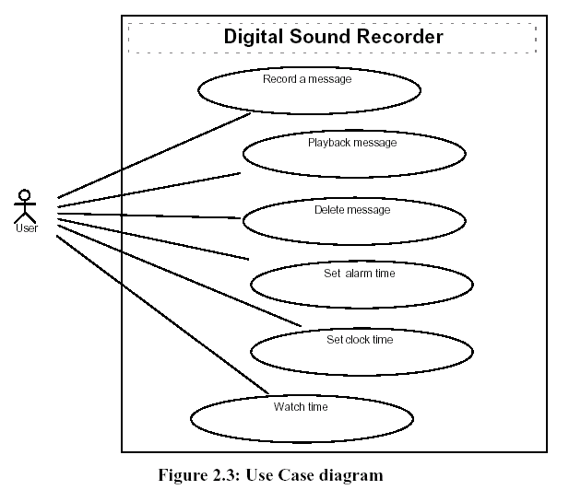
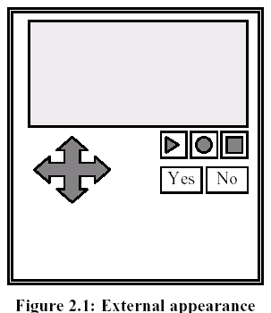
Digital Sound Recorder: Showing the Process
From Requirements-to-Analysis-to-Design

Slide 9
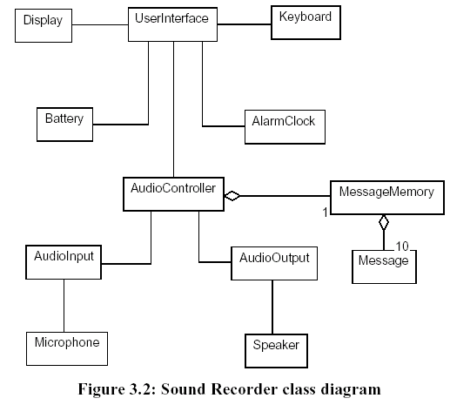
Digital Sound Recorder:
Analysis Class Diagram (Object-Oriented Analysis, defining the domain objects)

Slide 10
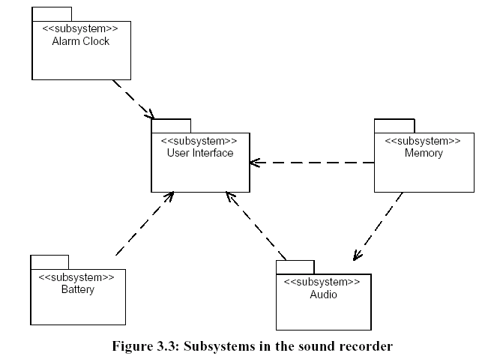
Digital Sound Recorder:
The OOD Static Model: Designing the Architecture
Design
Class
Diagram:
Designing
The
Subsystems,

Slide 11
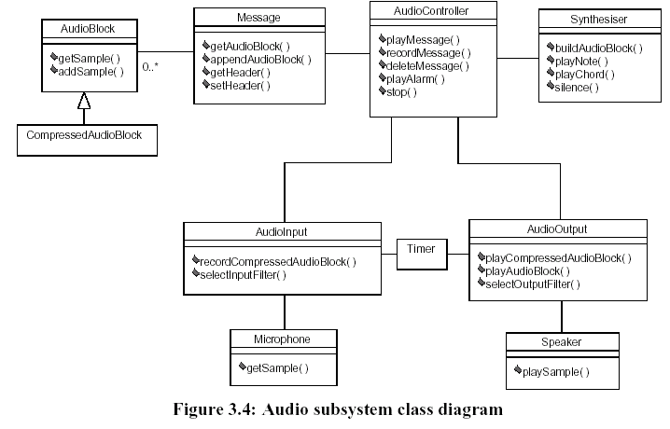
Digital Sound Recorder:
The OOD Static Model: Designing the Classes in Each Subsystem, Shown is the Audio Subsys. only
Interactions between
Objects are defined
Using Design
Sequence diagrams

Slide 12
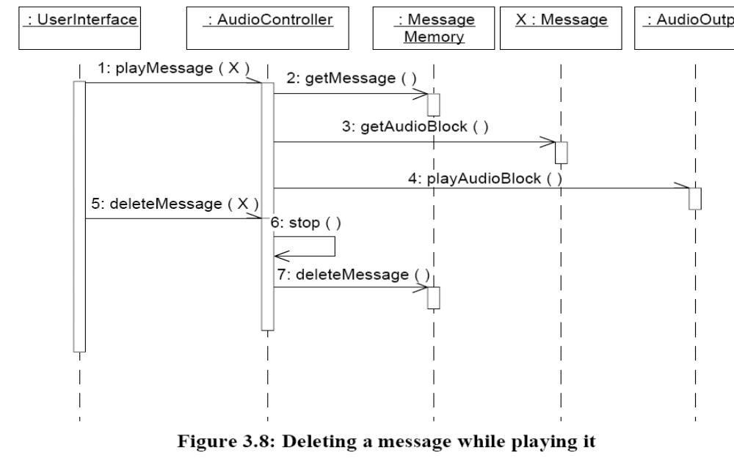
Digital Sound Recorder: Object Interactions
The OOD Dynamic Models (Design Sequence diagrams)
shows the interactions
between objects
in different subsystems
Design Sequence Diagrams
can help find operations of
classes during design

Slide 13
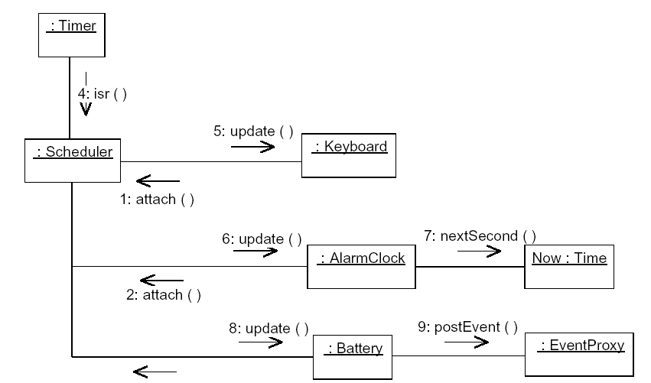
Digital Sound Recorder: Object Interactions The OOD Dynamic model (Design Collaboration diag.)
Interactions are shown using a UML collaboration diagram. Timer interrupt update scenario
Notice an
EventProxy
Class is added
For posting
Events.
Uses the Observer
And Proxy
Desgin patterns

Slide 14
Object Oriented Design (OOD)
Design the system as a set of interacting Objects
  1. Design Models
    Static Structural Models ( class diagrams )
    Dynamic Interaction Models (Sequence/Collaboration diagrams)
    Dynamic Object Behavioral Models (StateChart diagrams)
  2. Detailed Class and object description
    Visibility (Private, protected, and public attributes )
    Concurrency

Slide 15
OOD (Cont’d)
3. Evaluate and Refine Design according to the Design Goodness Criteria
  Coupling:
    The manner and degree of interdependence between classes (objects)
  Cohesion:
    The degree and manner to which the tasks performed by an object are related to each other
  Complexity
    The number and complexity of operations and attributes of a class

Slide 16
Static and Dynamic Design: Iterative Development
The Static design class diagram is developed iteratively along with the dynamic models represented in design sequence diagrams or collaboration diagrams
Design sequence diagrams show detailed interactions between objects of classes in different subsystems
They are defined based on analysis sequence diagrams developed for a given Use- Case scenario defined in the analysis (or the requirements) model

Slide 17
Static and Dynamic Design
The development of Design Class Diagrams is completed by defining the attributes and operations of classes to support the interactions represented in the dynamic model.
Operations of classes in the design class diagram are defined using the dynamic interactions in the dynamic model sequence diagrams
New classes might be needed in the design class diagram to support the interactions of objects in the sequence diagrams (e.g., Interface classes, proxy classes, scheduler classes etc.)

Slide 18
Class Operations Defined From Sequence Diagrams
The behavior of a class is represented by its operations
Operations may be found by examining interaction diagrams
registration
registration
form
manager
RegistrationManager
3: add course(joe, math 01)
addCourse
(Student,Course)

Slide 19
OOD: How can we Identify Classes of Objects ?
Define classes such that each performs a specific function or task to maximize cohesion and minimize coupling, the following are typical examples of classes
Controllers
  Subsystem controls a given aspect of the system
Coordinators/Schedulers
  Coordinates several control classes
Data Collectors/Monitors
  Collects data from external environment
Data analyzers
  Provides reports and/or displays
Servers
  Provides service for client classes,
User/Device Interface
  Collection of classes supporting needs of users or devices

Slide 20
OOD: How can we develop Class Diagrams?
The development of the class diagram can be done using consolidated collaboration diagrams
These diagrams are obtained from combining several collaboration diagrams developed from different scenarios

Slide 21
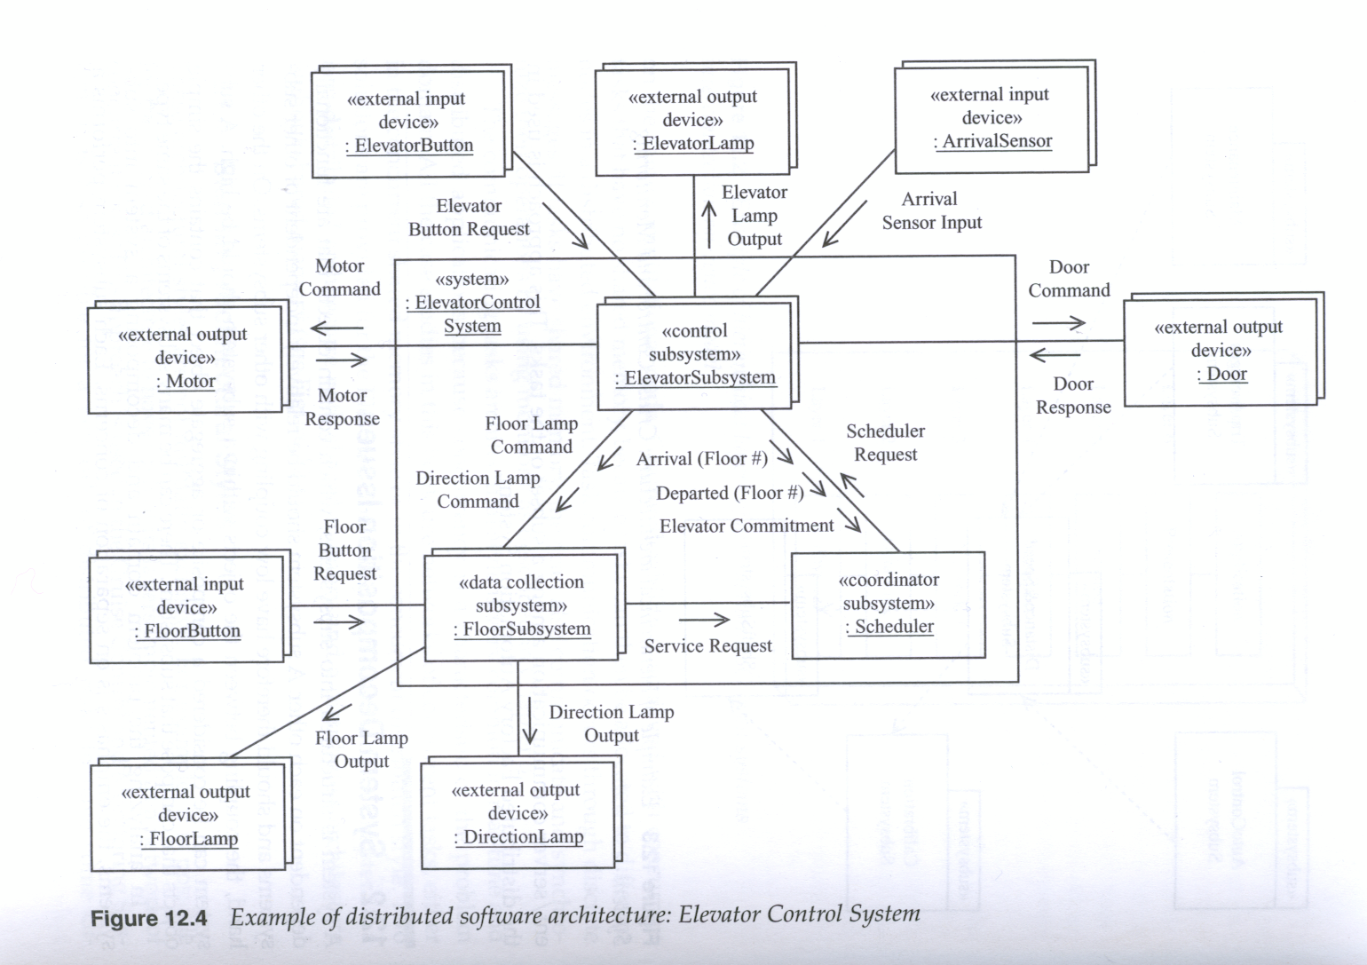
Example: Consolidated Collaboration Diagram of an Elevator Control System

Slide 22
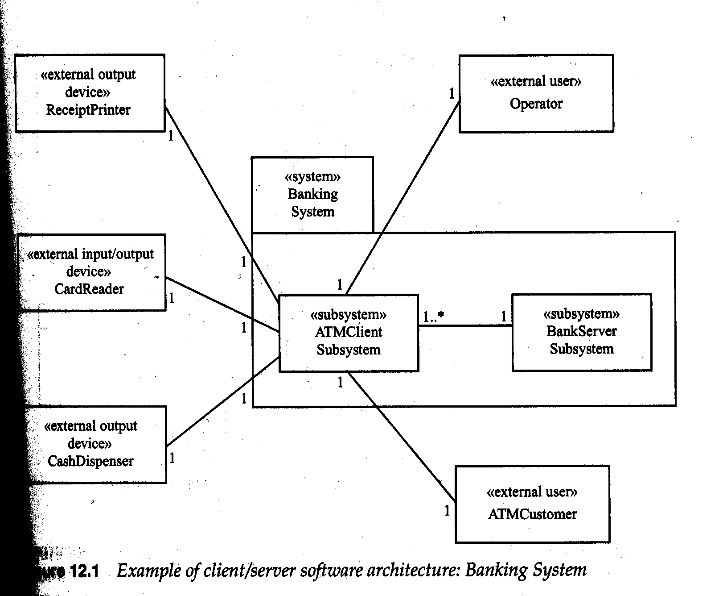
Example: The ATM Banking System Architecture Showing external classes

Slide 23
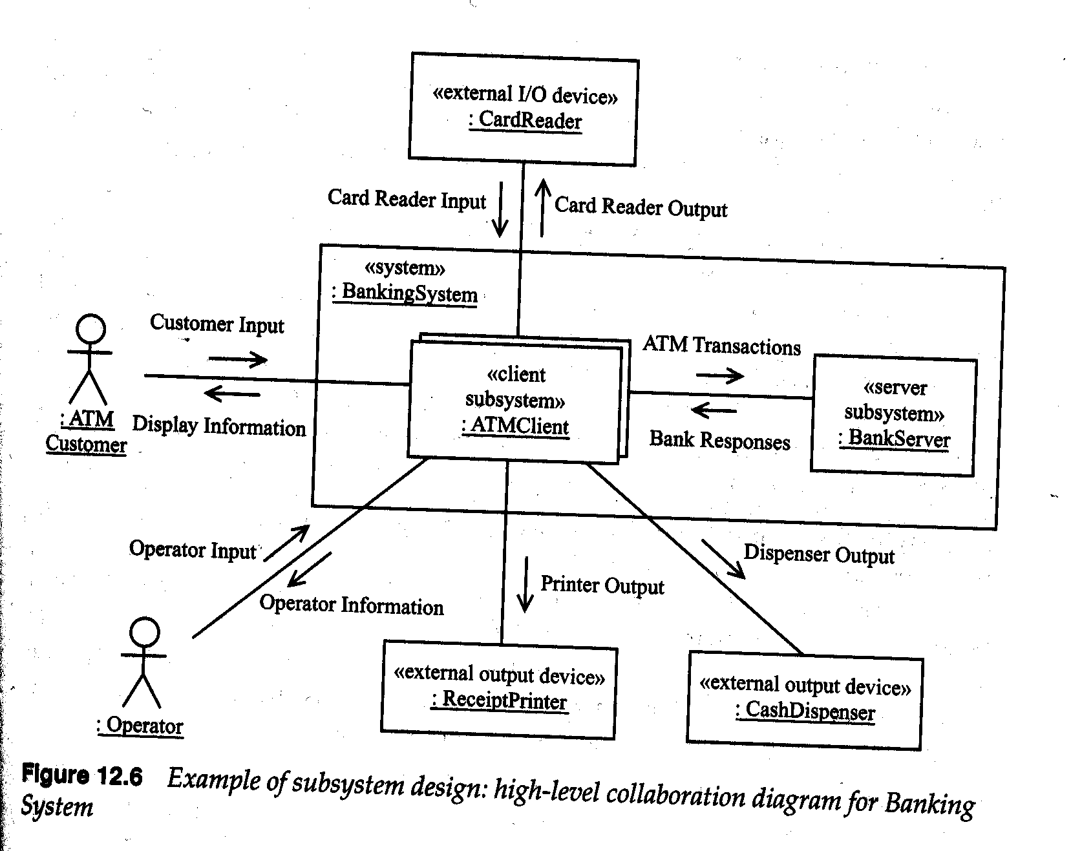
Consolidated Collaboration Diagram of the ATM Banking System (the dynamic model):
Combines several usage scenarios

Slide 24
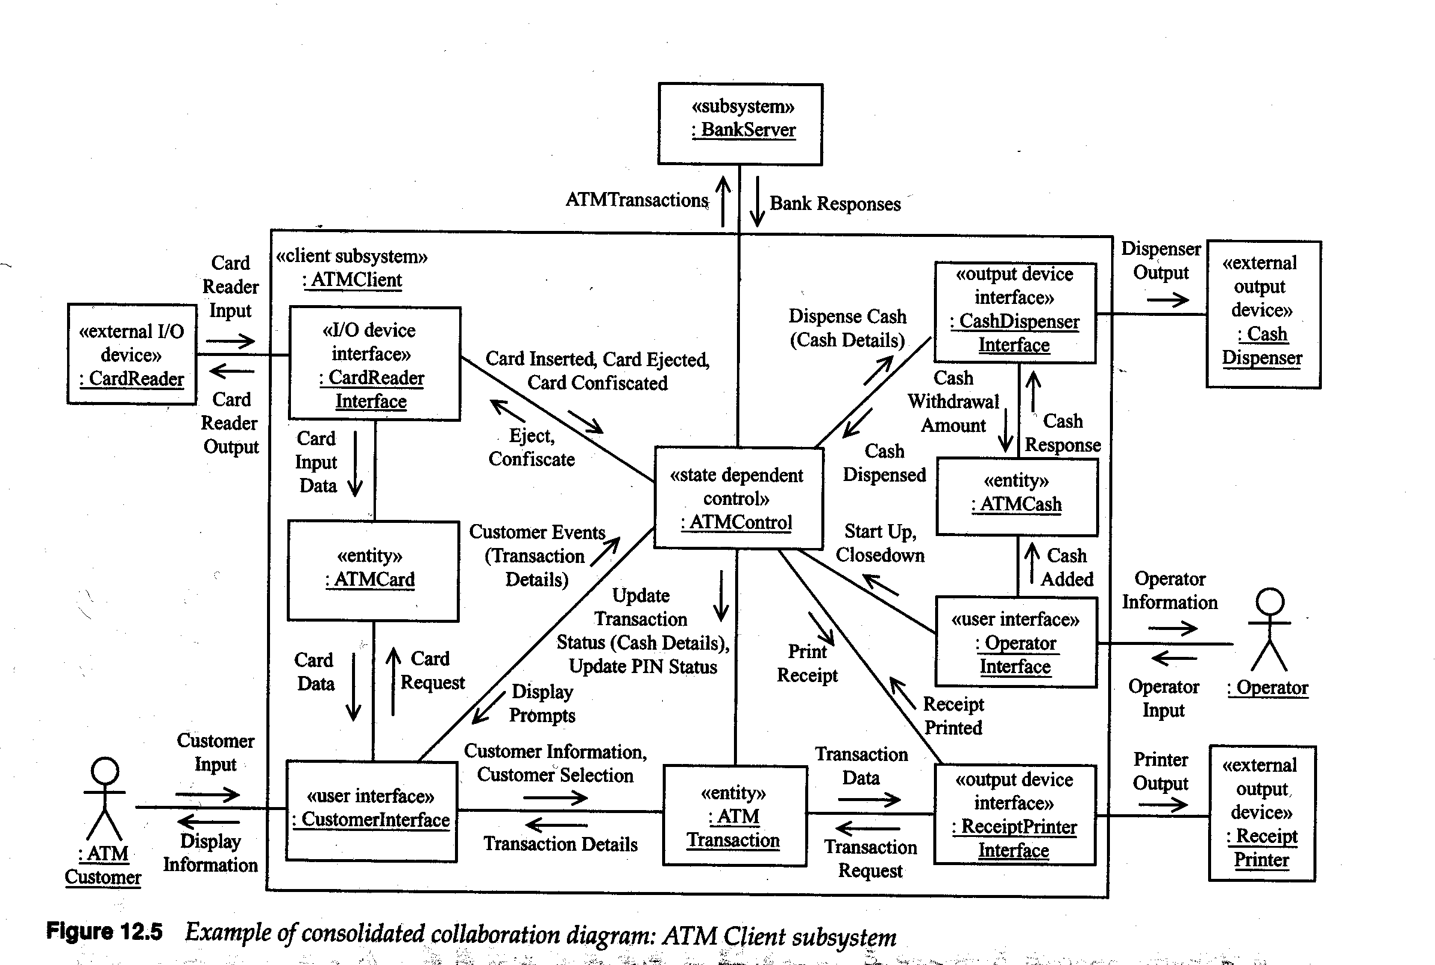
Consolidated Collaboration Diagram of the ATM Client Subsystem
The diagram can be easily used
to develop the class diagram
of the ATM Client Subsys.

Slide 25
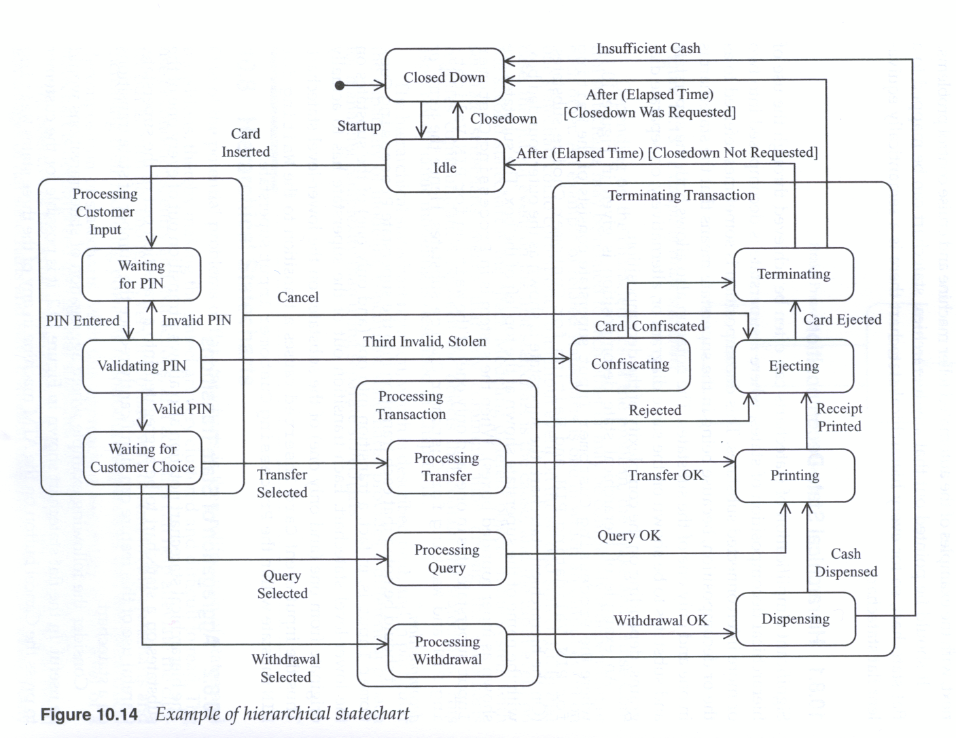
OOD: How can we define the Behavior of Classes
Example: State Chart of The ATMControl Class
StateCharts can be used to Refine
the class diagram using the
State Pattern

Slide 26
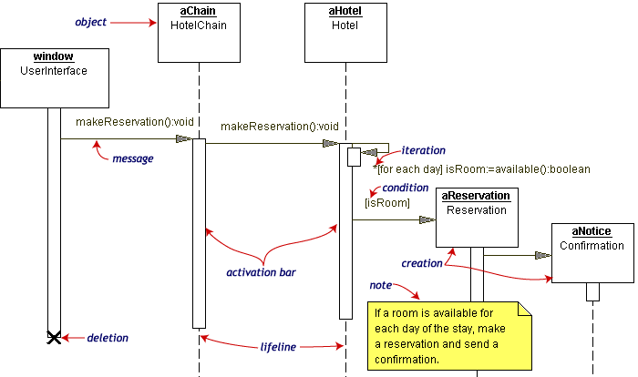
Examples of Design Sequence Diagrams Notation

Slide 27
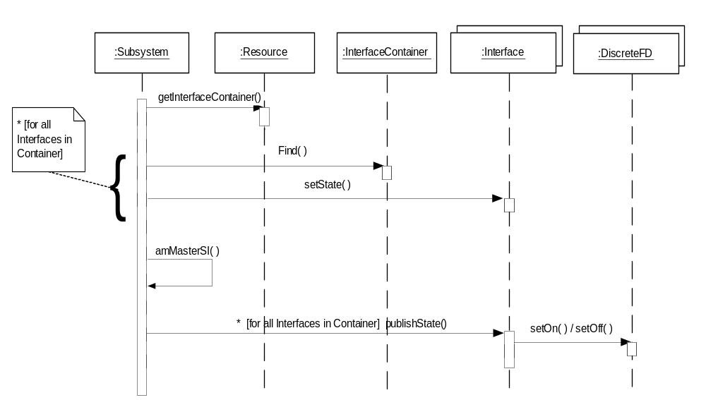
Examples of Design Sequence Diagrams Notation
Compound and Simple Iteration

Slide 28
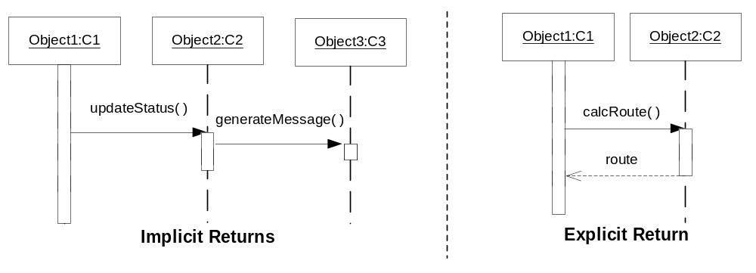
Examples of Design Sequence Diagrams Notation
Messages specified on interactions can be synchronous or asynchronous
Synchronous (sequential call)

Slide 29
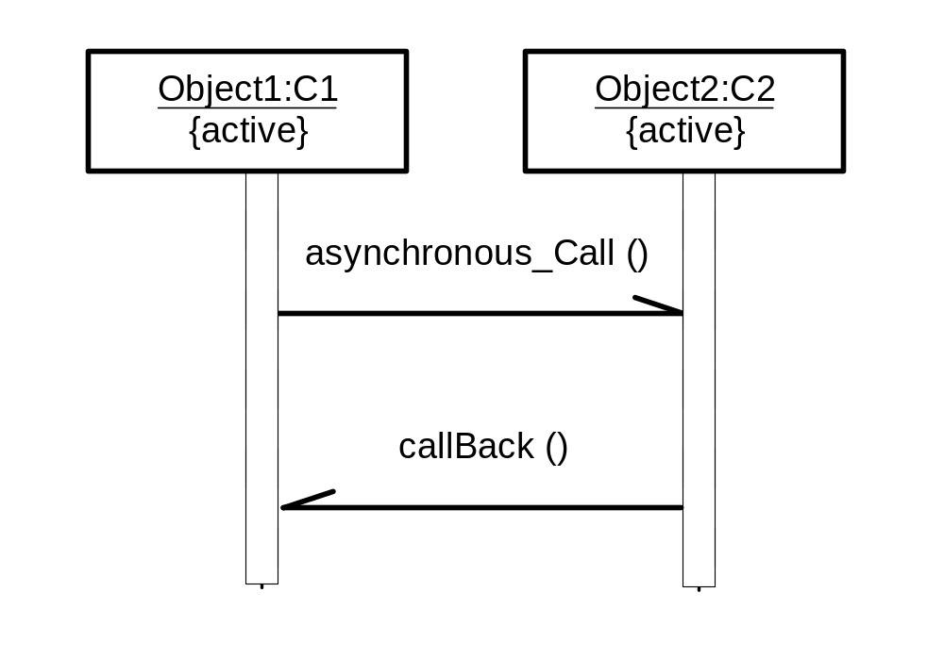
Examples of Design Sequence Diagrams Notation
Asynchronous (Concurrent Interactions)

Slide 30
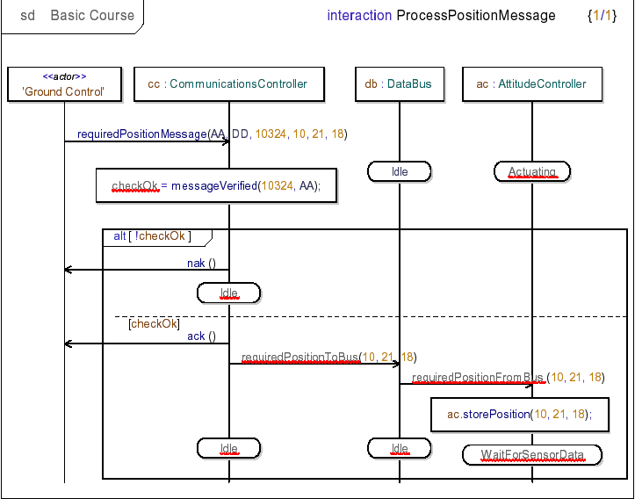
Examples of Design Sequence Diagrams Notation (UML 2)

