Slide 1
Software Engineering I
Object-Oriented Design
Software Design Refinement
Using Design Patterns
Instructor: Dr. Hany H. Ammar
Dept. of Computer Science and Electrical Engineering, WVU

Slide 2
Outline
The Requirements, Analysis, Design, and Design Refinement Models
Design refinement
Class diagram refinement using design patterns
Design patterns examples
  The Facade pattern
  The Strategy Pattern
  The State Pattern
  The Command Pattern
  The Observer Pattern
  The Proxy Pattern
Design Patterns Tutorials

Slide 3
The Requirements, Analysis, Design, and Desgin Refiement Models
Requirements
Elicitation
Process
Use Case Diagrams/
Sequence Diagrams
(the system level)
Functional/
Nonfunctional
Requirements
- Analysis Class Diagrams
- State Diagrams/
Refined Sequence
Diagrams (The object
level)
The Analysis
Process
Static Analysis
Dynamic Analysis
The Design
Process:
Initial Design
Design
Refinement
Design Class Diagrams
Design Sequence Diagrams
Static Architectural
Design
Dynamic Design
Design Refinement
Refined Design Class
Diagrams

Slide 4
Design Refinement
It is difficult to obtain a quality design from the initial design
The initial design is refined to enhance design quality using the software design criteria of modularity, information hiding, complexity, testability, and reusability.
New components (or new classes) are defined and existing components (or classes) structures are refined to enhance design quality
The design refinement step is an essential step before implementation and testing.

Slide 5
Class Diagram Refinement
Using Design Patterns
Design Class Diagrams are further refined to enhance design quality (i.e., reduce coupling, increase cohesion, and reduce component complexity) using design patterns
A design pattern is a documented good design solution of a design problem
Repositories of design patterns were developed for many application domains (communication software, agent-based systems, web applications)
Many generic design patterns were defined and can be used to enhance the design of systems in different application domains

Slide 6
What is a Design Pattern
What is a Design Pattern?
A design pattern describes a design problem which repeatedly occurred in previous designs, and then describes the core of the solution to that problem
Solutions are expressed in terms of classes of objects and interfaces (object-oriented design patterns)
A design pattern names, abstracts, and identifies the key aspects of a high quality design structure that make it useful for creating reusable object-oriented designs

Slide 7
Defining a Design Pattern
Design Patterns are documented in the literature by a template consisting of the following
A Design Pattern has 5 basic parts:
1. Name
2. Problem
3. Solution
4. Consequences and trade-of of application
5. Implementation: An architecture using a design class diagram

Slide 8
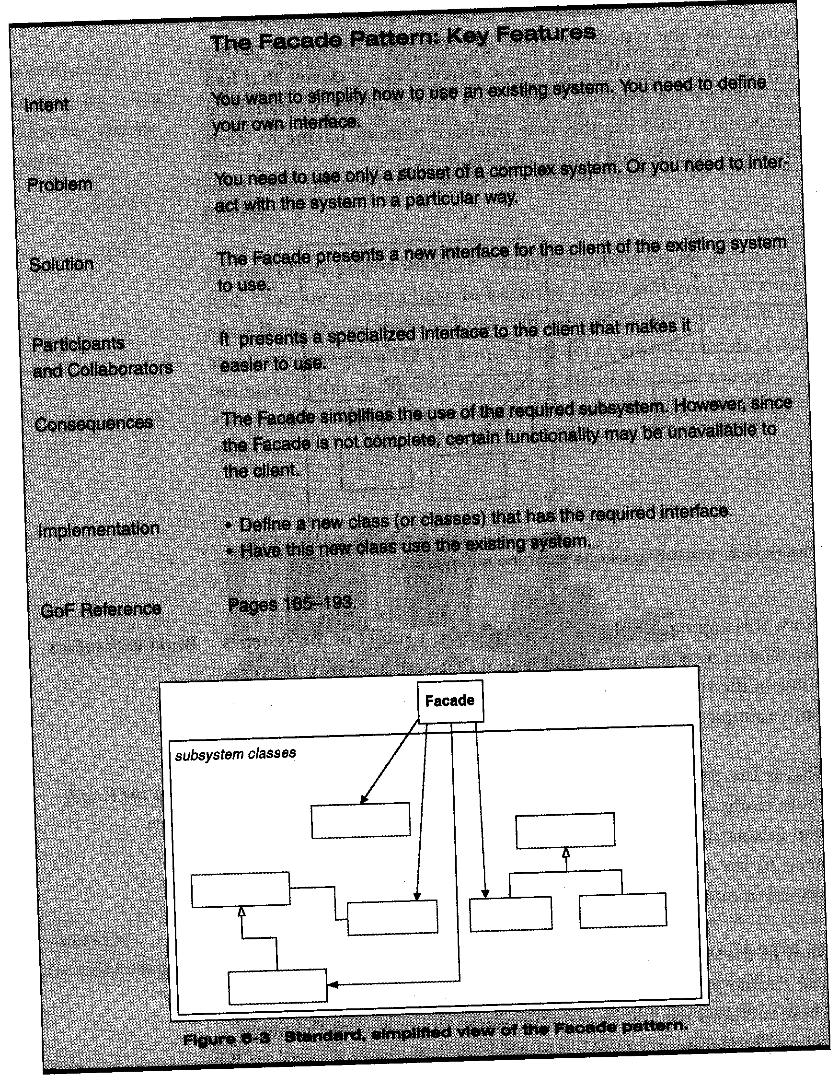
Example of Pattern Definition: The Façade Pattern Provides
An Interface To a Subsystem

Slide 9
The Facade Pattern
The class Facade is introduced as an interface to the whole subsystem.
Any client class needs a service from any of the subsystem classes will be send the request to the facade class.
All the subsystem interfaces are combined in one class

Slide 10
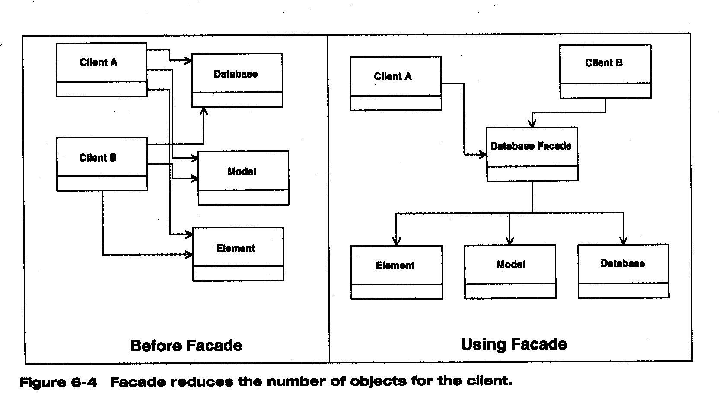
Example of Using the Design Pattern
Design Patterns produce quality designs by reducing coupling
Example of how a Façade Pattern reduces coupling

Slide 11
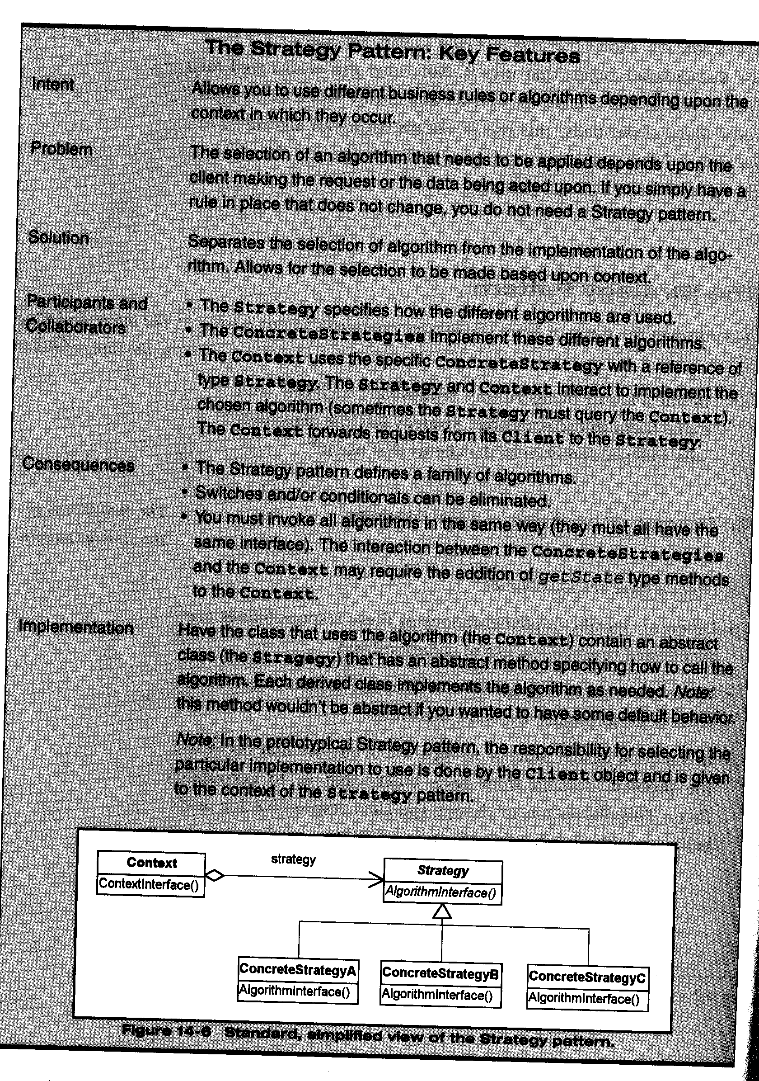
Another Example: The Strategy Pattern template

Slide 12
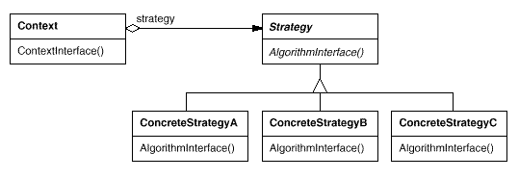
Another Example of Design Patterns
The Strategy Pattern: lets the algorithm vary independently from clients that use it
Controller Class
Abstract Class
Default control
Strategy
Control Strategy A
Control Strategy B
Control Strategy C

Slide 13
The Strategy Pattern
The Strategy Pattern Context class has multiple control strategies provided by the concrete strategy classes, or by the abstract strategy (by default)
The pattern lets us vary the algorithm that implements a certain function during run time depending on the conditions of the system
The Pattern reduces coupling by having the client class be coupled only to the context class

Slide 14
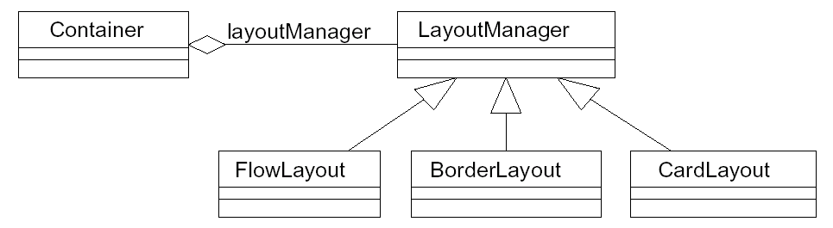
Examples of Design Patterns
The Strategy Pattern
Example of using the pattern in JAVA AWT GUI components lay out managers

Slide 15
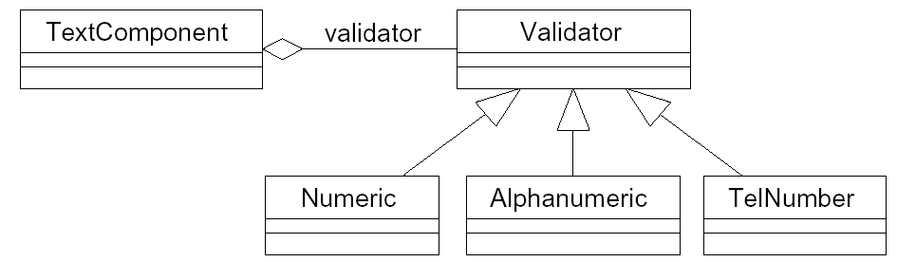
Examples of Design Patterns
The Strategy Pattern: another example
Situation: A GUI text component object wants to decide at runtime what strategy it should use to validate user input. Many different validation strategies are possible: numeric fields, alphanumeric fields, telephone-number fields, etc.

Slide 16
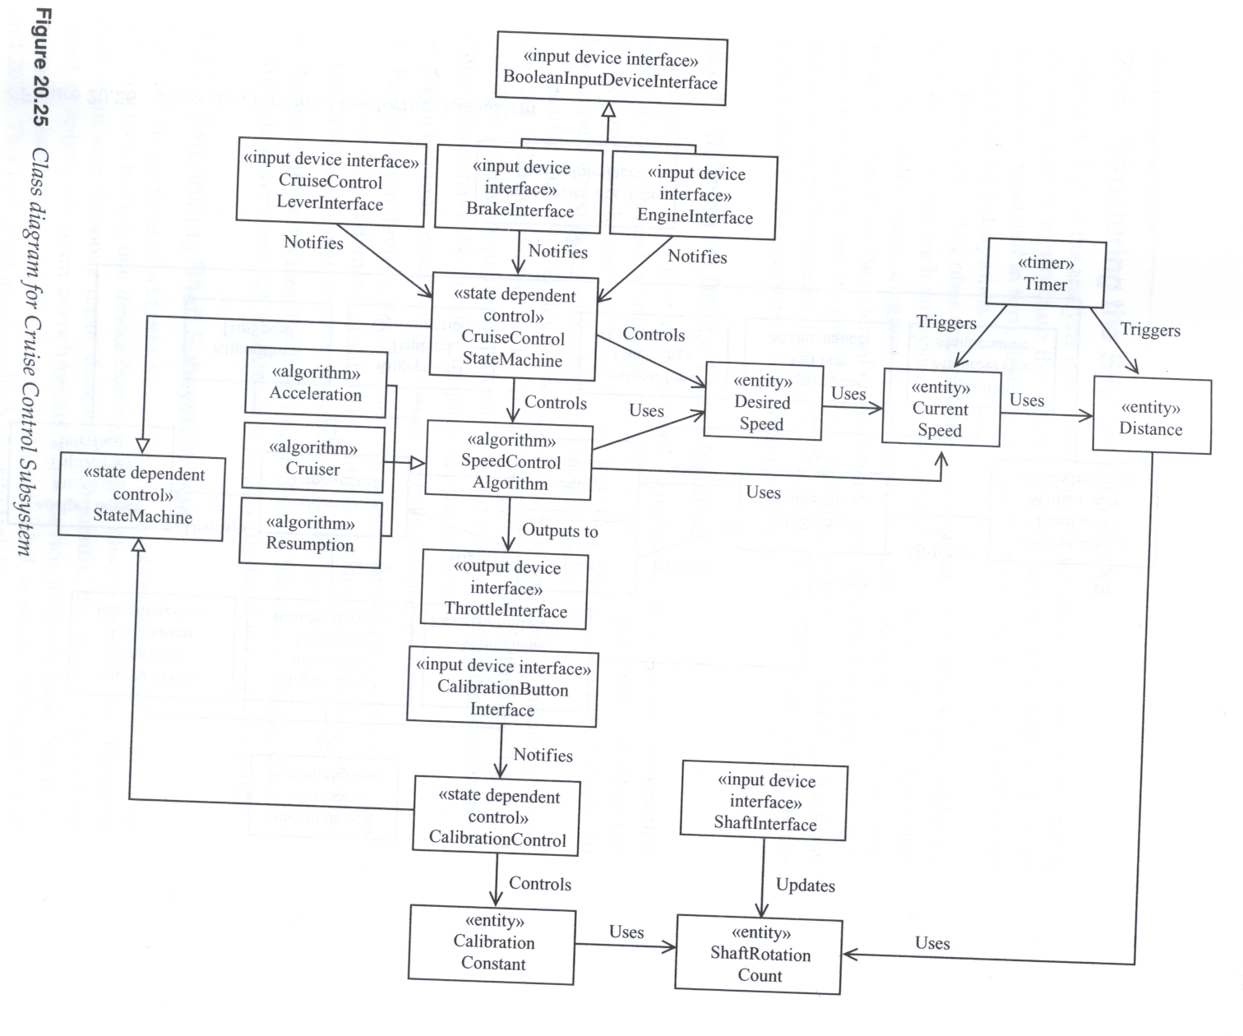
Example
of using the Strategy
Pattern: SpeedControl
Is the Strategy class

Slide 17
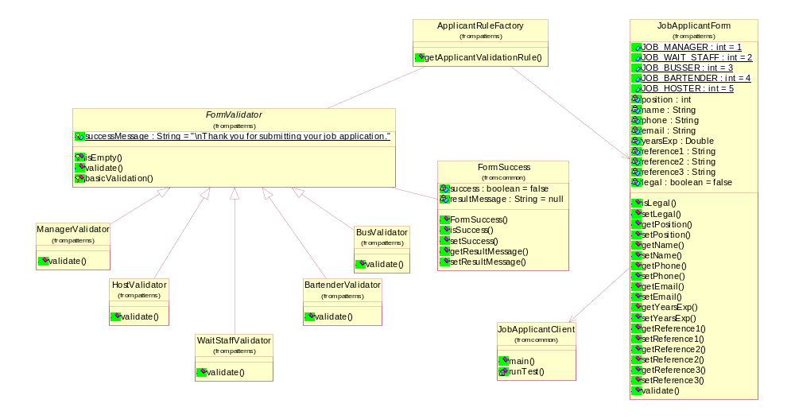
Another example of using the Strategy Pattern: A Job Application System
The complexity of class JobApplication is reduced by moving the validate() operation
to the Strategy Pattern classes

Slide 18
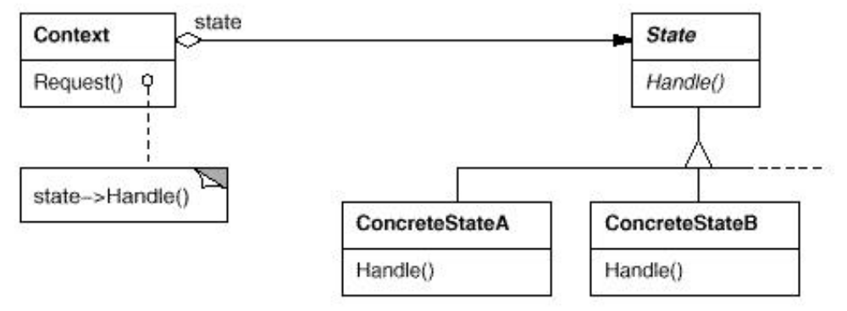
Examples of Design Patterns
The State Pattern
Similar in structure (static) to the Strategy pattern but differs in dynamics
Events are handled based on the current state of the object

Slide 19
Examples of Design Patterns
The State Pattern
The State Pattern: is a solution to the problem of how to make the behavior of an object depend on its state.
Context class
<<interface>>
State
The
Context
Class
MultiStateOb
state
Abstract State
Class
1..N
Current State
+CreateInitState()
Setstate()
Handle()
Changestate()Deletestate()
Lets a mutli state class divide its
responsibilities (Opr1(),Opr2(),
and Oprn() on multiple state
classes.
ConcreteState 1
concreteState n
……………..
For more Info, see
http://home.earthlink.net/
~huston2/dp/state.html
Handle(), Oprn()
Handle()
Opr1(),Opr2()
N concrete state
classes

Slide 20
Examples of Design Patterns
The State Pattern
The State pattern is a similar in structure to the Strategy Pattern but with different behavior or dynamics. the state objects are active one at a time depending on the actual state of the context object.
The structure is defined as follows:
  Define a "context" class to present a single interface to the outside world.
  Define a State abstract base class.
  Represent the different "states" of the state machine as derived classes of the State base class.
  Define state-specific behavior in the appropriate State derived classes.
  Maintain a pointer to the current "state" in the "context" class.
  To change the state of the state machine, change the current "state" pointer
State Transitions can be defined for each State class
To be discussed later at length in slides 10 on

Slide 21
Examples of Design Patterns
The context class Multistateob would create the initial state object to provide the services of the initial state (it will set its current state to its initial state)
The initial state object would sense the condition for state transition to a new state, when this occurs it would then create an object of the new state and destroy itself
Each state object implements the transition, actions, and activities in the state it represents

Slide 22
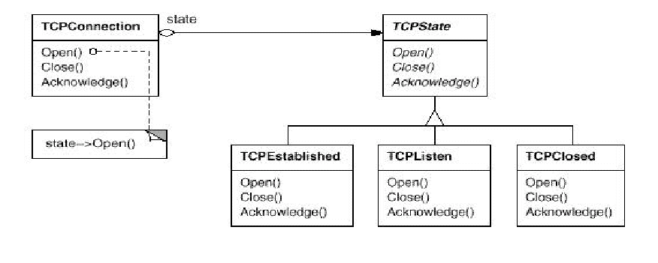
Examples of Design Patterns
The State Pattern
TCP connection example

Slide 23
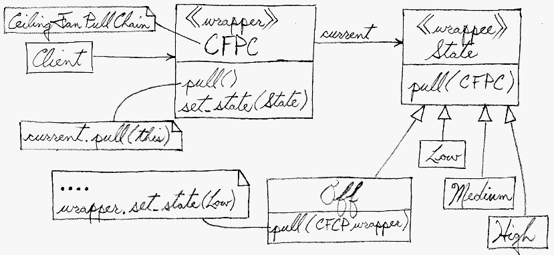
Examples of Design Patterns
The State Pattern
Structure
A Ceiling Fan Pull Chain Example :

Slide 24
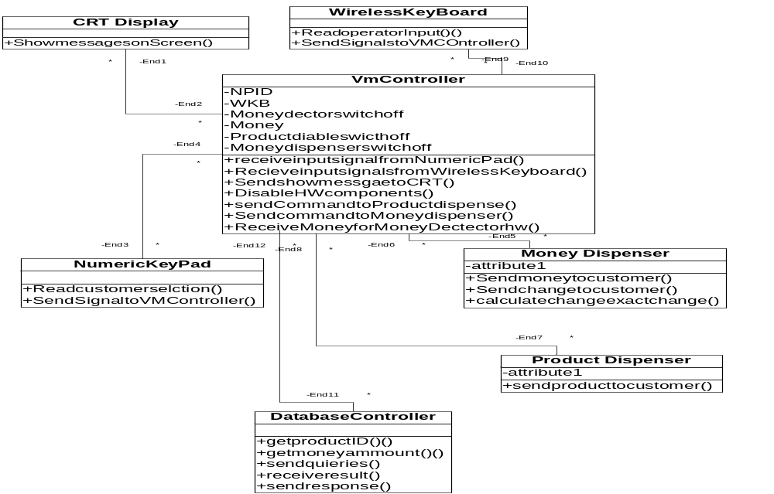
Design Patterns Application Example: The VM System
The initial design class diagram of a Vending Machine

Slide 25
The State Diagram of the VM Controller Class
UserMode
Interact with the User
Received input
Signal from Wireless
Keyboard
Reset
MiantenanceMode
Interact with the
Maintenance Operator

Slide 26
Design Patterns Application Example: The VM System
The State Pattern Applied to the 2 state VM example
Class of Objects
<<interface>>
VMController State
VMContoller
state
2
Abstract State
Class
++CreateInitState()
Setstate()
Changestate()
Deletestate()
Concrete State 1 Class
Concrete State 2 Class
UserMode
MaintenanceMode
+UpdateDatabase()
+InsertMoney()
+SelectProduc()

Slide 27
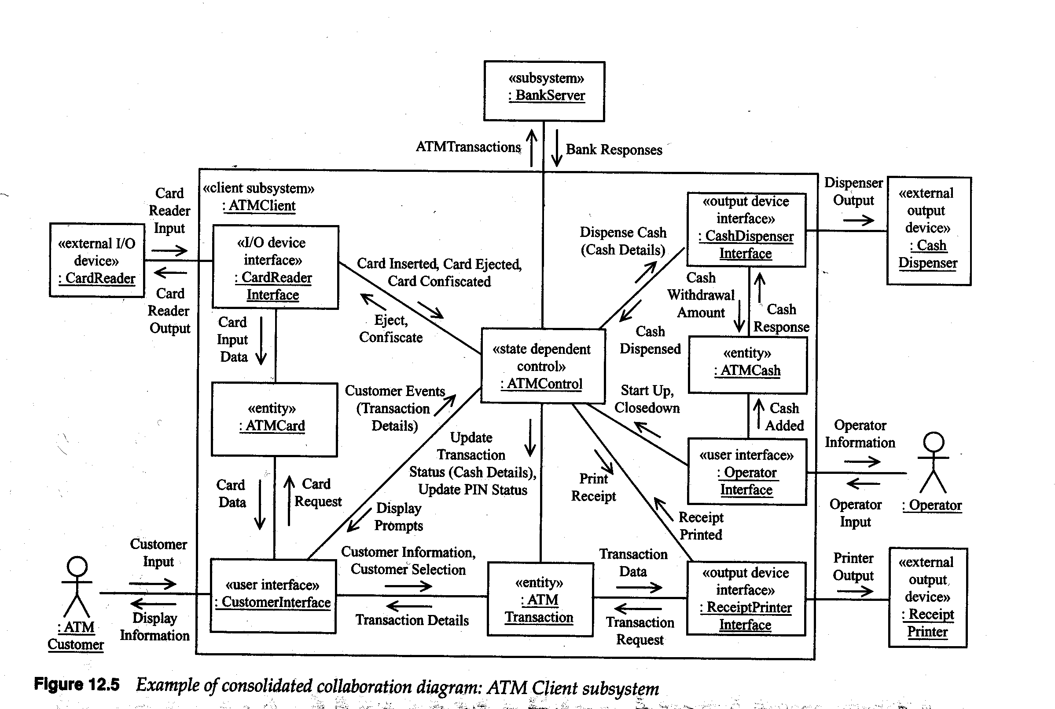
Recall The Consolidated Collaboration Diagram of the ATM Client Subsystem
The diagram can be easily used
to develop the class diagram
of the ATM Client Subsys.

Slide 28
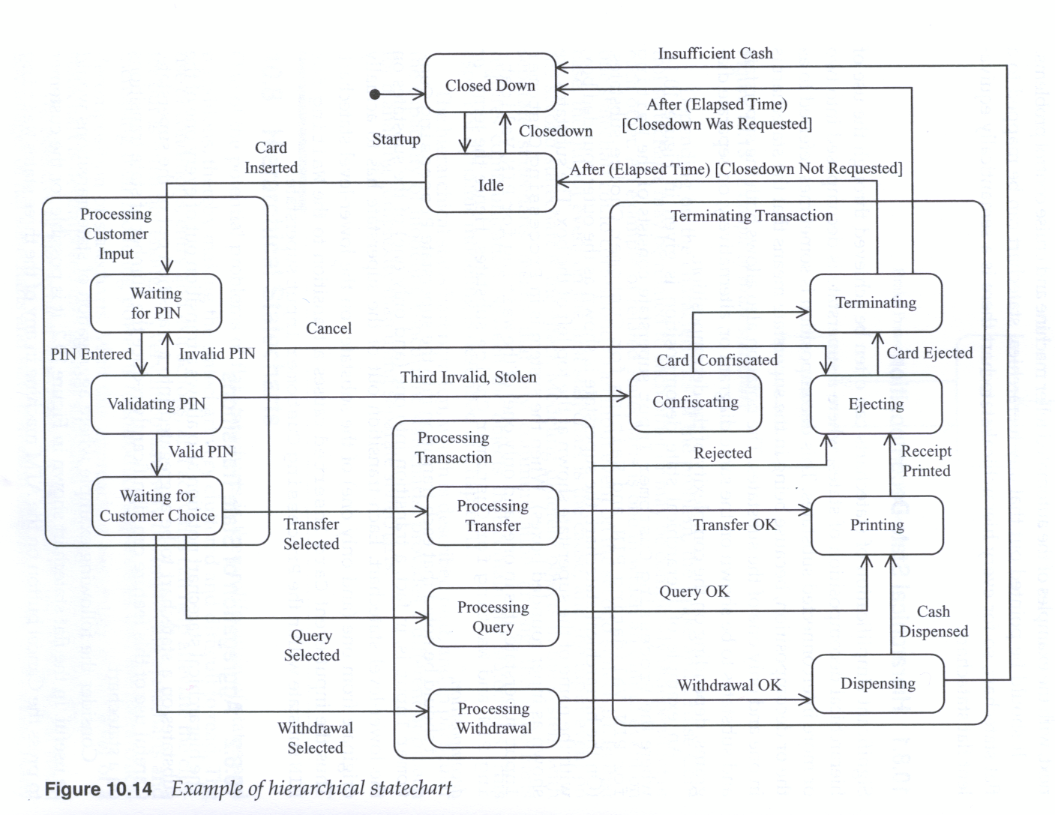
Example: How can we apply
The State Pattern to the
ATM system using
This ATM controller
StateChart ?

Slide 29
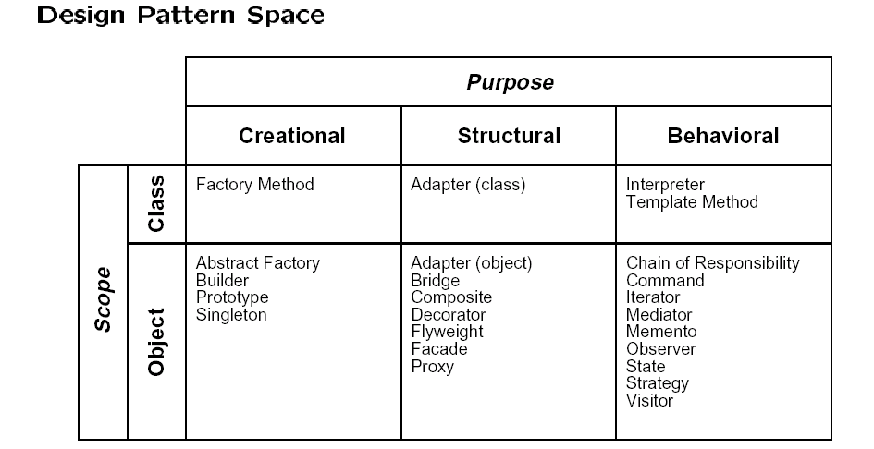
Types of Design Patterns
The Gang of Four (GoF) Patterns (Gamma et al 1995)

Slide 30
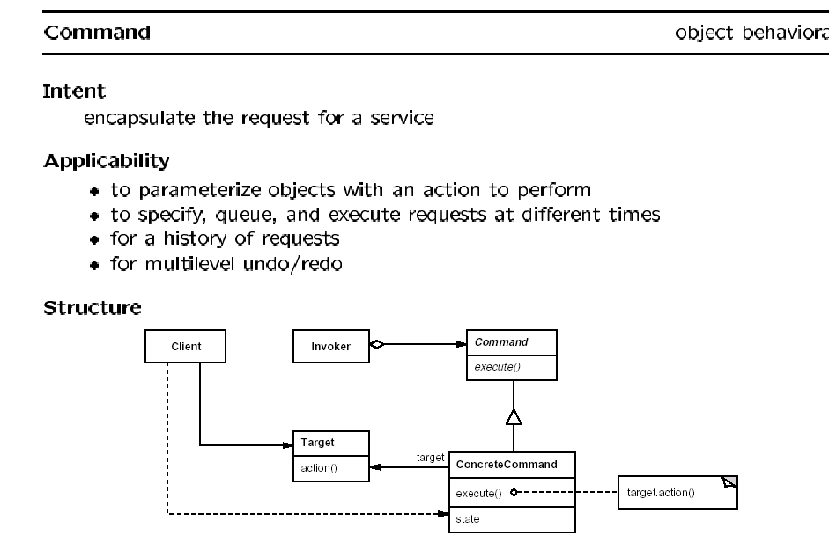
Examples of Behavioral Design Patterns
The Command Pattern: operator commands or user or customer requests are treated as a class of objects

Slide 31
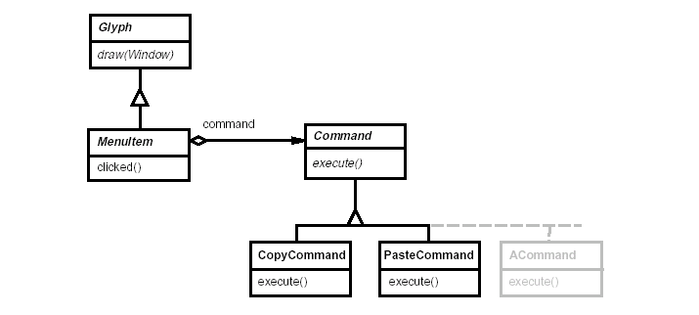
The Command Pattern
Example of using the Command Pattern in a Menu driven graphics application

Slide 32
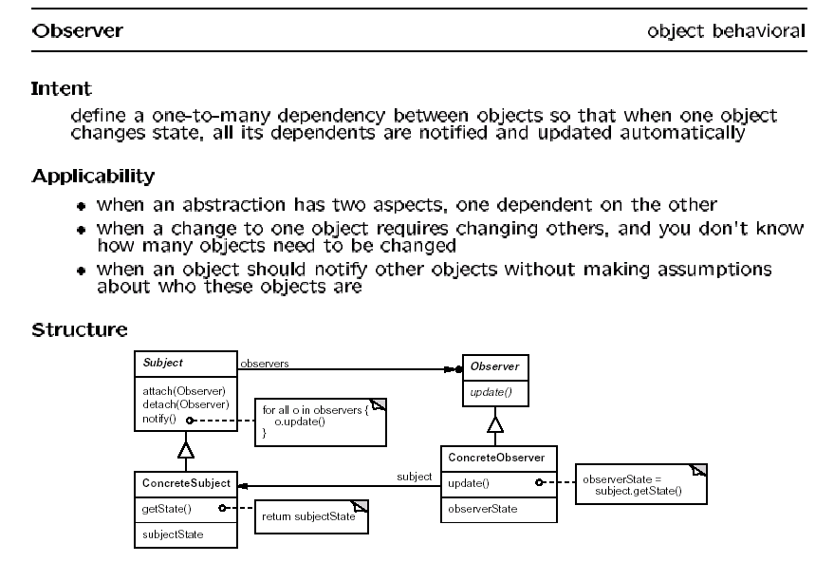
Examples of Behavioral Design Patterns
The Observer Pattern: Multiple observer objects are notified when changes of states subjects occur

Slide 33
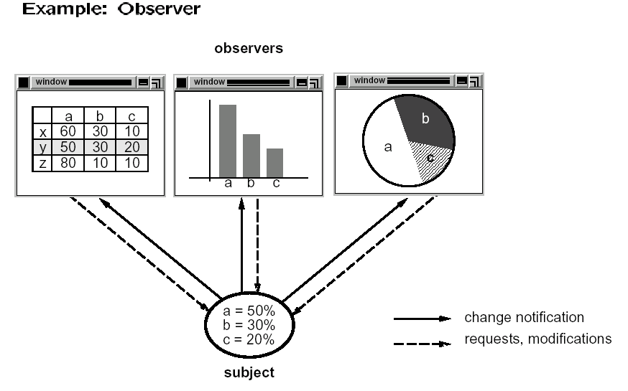
The Observer Pattern

Slide 34
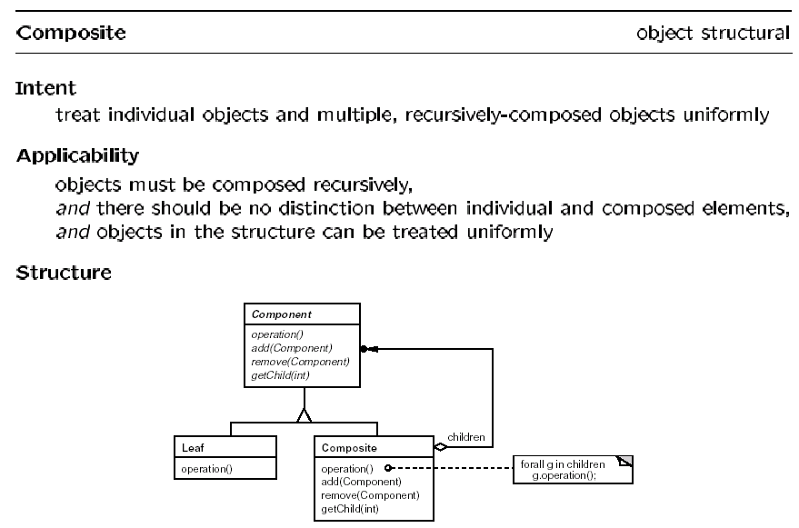
Examples of Structural Design Patterns
The Composite Pattern

Slide 35
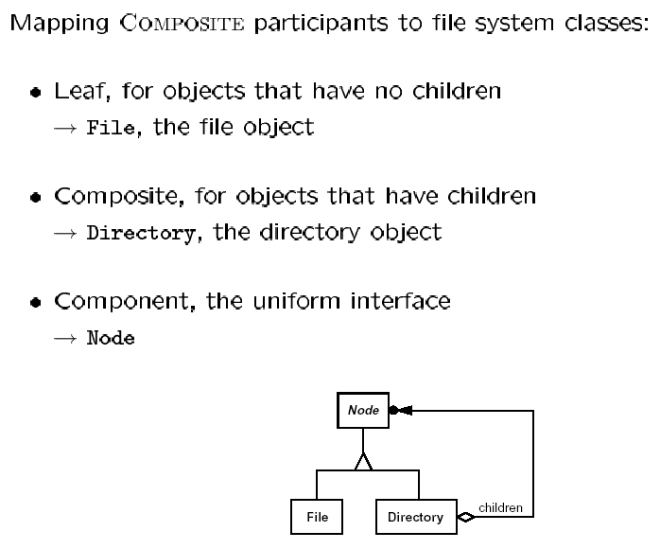
Examples of Design Patterns
The Composite Pattern :File System Structure

Slide 36
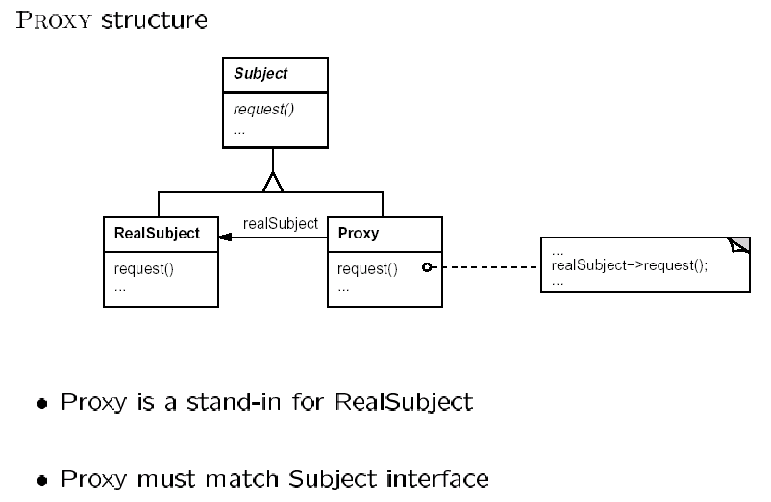
Examples of Structural Design Patterns
The Proxy Pattern (used heavily in communication software, CORBA, SOA )

Slide 37
Design Patterns Examples and Tutorials
Design Refinements Examples
Two tutorials by John Vlissides
  An Introduction to Design Patterns
  Also on the design patterns CD by Gama et al
  Designing with Patterns
Tutorial: More on Design patterns
The VISITOR family of design patterns
TEMPLATE METHOD & STRATEGY Patterns: :Inheritance vs. Delegation
Pattern-Oriented Software Architectures
Patterns & Frameworks for Concurrent & Distributed Systems by D. C. Schmidt

