Slide 1

Tor – SFD13

Slide 2
$ whoami
Jurre van Bergen
Anonymity/Privacy Enthusiast
Board member: hartvoorinternetvrijheid.nl
GPG:
2976 FD1A 2ABE FB14 3907 58CE B739 2967 EA80 1D02

Slide 3
What is this Tor thing?

Slide 4
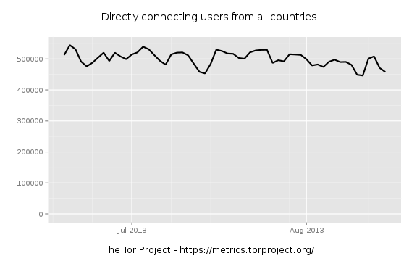
Tor helps people

Slide 5
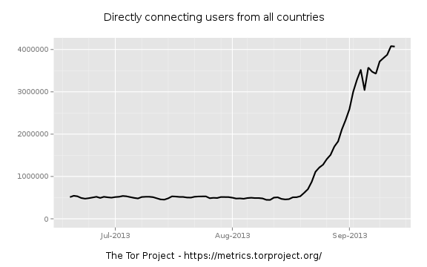
A botnet?

Slide 6
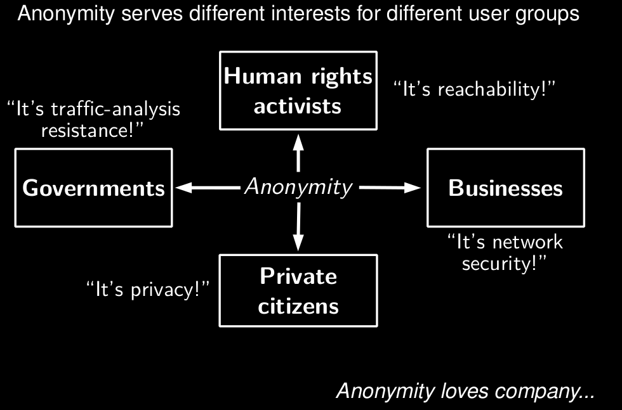

Slide 7
What's Tor?
Tor is free software
Supported by The Tor Project, Inc., a 501(c)(3) non-profit US organization
Tor network

Slide 8
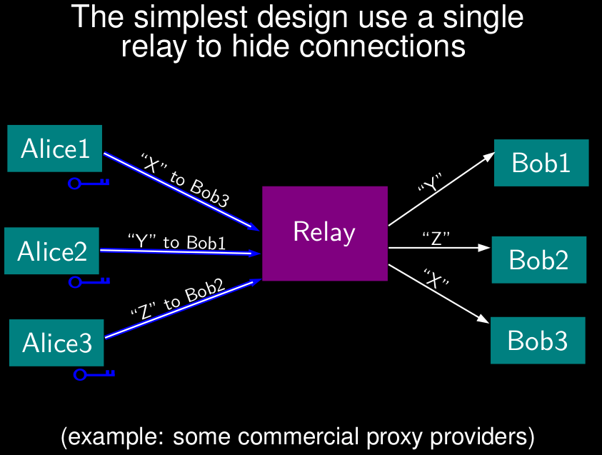

Slide 9
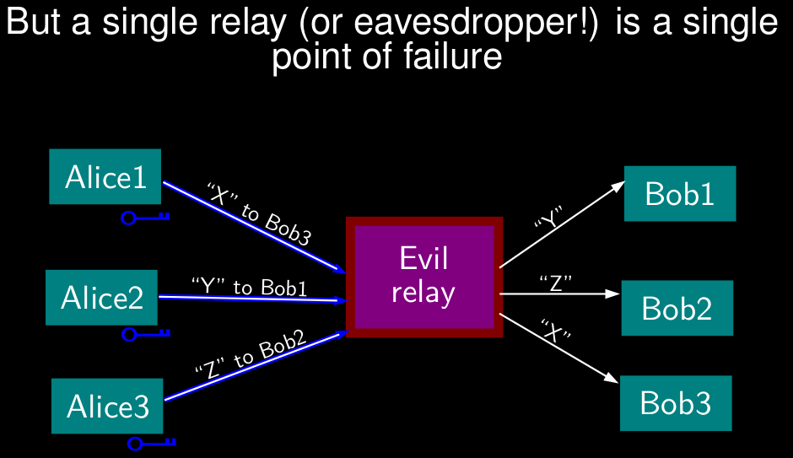

Slide 10
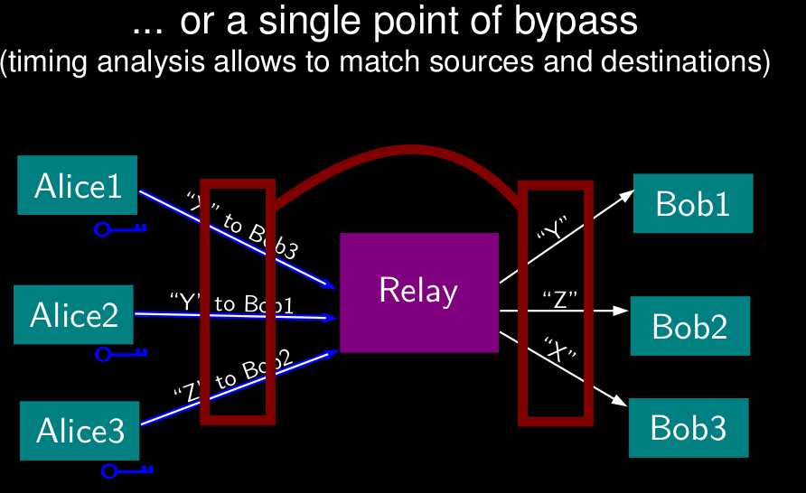

Slide 11
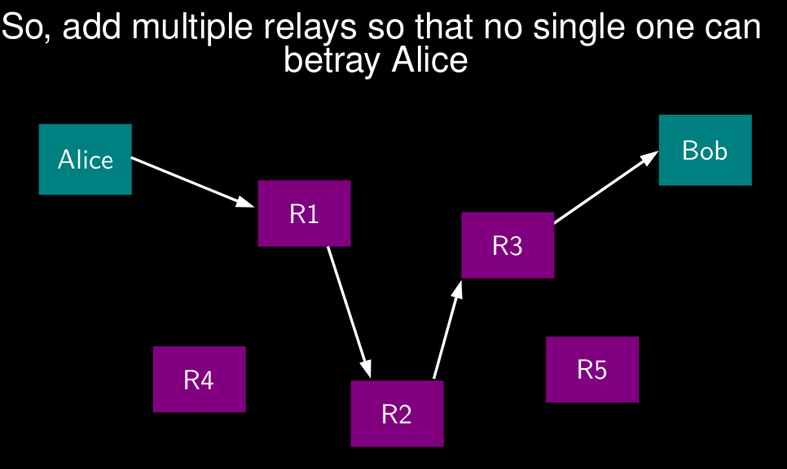

Slide 12
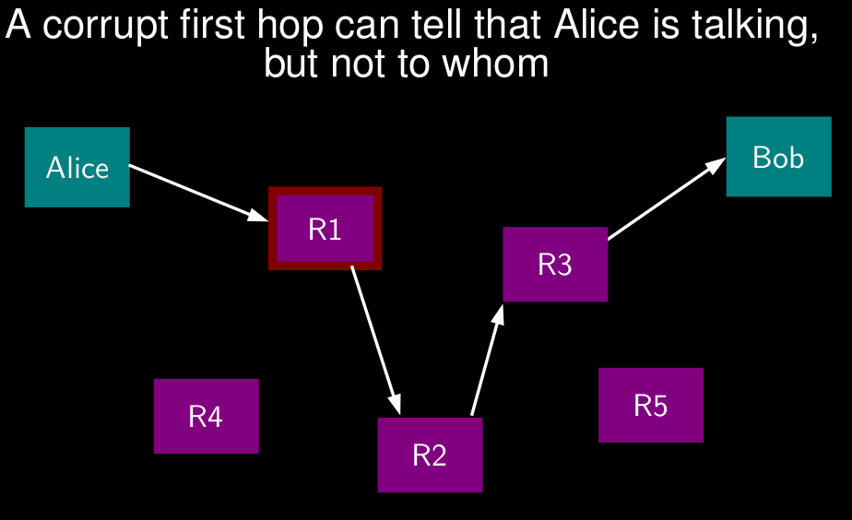

Slide 13
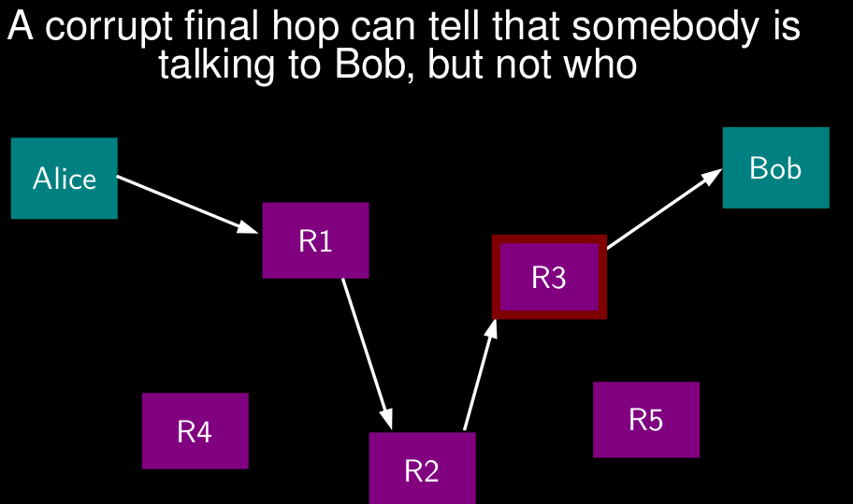

Slide 14
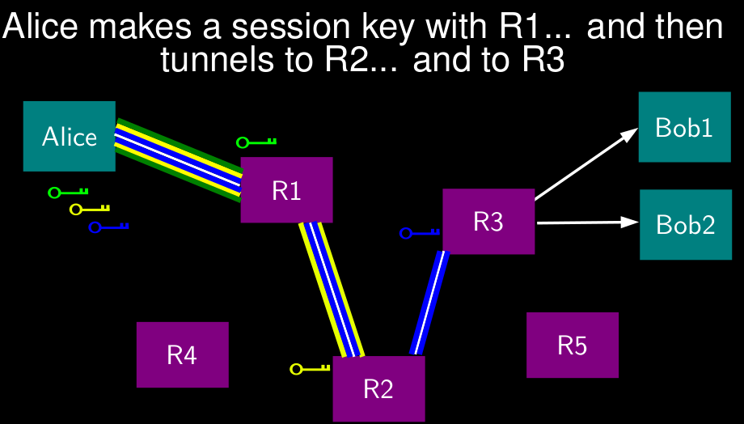

Slide 15
The Tor network

Slide 16
The Tor network
Nearly 4000 relays
around 3600 volunteer operators
current total measured bandwidth 35 Gb/s
diversity issue: a mere 40 relays see 80% of the total traffic

Slide 17
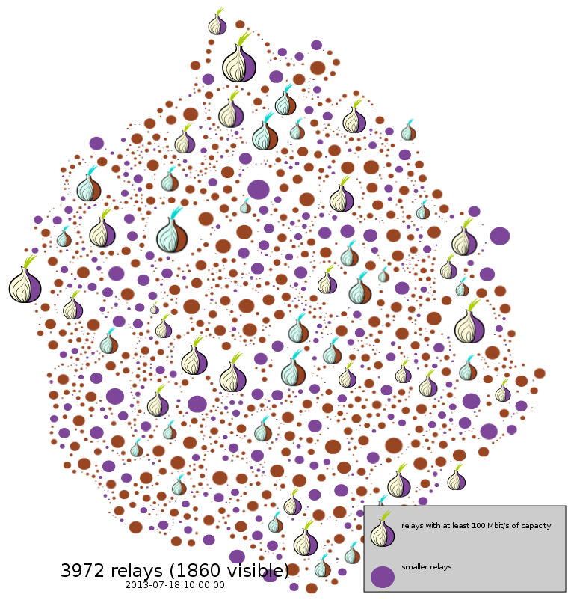

Slide 18
Using Tor

Slide 19
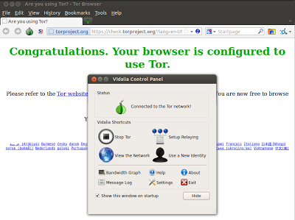
Desktop/Laptop

Slide 20
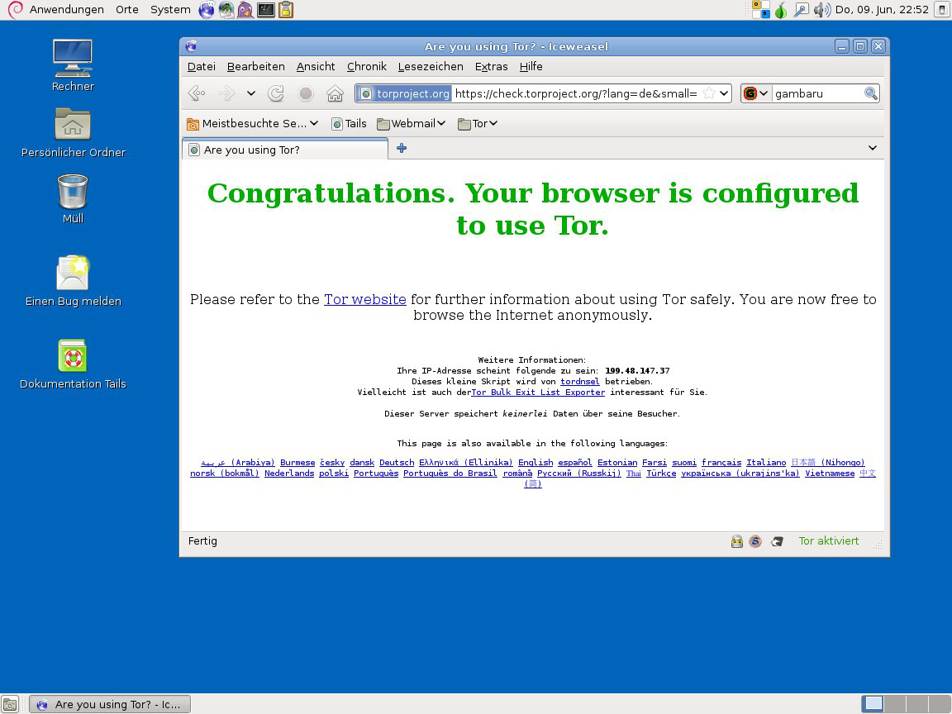
Livecd

Slide 21
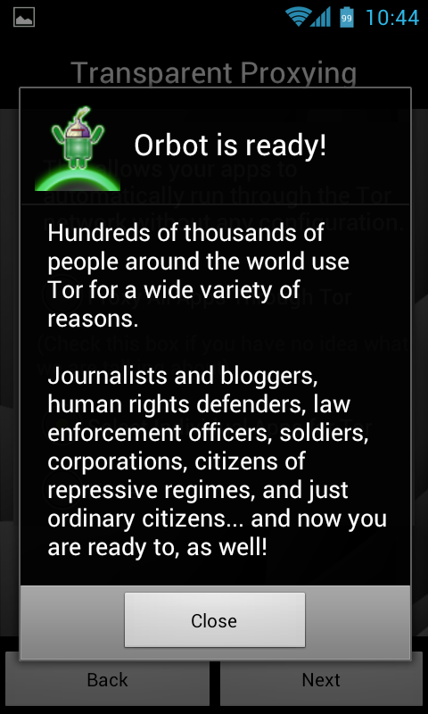
Android

Slide 22
Censorship

Slide 23
Censors do not want Tor
The list of Tor relays is public
Upside: server administrators can block exit nodes if they really need to.
Downside: allow blocking access to the Tor network
Direct Tor connections are currently blocked in China, Iran, Kazakhstan, Syria, the Philippines, ...

Slide 24
Bridges
Limited kind of Tor relay
Private entry point in the Tor network
Different pool of bridge ip addresses
Some bridges are completely private

Slide 25
Censors really do not want Tor
Tor traffic is recognizable
DPI became pervasive

Slide 26
Obfuscated bridges
Obsfproxy makes traffic look like noise
Pluggable transport framework.
Arms race goes on...

Slide 27
Tor needs your help

Slide 28
Tor needs your help!
Support
Translations
Development (C, Python, C++, JS, Java, R, ..)
Research
Testing
Outreach
Financial support

Slide 29
Hart voor Internetvrijheid
Umbrella organisation under torservers.net
Running relays and soon bridges.
We need your financial support!
https://www.hartvoorinternetvrijheid.nl/donaties.html

Slide 30

Thanks!
Irc.oftc.net #tor-dev

