Slide 1
TA3M – Newsflash
Jurre van Bergen

Slide 2


Slide 3


Slide 4


Slide 5
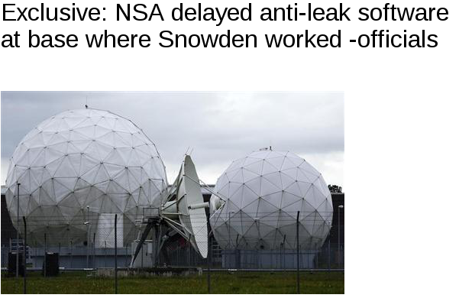

Slide 6


Slide 7
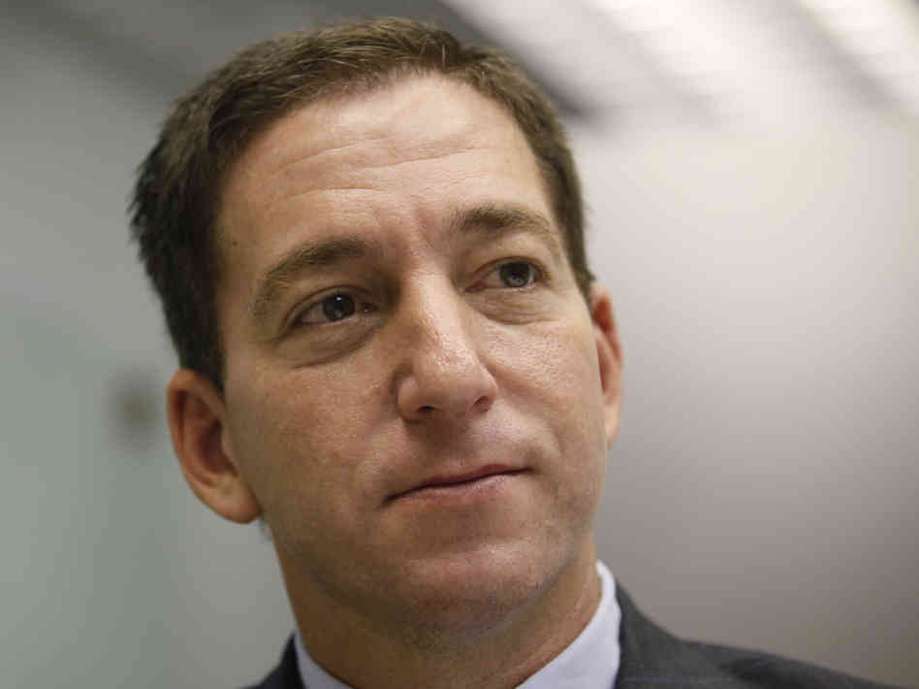



Slide 8


Slide 9


Slide 10


Slide 11
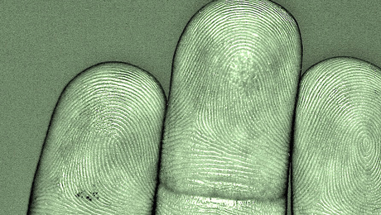

Slide 12
Stop Watching Us.
October 26th.
Rally in the U.S

Slide 13
https://github.com/drwhax/presentations/ta3m

