Slide 1
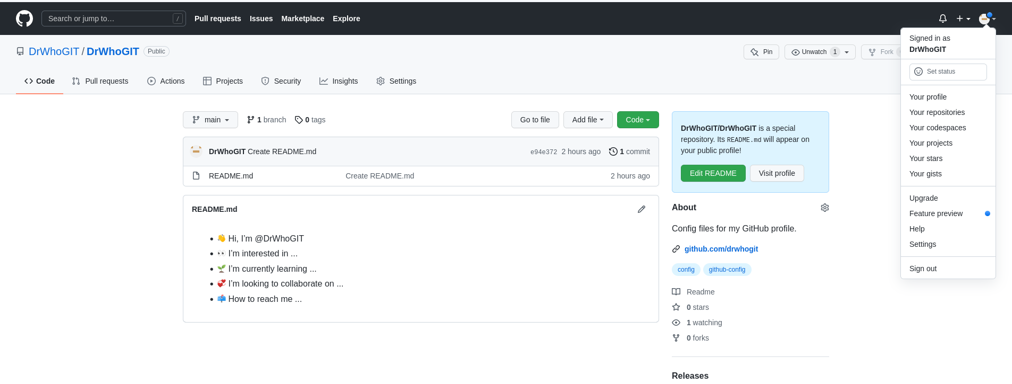
mao@maoz:~/.ssh$ git config --global user.email "maogit@fastmail.fm"
mao@maoz:~/.ssh$ git config --global user.name "Misha"
mao@maoz:~$ pwd
/home/mao
mao@maoz:~$ cat .gitconfig
[user]
email = maogit@fastmail.fm
name = Misha
mao@maoz:~$
mao@maoz:~/dev/DrWhoGIT$ ls
README.md

Slide 2
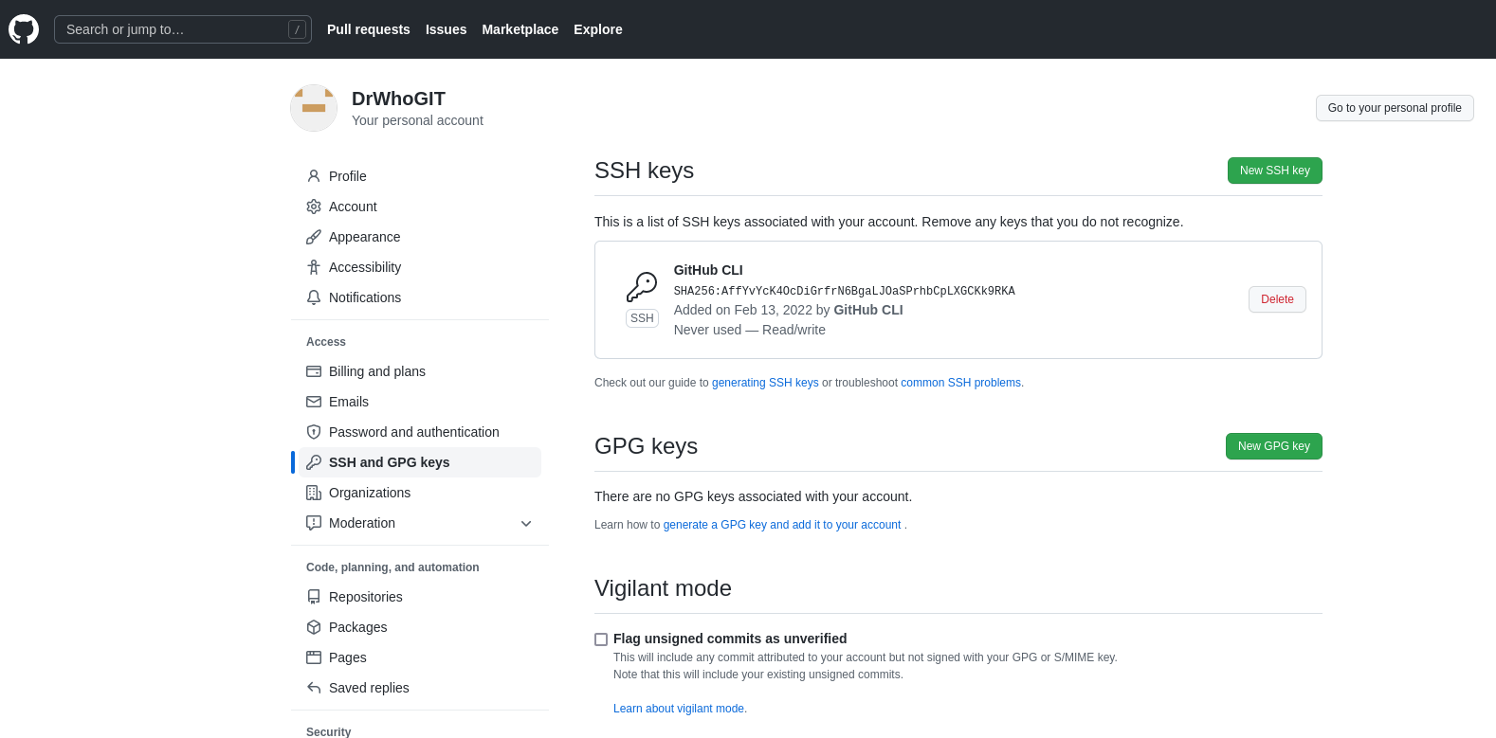
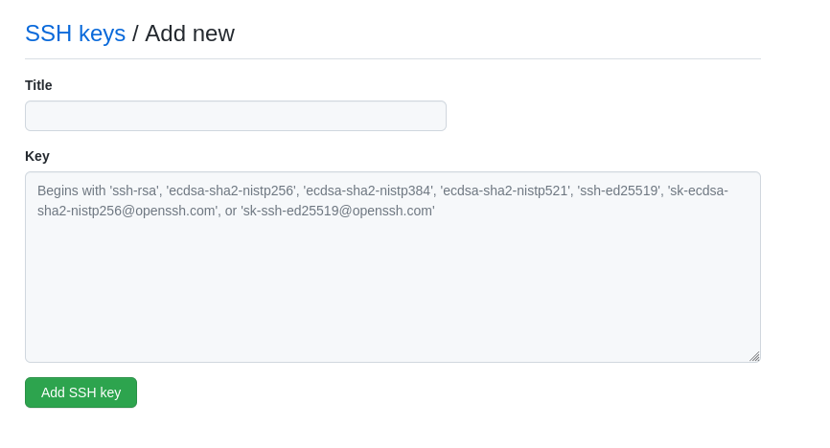
Now via the github website past in your public ssh key so changes can be properly sync’d between the local machine and gethub

Slide 3
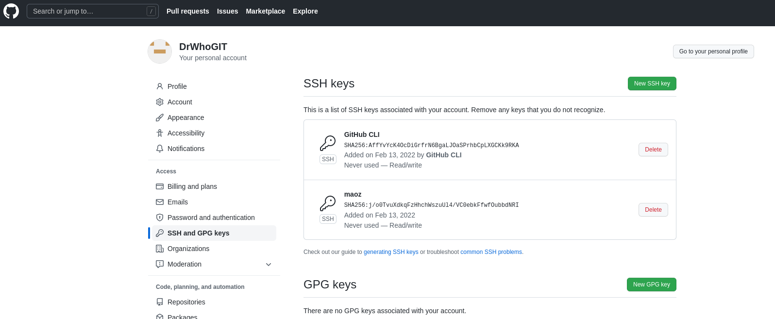

Slide 4
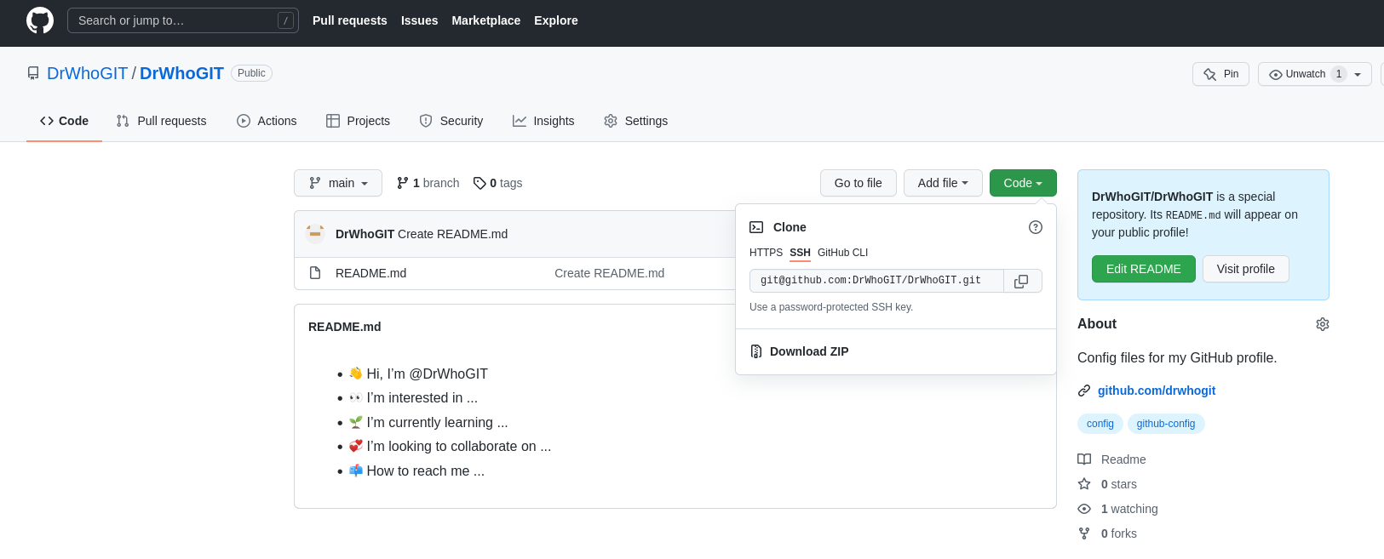
Now that our public key has been uploaded, its time to sync/clone our environment in github with our local machine. Here we will copy the SSH link which will be later pasted in a command issued on our local machine

Slide 5
Copied from tfrom GitHub as shown on prior slide
mao@maoz:~/dev$ pwd
/home/mao/dev
mao@maoz:~/dev$ git clone git@github.com:DrWhoGIT/DrWhoGIT.git
Cloning into 'DrWhoGIT'...
The authenticity of host 'github.com (140.82.113.4)' can't be established.
ECDSA key fingerprint is SHA256:p2QAMXNIC1TJYWeIOttrVc98/R1BUFWu3/LiyKgUfQM.
Are you sure you want to continue connecting (yes/no/[fingerprint])? yes
Warning: Permanently added 'github.com,140.82.113.4' (ECDSA) to the list of known hosts.
remote: Enumerating objects: 3, done.
remote: Counting objects: 100% (3/3), done.
remote: Compressing objects: 100% (2/2), done.
remote: Total 3 (delta 0), reused 0 (delta 0), pack-reused 0
Receiving objects: 100% (3/3), done.
mao@maoz:~/dev$ ls
DrWhoGIT
mao@maoz:~/dev$ cd DrWhoGIT
mao@maoz:~/dev/DrWhoGIT$ ls
README.md
mao@maoz:~/dev/DrWhoGIT$

Slide 6
mao@maoz:~/dev/DrWhoGIT$ mkdir Temporary
mao@maoz:~/dev/DrWhoGIT$ cd Temp*
mao@maoz:~/dev/DrWhoGIT/Temporary$ ls
mao@maoz:~/dev/DrWhoGIT/Temporary$ vi testing2
mao@maoz:~/dev/DrWhoGIT/Temporary$
Thou we added a folder and
new file git doesn’t show any
changes
mao@maoz:~/dev/DrWhoGIT/Temporary$ git status
On branch main
Your branch is up to date with 'origin/main'.
Untracked files:
(use "git add <file>..." to include in what will be committed)
./
nothing added to commit but untracked files present (use "git add" to track)
Add new file called testing2. As a side note we could have just done: git add . (and that is a period)
mao@maoz:~/dev/DrWhoGIT/Temporary$ git add testing2
mao@maoz:~/dev/DrWhoGIT/Temporary$ git status
On branch main
Your branch is up to date with 'origin/main'.
Changes to be committed:
(use "git restore --staged <file>..." to unstage)
new file: testing2

Slide 7
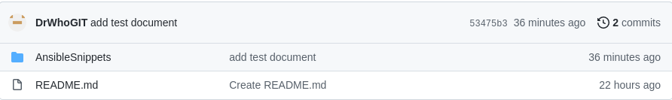
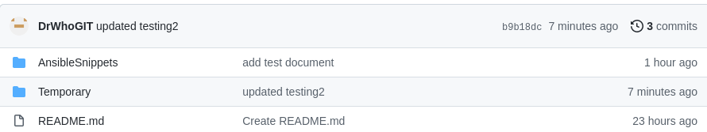
We don’t yet see the updated folder/file
mao@maoz:~/dev/DrWhoGIT/Temporary$ git commit -m "updated testing2"
[main b9b18dc] updated testing2
1 file changed, 1 insertion(+)
create mode 100644 Temporary/testing2
mao@maoz:~/dev/DrWhoGIT/Temporary$ git push
Warning: Permanently added the ECDSA host key for IP address '140.82.114.3' to the list of known hosts.
Enumerating objects: 5, done.
Counting objects: 100% (5/5), done.
Delta compression using up to 16 threads
Compressing objects: 100% (2/2), done.
Writing objects: 100% (4/4), 380 bytes | 380.00 KiB/s, done.
Total 4 (delta 0), reused 0 (delta 0)
To github.com:DrWhoGIT/DrWhoGIT.git
53475b3..b9b18dc main -> main

Slide 8
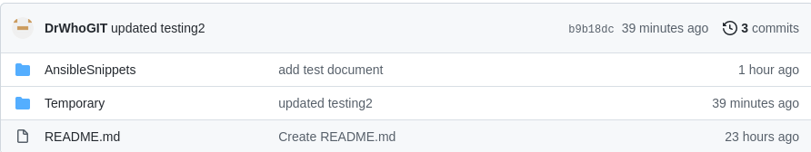
mao@maoz:~/dev/DrWhoGIT/Temporary$ rm testing2
mao@maoz:~/dev/DrWhoGIT/Temporary$ git status
On branch main
Your branch is up to date with 'origin/main'.
Changes not staged for commit:
(use "git add/rm <file>..." to update what will be committed)
(use "git restore <file>..." to discard changes in working directory)
deleted: testing2
no changes added to commit (use "git add" and/or "git commit -a")

Slide 9
mao@maoz:~/dev/DrWhoGIT$ git ls-tree -r main
100644 blob 90bfcb510602aa11ae53a42dcec18ea39fbd8cec AnsibleSnippets/test
100644 blob e1b46a22aa61d844840e7e4470d69c1e28507817 README.md
100644 blob ce24ad6381f66de337b36c963196164c8be01caa Temporary/testing2
mao@maoz:~/dev/DrWhoGIT$ git rm Temporary/testing2
rm 'Temporary/testing2'
mao@maoz:~/dev/DrWhoGIT$ git status
On branch main
Your branch is up to date with 'origin/main'.
Changes to be committed:
(use "git restore --staged <file>..." to unstage)
deleted: Temporary/testing2
mao@maoz:~/dev/DrWhoGIT$ git commit -m "remove file Temporary/testing2"
[main e07b22b] remove file Temporary/testing2
1 file changed, 1 deletion(-)
delete mode 100644 Temporary/testing2
mao@maoz:~/dev/DrWhoGIT$ git push
Enumerating objects: 3, done.
Counting objects: 100% (3/3), done.
Delta compression using up to 16 threads
Compressing objects: 100% (2/2), done.
Writing objects: 100% (2/2), 228 bytes | 228.00 KiB/s, done.
Total 2 (delta 1), reused 0 (delta 0)
remote: Resolving deltas: 100% (1/1), completed with 1 local object.
To github.com:DrWhoGIT/DrWhoGIT.git
b9b18dc..e07b22b main -> main

Slide 10
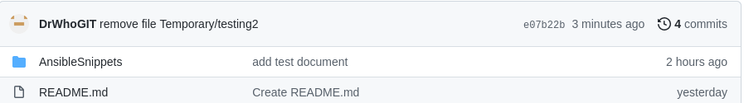
Following the push we now see that the folder and file is gone..once the folder is empty git will remove an empty folder following the file deletion

