Slide 1
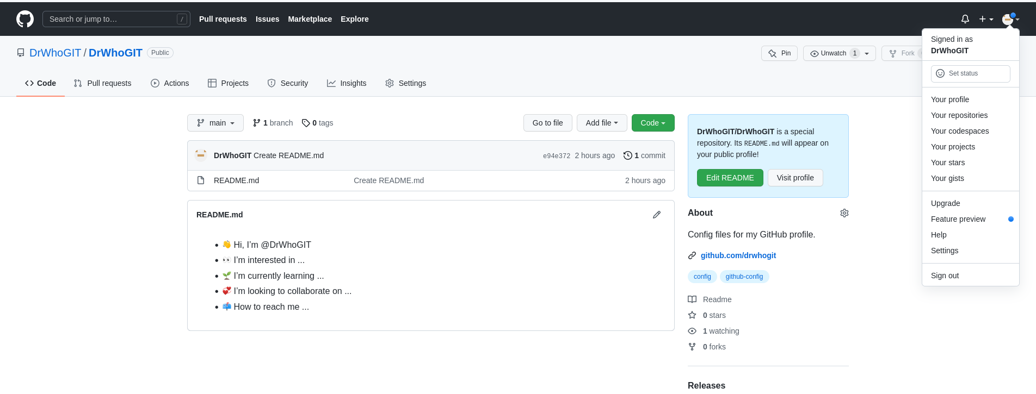
mao@maoz:~/.ssh$ git config --global user.email "maogit@fastmail.fm"
mao@maoz:~/.ssh$ git config --global user.name "Misha"
mao@maoz:~$ pwd
/home/mao
mao@maoz:~$ cat .gitconfig
[user]
email = maogit@fastmail.fm
name = Misha
mao@maoz:~$
mao@maoz:~/dev/DrWhoGIT$ ls
README.md

Slide 2
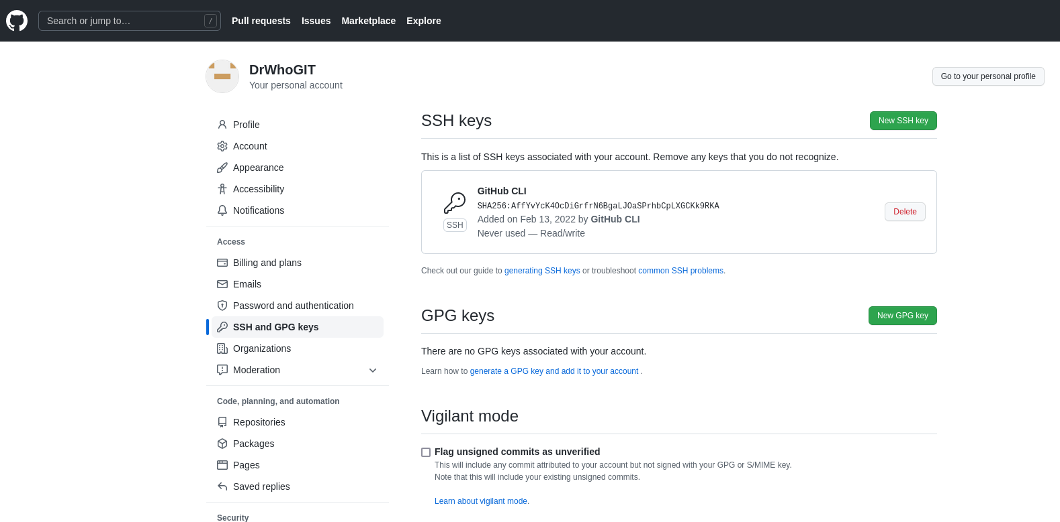
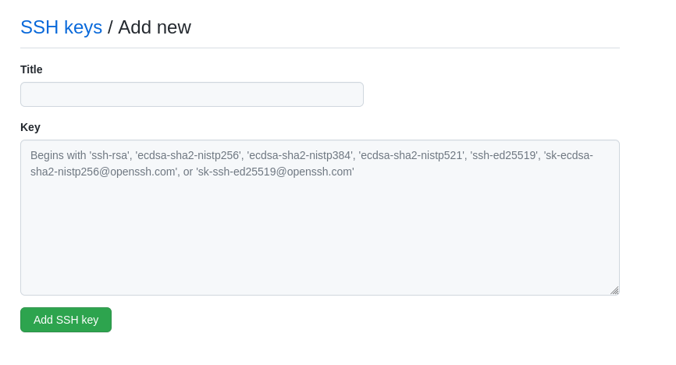
Now via the github website past in your public ssh key so changes can be properly sync’d between the local machine and gethub

Slide 3
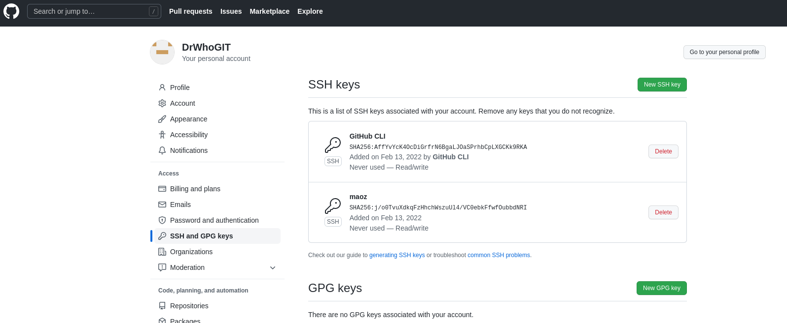

Slide 4
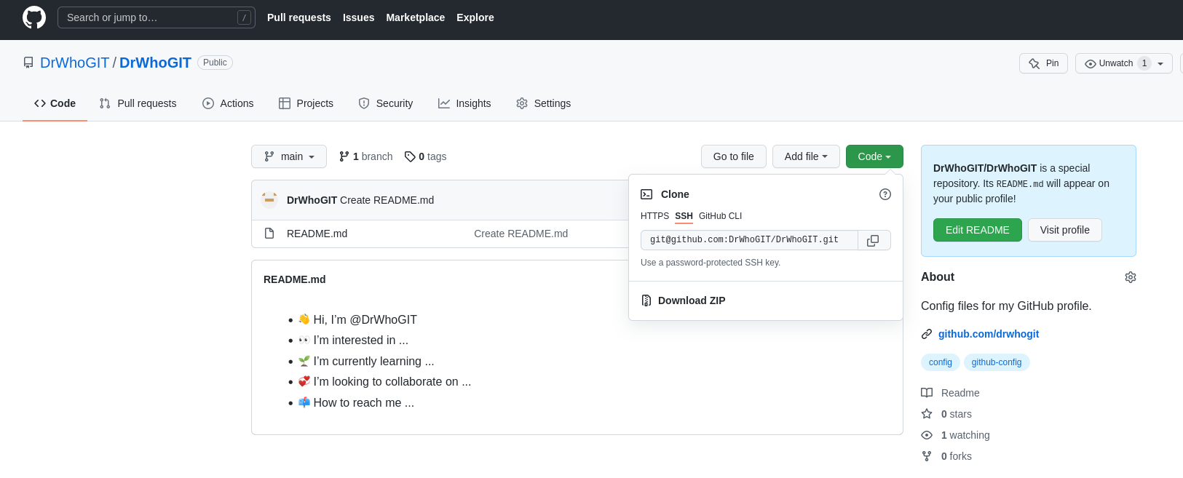
Now that our public key has been uploaded, its time to sync/clone our environment in github with our local machine. Here we will copy the SSH link which will be later pasted in a command issued on our local machine

Slide 5
Copied from tfrom GitHub as shown on prior slide
mao@maoz:~/dev$ pwd
/home/mao/dev
mao@maoz:~/dev$ git clone git@github.com:DrWhoGIT/DrWhoGIT.git
Cloning into 'DrWhoGIT'...
The authenticity of host 'github.com (140.82.113.4)' can't be established.
ECDSA key fingerprint is SHA256:p2QAMXNIC1TJYWeIOttrVc98/R1BUFWu3/LiyKgUfQM.
Are you sure you want to continue connecting (yes/no/[fingerprint])? yes
Warning: Permanently added 'github.com,140.82.113.4' (ECDSA) to the list of known hosts.
remote: Enumerating objects: 3, done.
remote: Counting objects: 100% (3/3), done.
remote: Compressing objects: 100% (2/2), done.
remote: Total 3 (delta 0), reused 0 (delta 0), pack-reused 0
Receiving objects: 100% (3/3), done.
mao@maoz:~/dev$ ls
DrWhoGIT
mao@maoz:~/dev$ cd DrWhoGIT
mao@maoz:~/dev/DrWhoGIT$ ls
README.md
mao@maoz:~/dev/DrWhoGIT$

Slide 6
mao@maoz:~/dev/DrWhoGIT$ mkdir Temporary
mao@maoz:~/dev/DrWhoGIT$ cd Temp*
mao@maoz:~/dev/DrWhoGIT/Temporary$ ls
mao@maoz:~/dev/DrWhoGIT/Temporary$ vi testing2
mao@maoz:~/dev/DrWhoGIT/Temporary$
Thou we added a folder and
new file git doesn’t show any
changes
mao@maoz:~/dev/DrWhoGIT/Temporary$ git status
On branch main
Your branch is up to date with 'origin/main'.
Untracked files:
(use "git add <file>..." to include in what will be committed)
./
nothing added to commit but untracked files present (use "git add" to track)
Add new file called testing2. As a side note we could have just done: git add . (and that is a period)
mao@maoz:~/dev/DrWhoGIT/Temporary$ git add testing2
mao@maoz:~/dev/DrWhoGIT/Temporary$ git status
On branch main
Your branch is up to date with 'origin/main'.
Changes to be committed:
(use "git restore --staged <file>..." to unstage)
new file: testing2

Slide 7
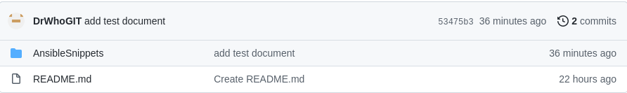
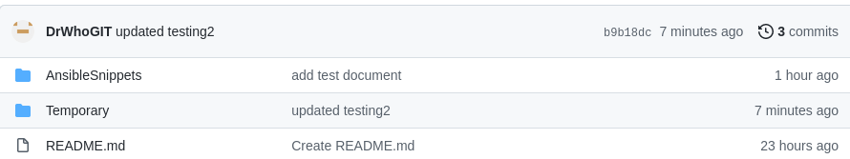
We don’t yet see the updated folder/file
mao@maoz:~/dev/DrWhoGIT/Temporary$ git commit -m "updated testing2"
[main b9b18dc] updated testing2
1 file changed, 1 insertion(+)
create mode 100644 Temporary/testing2
mao@maoz:~/dev/DrWhoGIT/Temporary$ git push
Warning: Permanently added the ECDSA host key for IP address '140.82.114.3' to the list of known hosts.
Enumerating objects: 5, done.
Counting objects: 100% (5/5), done.
Delta compression using up to 16 threads
Compressing objects: 100% (2/2), done.
Writing objects: 100% (4/4), 380 bytes | 380.00 KiB/s, done.
Total 4 (delta 0), reused 0 (delta 0)
To github.com:DrWhoGIT/DrWhoGIT.git
53475b3..b9b18dc main -> main

Slide 8
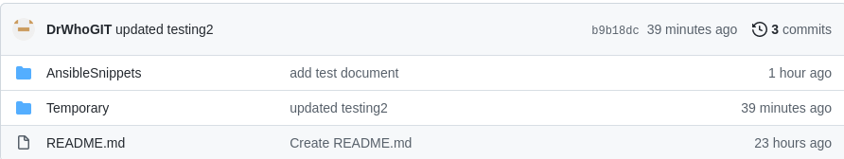
mao@maoz:~/dev/DrWhoGIT/Temporary$ rm testing2
mao@maoz:~/dev/DrWhoGIT/Temporary$ git status
On branch main
Your branch is up to date with 'origin/main'.
Changes not staged for commit:
(use "git add/rm <file>..." to update what will be committed)
(use "git restore <file>..." to discard changes in working directory)
deleted: testing2
no changes added to commit (use "git add" and/or "git commit -a")

Slide 9
mao@maoz:~/dev/DrWhoGIT$ git ls-tree -r main
100644 blob 90bfcb510602aa11ae53a42dcec18ea39fbd8cec AnsibleSnippets/test
100644 blob e1b46a22aa61d844840e7e4470d69c1e28507817 README.md
100644 blob ce24ad6381f66de337b36c963196164c8be01caa Temporary/testing2
mao@maoz:~/dev/DrWhoGIT$ git rm Temporary/testing2
rm 'Temporary/testing2'
mao@maoz:~/dev/DrWhoGIT$ git status
On branch main
Your branch is up to date with 'origin/main'.
Changes to be committed:
(use "git restore --staged <file>..." to unstage)
deleted: Temporary/testing2
mao@maoz:~/dev/DrWhoGIT$ git commit -m "remove file Temporary/testing2"
[main e07b22b] remove file Temporary/testing2
1 file changed, 1 deletion(-)
delete mode 100644 Temporary/testing2
mao@maoz:~/dev/DrWhoGIT$ git push
Enumerating objects: 3, done.
Counting objects: 100% (3/3), done.
Delta compression using up to 16 threads
Compressing objects: 100% (2/2), done.
Writing objects: 100% (2/2), 228 bytes | 228.00 KiB/s, done.
Total 2 (delta 1), reused 0 (delta 0)
remote: Resolving deltas: 100% (1/1), completed with 1 local object.
To github.com:DrWhoGIT/DrWhoGIT.git
b9b18dc..e07b22b main -> main

Slide 10
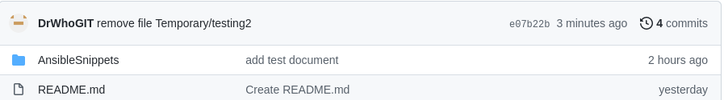
Following the push we now see that the folder and file is gone..once the folder is empty git will remove an empty folder following the file deletion

Slide 11
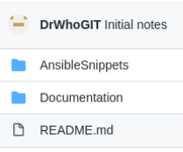
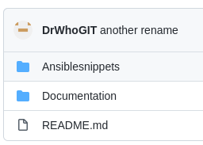
mao@maoz:~/dev/DrWhoGIT$ git mv ansiblesnippets Ansiblesnippets
mao@maoz:~/dev/DrWhoGIT$ git commit -m "another rename"
[main 5bdd445] another rename
1 file changed, 0 insertions(+), 0 deletions(-)
rename {ansiblesnippets => Ansiblesnippets}/test (100%)
mao@maoz:~/dev/DrWhoGIT$ git push
Enumerating objects: 3, done.
Counting objects: 100% (3/3), done.
Delta compression using up to 16 threads
Compressing objects: 100% (2/2), done.
Writing objects: 100% (2/2), 225 bytes | 225.00 KiB/s, done.
Total 2 (delta 1), reused 0 (delta 0)
remote: Resolving deltas: 100% (1/1), completed with 1 local object.
To github.com:DrWhoGIT/DrWhoGIT.git
84953ad..5bdd445 main -> main
mao@maoz:~/dev/DrWhoGIT$ git status
On branch main
Your branch is up to date with 'origin/main'.
nothing to commit, working tree clean

