Slide 1

Azure SignalR – Serverless Push Messaging for the Web
Rainer Stropek | @rstropek | Microsoft MVP, Regional Director
Presented by

Slide 2

SignalR
Workshop
Rainer Stropek
software architects gmbh
Web
Mail
Twitter
http://www.timecockpit.com
rainer@timecockpit.com
@rstropek
Real-Time Web with Websockets and SignalR

Slide 3
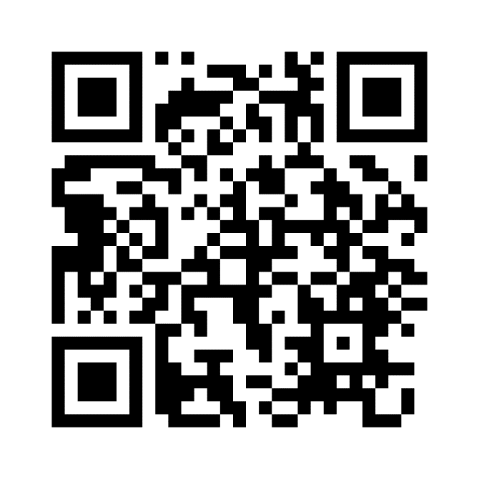
Sample, Keep in Touch
https://aka.ms/AA6vt1n

Slide 4
Websockets Basics

Slide 5
What are Websockets
Full-duplex communication over a single TCP connection
Compatible with the HTTP
Over port 80 and 443
WebSocket handshake uses the HTTP Upgrade header
Demo: https://www.websocket.org/echo.html
Problem: Not very rich protocol

Slide 6
WebSockets
WebSockets introduction
Node.js
Go

Slide 7
What is SignalR?

Slide 8
Protocol (GitHub)
Protocol for duplex RPC
Works with any message-based transport (transport requirements)
Encodings: JSON, MessagePack
Handshaking
Client and server agreeing on a protocol version (handshake messages always JSON)
Invocation Types
Blocking invocation – caller calls callee and expects optional result synchronously
Non-blocking invocation – no result expected
Streaming invocation – one or more results
Pings to detect unexpected disconnects

Slide 9
ASP.NET Core Server
Transports
WebSockets
Server-Sent Events
Long Polling
Integrated in other ASP.NET Core services
E.g. Web API and SignalR in a single project
Clients
JavaScript (compatible down to IE11)
.NET (including mobile apps on Xamarin)
Java
Experimental: C++, Swift
https://docs.microsoft.com/en-us/aspnet/core/signalr/supported-platforms?view=aspnetcore-3.1

Slide 10
SignalR
Simple SignalR
Greeting
Streaming

Slide 11
Azure SignalR

Slide 12
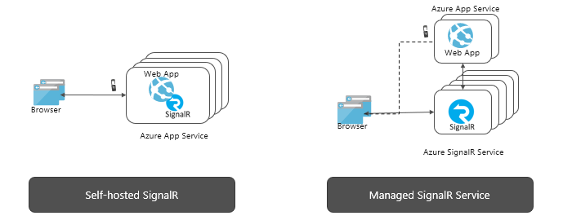
Purpose
Scalability
Many clients
Multiple regions
Serverless
No own SignalR server necessary
Different platforms
Event-driven functions

Slide 13
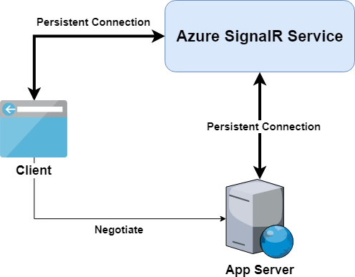
Protocol
Negotiate Endpoint per Hub
Multiplex connections through Azure SignalR

Slide 14
Using Azure SignalR
public void ConfigureServices(IServiceCollection services) {
…
services.AddSignalR();
}
public void Configure(IApplicationBuilder app)
{
…
app.UseSignalR(routes => {
routes.MapHub<Chat>("/chat"); });
}
<PackageReference Include="Microsoft.Azure.SignalR" … />
public void ConfigureServices(IServiceCollection services) {
…
services.AddSignalR().AddAzureSignalR("Endpoint=…");
}
public void Configure(IApplicationBuilder app) {
…
app.UseAzureSignalR(routes => {
routes.MapHub<Chat>("/chat"); });
}
Add SDK reference
Change configuration
Sample Code
ChatRoom

Slide 15
Workshop
Classic:
Endpoint=https://apisummitclassic.service.signalr.net;AccessKey=7dLrT889p8ZD2snl2f+OqkQ3XWxhFTENRqPwgLtkeV4=;Version=1.0;
Serverless:
Endpoint=https://apisummitserverless.service.signalr.net;AccessKey=/9YK+jNndeB+raor4kFbZs46ft9cZMyZ9lMo6gy4Cpw=;Version=1.0;

Slide 16
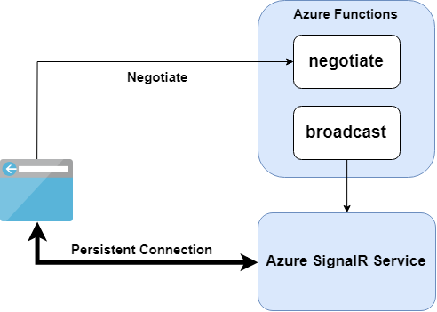
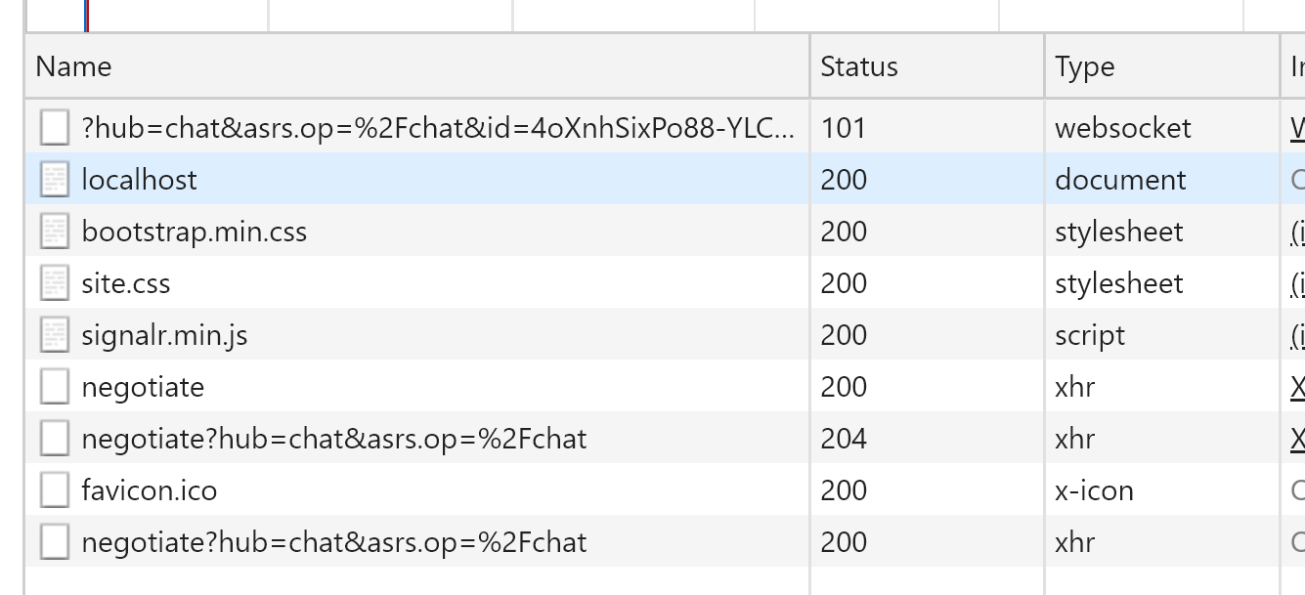
Protocol
negotiate endpoint
Runs locally
Redirects to Azure SignalR
Demo: Chat
Local
Azure

Slide 17
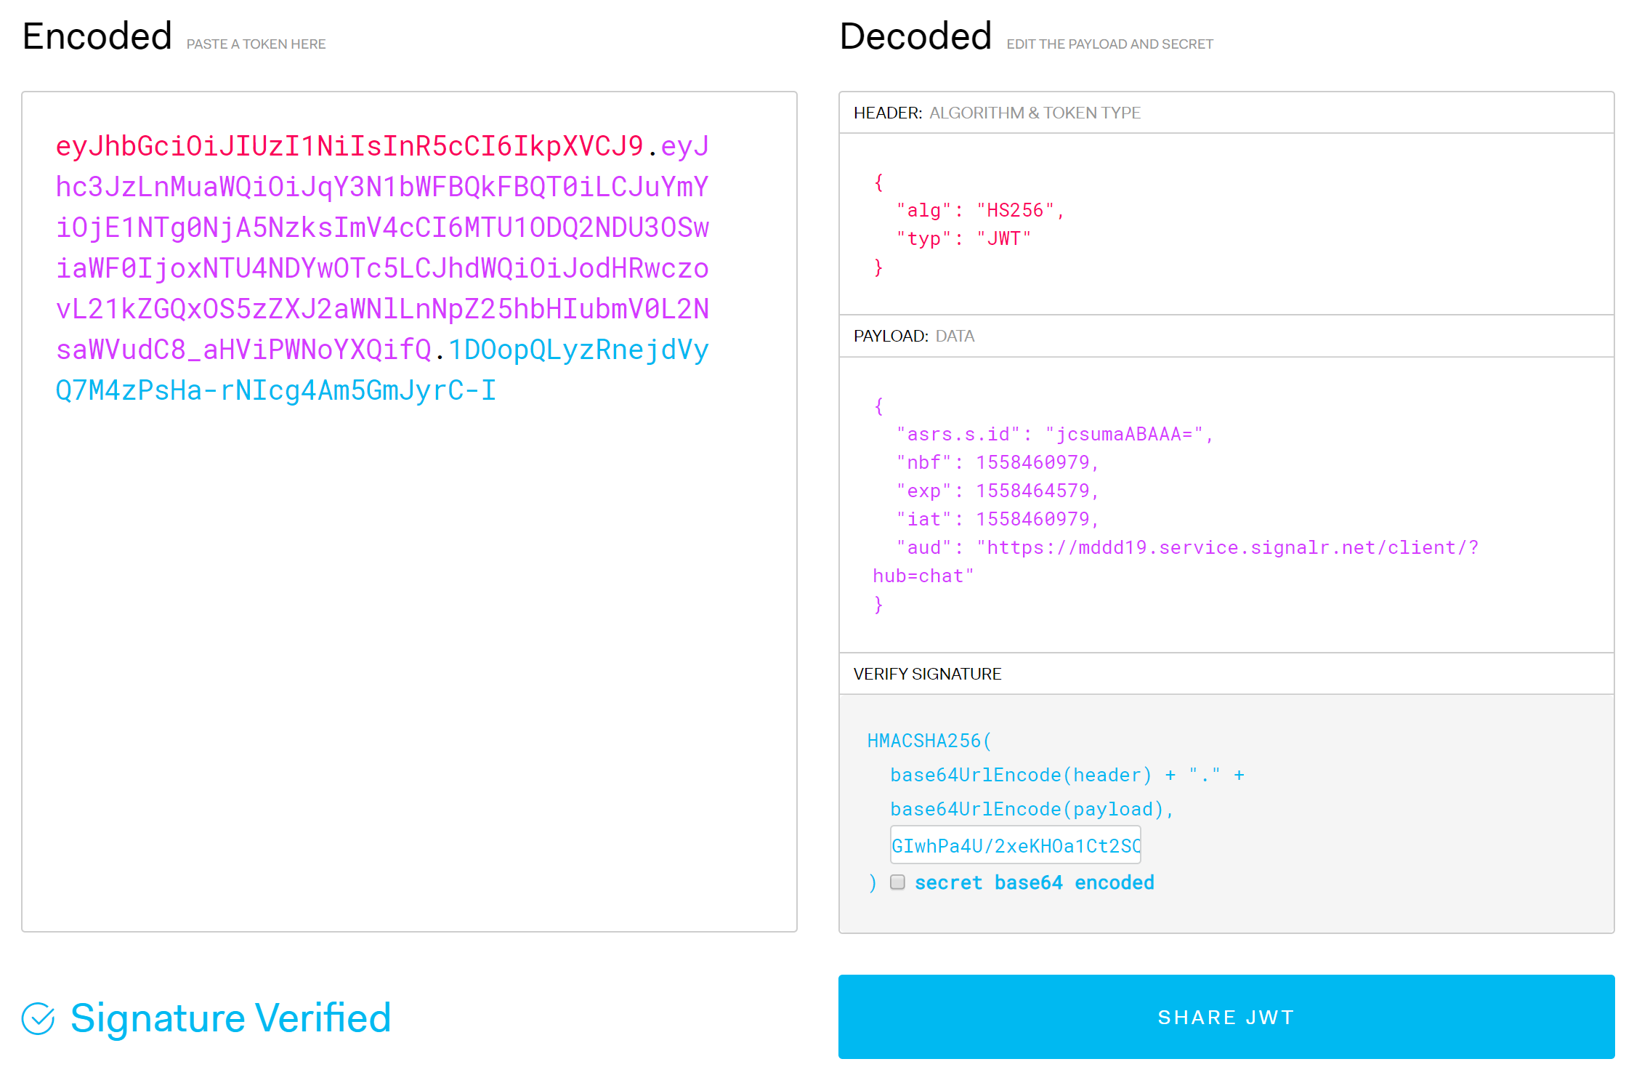
JWT Token
Access Token returned by negotiate
aud is Azure SignalR
Signed with access key from Azure portal
Demo: jwt.io

Slide 18
Browser
Azure SignalR
ASP.NET Core 3
DOM
App
Blazor JS
SignalR „Circuit“
Blazor
Render Batch
HTML
Core CLR

Slide 19
Thank You for Watching
https://aka.ms/AA6vt1n

