Slide 1

gRPC – Language-agnostic Remote Procedure Calls
Rainer Stropek | @rstropek | Microsoft MVP, Regional Director
Presented by

Slide 2
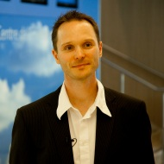
gRPC
Workshop
Rainer Stropek
software architects gmbh
Web
Mail
Twitter
http://www.timecockpit.com
rainer@timecockpit.com
@rstropek
Remote Procedure Calls with .NET Core

Slide 3
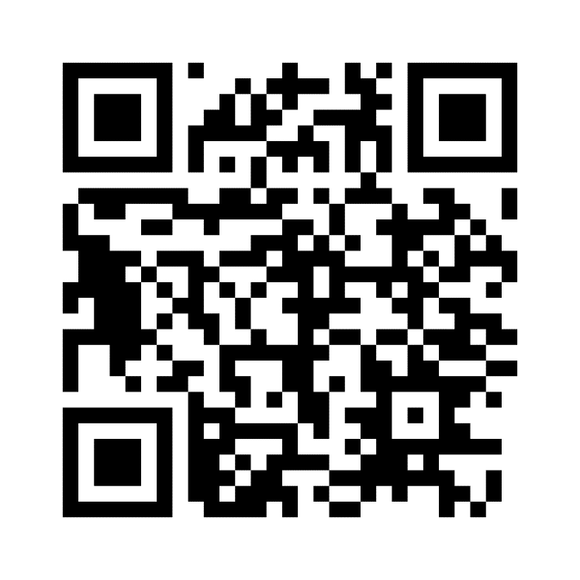
Sample Code, Keep in Touch
https://aka.ms/AA6w0li

