Slide 1

Swagger
Workshop
Rainer Stropek
software architects gmbh
Web
Mail
Twitter
http://www.timecockpit.com
rainer@timecockpit.com
@rstropek
OpenAPI Workshop

Slide 2

Your Host
Rainer Stropek
Developer, Entrepreneur
Azure MVP, MS Regional Director
IT-Visions
Contact
software architects gmbh rainer@timecockpit.com Twitter: @rstropek

Slide 3
What‘s Swagger?

Slide 4

OpenAPI
Language-agnostic specification for describing REST APIs
Originated from Swagger
Donated to Open API Initiative in 2015 by SmartBear
Swagger 2.0 became the OpenAPI Specification
Linux Foundation Collaborative Project
Specifications
GitHub
Read online

Slide 5
Use Cases
API Design
Structured YAML files (OpenAPI specs) instead of plain text
Machine readable, “tool-able”
API Development
Code generators for client and server
API Documentation
Generate beautiful API docs from OpenAPI specs
Generate OpenAPI specs from existing code
API Testing
Verify
Exploratory testing

Slide 6
VS Code

Slide 7
Visual Studio Code
Open-Source, Cross-Platform
Good OpenAPI support through plugins
Look for openapi in Plugins
openapi-lint (uses Speccy)
openapi-designer

Slide 8
OpenAPI Spec

Slide 9
YAML
Human-friendly JSON
Without {}
Without ,
With tricky indentations
Superset of JSON
JSON is valid YAML
http://yaml.org/

Slide 10
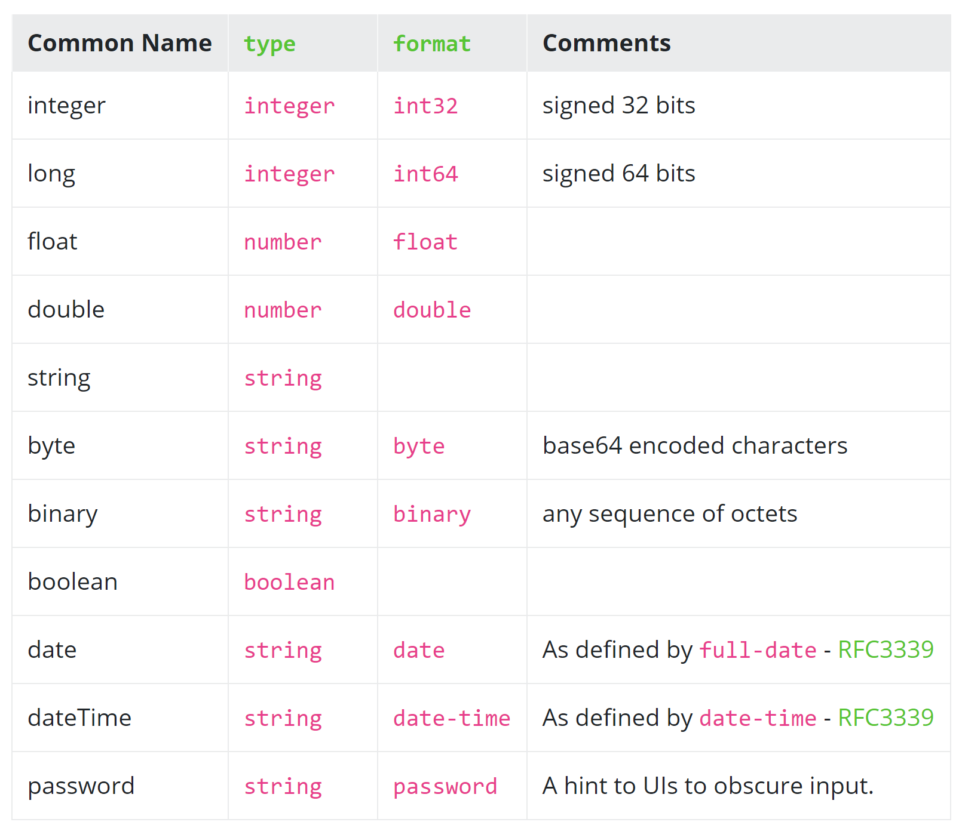
Data Types
https://swagger.io/specification/#dataTypes

Slide 11
References
$ref
JSON Reference
Relative (inside file) and absolute
$ref: '#/components/schemas/Pet‘
$ref: definitions.yaml#/Pet

Slide 12
Document Structure
openapi: <version>
info:
Metadata about the API
https://swagger.io/specification/#infoObject
servers:
Servers implementing the REST API
https://swagger.io/specification/#serverObject
paths:
Endpoints and there implementation
components:
Reusable objects referenced in other parts of the API specification
security:
Security scheme used by the operations
https://swagger.io/specification/#securitySchemeObject
tags:
Additional metadata
https://swagger.io/specification/#tagObject
externalDocs:
Link to additional documentation
https://swagger.io/specification/#externalDocumentationObject
Swagger Editor
https://editor.swagger.io
Swagger Hub
https://app.swaggerhub.com/
Docker Image
swaggerapi/swagger-editor
NPM Package
swagger-editor
https://swagger.io/specification/#oasObject

Slide 13
Path Items
summary: …
description: …
get | post | put | delete …:
Definition of operations
https://swagger.io/specification/#operationObject
Metdata like tags, summary, description…
operationId:
Unique string used to identify the operation
parameters:
A list of parameters that are applicable for this operation
https://swagger.io/specification/#parameterObject
requestBody:
https://swagger.io/specification/#requestBodyObject
responses:
https://swagger.io/specification/#responsesObject
deprecated: …
security: …
servers: …
servers:
Alternative servers
parameters:
Parameters applicable for all operations of this path
Tip: Use $ref to reference external document
https://swagger.io/specification/#pathItemObject

Slide 14
Schema
type: object | array | primitive data type
format: … (see data types)
properties:
Property definitions
https://swagger.io/specification/#schemaObject
nullable: …
discriminator:
Support for polymorphism
https://swagger.io/specification/#schemaComposition
readOnly: …
writeOnly: …
xml:
Describes XML representation of property
https://swagger.io/specification/#xmlObject
externalDocs: …
example: …
deprecated: …
Input and output data types
Tip: Use $ref to reference schema objects that are used in multiple locations
Derive from other schemas
allOf, oneOf, …
https://swagger.io/specification/#schemaObject

Slide 15
Exercise

Slide 16
Exercise
Write an OpenAPI spec for the following RESTful Web API
Use a Swagger tool (e.g. Editor, Hub) or Visual Studio Code
Verify your spec with Swagger Editor or Hub
See API description on the following slides
Make proper assumptions for min, max, length, etc.
Sample Implementation
API Spec YAML
Source on GitHub (API spec, implementation with Node.js)
Deployment in Azure at https://swagger-workshop.azurewebsites.net
Sample requests

Slide 17
Endpoints and Operations
Event management
Get a list of all events with optional parameter indicating whether to return past events
Add an event
Get data of a specific event
Registrations
Let participants register for an event
Get all registrations for an event
Check in
Let a participant check in for an event

Slide 18
Data Types
Event
ID (generated by server)
Event date
Location
Eventbrite ID (ID of event in the external system Eventbrite)
Quantity Sold
Quantity Total

Slide 19
Data Types
Participant
ID (generated by server)
Given Name
Familiy Name
Email
GoogleSubject (ID of the associated Google account)
Eventbrite ID (ID of event in the external system Eventbrite)
Year of Birth
Gender (male, female, unknown)

Slide 20
Data Types
Registration
Event
Participant
Needs computer (indicating whether the participant needs a rental computer)
Check in (indicating whether the participant is already checked in)
Error
Error Message

Slide 21
Solutions
OpenAPI Spec (V3)
GitHub (YAML)
Raw (JSON)
Swagger Spec (V2)
GitHub (YAML)
Raw (JSON)

Slide 22
Tools
Here: Docker images

Slide 23
Tools
Tools by SmartBear
Open Source and commercial
See https://swagger.io/tools/
Various OpenAPI Tools
https://openapi.tools/

Slide 24
OSS Swagger Tools
Run Swagger Editor locally with Docker
V3 and V2
Run Swagger UI locally with Docker
Run Swagger Codegen
Node.js with TypeScript

Slide 25
Swagger Tools
# Run Swagger Editor (V3)
docker run -d -p 8080:8080 swaggerapi/swagger-editor
# Run Swagger Editor (V2)
docker run -d -p 8082:8080 swaggerapi/swagger-editor:v2.10.5
# Run Swagger UI for our API (V3)
docker run -d -p 8081:8080 -e API_URL=https://raw.githack.com/rstropek/node-mongo-sample/master/api3.json swaggerapi/swagger-ui
# Run Swagger CodeGen
docker run --rm swaggerapi/swagger-codegen-cli-v3:3.0.8 langs
docker run --rm --mount type=bind,src=c:\temp\swagger-reh,dst=/local/out swaggerapi/swagger-codegen-cli-v3:3.0.8 generate -l typescript-angular -i https://raw.githack.com/rstropek/node-mongo-sample/master/api3.json -o /local/out/ts

Slide 26
.NET (Core)
Swashbuckle: Generate Swagger from ASP.NET (Core)
Swashbuckle.AspNetCore
GitHub
Alternative/extension: NSwag
GitHub
AutoRest
Generate Clients based on OAS
GitHub
See also https://docs.microsoft.com/en-us/aspnet/core/tutorials/web-api-help-pages-using-swagger?view=aspnetcore-2.1

Slide 27
Java
Springfox
https://springfox.github.io/springfox/docs/current/

Slide 28
.NET Core
Add Swashbuckle/NSwag to ASP.NET Core API
Docs
Generate C# Client with AutoRest

Slide 29
AutoRest
npm install autorest@beta
npx autorest --input-file=C:\Code\GitHub\node-mongo-sample\api3.yaml --csharp --output-folder=CSharp --namespace=EventMgmt
https://github.com/Azure/autorest

Slide 30
Q&A
Workshop
Rainer Stropek
software architects gmbh
Web
Mail
Twitter
http://www.timecockpit.com
rainer@timecockpit.com
@rstropek
Thank you for attending!

