Slide 1
DeBERTa & DeBERTaV3
Microsoft Research

Slide 2
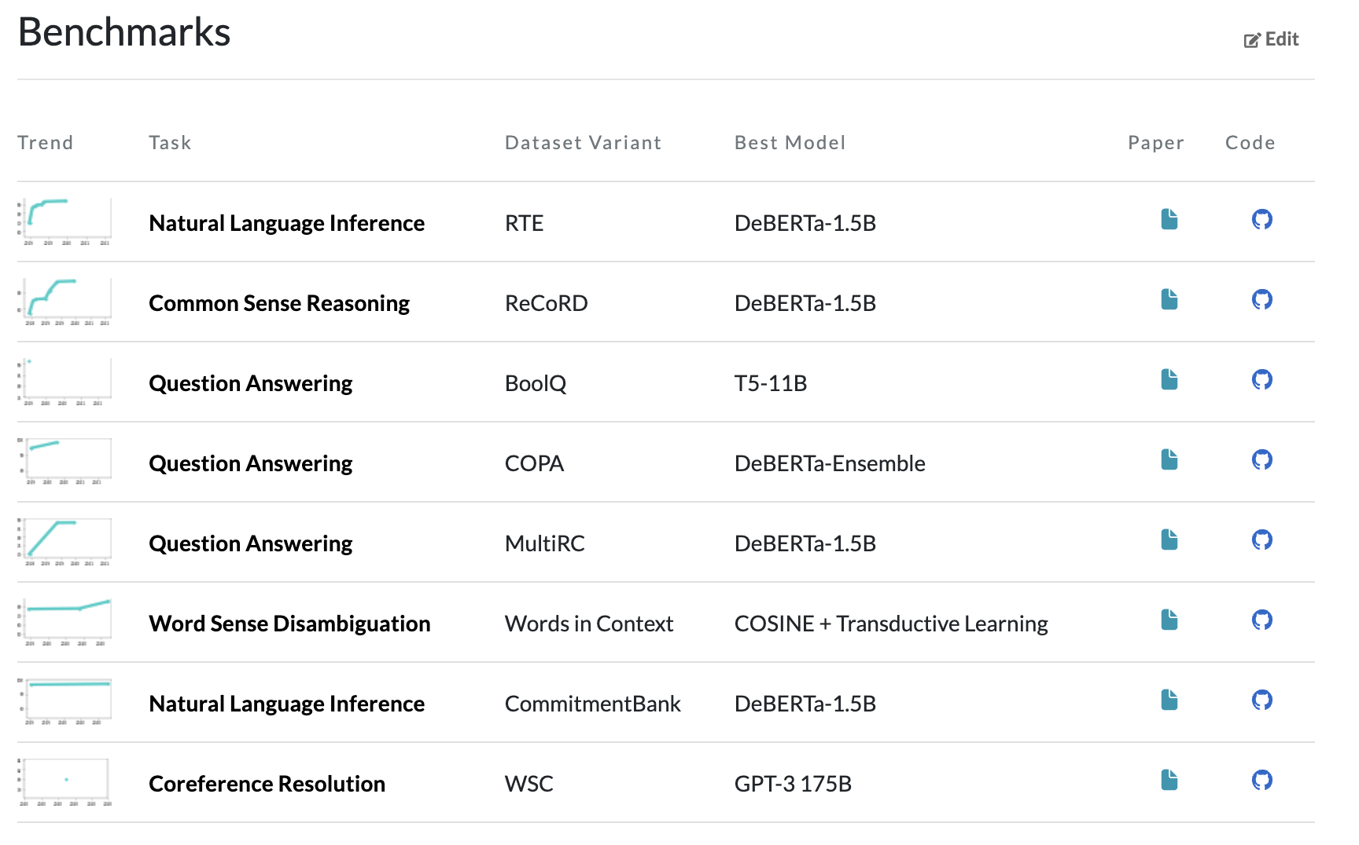
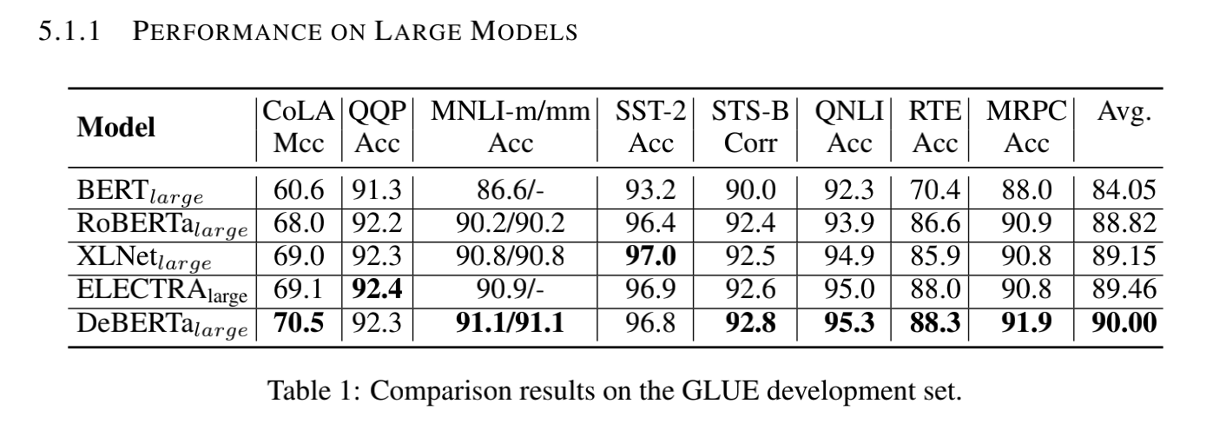
DeBERTa
Best model in GLUE/SuperGLUE till now
With only half training data size and effective samples compared to RoBERTa

Slide 3
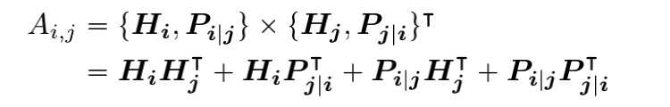
DeBERTa: Disentangled Attention
Standard BERT add positional, segment and token embeddings together into a single vector as model input, which could fuse different information
In contrast, DeBERTa adopts two concatenated vectors H and P to represent a token, and atttention between two tokens are described as follows:
Here H_{i} is the content vector of token i, and P_{i|j} is relative position vector of token i to token j.
The author asserts that the position-to-position attention doesn't provide much useful information, so only the first three terms are kept.

Slide 4
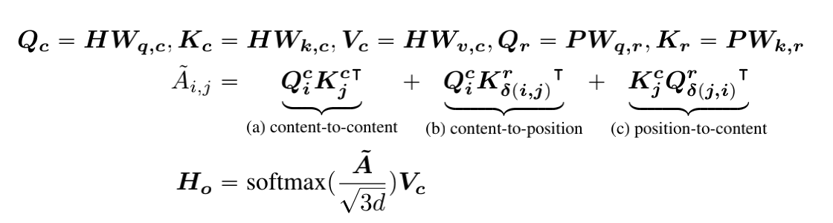
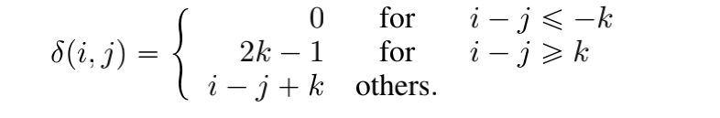
DeBERTa: Disentangled Attention
The detail in each attention head is illustrated below:
Note here relative positional Qr and Kr are obtained by separate projection matrix different from projection matrix of content Qc and Kc.
The relative position of i to j is defined as:

Slide 5
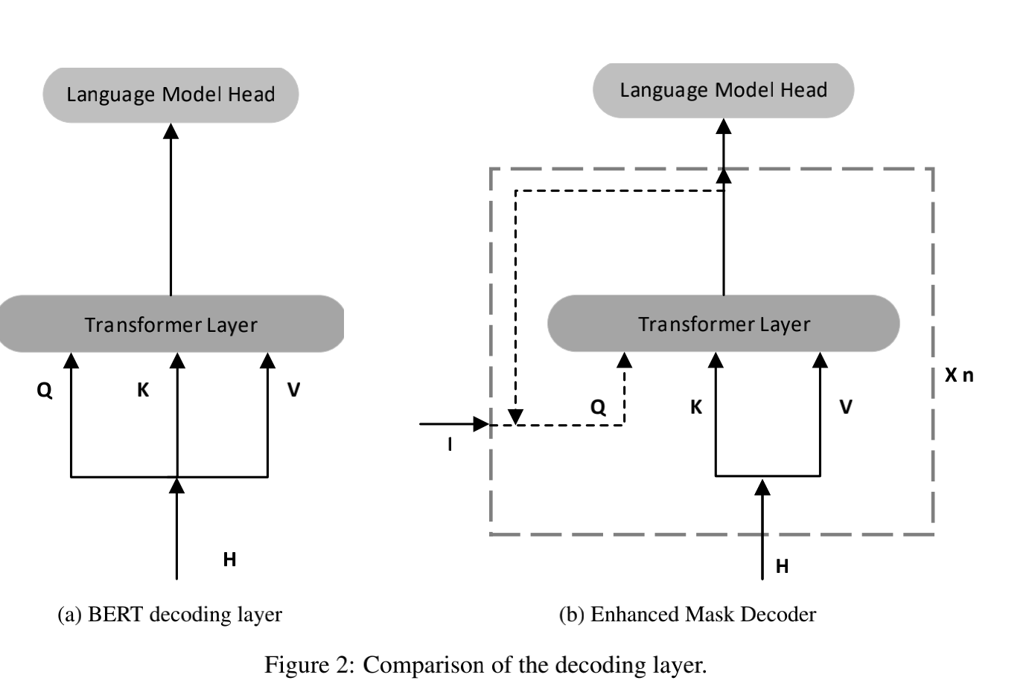
DeBERTa: EMD
Enhanced Mask Decoder (EMD) is adopted in place of standard transformer layer, mainly aimed to inject absolute positional information I

Slide 6
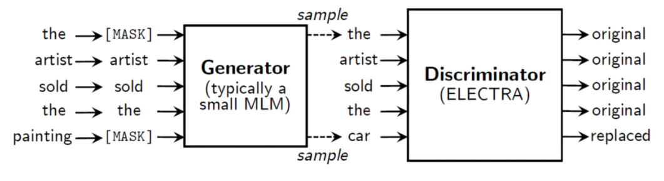

DeBERTaV3: RTD
Replaced Token Detection (RTD) is a GAN-style pretraining task.
Generator and discriminator are trained jointly: $L = L_{G} + λL_{D}$ ( not a minimax optimization problem as in GAN, actually a multitask MLE )
Advantage : Each token contributes some information to model ( conversely, only 15% tokens are predicted in MLM )

Slide 7
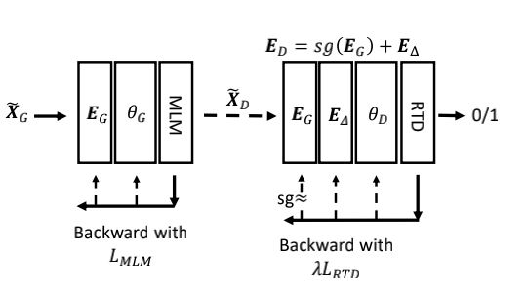
DeBERTaV3: GDES
Gradient-Distangled Embedding Sharing (GDES)
train two model seperately, with partly shared word embeddings
based on the fact that two pretraining goals drive model parameters to very different directions -- “tug-of-war procedure”
MLM tries to map the tokens that are semantically similar to the embedding vectors that are close to each other. RTD, on the other hand, tries to discriminate semantically similar tokens, pulling their embeddings as far as possible to optimize the classification accuracy.

Slide 8
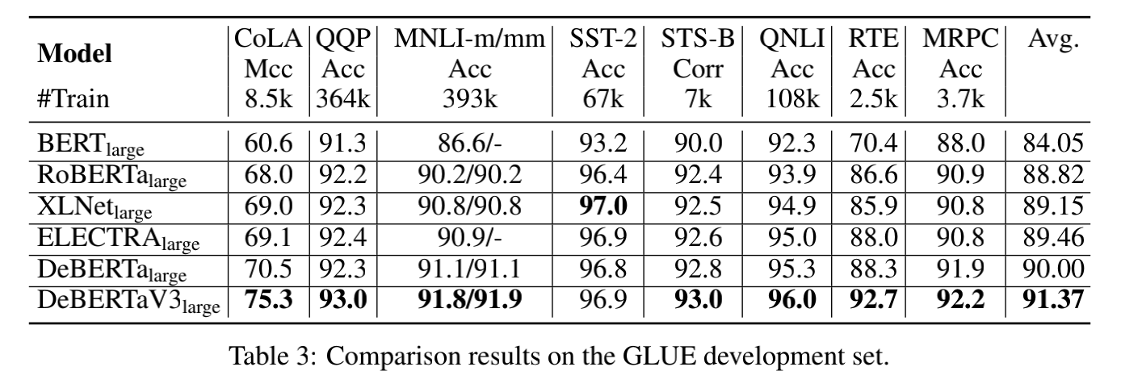
DeBERTaV3
DeBERTaV3 outperforms DeBERTa by 1.37% on GLUE datasets.

