Slide 1
∞-former: Infinite Memory Transformer
Instituto de Telecomunicações Deepmind

Slide 2
Motivation
Vanilla transformer cannot deal with extremely long input, if not splitted into segments ( e.g., 512 tokens per segment for BERT ) at the loss of inter-segment interaction.
Several following works proposed solutions, which can be catogerized into
a) Design appropriate attention method ( a.k.a appropriate reception field ):
Transformer-XL caches the last segment, allowing queries in current segment at layer L+1 to receive information ( values ) from last segment at layer L;
Longformer designes attention pattern to sparsify attention matrix.
b) Compress memory itself
Compressive transformer compress old memory at fixed rate to save memory space for long sequence.
∞-former......

Slide 3
Key idea of ∞-former
What about dealing with loooooooong sequence, which we don't even want a theoratical upper bound?
RNN does have this property, by rewriting the same hidden state and store whole information in it. BAD PROPERTY!
If we compress memory with a many-to-one style at some compress rate c, we'll always have an upper bound O( L*c) for maximum input length. ( L boxes in total, put c balls into single box )
So we need a pool that can hold infinite data points ( tokens ) within, which is a continuous space. ( the length of a single point in a line is 0, always enough space left)

Slide 4







Continuous memory
The first problem is how to convert our discrete input into a continuous signal.
By performing multivariate ridge regression:
- Rescale positions of tokens in a segment into [0,1], by setting ( i=1,2,...L )
- Prepare N Guassian density funtions: , where are linearly spaced in [0,1]
and share a same ( hyperparameter )
- Run following regression where is the concatenation of N Guassian
functions and B is the coefficient matrix
- The sample points are , which can be used to compute B:
- Substitute this B into regression function, we have the continuous singal.

Slide 5
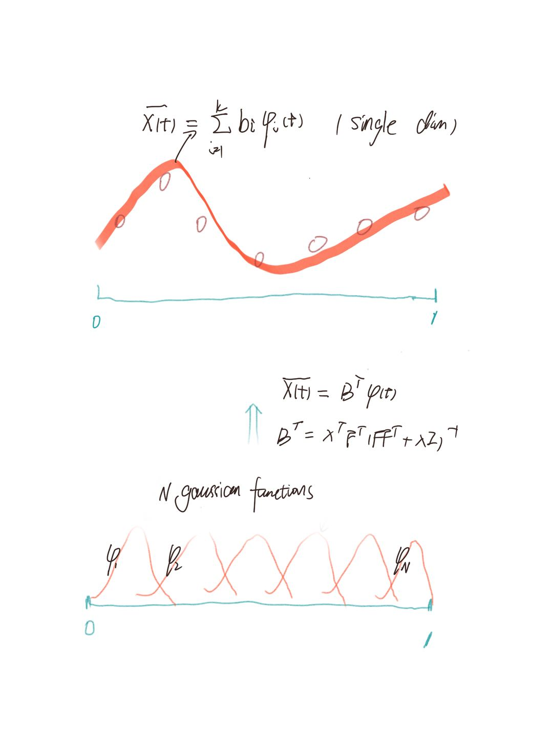
Continuous memory
It is actually a 'degraded' regression, in the meaning that
for each segment the sample points are constant F
( and thus constant G).
Thus in another perspective, the transformation from
input X to coefficient matrix B ( B^{T}=X^{T}G), is nothing more
than a matrix factorization with input X projecting to
base G to get coordinates B.
B is the low-rank representation for corresponding input
X. This property will be used later.

Slide 6
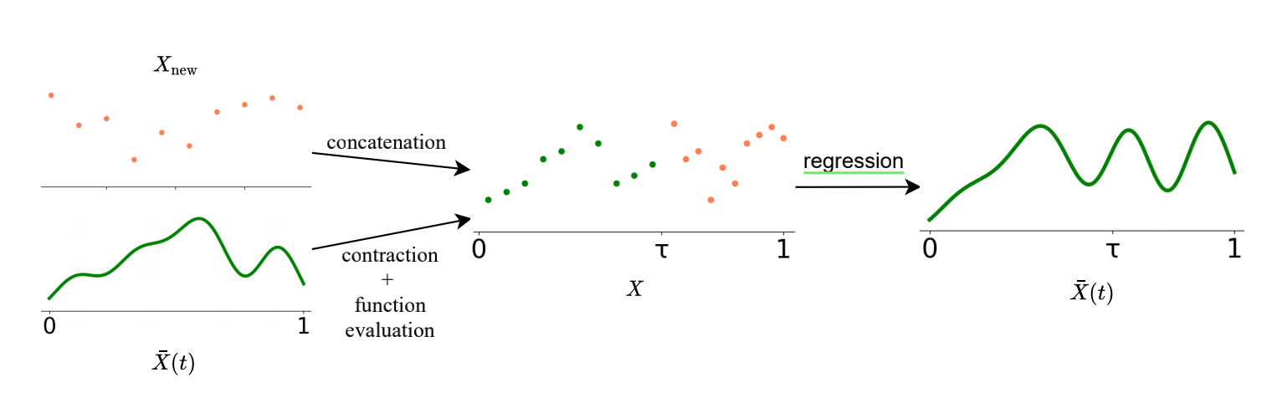

LTM construction
Long-term memory is constructed in an iterative way.
For each segment,
- contract and evaluate M points in old (discretization)
- pad with new L points in current segment
- perform regression again to obtain new (“continuerization”)
This is done at every layer, where is input or hidden states at that layer.
It causes error accumulation through segment going down to end of document.

Slide 7
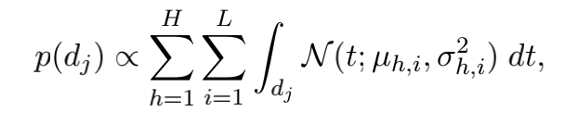
LTM construction
segement
The evaluation of old memory , can be done either at linearly spaced interval.
Or in a “Sticky Memory” fashion, in which higher sampling probability is assigned to those areas that are intensely attented by model before.

Slide 8
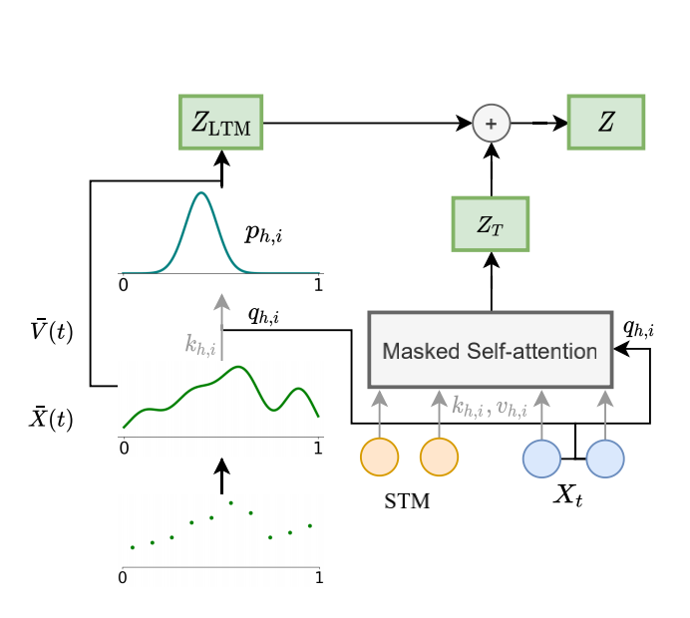
Model structure
Now we have already obtained long-term memory
at each layer, next is to design a proper model
to make use of that memory.
The component in red box, is a standard transformer head attending to current segment.
Plus additional attention to long-term memory.
The output context Z of each head is the sum of context of current segment Z_{T} and context of long-term memory Z_{LTM.}

Slide 9

Model structure
Remeber is obtained by running regression
and we have pointed that B is the low-
rank representation for corresponding X ( here the
compressed past sequence).
Thus it is reasonable to compute K and V of long-term memory using B:
and use Q of current segment to attend to them
(cross-attention).

Slide 10
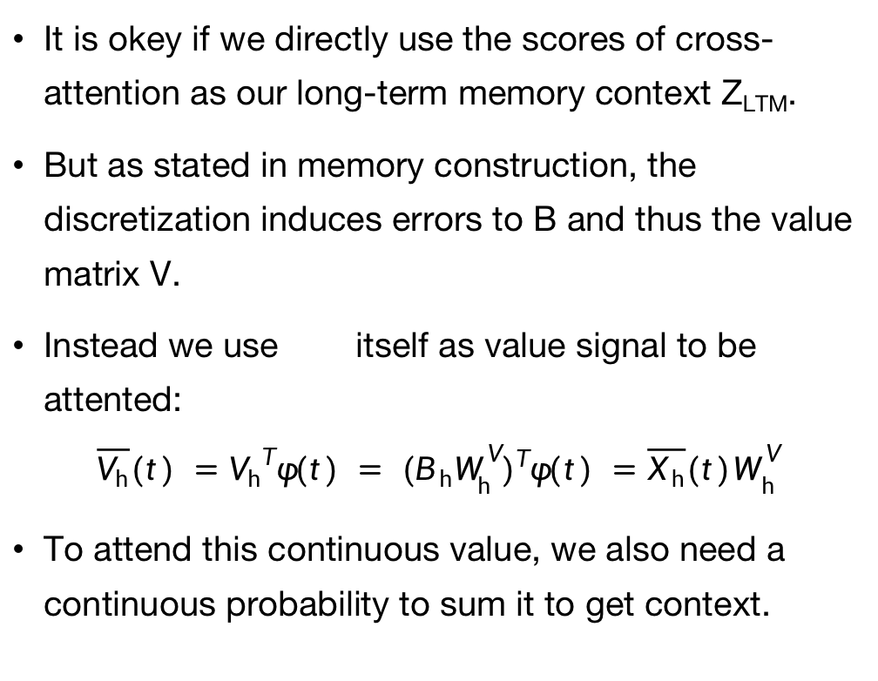
Model structure
It is okey if we directly use the scores of cross-attention as our long-term memory context Z_{LTM}.
But as stated in memory construction, the discretization induces errors to B and thus the value matrix V.
Instead we use itself as value signal to be attented:
$$\overline{V_{h}}(t) ={V_{h}}^{T}φ(t) = {(B_{ h}W_{ h}^{ V})}^{T}φ(t) =\overline{X_{ h}}{(t)W}_{ h}^{ V}$$
To attend this continuous value, we also need a continuous probability to sum it to get context.

Slide 11
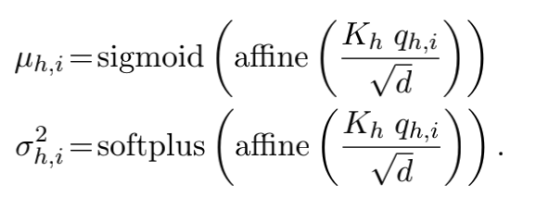

Model structure
The author made a simplification here, assuming the continuous probability to be a Guassian probability density function, whose mean and variance is computed by a network:
With this probability, the context of long-term memory ( at single token position of single head ):

Slide 12
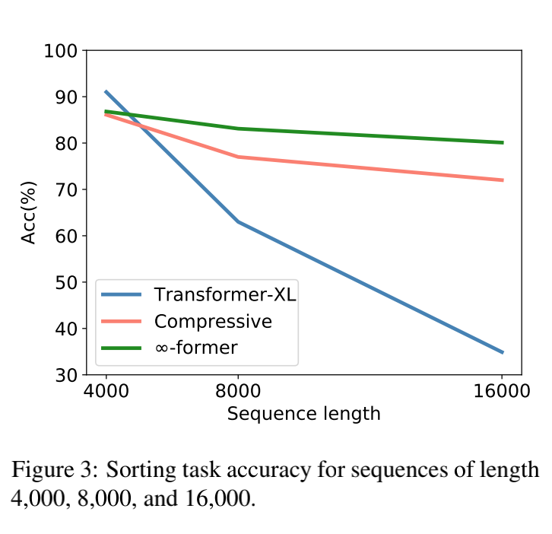
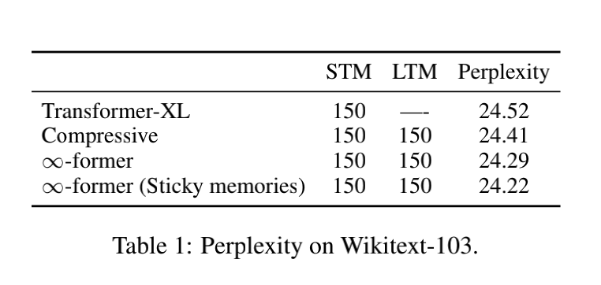
Experiment results
Frequency Sorting
Language Modeling

Slide 13
Comments and discussion
( Following contents are personal understanding, with possible errors and flaws)
The idea of transforming discrete signal into continous signal to store information
is a major contribution of this paper.
Though some implementation details are not that perfect and can be discussed.

Slide 14

Discussion on the long-term memory
😃
- Design a set of latent basis to synthesize continuous signal
- choose Guassian to be ，which is for the convience of computational complexity of continuous attention with erf funtion.
- Evaluate these at same positions (i.e, t=i/L for i=1,2,...L) for different segments,
which makes sample points a constant (otherwise the F
will need to be computed for each segment )

Slide 15

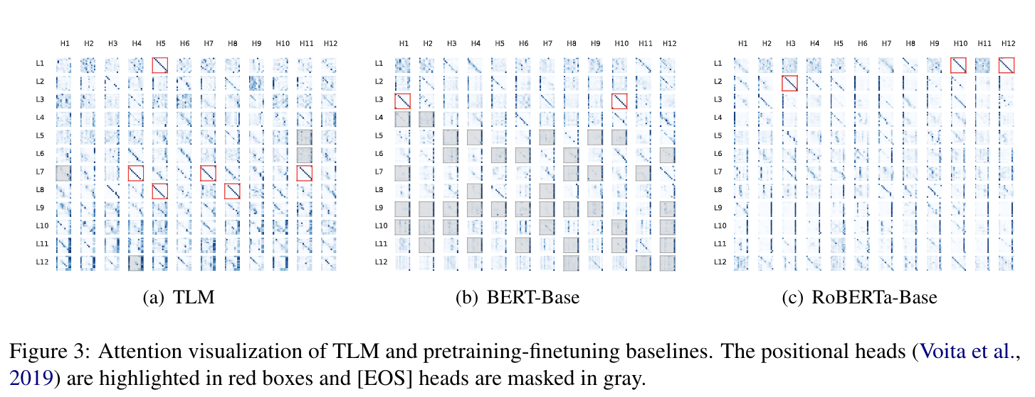
Discussion on the long-term memory
😫
- New inductive bias: The combination of Gaussian functions have natural property of smoothness ( as used in Guassian smoothing for signal processing ), which might be disobeied in token sequence.
The author used 1x3 convolutional kernel to smooth sequences before regression to adapt to property above, which apprently introduced noises.
- learnable basis instead of constant?
- better information decomposition method?
Information decomposition is what heads do by learning from loss. We do have observed explainable patterns of heads processing different signal components.

Slide 16
Discussion on the long-term memory
😫
- Last segment has most fine-grained memory, while old ones have more compact one.
It's fair to store information in this fashion as we human do.
It's not fair to use probability function of same scale ( variance ) to integrate them together without any different treatment.
- use bidirectional language modelling to eliminate that bias?

Slide 17
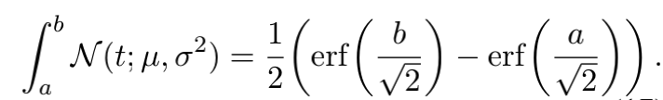

Discussion on the continuous attention
😃
- Computational efficient
Note the value function $\overline{V_{h}}(t) = \overline{X_{h}}{(t)W}_{h }^{V} ={(B_{h}W_{h}^{V})}^{T}φ(t) ,$where $φ(t)$ is a Guassian function. When take integration on p_{h,i}(t) which is also a Guassian
$$z_{h,i}=\int_{0}^{1}{\overline{V_{h}}(t)}p_{h,i}(t)dt={(B_{h}W_{h}^{V})}^{T}\int_{0}^{1}{φ(t)}p_{h,i}(t)dt$$
Since the product of two Guassian functions are a scaled Guassian, this integral can be simply done with

Slide 18
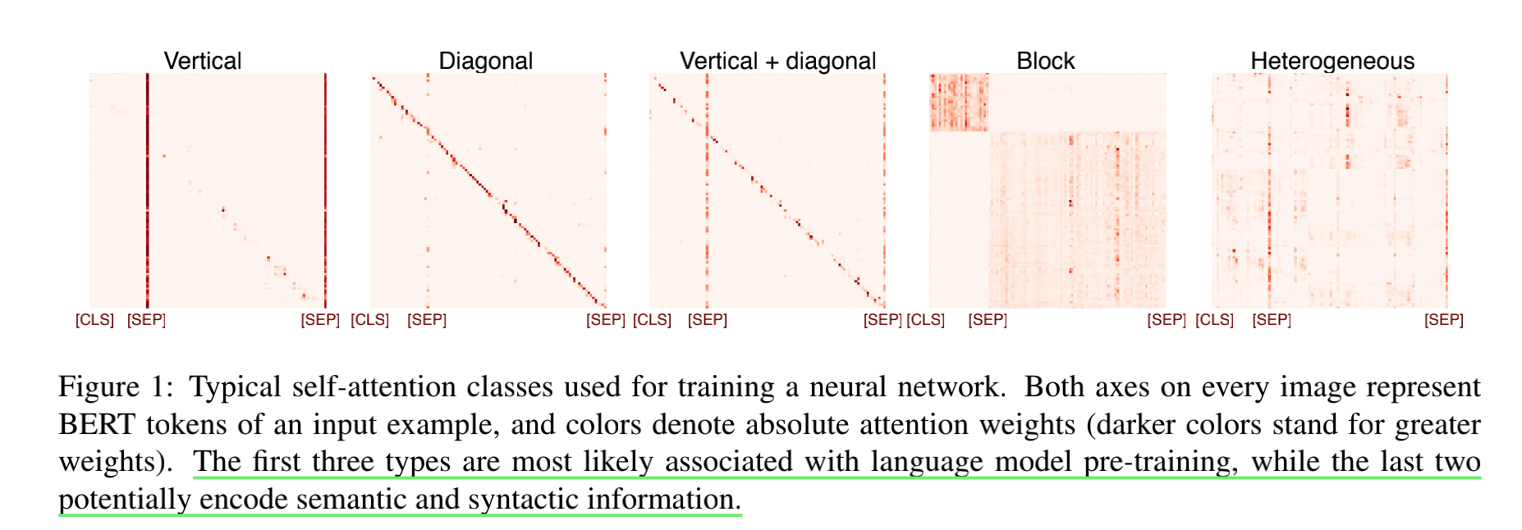
Discussion on the continuous attention
😫
- Guassian is unimodal, with the assumption that the importance of attention area is smooth, and adjacent area will be assigned similar weight.
It applies to heads with regular attention patterns ( vertical, diagonal, ect.).
It does not apply to heads with heterogeneous patterns, which encodes semantic and syntactic meanings.

Slide 19
Summary
One idea behind this paper is to parameterize the input, with additional inductive bias of chosen parametric model.
Just on contrary to kernel regression where we store all training data points for a better predict precision, here we sacrifice precision for advoiding storing all previous data ( embeddings & hidden states ).
Future work can be done for a better parameterization method.

