Slide 1
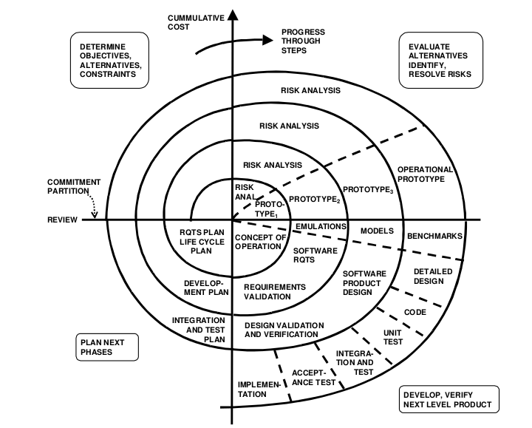
Spiral Model with Focus on HCD(Human Centered Design)
Features an extense requirements evaluation to correctly gather users needs.
Iterative risk assessments and prototypes to correctly portray requirements fulfilments, updating them when needed.
Periodical Logs and Meetings to estimate contributions by each team member.
May become out of scope with larger projects, cost inefficient at long run.

