Slide 1
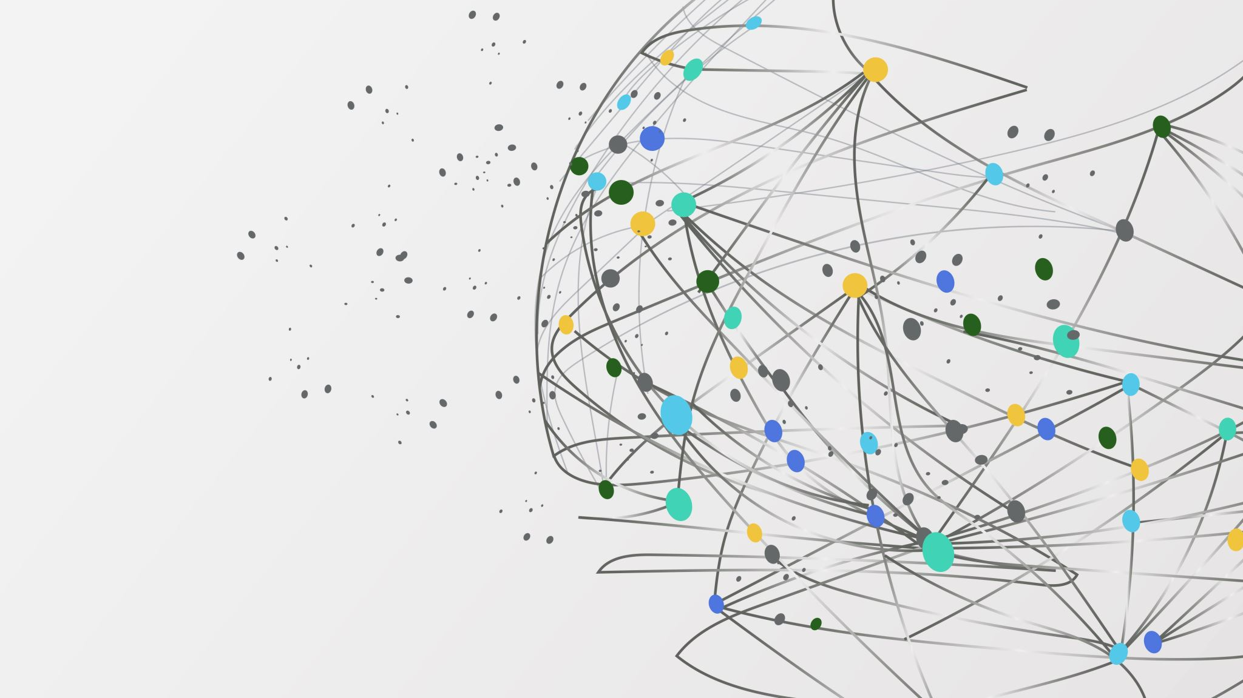
AIDI2003 - INCLASS 06
BotBuster
Group 06
Umar | Prashant | Mahesh | Khadija

Slide 2
Problem & Value
Online product reviews are increasingly polluted by AI-generated, fake or bot-written content.
These reviews often mislead consumers, manipulate product ratings and damage the credibility of e-commerce platforms.
Traditional moderation tools can't keep up with how advanced AI-generated text and bot activity have become.
BotBuster provides an intelligent review filtering system that combines sentiment analysis, linguistic pattern detection and bot behavior tracking to accurately tag suspicious content.
This helps platforms ensure review authenticity, improves consumer trust and supports fair business practices by exposing misleading or fake reviews.

Slide 3
Feature | Tasks | Assignee
Sentiment Analysis | • Define sentiment categories (positive/negative/neutral) | Md. Umar
 | • Integrate sentiment scoring using VADER/TextBlob | Md. Umar
 | • Test and validate on sample reviews | Md. Umar
Tagging AI-Generated Reviews | • Research GPTZero & DetectGPT logic | Prashant Verma
 | • Implement tagging logic in the backend | Prashant Verma
 | • Create test cases for AI vs human reviews | Prashant Verma
Linguistic Signature Analyzer | • Analyze AI review tone/style examples | Khadija Ramzi
 | • Design rule-based pattern detection (e.g., repetition, formal tone) | Khadija Ramzi
 | • Document linguistic fingerprint indicators | Khadija Ramzi
Bot Detection Engine | • Research IP/user-agent flagging methods | Mahesh Shama
 | • Implement bot detection rules (frequency, spoofing, anomalies) | Mahesh Shama
 | • Test with fake vs normal review metadata | Mahesh Shama
General / Project Management | • Trello board setup & organization | Khadija Ramzi
 | • Weekly task updates and progress check-ins | Everyone
 | • Word document & final zip packaging | Md. Umar

Slide 4
Timeline & Deliverables
Week | Focus Area | Activities
1–2 | Project Kickoff & Research | Team formation, topic selection, initial Trello board setup, role assignment
3–4 | Tool Research & Data Exploration | Research on fake reviews, sentiment tools, and AI-detection methods
5–6 | Feature Development (Round 1) | Start implementing Sentiment Analysis and AI Tagging modules
7–8 | Feature Development (Round 2) | Develop Linguistic Analyzer and Bot Detection logic
9–10 | Testing & Review | Validate features, test outputs, apply refinements
11 | Final Integration & Trello Updates | Connect all components, finalize Trello cards, update documentation
12 | Final Submission | Prepare Word document, reflection notes, feedback, and submit .zip file

Slide 5
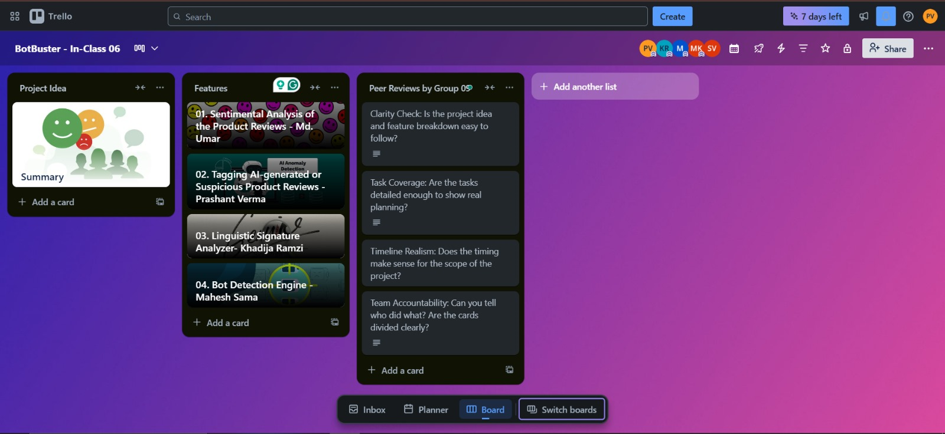
BotBuster - Trello

